Slide 1
Sunday School Teacher: "Now Little Johnny, I want you to memorize today's motto, 'It is more blessed to give than to receive."
Little Johnny: "Yes ma'am, but I know it already. My father says he has always used that as his motto in his business."
Teacher: "Oh, how noble of him! And what is his business?"
Little Johnny: "He's a boxer."

Slide 3
How Can I Apologize? Let Me Count the Ways
Edward Church
July 12, 2020
Freedom from Myself
Pt 2

Slide 4
God is About Relationship
God in His Power and Wisdom…
Ordained
Designed
Although Adam had Relationship
God
Animals
Still Alone
“Now the Lord God said, It is not good (sufficient, satisfactory) that the man should be alone; I will make him a helper (suitable, adapted, complementary) for him.” Genesis 2:18 (AMP)

Slide 5
Even Healthy Relationships Have Problems
Relationships
Individuals Need to Feel Loved and Appreciated Relationships Provide This
But they can also Promote Misunderstanding
Actions Run Contrary
Emotions Get Stirred
Feelings Get Hurt
To Guard This,
We Need To Deal Effectively…

Slide 6
Even Healthy Relationships Have Problems
Relationships
Individuals Need to Feel Loved and Appreciated Relationships Provide This
To Guard this, they Need to Deal Effectively…
The Reality
No One Is Perfect.
If People Do Not Deal With the Failures…
…Resulting In An Emotional Barrier of Hurt
The Revelation
• Apologizing
• Forgiving

Slide 7
Five Relational Languages…
Love Languages…
…Help Us Connect
Languages of Apology
…Help Us Re-Correct

Slide 8
Guidelines for Real Apologies
Number One Rule
NEVER say “I’m sorry…but”
…even if there was wrongdoing on other side
The “but” nullifies the whole apology
It’s an attempt to excuse your own bad behavior based on their bad behavior
It takes strength/ humility but you ALWAYS have a choice over your actions
Be responsible for owning up on your end
God will deal with your spouse separately

Slide 9
Five Languages of Apology
#1- Expressing Regret
Expressing Regret Is Often with the Words, “I’m Sorry.”
It is the Apology Language that…
…Focus’ in On “Emotional Hurt”
It is an Admission of Guilt and Shame…
…for Causing Pain to Another Person
Example: the Prodigal Son
Luke 15:21 (AMP) ²¹ And the son said to him, Father, I have sinned against heaven and in your sight; I am no longer worthy to be called your son [I no longer deserve to be recognized as a son of yours]!

Slide 10
For Those Who Listen for “Expressing Regret” Apologies….
…a simple “I’m sorry” is all they look for.
There is no need for explanation or “pay back” provided if apology has truly come from the heart.
“Expressing Regret” is a powerful Apology Language…
…because it gets right to the point.
It Doesn’t Make Excuses or Attempt to Deflect Blame.
Above all, “Expressing Regret” Takes Ownership of the Wrong.
For that reason, “Expressing Regret” is understood as a Sincere Commitment to …
…Repair and Rebuild the Relationship

Slide 11
The “Expressing Regret” Apology Language speaks most clearly when the person offering the apology reflects sincerity not only verbally, but also through Body Language.
Unflinching eye contact/ a gentle, but firm touch are two ways that body language can show sincerity.
• Communicates that you feel badly about your behavior
Never use the words “I’m sorry” alone.
Always tell the person that you are apologizing to why you are sorry.

Slide 12
#2- Accepting Responsibility
Accepting responsibility is saying that…
…you were wrong and not blaming anyone else.
Example: The Prodigal Son
Luke 15:18 (AMP) ¹⁸ I will get up and go to my father, and I will say to him, Father, I have sinned against heaven and in your sight.
He Accepted Responsibility “I will Get Up and Go…”
It was My Actions that Brought me to this place
…my actions will take me back to possibility

Slide 13
Accept Responsibility
It is Difficult for Some People to Admit That They’re Wrong.
It makes them doubt their self-worth even feel like a failure.
we must all admit that we are sinners and that we will make mistakes.
Realize We Will Make Poor Decisions that Hurt Our Relationships
We are going to have to admit that we were wrong.
We have to Accept Responsibility for our own failures.

Slide 14
Accept Responsibility
We Need To Learn How to Overcome Ego…
…The Desire To Not Be Viewed as a Failure
…Simply Admit that Our Actions Were Wrong.
This Apology Means Allowing Yourself To Look Weak…
…But Actually It Takes Great Strength to Do This
It Makes A World Of A Difference to Those…
…Who Speaks This Language.

Slide 17
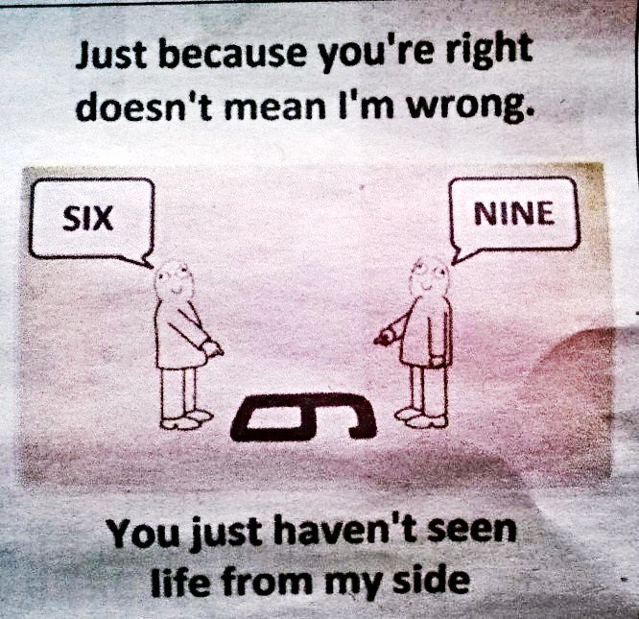

Slide 19
Five Languages of Apology
C. Making Restitution
Making restitution is addressing what can be done to make it right.
Biblical example: Zacchaeus (Luke 19:8).
There is a correlation between one’s love language and language of apology. For those whose language of apology is making restitution, their answer to, “What can be done to make this right?” will likely be in keeping with their love language.
How a language of apology speaks to a person depends on the nature of the offense. • For small offenses, a simple, “I’m sorry” usually works.
• For huge offenses, more than one language of apology will be necessary.

Slide 20
Make Restitution
In our society, many people believe that wrong acts demand justice. The one who commits the crime should pay for their wrongdoing. A mate who speaks this love language feels the same way towards apologies. They believe that in order to be sincere, the person who is apologizing should justify their actions. The mate who’s been hurt simply wants to hear that their mate still loves them.
There are many effective ways to demonstrate sincerity in an apology. Each mate must learn the other’s love language in order to complete the act of restitution. Though some mates may feel a though all is forgotten with a bouquet of flowers, that may not necessarily work for all mates. Every mate should uncover what their partner’s main love language is (Words of Affirmation, Quality Time, Acts of Service, Physical Touch, and Receiving Gifts) and use that specific language in order to make restitutions in the most effective way.
For a mate whose primary apology language is making restitutions, no matter how often you say “I’m sorry”, or “I was wrong”, your mate will never find the apology sincere. You must show strong efforts for making amends. A genuine apology will be accompanied by the assurance that you still love your mate and have a desire to right the wrong-doings committed.

Slide 21
Five Languages of Apology
D. Genuinely Repenting
Genuinely repenting is expressing the desire to change your behavior.
“From that time Jesus began to preach and say, ‘Repent, for the kingdom of heaven is at hand.’”—Matthew 4:17
“Peter said to them, ‘Repent, and each of you be baptized in the name of Jesus Christ for the forgiveness of your sins; and you will receive the gift of the Holy Spirit.’”— Acts 2:38
Biblical example: the New Testament, in particular the Book of Acts.
3. As Christians, we are called to repent of sin.
4. Repent means to turn around.

Slide 22
Genuinely Repent
For some individuals, repentance is the convincing factor in an apology. Some mates will doubt the sincerity of an apology if it is not accompanied by their partner’s desire to modify their behavior to avoid the situation in the future.
It’s important to remember that all true repentance begins in the heart. A mate must feel poorly for hurting their loved one, and rely on God’s help in order to truly change. Admitting you are wrong creates vulnerability. It allows your mate to get a glimpse of your heart. The glimpse of true self is assurance that the apology was sincere.
One important aspect of genuinely repenting is verbalizing your desire to change. Your mate cannot read your mind. Though you may be trying to change inside, if you do not verbalize your desire to change to your mate, most likely they will still be hurt.
Many people have problems with repenting when they do not feel as though their actions were morally wrong. However, in a healthy relationship, we often make changes that have nothing to do with morality and everything to do with building a harmonious marriage.
It is also important to make a dedicated plan for change. Often apologies involving repentance fail because the person never set up steps of action to help ensure success. A person must first set goals for their change. After you create realistic goals, then you can start implementing a plan to change. Taking baby steps towards repentance instead of insisting on changing all at once will increase your chances of successfully changing your ways.
It is important to remember that change is hard. Constructive change does not mean we will immediately be successful. There will be highs and lows on the road to change. You must remember that with God’s help, anyone can change their ways if they are truly and genuinely ready to repent.

Slide 23
Five Languages of Apology
E. Requesting Forgiveness
Requesting forgiveness is requesting that the person forgives you.
For some people, if you have not requested forgiveness, you have not apologized.
Biblical example: David (Psalm 51).
• Blot out my transgressions
• Wash away all my iniquity
• Cleanse me from my sin

Slide 24
Request Forgiveness
In some relationships, a mate wants to hear their partner physically ask for forgiveness. They want assurance that their mate recognizes the need for forgiveness. By asking forgiveness for their actions, a partner is really asking their mate to still love them. Requesting forgiveness assures your mate that you want to see the relationship fully restored. It also proves to your mate that you are sincerely sorry for what you’ve done. It shows that you realize you’ve done something wrong. Requesting forgiveness also shows that you are willing to put the future of the relationship in the hands of the offended mate. You are leaving the final decision up to your partner – to forgive or not forgive.
Requesting forgiveness is not easy. It often leaves one vulnerable to the fear of rejection. Along with the fear of rejection is the fear of failing. Many people have a hard time seeking forgiveness because it means admitting that you have failed. The only way to overcome this fear is to recognize that it is very common amongst mankind. The commonality makes it okay to be a failure. It allows a stubborn mate to apologize to their partner and become a healthy individual.
Ultimately, it’s important to remember that there is a difference between asking for forgiveness and DEMANDING forgiveness. When we demand forgiveness, we tend to forget the nature of forgiveness. Forgiveness is a choice the offended party is supposed to make. Demanding forgiveness takes away the sincerity of asking for it.
Remember not to treat forgiveness lightly. It is something to be cherished and appreciated. The act of forgiveness is hard on both ends – for the person who’s asking and for the person who’s accepting.

Slide 25
Language #1: Expressing Regret or “I am sorry”
Language #2: Accepting Responsibility or “I was wrong”
Language #3: Making Restitution or “What can I do to make it right?”
Language #4: Genuinely Repenting or “I’ll try not to do that again”
Language #5: Requesting Forgiveness or “Will you please forgive me?”

Slide 27
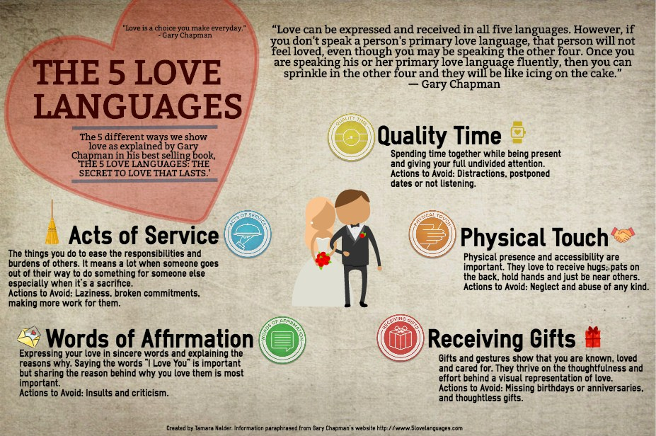
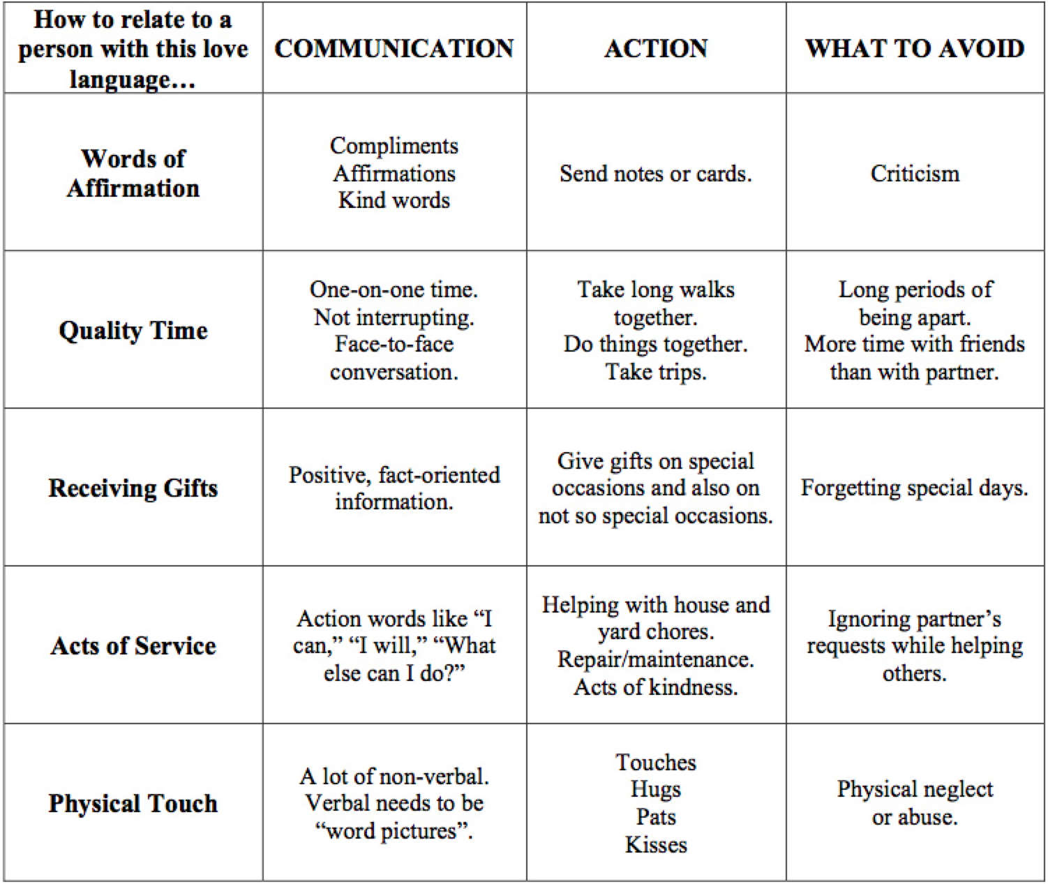

Slide 28
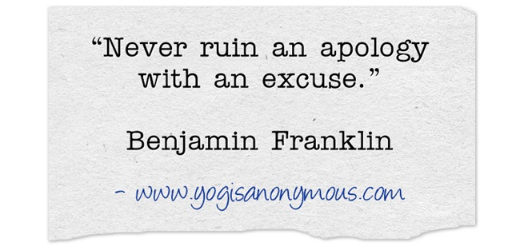

Slide 29
What Apologies Are Not… “Missed it by that much”
Common Formats For Apology that Are “Counterfeit”
“Sorry-excuse”
Example:
“I’m sorry I didn’t call-I’ve been really busy.”
Translation:
“Please be understanding about the fact that other things were more important than you.”

Slide 30
Apologizing
The Bible is Very Positive Regarding the Issue of Apologizing
“He who conceals his transgressions will not prosper, but he who confesses and forsakes them will find compassion.” Prov 28:13
“But your iniquities have made a separation between you and your God, and your sins have hidden His face from you so that He does not hear.” Isaiah 59:2
“Therefore if you are presenting your offering at the altar, and there remember that your brother has something against you, leave your offering there before the altar and go; first be reconciled to your brother, and then come and present your offering.” Matt 5:23-24

Slide 31
What Apologies Are Not… “Missed it by that much”
• “Sorry-excuse” “I’m sorry I didn’t call-I’ve been really busy.”
“Sorry-Denial of Intent”
Ex-“I’m sorry you took it that way. It wasn’t what I meant.”
Tr-“I think it’s too bad that you had difficulty understanding me correctly.”
Ex-“I’m sorry if I offended you.”
Tr-“I can’t think of anything I did wrong, but if you think so, I’d be happy to apologize so I can get back in your good graces.”

Slide 32
What Apologies Are Not… “Missed it by that much”
• “Sorry-excuse” “I’m sorry I didn’t call-I’ve been really busy.”
• “Sorry-denial of intent” “I’m sorry you took it that way. Not what I meant.”
“Sorry-Blame”
Example:
“I’m sorry I didn’t call sooner. Have you been feeling insecure about our relationship lately?”
Translation:
“If you are upset about my not calling, the real cause is your own insecurity, not anything I did.”

Slide 33
Guidelines For Real Apologies
Decline to accept an apology that is not given sincerely.
When you accept an apology, knowing it wasn’t real, you pretend an issue is resolved while harboring resentments.
Gently, firmly, without anger.
refuse to accept an insincere apology,
You will feel greater confidence
You Won’t Feel manipulated or pacified
you hold the other person more accountable
without having to argue or try to force an apology.

Slide 34
Learning to Apologize
People learn different styles of apology/non-apology from parents.
• Research shows that about 10% of the population…
…almost never apologizes,
…most of these are men
…they learned this from their fathers

Slide 35
“Expressing Regret” is the Apology Language that Zeroes in On Emotional Hurt.
It is an admission of guilt and shame for causing pain to another person.
For those who listen for “Expressing Regret” apologies…. a simple “I’m sorry” is all they look for.
There is no need for explanation or “pay back” provided if apology has truly come from the heart.
“Expressing Regret” is a powerful Apology Language because it gets right to the point.
It Doesn’t Make Excuses or Attempt to Deflect Blame.
Above all, “Expressing Regret” Takes Ownership of the Wrong.
For that reason, “Expressing Regret” is understood as a Sincere Commitment to
…Repair and Rebuild the Relationship.
The “Expressing Regret” Apology Language speaks most clearly when the person offering the apology reflects sincerity not only verbally, but also through body language.
Unflinching eye contact/ a gentle, but firm touch are two ways that body language can show sincerity.

Slide 36
Guidelines For Real Apologies
Only say “I’m sorry,” when …
you mean it
can specify what you are apologizing for
A “healthy” or authentic apology can be stated clearly what we did that was disrespectful or inconsiderate without:
• immediately explaining why we did it,
• telling the person that however it looked or sounded, it wasn’t our real intention
• bringing up some other issue that suggests that the other person contributed to or caused the problem.

