Slide 1
Picked up a hitchhiker.
He asked if I wasn't afraid he might be a serial killer?
I told him the odds of two serial killers being in the same car was extremely unlikely.

Slide 2
Do you have a big but. I know I have a big but.
I think at one time or another, we have all had a big but.
Some of us might even have more than 1 big but.
When God asks us to do something, our big but appears.
We don’t even have to use the word But or But God..
any excuse we come up with to not obey is a big but. Today, we are going to look at another man that had a big but, 5 big buts to be exact.
Today we are going to look at Moses and his big buts and how God dealt with him and his big buts
and hopefully we can get rid of our own big buts once and for all.

Slide 4
Getting Your Big Buts… …Out of the Way “Excuses”
Edward Church
Sept 13, 2020
Exodus 3

Slide 5
Now is Not the Time…
…to Lay Low and Stay in the Shadows…
Now is the Time…
…for the Church to Rise and Shine…
We Are …
City on a Hill that Cannot Be Hid
Salt of the World
Light of the World

Slide 6
If Anybody Had…
Call on Their Life It was Moses
Some Falls in Their Life It was Moses
Moses’ Big Mission was Overshadowed by..
…His Five Big Buts (Excuses) Exodus 3:11–4:14
What Caused This ?
He Focused on the “What If’s” …
… Instead of the “What Is’”

Slide 7
Big But #1 “Who Am I?” (3:11)
Moses Struggled with His Identity
He Just Didn’t Feel Qualified;
he thought God had picked the wrong man
God’s Response: It doesn’t matter
who you are. I Am with you (3:12).
Who saved us and called us to a holy calling, not because of
our works but because of his own purpose and grace, which he
gave us in Christ Jesus before the ages began 2 Tim 1:9

Slide 8
Big But #2- “Who Are You?” (3:13)
He Didn’t Know God Well Enough…
….to describe Him to the people and lacked convictions concerning his relationship with God.
God’s Response: I AM WHO I AM…
…I AM ever Present
…I AM Everything you Need (3:14).
Know therefore that the Lord your God is God, the faithful God who keeps covenant and steadfast love with those who love him and keep his commandments, to a thousand generations, -Deut 7:9

Slide 9
Big But #3- What If They Don’t Listen? (4:1)
Moses Felt Intimidated
He Worried about the People’s Reaction to Him.
God’s Response: When I’m
finished, they’ll listen (4:2–9)
2 Timothy 1:7 (AMP) ⁷ For God did not give us a spirit of timidity (of cowardice, of craven and cringing and fawning fear), but [He has given us a spirit] of power and of love and of calm and well-balanced mind and discipline and self-control.

Slide 10
Big But #4- I’ve Never Been a Good Speaker (4:10)
Moses Fretted About His Inadequacies
Who Would Listen To Him…
…If He Couldn’t Even Speak Well?
God’s Response: Guess who made your mouth? (4:11, 12)
¹⁰ For we are God's [own] handiwork (His workmanship), recreated in Christ Jesus, [born anew] that we may do those good works which God predestined (planned beforehand) for us [taking paths which He prepared ahead of time], that we should walk in them [living the good life which He prearranged and made ready for us to live] Eph 2:10 (AMP)

Slide 11
Big But #5- I Know You Can Find Someone Else (4:13)
Moses Felt Inferior
He Compared Himself to Others—even his brother—and
…decided that he came up short.
God’s Response: OK, I will let Aaron go with you . . .
…but I’m still calling you to go (4:14)
Jeremiah 29:11 (MSG) I know what I'm doing. I have it all planned out—plans to take care of you,
not abandon you, plans to give you the future you hope for.

Slide 12
Start
Smart
Simple
Strong
Simply Put…
Do Small Things…
…in a Big Ways

Slide 13
G- Give Your Best
R- Refuse to Play the Game
A- Act Through Faith –vs Emotions
C- Calm
E- Example

Slide 15
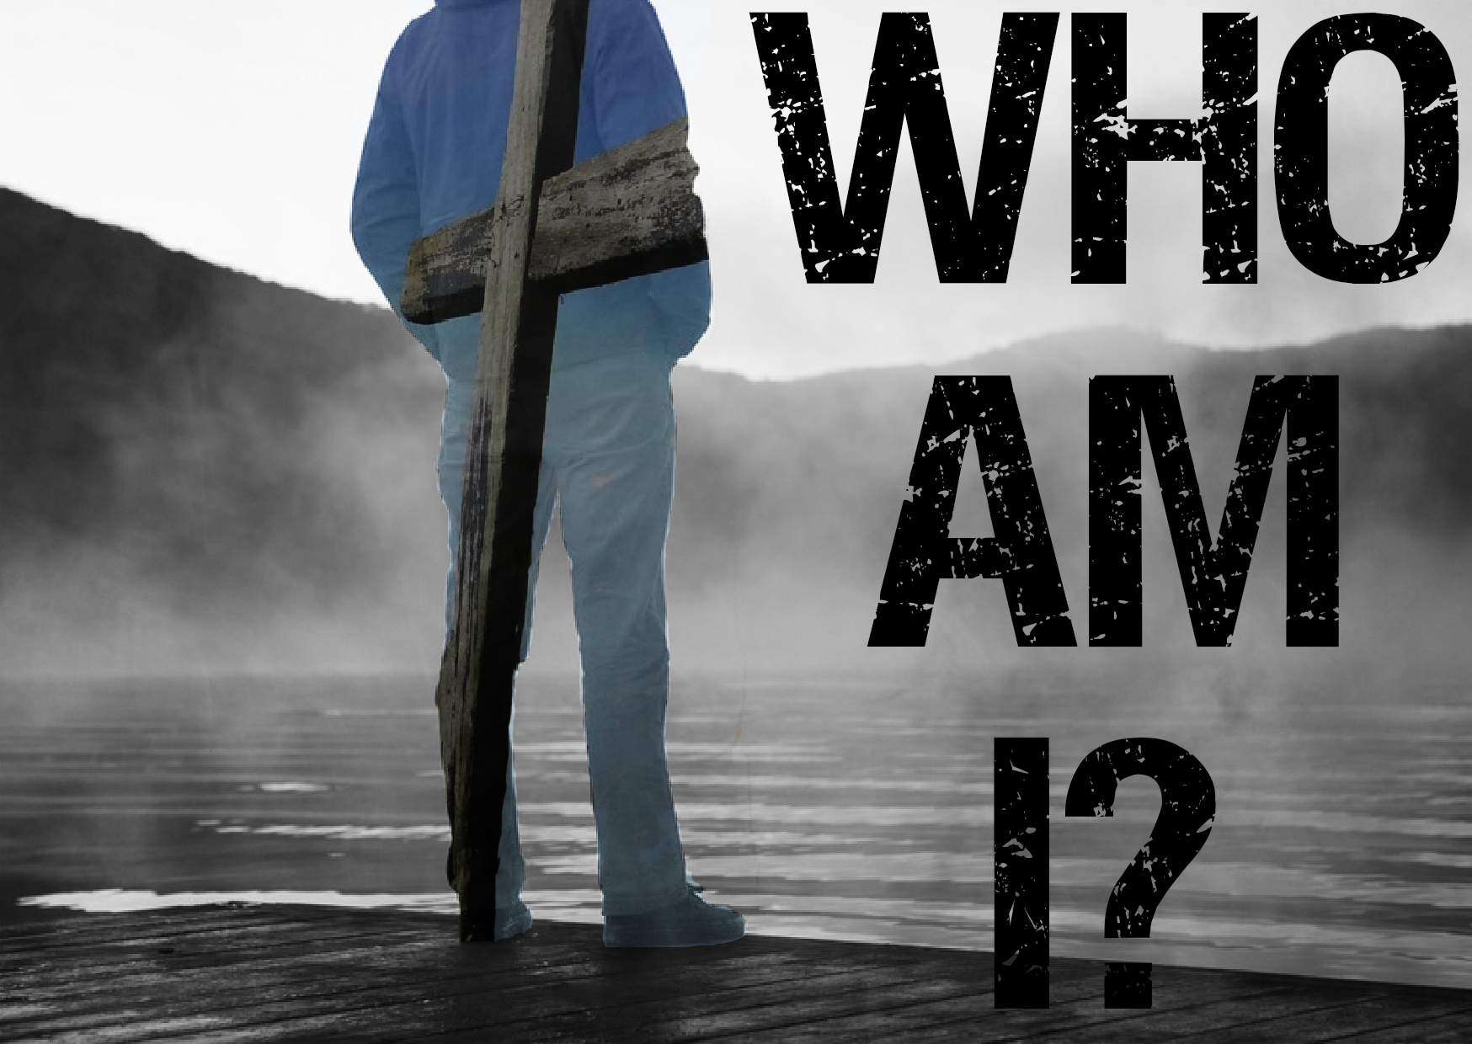
Again…
Has Anybody Noticed That
The World Has Gone Crazy?

