Slide 1
Two caterpillars are sitting on a leaf when a butterfly zooms by, startling them.
One turns to the other and says, "Boy, you'll never get me up in one of those things."

Slide 3
Revelation 1:1-8
Part 1

Slide 4
The Book of Revelation is a Powerful Book!
Yet it is:
Misunderstood
Misrepresented
Misinterpreted
If Not Careful, Many Will…
…Miss Out on the…
…Blessings of this Book!!!

Slide 5
The First Eight Verses Help Us to Understand the Rest of the Book
Notice:
Paul Wrote Seven Letters…
…to Seven Churches
John Wrote One Letter…
…to Seven Churches

Slide 6
Seven Churches of Revelation

Slide 7
The Purpose
It is a Powerful Book (1)
Revelation
What it Does Not Mean:
end times and frightening things
What it Does Mean:
to uncover, unveil, set forth

Slide 8
1st, the Person of Jesus Christ
He Came the 1st Time
As a Lamb
Bore a Cross
Remained Silent as a Lamb
Led the Slaughter
But Now Things Are Different…
He Is Alive / Well on the Isle of Patmos
Communicating His Will to John

Slide 9
2nd, the Plan of Jesus Christ
When He Comes the Next Time
He Will…
Come as a Lion
Wear a Crown
No Longer Remain Silent

Slide 10
Purpose
It is a Prophetic Book (1)
Shows what must “shortly come to pass”
Shortly means:
something that happens quickly / suddenly
once it starts it happens in…
…rapid-fire succession
2 Types of Prophecy in Revelation
Forth-tell -chap 1-3
Fore-tell -chap 4-22

Slide 11
Purpose
It is a Perfecting Book (1)
Genesis is a Book of Beginnings
Many Firsts
Revelation Completes It
Many Lasts
Genesis = Commencement of Heaven/ Earth
Revelation = Conservation of Heaven/ Earth
Genesis = Entrance of Sin / the Curse
Revelation = End of Sin / the Curse

Slide 12
Purpose
It is a Perfecting Book (1)
Gen. = Dawn of Satan/ His Activity
Rev. = Doom of Satan/ His Activity
Gen. = Tree of Life Relinquished
Rev. = Tree of Life Regained
Gen. = Death makes it’s Entrance
Rev. = Death makes it’s Exit
Gen. = Sorrow Begins
Rev. = Sorrow Banished

Slide 13
Purpose
It is a Pictorial Book (1)
Signified: to Give a Sign
Revelation is Full of Symbols and Numbers
Why is it Necessary to Use Signs?
They serve as a “Spiritual Code”
the Non-Jew Did Not Understand
They “Do Not Change”
Time Has No Effect On Them
They “Spark Emotions”
Beast -vs. Dictator
Lamp Stand -vs. Church

Slide 14
Purpose
Revelation was to Prepare…
…and Strengthen the Christians of
…Asia Minor (seven churches)
...that they will Remain Faithful
…Against the Impending Persecution

Slide 15
Purpose
The Overall Scope of the Book of Revelation:
Revelation 1:19
• Chap 1 -“things you have seen”
The Lord’s Work in His Church
• Chap 2-3 – “things which are”
The Lord’s Word to His Church
• Chap 4-22 – “things which shall be”
“ ”Lord’s Word (prophetic) after His Church

Slide 16
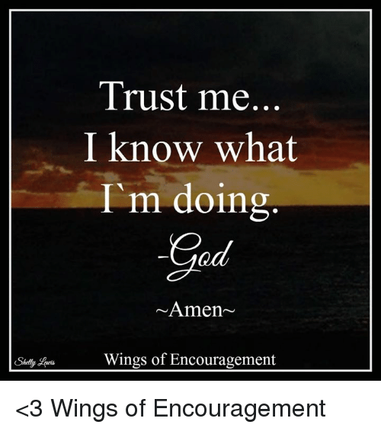

Slide 18
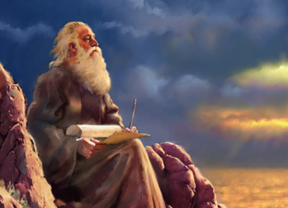
Reading Someone
Else's Mail
Revelation 1:1-8
Part 1

Slide 19
Purpose
It is a Profitable Book (3)
Profitable for Public Assembly
Blessed is he that Reads
Blessed is he that Hears
Profitable for Practical Application
Blessed is he that Keeps

Slide 20
Purpose
It is a Profitable Book (3)
Blessed =
…supremely blest/ happy- walk straight
Grace
divine influence upon the heart…
…for the highest good
Peace
quietness, rest, + set at one again.
Even in the Midst of Turmoil…
…He is Still the Prince of Peace.

Slide 21
The Seven Qualities God-Given Revelation
#1- It Is Not Discovered Or Created…
…But Revealed
#2- It Doesn’t Compete With Others…
…But Completes Others
#3- It Is Captivating…
…Hard To Get It Out Of Mind
#4- It Stops You…
…Before It Drives You To Act

Slide 22
The Seven Qualities God-Given Revelation
#5- It Drives You…
…to Serve Others
#6- Its Fulfillment Doesn’t Rest On Your Getting Ahead…
…But On Your Obedience
#7- It Drives You to…
…Deeper Relationship With God

Slide 23
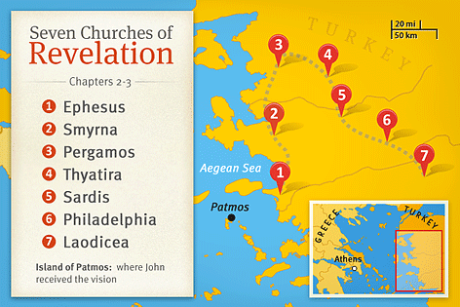
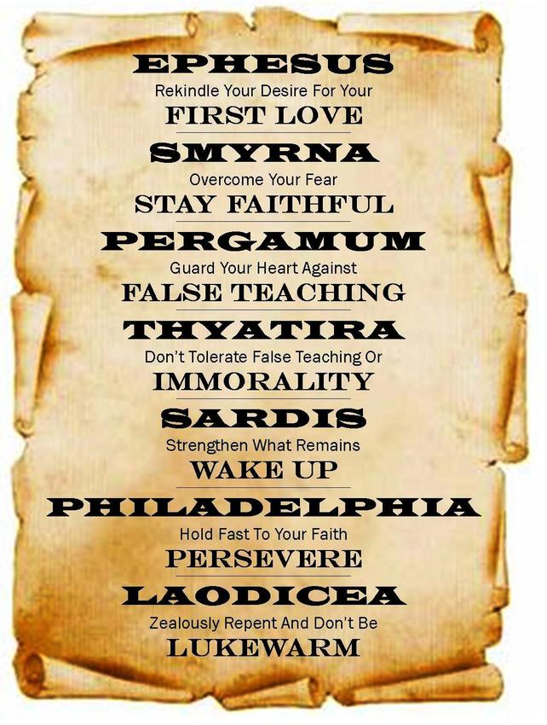
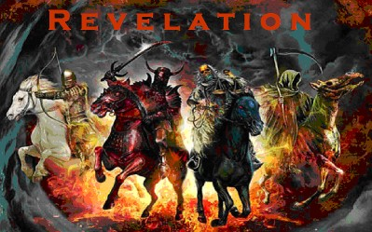
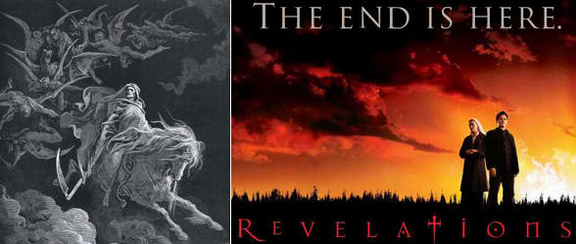

Slide 24
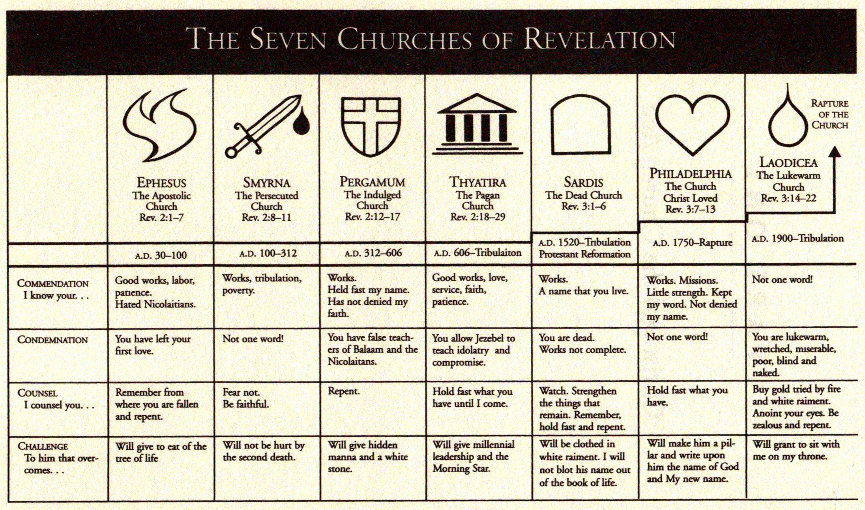
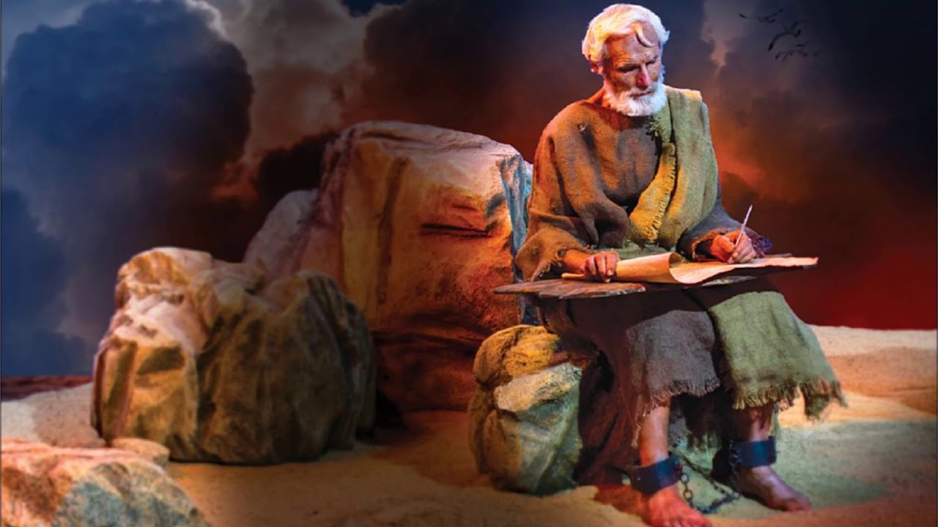

Slide 26
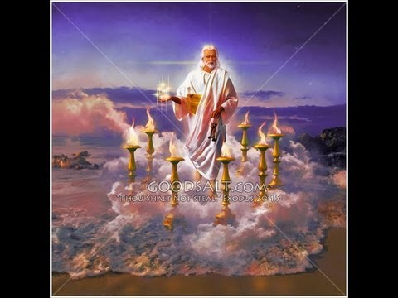
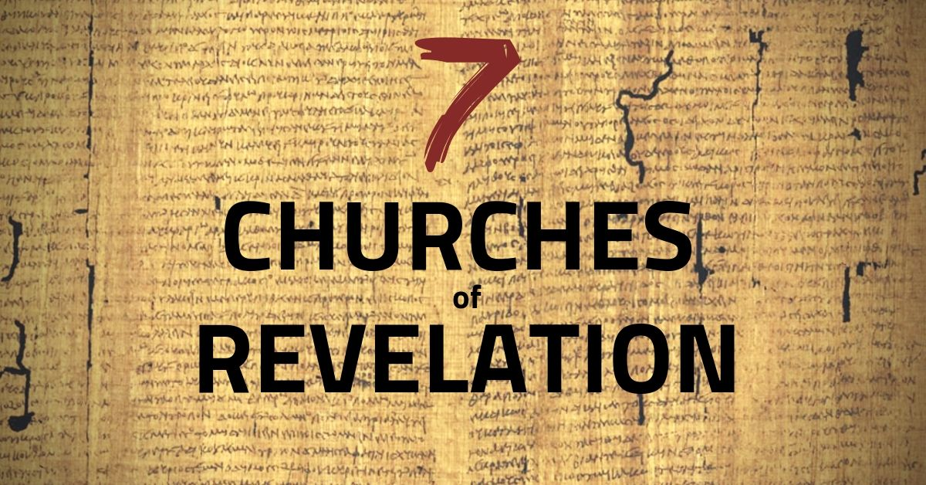
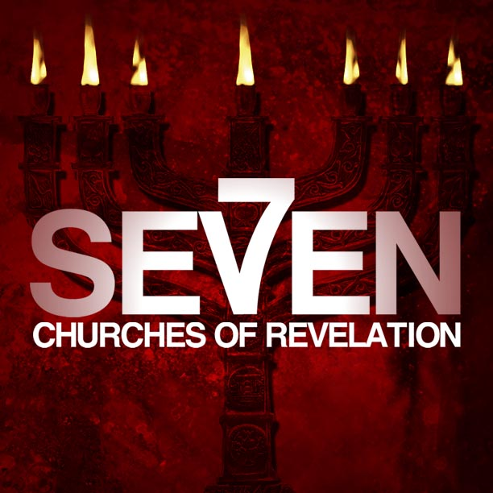

Slide 27
The Seven Beatitudes of Revelation
#1- (1:3), the blessedness of reading, hearing, obeying the Word of God
#2- (14:13), “Blessed are the dead who die in the Lord henceforth”
#3- (16:15), “Blessed is he who is awake, keeping his garments..”
#4- (19:9), “Blessed are those who are invited to the marriage supper of the Lamb”

Slide 28
The Seven Beatitudes of Revelation
#5- (20:6), “Blessed is he who shares in the first Resurrection”
#6- (22:7), “Blessed is he who keeps the Prophecy of the book”
#7- (22:14), “Blessed are those who do His commandments”

Slide 30
Reading Someone
Else's Mail
Revelation 1:1-8
Part 1

Slide 31
-Because we have enjoyed such great religious liberties for more than 240 years, the church is basically unprepared for the pressure that will soon be exerted on the church.
-The first century church was familiar with all of this. The early Christians were hated and despised as a religious sect all throughout the Roman Empire. There were various motivations behind the hatred:
• Politically—Despised because the Romans viewed them as disloyal because they refused to acknowledge Caesar as a divine authority.
• Religiously—Accused as being atheists because they did not worship the vast array of Roman gods and because they worshipped an invisible God, not an idol.
• Socially—They were from the lower classes of society (1 Cor. 1:26) and loathed by the Roman aristocracy.
• Economically—They were seen as a threat by the pagan priests, craftsmen, and merchants who profited from the idol worship.
They were surrounded by dark paganism, uninhibited immorality, withering slavery, and oppressive dictators. The Christians were enemies of the world. Because they were enemies of the world, this led to martyrdom for many of them.

Slide 32
Purpose
The lamp stands represented the churches. Why seven? There were seven churches in Asia Minor, but also seven was the number of completeness. Among these lampstands, John saw once again the risen Christ, The Son of Man. He’s in his full glory. “Son of Man” is a messianic title given to the Lord Jesus Christ because He is the fulfillment of that prophecy in Daniel 7.” (MacArthur). He is the Lord of the Lampstands:
1. The Churches are under Christ’s rule
2. The church received Christ’s care
3. The church is subject to Christ’s Judgement
4. The church relies on Christ’s power
5. The Church is unified in Christ’s presence
“Think what this vision would have meant to persecuted churches to whom John was writing. Think of the comfort knowing they were held in Christ’s hand.” (Wilmshurst). We too can and should know in all this that we are in these same hands. He cares for us, disciplines us, comforts, and rules over us. His presence is ever with us as he promised. Take comfort in these thoughts.

Slide 33
The description John gives of Christ Jesus has 7 distinct characteristics
1. He was wearing a robe down to his feet with a gold sash. This is the clothing of a priest. "For we do not have a high priest who is unable to sympathize with our weaknesses, but one who in every respect has been tempted as we are, yet without sin." (Hebrews 4:15)
2. His hair was white as wool and snow and his eyes were aflame with fire. John is seeing Jesus’ purity and purifying work. Not only does Jesus intercede for his Church, but He is purifying his church. His eyes are all-knowing and always watching. This is holy, wise, omniscient.
3. His feet were refined, burnished bronze. The emphasis here is on judgement and the purging work of Christ. Everything was and is under the rule of the King’s feet. His feet are pure and refined, but also purging, molten, and gleaming for perfect judgment. Not only in the church but in your life. For the believer this is a great comfort, for the sinner it is dreadful
4. The description of his voice is much like Ezekiel’s description in Ezekiel 43:2. which describes God’s voice was the sound of many waters. When he speaks the church must listen. And that will come through his spokesmen too. His voice comes to us in many forms. Visions, dreams, preachers, and still small nudges that we are to listen for in our lives. But mainly through the Word of God
5. In His hand is the seven stars. It is sometimes translated messengers, which some hold to be angels, but the best interpretation is the 7 pastors of the churches. We can be disappointed by many leaders, but the true leaders of the church are held in the hands of Christ. There may be persecutions, but leaders who are faithful to Christ and his word are held in his hand. It is so critical to raise and teaches our men!
6. The sword from his mouth is the truth of his Word. The church is to be faithful to the Word of God and we also know that the Word of God is protecting His church and the saints of the church. Jesus said, “I will make war against [my enemies] with the sword of my mouth” (Rev 2:16)
7. Lastly, we see that Jesus’ face shined like that of the sun and moon. The Righteousness and holiness of God glow the shekinah glory of God. He is perfect in every way.
Purpose

Slide 34
Purpose
there were the clear instructions of Jesus Christ. Christ repeats His commission to John. He tells John to write three things. Note: these things provide an outline for the book of Revelation. John was to write...
• the things that he had seen: that is, the vision of the glorified Christ (Rev. 1-2).
• the things which are: that is, the state and condition of the churches (Rev. 2-3).
• the things which shall be hereafter: that is, the consummation of human history, the coming again of the Lord Jesus Christ and the end of the world (Rev. 4-22).
Preacher's Outline and Sermon Bible - Commentary - The Preacher's Outline & Sermon Bible – Revelation.

Slide 35
Purpose
When John sees Christ glorified among the lampstands, John say he falls down as if he is a dead man. It is the same reaction Isaiah has in the throne room of heaven. He’s not excited with glee, he is filled with dread. Here Christ speaks
17 When I saw him, I fell at his feet as though dead. But he laid his right hand on me, saying, “Fear not, I am the first and the last, 18 and the living one. I died, and behold I am alive forevermore, and I have the keys of Death and Hades. 19 Write therefore the things that you have seen, those that are and those that are to take place after this. 20 As for the mystery of the seven stars that you saw in my right hand, and the seven golden lampstands, the seven stars are the angels of the seven churches, and the seven lampstands are the seven churches.
Jesus’s words to John are not cutting but strengthening. Do not be afraid (Rev 1:17). We as believers need to be reminded of that don’t we? We need to be reverent. We need to be humble. We need to be repentant. If we are like John, we don’t need to be afraid. “Don’t be afraid John. I’ve already risen. I’ve defeated your death and your grave. You are an overcomer. Therefore be faithful to what I’m telling you. Write this down. I have a message for the churches.” Revelation Fear Not!
Jesus went on to explain his authority to banish our terror: “Fear not, I am the first and the last, and the living one” (Rev. 1:17–18). This statement connects back to the words of God the Father in verse 8: “ ‘I am the Alpha and the Omega,’ says the Lord God, ‘who is and who was and who is to come, the Almighty.’ ” By taking up similar words, Jesus declares his oneness with the Father in a deity. As “the first and the last,” Jesus is sovereign over all that comes between, that is, overall time, history, and creation. As “the living one,” Jesus possesses the power and life needed to cast away all fear.
Conclusion
Here we see John’s vision. We’re part of the plan. This is not our church. This is Christ’s church. We need to be reminded of this. He’s our priest interceding on our behalf. He’s holding us in his hand. Are we faithful to him and his word? What do you think the risen Christ would say about GCC or your church? Are we under his rule

Slide 36
Purpose

Slide 37
Purpose

Slide 38
Purpose

Slide 39
Purpose

Slide 40
Purpose

Slide 41
Purpose

Slide 42
Purpose

