Slide 1
Politician comes up on some kids in a circle arguing-
Politician walks up and asks what they are doing- they say this dog wandered up and they are deciding who gets to keep it so we are having a contest.
He asked what is that? They said the boy who could tell the biggest lie would win the dog.
The politician begins to tell the boys that the bible discourages lying and then said that eh remembered when he was their age…he never told a lie….
There was a long silence…then one of the boys said..ok..go ahead and give him the dog!

Slide 3
John 3:16
November 1, 2020
Edward Church
Back to Basics #1 “Salvation”

Slide 4
Our World is in a Mess!
There Seems to be a Lot of Answers…
…But They All Lead to Symptoms
…the Problem Actually Started in a Garden
…the Answer Started in Another Garden
Romans Addresses this Problem…
…with a Plan
John Addresses the Answer…
…with a Promise

Slide 5
The Path to John 3:16 Runs Through Roman Road
Points
to
John 3:16

Slide 6
The Most Familiar Verse in the Bible
1st Verse Taught to Kids / New Converts
Whispered to Loved Ones on Deathbeds
Appears on Signs @ Sporting Events
Known by More People than Any Other

Slide 8
God
“Greatest Lover”
Only the Lord has the capacity to love every one…
…because He created us/ knows us intimately.
There is no other love that satisfies the longing soul and fills our hungry soul
So Loved
“Greatest Degree”
There is no love that can exceed the depth, breadth, length/ height of His magnificent love.
Whenever you begin to wonder if His love is sufficient for your problem know that…
His love far exceeds any dimension of the human mind.
The World
“Greatest Audience”
Only Jehovah knows everyone who has come into the world from the seed of Adam
The Creator is the one who can speak to the hearts of everyone in the world
simultaneously without any delay, distraction or distortion.

Slide 9
That He Gave
“Greatest Act”
When the Father sent His Son, the Lord Jesus, to be a Sacrifice
…for the Sins of the Whole World.
The Father Willingly Offered His Son so that Everyone Can Find a…
…Substitutionary Payment for the Forgiveness of their Sin
His Only Begotten Son
“Greatest Gift”
Because of this..
Bethlehem= “God With Us”
Calvary= “God For Us”
Pentecost= “God in Us”

Slide 10
That Whosoever
“Greatest Invitation”
Take advantage of the opportunity to be born again by faith in Jesus Christ
Please do not miss out in taking advantage of the opportunity given to you
Believes
“Greatest Simplicity”
To gain eternal life and forgiveness and deliverance from the penalty of our sins…
...hell, eternal separation from God and judgment. Only believe.
The things that are impossible with men are possible for those who believe.
In Him
“Greatest Attraction”
Things of the world come and go –fade away- grow old
Jesus will never go- The Life He offers Never Fades

Slide 11
Should Not Perish
“Greatest Promise”
Only Jesus Christ can offer assurance of salvation for those who place their faith in Him and ask Him to come into their life
…regardless of your background or problems.
But
“Greatest Difference”
In contrast to those who will perish, those who trust Christ for
Eternal Deliverance will live in Eternity in Heaven
all tears and sorrow will be wiped away and gladness and joy and
praise of God will fill us with everlasting joy.

Slide 12
Have
“Greatest Certainty”
You can be sure that whoever has the Son has eternal life…
…you will never have to fear evil because He is with you…
….comforting, protecting and guiding you all the way to heaven.
Eternal Life
“Greatest Possession”
What a joy to know that the Savior lets you start your eternal life…
…at the moment you accept Christ as Savior

Slide 13
John 3:16-17 (AMP) ¹⁶ For God so greatly loved and dearly prized the world that He [even] gave up His only begotten (unique) Son, so that whoever believes in (trusts in, clings to, relies on) Him shall not perish (come to destruction, be lost) but have eternal (everlasting) life. ¹⁷ For God did not send the Son into the world in order to judge (to reject, to condemn, to pass sentence on) the world, but that the world might find salvation and be made safe and sound through Him.

Slide 14
John 3:16
Love Enough for Us All
“For God so Loved the World”
Sacrifice Enough for Us All
“That He Gave Only Begotten Son”
Invitation Enough for Us All
“That Whosoever Believeth in Him”
Life Enough for Us All
“Should Not Perish, but Have Eternal Life”

Slide 15
Without John 3:16
We Would Be Forever Lost!!!

Slide 17
John 3:16-17 (AMP) ¹⁶ For God so greatly loved and dearly prized the world that He [even] gave up His only begotten (unique) Son, so that whoever believes in (trusts in, clings to, relies on) Him shall not perish (come to destruction, be lost) but have eternal (everlasting) life. ¹⁷ For God did not send the Son into the world in order to judge (to reject, to condemn, to pass sentence on) the world, but that the world might find salvation and be made safe and sound through Him.

Slide 18
John 3:16-17 (MSG) ¹⁶ "This is how much God loved the world: He gave his Son, his one and only Son. And this is why: so that no one need be destroyed; by believing in him, anyone can have a whole and lasting life. ¹⁷ God didn't go to all the trouble of sending his Son merely to point an accusing finger, telling the world how bad it was. He came to help, to put the world right again.

Slide 19
Satan Tried
Jesus Died
Disciples Cried
Jesus Thrived!!!
Satan Cried
Jesus Is Alive!!!
He Kept His Promise= He Arose!!!
He Will Also Keep His Promise to us!!!
We Will Rise Too!

Slide 20
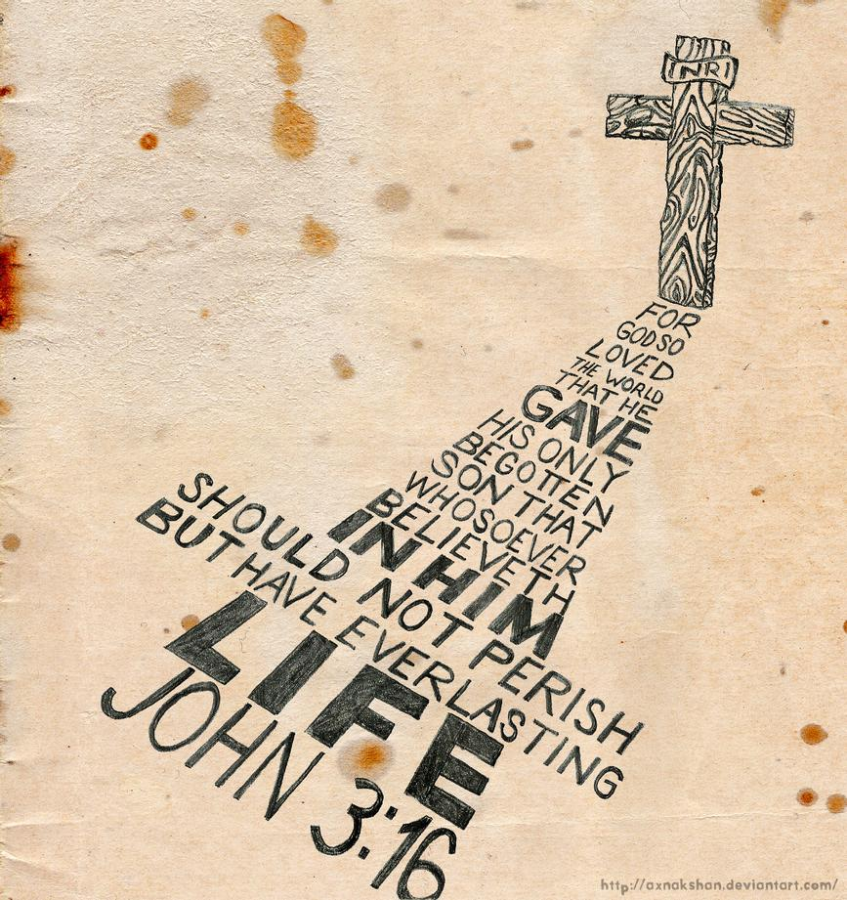
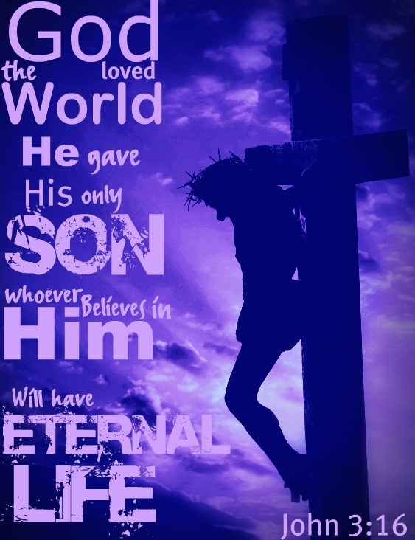
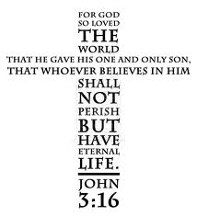
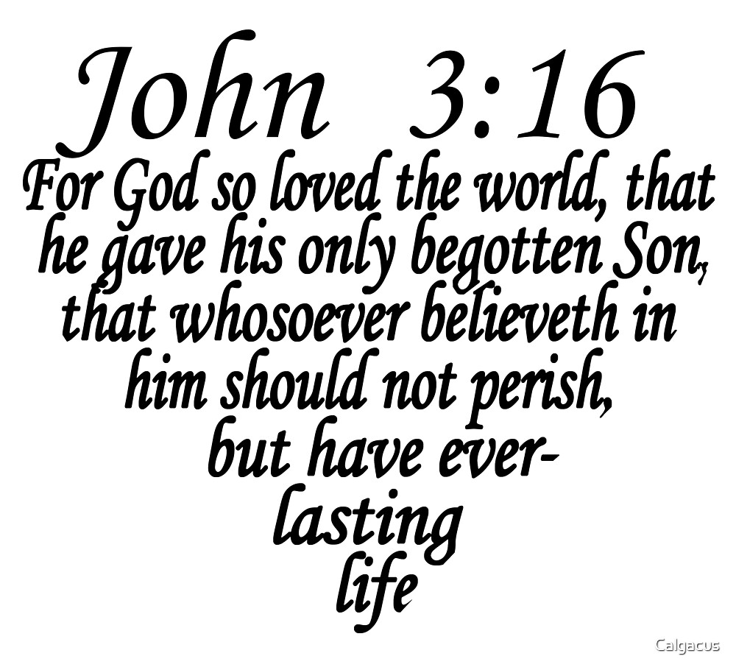
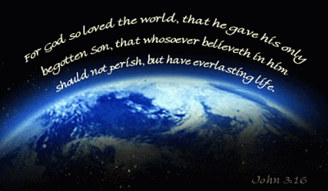
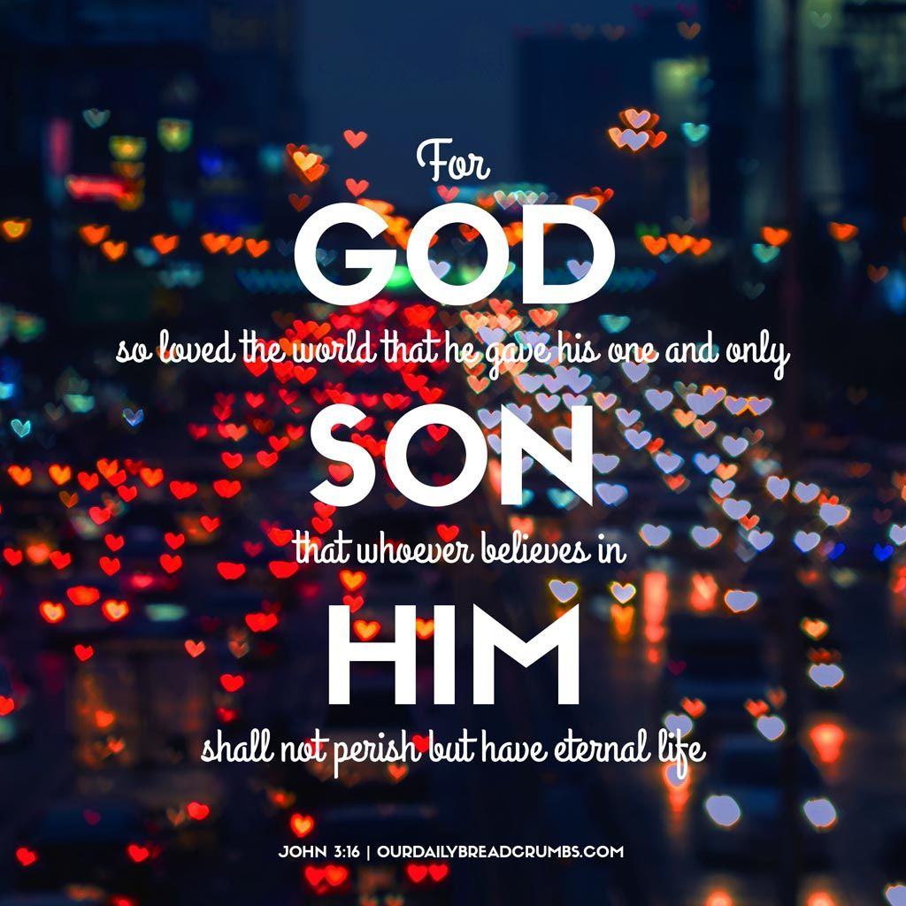

Slide 21
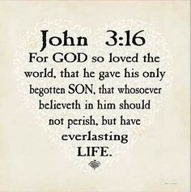
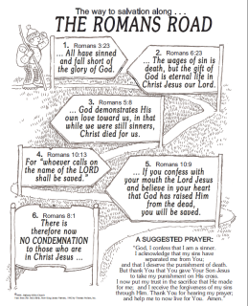
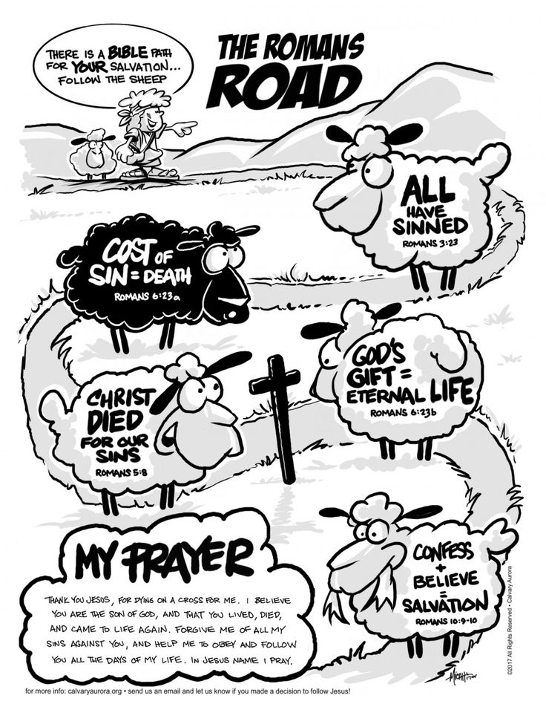
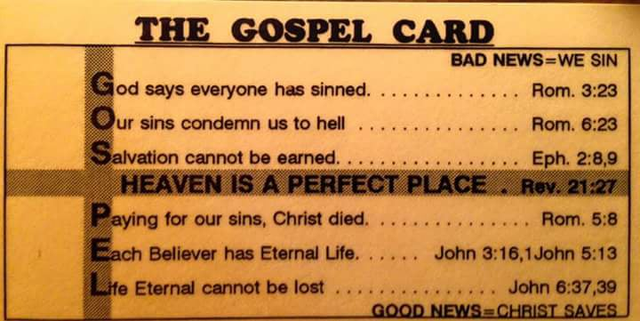
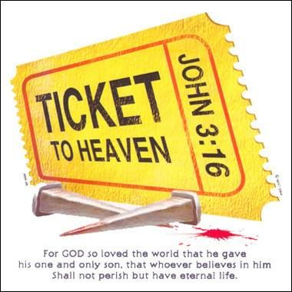
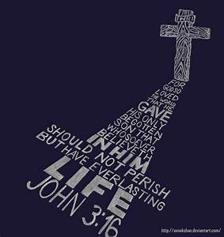

Slide 22
Back to Basics #1 Salvation
John 3:16

Slide 25
John 3:16
One person described John 3:16 this way: 1- GOD – the Greatest Lover
2- SO LOVED – the Greatest Degree
3- THE WORLD – the Greatest Number
4- THAT HE GAVE – the Greatest Act
5- HIS ONLY BEGOTTEN SON – the Greatest Gift
6- THAT WHOSOEVER – the Greatest Invitation
7- BELIEVETH – the Greatest Simplicity
8- IN HIM – the Greatest Person
9- SHOULD NOT PERISH – the Greatest Deliverance
10- BUT HAVE – the Greatest Certainty
11- EVERLASTING LIFE – the Greatest Possession
(I’m not sure who the author was)

Slide 35
John 3:16 –You ever have somebody tell u something simple / u thank them 4 reminding? Not Normal Sun PM message -but it is so Simple Sometimes We Forget!
The Most Familiar verse in the Bible
One of 1st verses taught to Kids / New Converts
Whispered to Loved Ones on Deathbeds
Appears on Signs @ Sporting Events
Known by more People than Any Other
John 3:16 is a Message from God for us All ….it has…
Love Enough for Us All –“For God so Loved the World”
What if God Had not Loved –no Hope, No Purpose
But God so Loves us ALL!!!
No Matter What we have Done, our Position in life, how Worthless we feel
Sacrifice Enough for Us All –“That He Gave Only Begotten Son”
The Birth in Bethlehem is in these Words
The Sinless Life of Jesus is in the Words
The Death of Jesus is in these Words
The Resurrection of Jesus is in these Words
God’s Love Moved Him to Give His Son
The Sufficient Sacrifice for Our Sins
The Lamb of God Sac for us all – John 1:19
Cleanses from All Sin – I John 1:7-9
All of Our Sins were Laid on Him –Isa 53:5-6
Washed from All our Sins by His Blood –Rev 1:5
Invitation Enough for Us All – “That Whosoever Believeth in Him”
Whosoever is a Great Word –
Not Based on Social Status –nor Hindered by Past
Put your Name in this Text- esp. when Satan is Planting Seeds
Life Enough for Us All – “Should Not Perish, but Have Eternal Life”
Our Natural Lifespan is about 70 – 80 years
Everlasting Life is Far Better
Natural is corruptible –Spiritual is Incorrupt

Slide 36
Natural is corruptible –Spiritual is Incorrupt
John 3:16 –the Gospel in Miniature
1- GOD – the Greatest Person
2- SO LOVED – the Greatest Degree
3- THE WORLD – the Greatest Number
4- THAT HE GAVE – the Greatest Act
5- HIS ONLY BEGOTTEN SON – the Greatest Gift
6- THAT WHOSOEVER – the Greatest Invitation
7- BELIEVETH – the Greatest Simplicity
8- IN HIM – the Greatest Person
9- SHOULD NOT PERISH – the Greatest Deliverance
10- BUT HAVE – the Greatest Certainty
11- EVERLASTING LIFE – the Greatest Possession
Simple Devotion
Satan tried
Jesus died
Disciples cried
Jesus is thrived!!!
Satan cried
Jesus is alive!!!
#1 –He kept his promise –he arose!!!
#2 –He will also keep His Promise to us!!!
-we need not fear in Life
-we need not fear in Death!!!!!
He is Alive!!!!

Slide 37
Love Enough for Us All
“For God so Loved the World”
What if God Had not Loved –no Hope, No Purpose
But God so Loves us ALL!!!
No Matter What we have Done…
…our Position in life,
…how Worthless we feel

Slide 38
Sacrifice Enough for Us All
“That He Gave Only Begotten Son”
The Birth in Bethlehem is in these Words
The Sinless Life of Jesus is in the Words
The Death of Jesus is in these Words
The Resurrection of Jesus is in these Words
The Lamb of God Sac for us all – John 1:19
Cleanses from All Sin – I John 1:7-9
All of Our Sins were Laid on Him –Isa 53:5-6
Washed from All our Sins by His Blood –Rev 1:5

Slide 39
Invitation Enough for Us All
“That Whosoever Believeth in Him”
Whosoever is a Great Word –
Not Based on Social Status –
nor Hindered by Past
Put your Name in this Text-
esp. when Satan is Planting Seeds

Slide 40
Life Enough for Us All
“Should Not Perish, but Have Eternal Life”
Our Natural Lifespan is about 70 – 80 years
Everlasting Life is Far Better
Natural is corruptible –Spiritual is Incorrupt

Slide 41
John 3:16 –the Gospel in Miniature
1- GOD – the Greatest Person
2- SO LOVED – the Greatest Degree
3- THE WORLD – the Greatest Number
4- THAT HE GAVE – the Greatest Act
5- HIS ONLY BEGOTTEN SON – the Greatest Gift
6- THAT WHOSOEVER – the Greatest Invitation
7- BELIEVETH – the Greatest Simplicity
8- IN HIM – the Greatest Person
9- SHOULD NOT PERISH – the Greatest Deliverance
10- BUT HAVE – the Greatest Certainty
11- EVERLASTING LIFE – the Greatest Possession

Slide 42
Satan tried
Jesus died
Disciples cried
Jesus is thrived!!!
Satan cried
Jesus is alive!!!
#1 –He kept his promise –He arose!!!
#2 –He will also keep His Promise to us!!!
-we need not fear in Life
-we need not fear in Death!!!!!
He is Alive!!!!

