Slide 1
Helpful Hints
Clumsy? Avoid cutting yourself while slicing vegetables get someone else to hold them while you chop away.
High blood pressure sufferers: simply cut yourself and bleed for a while, thus reducing the pressure in your veins.
A mouse trap, placed on top of your alarm clock, will prevent you from rolling over and going back to sleep when you hit the snooze button
If you have a bad cough, take a large dose of laxatives, then you will be afraid to cough.
Have a bad tooth ache? Hit your thumb with a hammer, then you will forget about the tooth ache.
And most helpful of all –
DO NOT TRY ANY OF THE ABOVE HINTS.

Slide 3
November 8, 2020
Edward Church
7 Churches pt 3
“Let Me Introduce Myself”

Slide 4
Purpose
Revelation was to Prepare…
…and Strengthen the Christians of
…Asia Minor (seven churches)
...that they will Remain Faithful
…Against the Impending Persecution

Slide 5
Purpose
Revelation 1:19
• Chap 1 -“things you have seen”
The Lord’s Work in His Church
• Chap 2-3 – “things which are”
The Lord’s Word to His Church
• Chap 4-22 – “things which shall be”
“ ”Lord’s Word (prophetic) after His Church

Slide 6
Revelation 1:20 (KJV)
“The mystery of the seven stars which thou
sawest in my right hand, and the seven
golden candlesticks. The seven stars are
the angels of the seven churches: and the
seven candlesticks which thou sawest are the seven churches”

Slide 7
The Power of this Vision
What this Would Mean to Persecuted Churches
Comfort Knowing Jesus…
…was in the Middle of the Churches
…They Were Held in His Hand.
We Too Should Know In All This…
…He is Still in the Middle
…We Are Still in His Hands.
He Comes to Us, Cares For Us, Comforts Us…
…We Don’t Have to Be Afraid

Slide 8
Revelation 2-3 Has a 3-fold View
It Can Be Viewed…
Practically
They represent literal congregations
Prophetically
They represent different church ages
Personally
They rep. modern congregations
They rep. individual Christians

Slide 9
Revelation chapters 2 and 3
He Calls Each of These Churches
…By Name
He Gives Each Church…
…a Specific Word
He Gives Each Church…
…a Special Promise

Slide 10
Thirty Years Have Passed…
The Lord Comes to His Churches…
…to Speak to Them About
Where They Are…
Where He Wants Them to Be…
He Comes to Them w-…
…a Message Of Comfort

Slide 11
Each Church has Unique Introduction
They are Reminded in (1) that He Has Them Safely in His Hand.
The Word “Holdeth” Speaks of…
“Being In Absolute Control”.
In a Society That Was Out Of Control, They Needed To Know…
…He Was In Control.

Slide 12
Loveless Church- Ephesus (2:1-7)
Persecuted Church- Smyrna (2:8-11)
Compromising Church- Pergamos (2:12-17)
Divided Church- Thyatira (2:18-29)
Lifeless Church- Sardis (3:1-6)
Living Church- Philadelphia (3:7-13)
Lukewarm Church- Laodicea (3:14-22)

Slide 13
Jeremiah 29:11 (MSG) I know what I'm doing. I have it all planned out—plans to take care of you, not abandon you, plans to give you the future you hope for.

Slide 15
Revelation Chapters 2 and 3
Paul Wrote Seven Letters…
…to Seven Churches
John Wrote One Letter…
…to Seven Churches

Slide 16
Pt 4
You’ve lost that Loving Feeling

Slide 17
7 Churches “Ephesus” You’ve Lost that Loving Feeling!
Revelation 2:1-7

Slide 18
God Plants Church in this…
The Early Church Center Migrated…
Jerusalem
Antioch
Ephesus
The Church at Ephesus was…
Started by Paul
Pastored by Timothy
Pastored by John

Slide 19
Each church has Unique Introduction
They are reminded in verse 1 that He has them safely in His hand.
The word “holdeth” speaks of “being in absolute control”.
In a society that was out of control, they needed to know…
…He was in control.

Slide 20
Jesus makes
Four observations
About His Church
At Ephesus…

Slide 21
I. Jesus Examines Their Reputation -v 2-3, 6
…He speaks a word of Commendation
1. He Commends their Dedication -v2a
a- Works –
speaks of “that which is accomplished”
b- Labor –
literally means “a beating”.
It speaks of…
…“intense work coupled with toil
and trouble.”
c- Patience –
speaks of “steadfast endurance”.

Slide 22
These people realized 4 things…
1. …that a church will not build itself.
2. …that a church cannot sustain itself.
3. …that a church needs people who…
…will stick by it!
(commit emotionally)
4. …that a church needs people who…
…will work to do these things!
(commit physically)

Slide 23
I. Jesus Examines their Reputation -v2,3,6
2. He Commends their Discernment -v2b,
a- “canst not bear”
Take to self -receive / practise
b- “them which are evil”
Worthless - of no spiritual value

Slide 24
I. Jesus Examines their Reputation -v2,3,6
3. He Commends their Discipline -v2c, 6
a- “hast tried/ found”
held fast to correct doctrine
They took a stand against the Nicolaitans (Nikao =to Conquer +
Laos =the People)

Slide 25
I. Jesus Examines their Reputation -v2,3,6
4. He Commends their Determination -v3
a- “hast borne”
…carried the load
b- “hast patience”
…with conquering endurance
c- “hast labored”
…unto point of exhaustion
d- “hast not fainted”
…did not give up

Slide 26
The letters to the seven churches can be interpreted 3 different ways:
Practically, (to a literal church, and to individual churches throughout history);
Prophetically, (Church history - Pentecost to 100 A.D.);
Personally, (To every believer.)
These seven message should speak to each individually as well as to the
neds of this church here. But, do not forget, that this letter went to a real, active church.
Ill. Ephesus, "the Vanity Fair Of Asia", "The Supreme Metropolis of Asia.".
Famous 3 Ways:
1. Religion: The temple of Diana; 7th wonder of world; bank; art; sin;
2. Comercially: Port city; Military city, industrial city;
3. Politically: A free city, self rule. It was here that Paul founded the church in Ephesus, Acts 18.
He spent 3 years here preaching and training the people; Apollos preached here,
Acquila and Priscilla ministered here; pastored by Timothy and later by John.
A church greatly blessed by much spiritual light. Yet, they were a church with a problem.
Jesus came to them and diagnosed them as cold and fallen. Verse 1 identifies the speaker as Jesus.
He is walking in His church seeing and judging.
We are reminded that He is in full control.
Let's listen in as Jesus gives them the cure for the common cold.

Slide 27
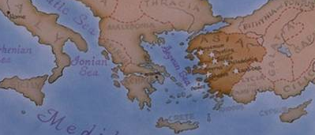
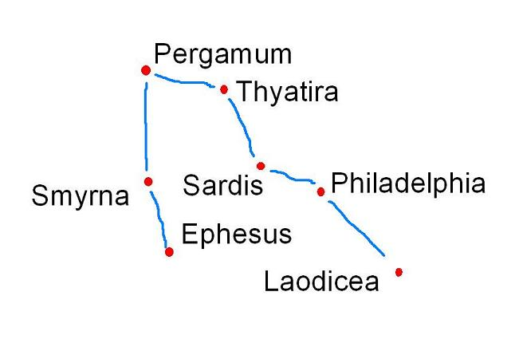
Seven Churches of Revelation

Slide 29
They can be Viewed Practically – These letters were sent to literal, real congregations that were actually functioning at the close of the First Century.
They can be Viewed Prophetically – These churches represent different stages of the church over the last 2,000 years. The church at Ephesus represents the time period between the Day of Pentecost and 100 AD. This was a time of great expansion for the early church. It was also a time when some began to lose their zeal and fervency.
They can be Viewed Personally – These letters speak to congregations, but we should also be mindful that the Lord has a word for the individual in these letters as well. He has something to say to you and to me about our relationship with Him

Slide 31
The Churches are under Christ’s Rule
The Church received Christ’s Care
The Church is subject to Christ’s Judgement
The Church relies on Christ’s Power
The Church is unified in Christ’s Presence
Think what this vision would have meant to persecuted churches to whom John was writing.
Think of the comfort knowing they were held in Christ’s hand.

Slide 32
The lamp stands represented the churches.
Why seven?
There were seven churches in Asia Minor, but also seven was the number of completeness. Among these lampstands, John saw once again the risen Christ, The Son of Man. He’s in his full glory.
He is the Lord of the Lampstands:

Slide 33
The lamp stands represented the churches. Why seven? There were seven churches in Asia Minor, but also seven was the number of completeness. Among these lampstands, John saw once again the risen Christ, The Son of Man. He’s in his full glory. “Son of Man” is a messianic title given to the Lord Jesus Christ because He is the fulfillment of that prophecy in Daniel 7.” (MacArthur). He is the Lord of the Lampstands:
The Churches are under Christ’s rule
The church received Christ’s care
The church is subject to Christ’s Judgement
The church relies on Christ’s power
The Church is unified in Christ’s presence
“Think what this vision would have meant to persecuted churches to whom John was writing. Think of the comfort knowing they were held in Christ’s hand.” (Wilmshurst). We too can and should know in all this that we are in these same hands. He cares for us, disciplines us, comforts, and rules over us. His presence is ever with us as he promised. Take comfort in these thoughts.

Slide 34
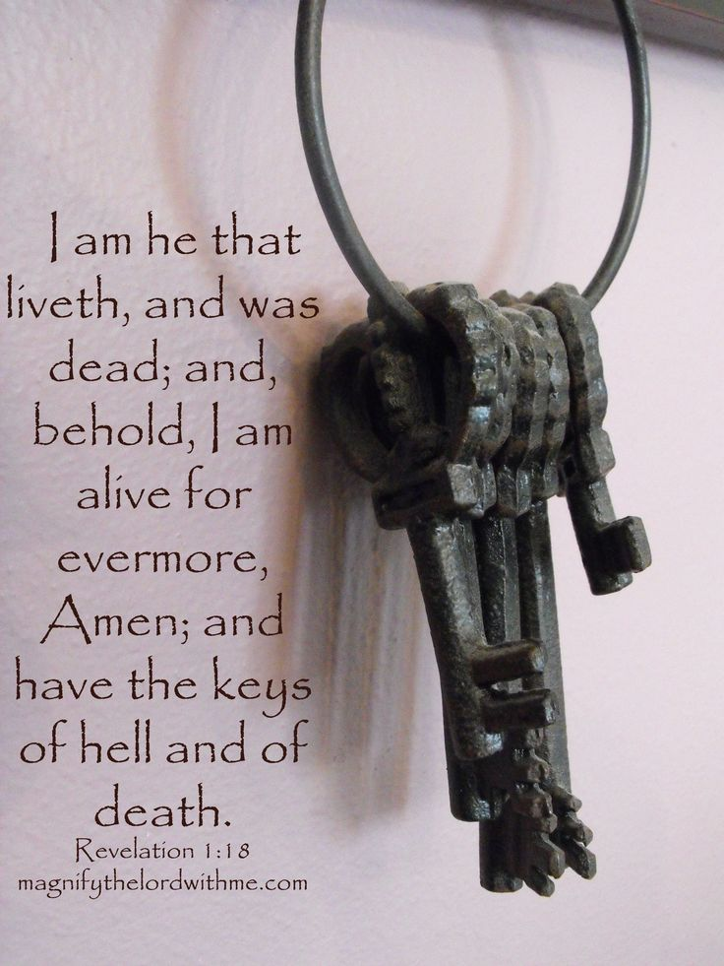
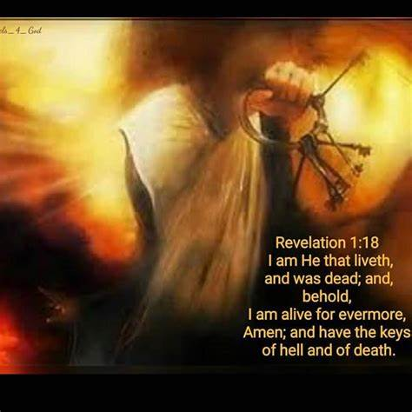
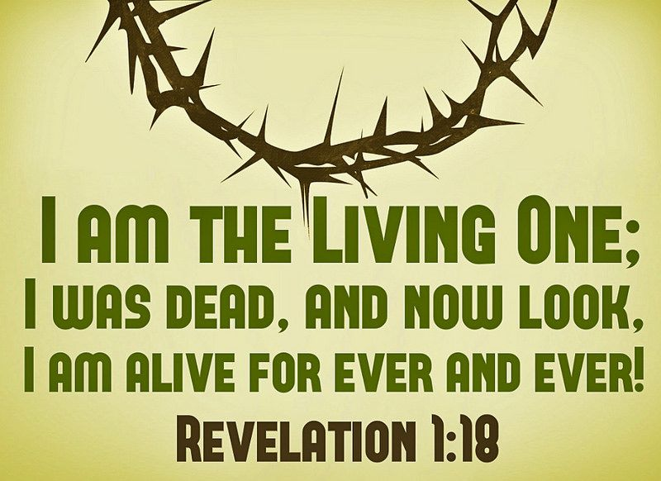
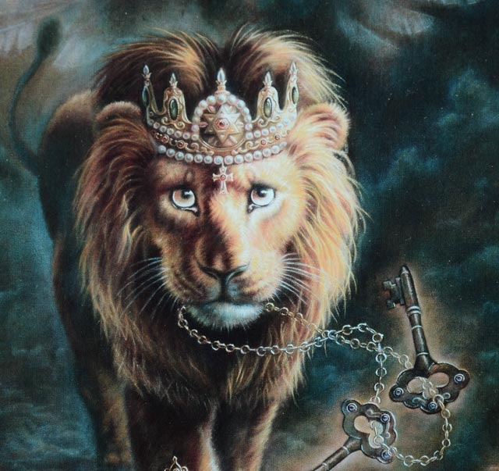
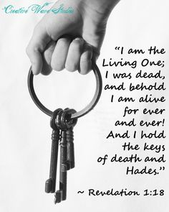
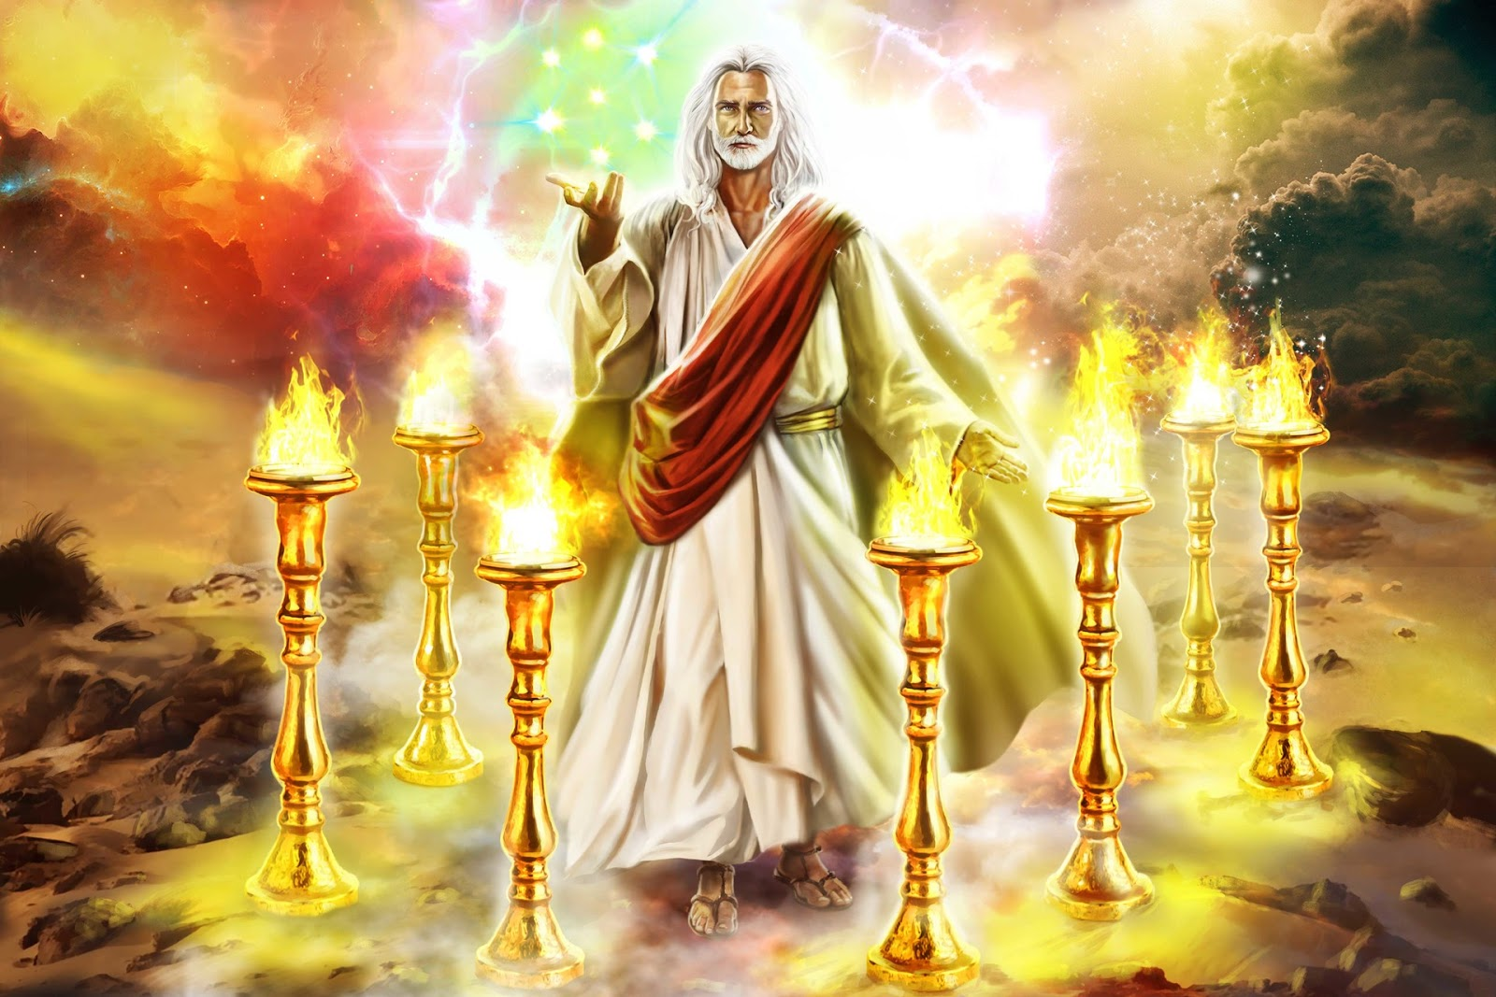

Slide 35
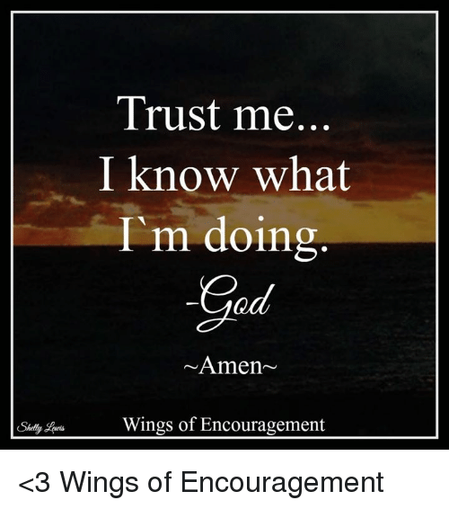

Slide 37
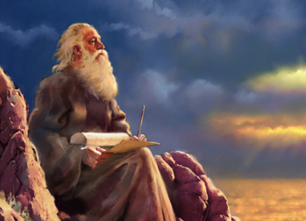
Reading Someone
Else's Mail
Revelation 1:1-8
Part 1

Slide 38
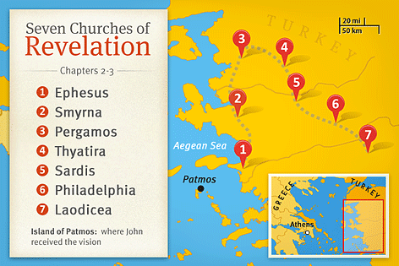
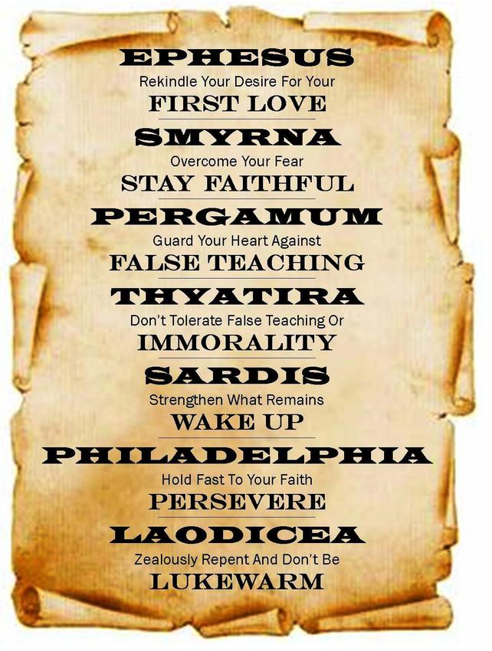
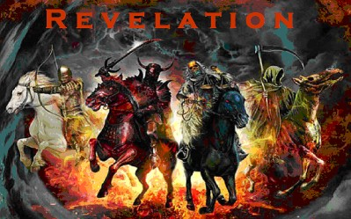
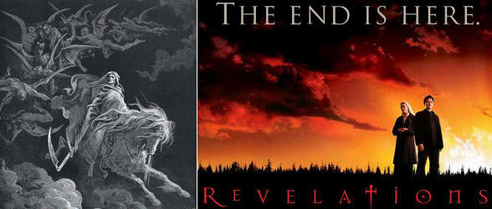

Slide 39
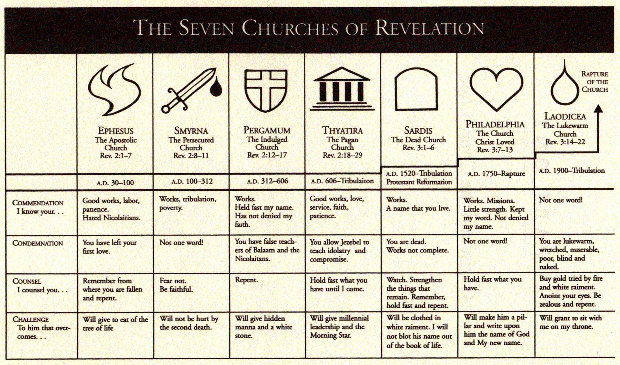
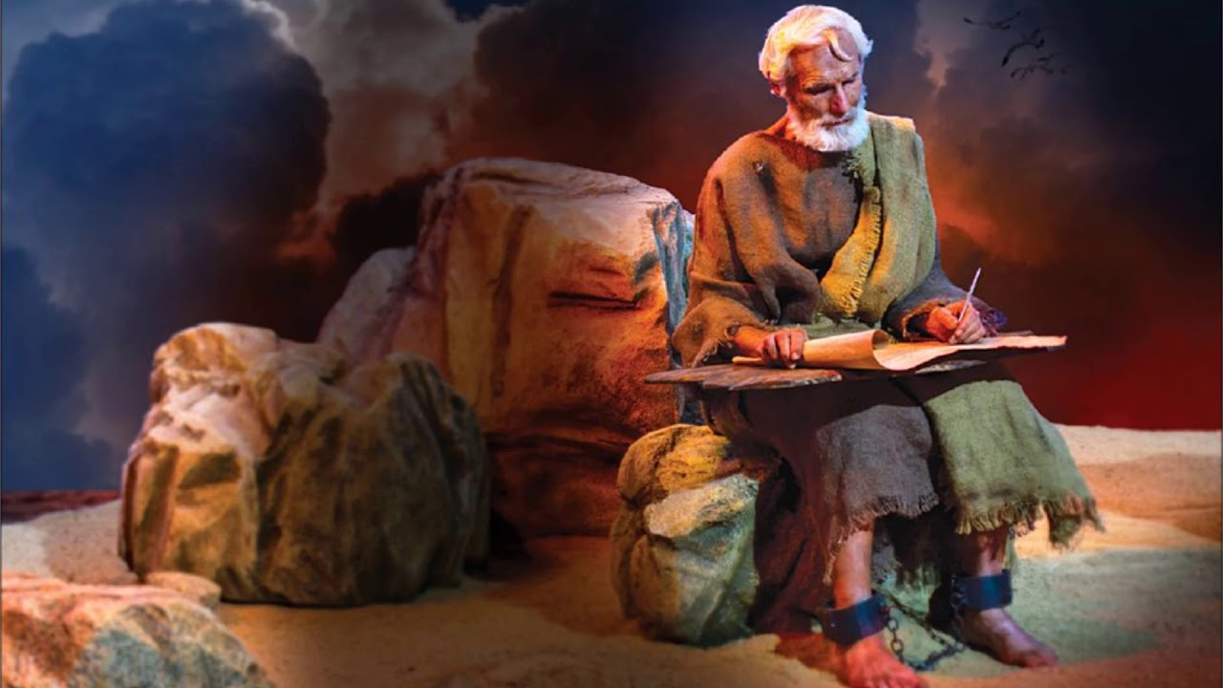

Slide 41
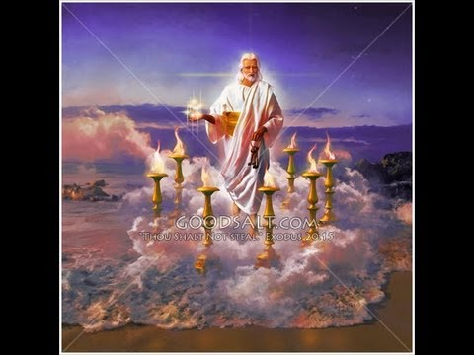
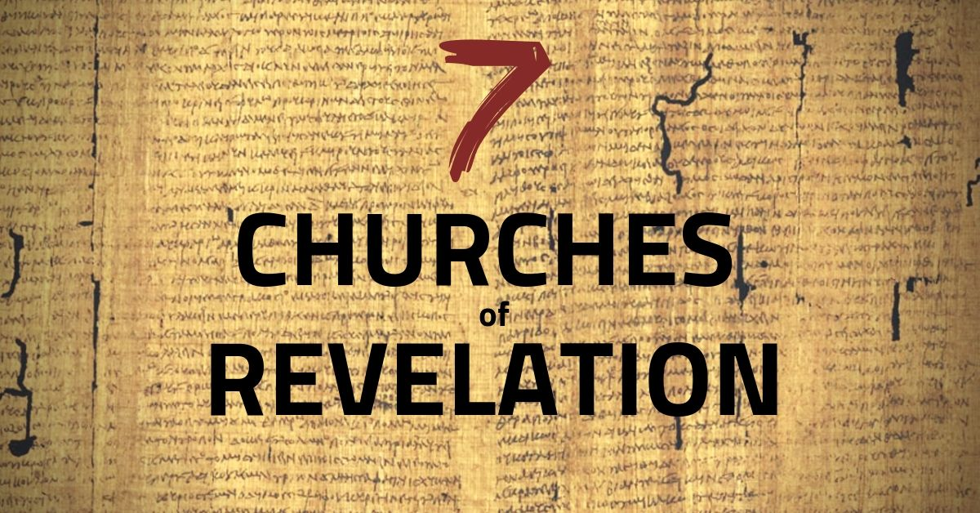
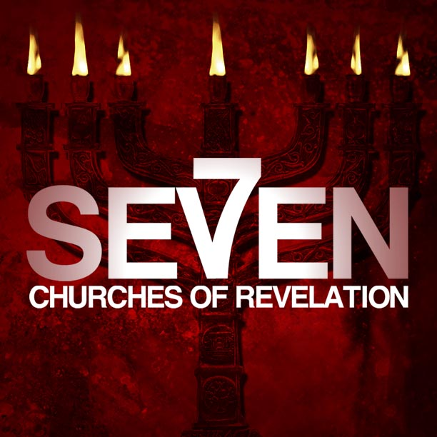
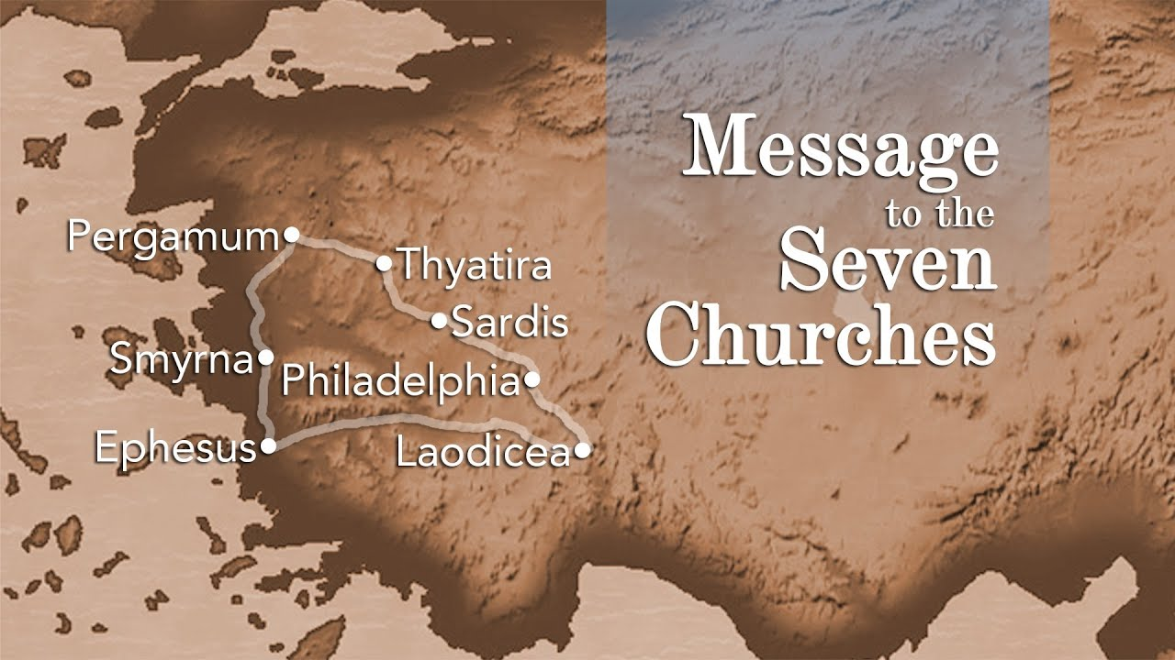

Slide 42
Reading Someone
Else's Mail
Revelation 1:1-8
Part 1

Slide 43
-Because we have enjoyed such great religious liberties for more than 240 years, the church is basically unprepared for the pressure that will soon be exerted on the church.
-The first century church was familiar with all of this. The early Christians were hated and despised as a religious sect all throughout the Roman Empire. There were various motivations behind the hatred:
• Politically—Despised because the Romans viewed them as disloyal because they refused to acknowledge Caesar as a divine authority.
• Religiously—Accused as being atheists because they did not worship the vast array of Roman gods and because they worshipped an invisible God, not an idol.
• Socially—They were from the lower classes of society (1 Cor. 1:26) and loathed by the Roman aristocracy.
• Economically—They were seen as a threat by the pagan priests, craftsmen, and merchants who profited from the idol worship.
They were surrounded by dark paganism, uninhibited immorality, withering slavery, and oppressive dictators. The Christians were enemies of the world. Because they were enemies of the world, this led to martyrdom for many of them.

Slide 44
Purpose

Slide 45
Seven Churches of Revelation

