Slide 1
A man in Chicago calls his son in New York the day before Thanksgiving and says,"I hate to ruin your day, but I have to tell you that your mother and I are divorcing; forty-five years of misery is enough.
"Pop, what are you talking about?" the son screams. We can't stand the sight of each other any longer," the father says. "We're sick of each other, and I'm sick of talking about this, so you call your sister in Dallas and tell her."
Frantic, the son calls his sister, who explodes on the phone. "Like heck they're getting divorced," she shouts, "I'll take care of this,"
She calls Chicago immediately, and screams at her father, "You are NOT getting divorced. Don't do a single thing until I get there. I'm calling my brother back, and we'll both be there tomorrow. Until then, don't do a thing, DO YOU HEAR ME?" and hangs up. The old man hangs up his phone and turns to his wife. "Okay," he says, "they're coming for Thanksgiving and paying their own way."

Slide 3
November 29, 2020
Edward Church
7 Churches pt 6
2:8-11
“Thanksgiving…
…Out of this World”

Slide 4
Thanksgiving Day in our country has deviated so from what it was intended to be.
In 1789, George Washington had said: “It is the duty of all Nations to acknowledge the providence of Almighty God, to obey his will, to be grateful for his benefits, and humbly to implore his protection and favor.”
The Focus has been Reduced from God to…
Parades
Sports
Black Friday!
But that’s Here on Earth…
…In Heaven is a Different Story

Slide 5
⁹ After this I beheld, and, lo, a great multitude, which no man could number, of all nations, and kindreds, and people, and tongues, stood before the throne, and before the Lamb, clothed with white robes, and palms in their hands; ¹⁰ And cried with a loud voice, saying, Salvation to our God which sitteth upon the throne, and unto the Lamb. ¹¹ And all the angels stood round about the throne, and about the elders and the four beasts, and fell before the throne on their faces, and worshipped God, ¹² Saying, Amen: Blessing, and glory, and wisdom, and thanksgiving, and honour, and power, and might, be unto our God for ever and ever. Amen. -Rev 7:9-12

Slide 6
Worship is Made Up of Two Primary Factors
Adoration(to make big) +
Thanksgiving → 4 things
Faith (knowing He is able to…)
Vision (seeing what he has done, is and will do)
Gratitude (appreciation to God)
Decision (Even when I don’t understand)

Slide 7
The Multitude of the Redeemed, All the Angels, the Twenty-Four Elders, and the Four Living Creatures Joined in the Adoration.
The Worship / Praise is Sevenfold
Each of the Seven Items Carries Power

Slide 8
7 is God’s Number of….
Completion
Perfection

Slide 9
Amen
This Starts the Seven-Fold Thanksgiving…
Amen= One of the Most Powerful Words
At End of Statement=
“So be it – may it be fulfilled”
At Beginning=
“Surely this is of a Truth”

Slide 10
Our God, the Giver Deserves Our …
Adoration and Praise!
We Do Not Provide.
God Does!
Magnify Him.
It is from HIM that ALL BLESSINGS FLOW…
…so to HIM all Praise Should Flow,
…ESPECIALLY for the Blood of Christ!
We are Seated in the Heavenlies by Christ

Slide 11
Opinion – Estimate –to take all things in consideration and…
Realize we Need to GIVE God
…the Exaltation that He Alone Deserves
Give to God What BELONGS to Him.
Praise Him for His Magnificence, Excellence,
…Preeminence, Dignity, Grace of God.
Glory Be to Him!

Slide 12
God Possesses All Knowledge / All Wisdom
They are Given as Gifts to Man.
No Human Understanding…
…Can Stand Against God’s Wisdom.
Supreme Intelligence/ Knowledge…
…Belongs Only to God:
“Oh, the depth of the riches both of the wisdom and knowledge of God! How unsearchable are His judgments and unfathomable His ways!” –
Romans 11:33

Slide 13
Esteem is Respect given to the Supreme God, Maker of Heaven and Earth, the Redeemer of your Heart and Life.
Our Lord and our God Paid the Price to Buying Our Redemption.
HE Deserves ALL Honor.
He is not “a” king, but THE Sovereign Eternal RULER over all that exists.
All Praise / glory / wisdom / Honor / Power be to our God.

Slide 14
A Small Part of God’s Inherent Strength has been revealed to you in Creation…
…but also in Christ and in the Cross.
His power has been Revealed Over Sin / Death at the Tomb.
His Triumphant Power Has Been Revealed In The Ascension of Our Lord Jesus.
His Inherent / Indwelling Power Has Been Revealed In Your Life Through the Holy Spirit.

Slide 15
God has the UNWAVERING ABILITY to Exercise His Power.
His Spirit Who Lives Within You, / God’s Might Power in the Church, and Sovereign Over All that He has Made, Is Solid / Inexhaustible.
“Finally, be strong in the Lord and in the strength of His might.” We are not strong because of the things we have or by what we have done, but because of the God in whom we believe” - Eph. 6:10

Slide 16
Saved the Best for Last ?
Word for Thanks is Grounded…
…in GRACE OF God that Brings Forgiveness,
Reconciliation, And Exceedingly Great Joy!
The multitude of Heaven will never stop thanking and praising God for His Strength and Power to Save, and neither will I!
Their faith has become sight! They will honor and bless our God forever, giving Him the glory that He deserves.

Slide 17
The Greatest Form of Praise…
Hebrews 13:15 “Through Jesus, therefore, let us continually offer to God a sacrifice of praise-the fruit of lips that confess his name”
Even If I Do Not Feel Like it…
He Still…
Deserves It
Desires It
Dwells in It!!

Slide 19
Amen

Slide 21
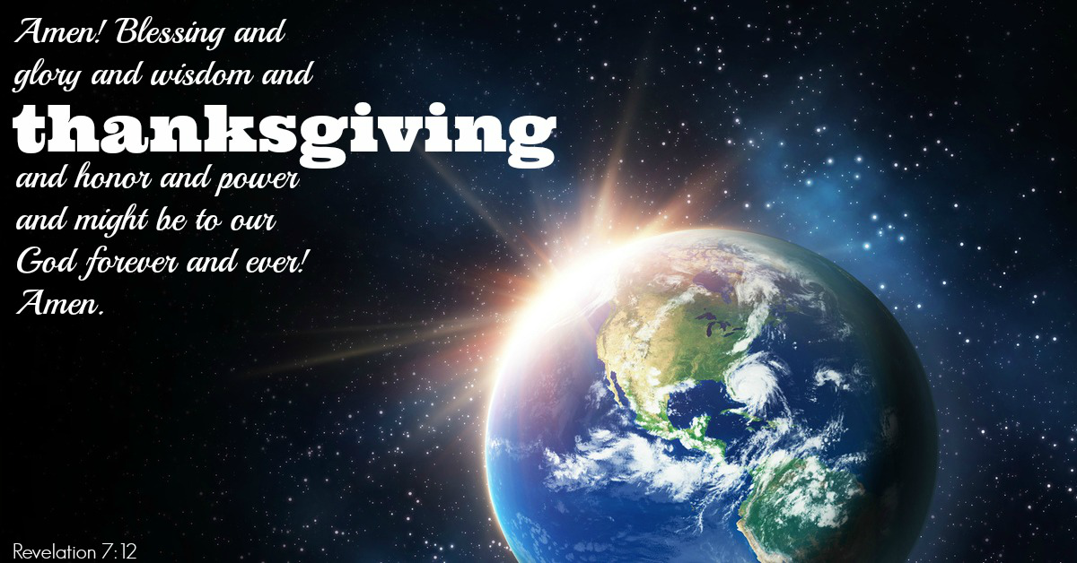
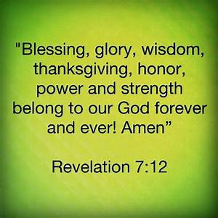
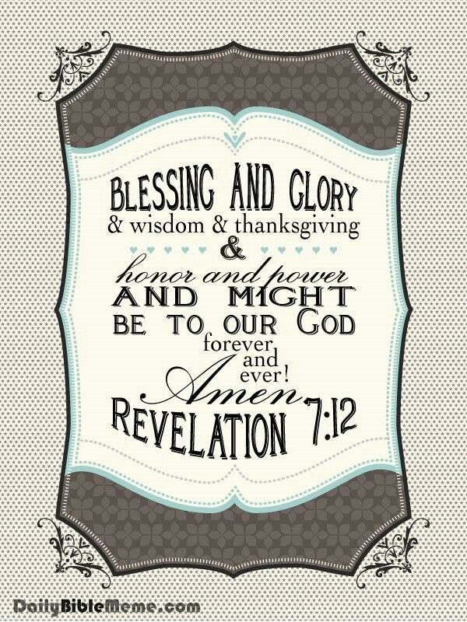
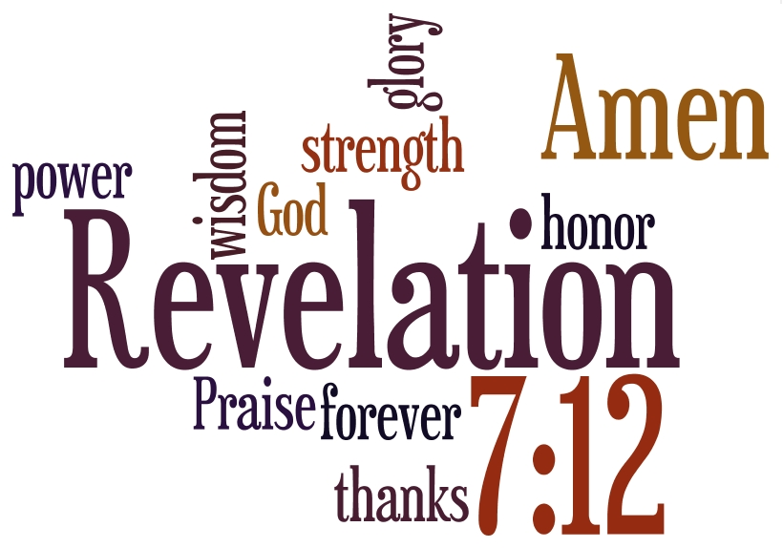

Slide 24
The Pilgrims Get the Credit for the First Thanksgiving…
It has been Celebrated
Many Times
In Many Ways…
But there is One Coming…
…that will Be Like No Other

Slide 25
Faith
Belief that God has control of the situation
Leads to…
Praise
Acknowledge God’s control of the situation
Leads to…Thanksgiving
Expression of gratitude to God
Leads to…Victory!!!

Slide 26
Thanksgiving is Made Up
Gratitude- for What He Has Done
Faith- Sets Up Divine Communication
Vision- Sees Gods Hand with the Heart
Decision- Decides to hold on
when you don’t understand
til I do see His Hands with my eyes

