Slide 1
A mother mouse and her daughter are suddenly attacked by a cat! The mother mouse yells, "WOOF! ARF! WOOF!!" and the cat runs away.
"See?" says the mother to the daughter. "It's important to know a foreign language!"

Slide 3
November 15, 2020
Edward Church
7 Churches pt 4
“You’ve Lost that Loving Feeling”

Slide 4
The Lord Comes to His Churches…
…to Speak to Them About
Where They Are…
Where He Wants Them to Be…
He Comes to Them w-…
…a Message Of Comfort

Slide 5
The Early Church Center Migrated…
Jerusalem
Antioch
Ephesus
The Church at Ephesus was…
Started by Paul
Pastored by Timothy
Pastored by John

Slide 6
Jesus Tells Ephesus…
…The Good
…The Bad
…The Ugly

Slide 7
Service (2a) Labor = “a beating”
“intense work coupled with toil / trouble.”
Reveals “Servant Heart”
Steadfast (2a)
Patience = “Steadfast Endurance”
They Served Christ even when it wasn’t Comfortable or Convenient

Slide 8
Secure (2b)
“canst not bear”= to receive / practice
“them which are evil” = worthless -of no spt value
behaved with the attitudes and actions consistent of a believer.
Selective (2c)
“hast tried/ found”= held fast to correct doctrine
did not allow anyone who was not a believer to instruct within the church.
Nicolaitans(Nikao -to Conquer +Laos -the People)

Slide 9
Suffering (3) “hast borne”
…carried the load
“hast patience”
…with conquering endurance
Solid (3b)
“hast labored”
…unto point of exhaustion
“hast not fainted”
…did not give up

Slide 10
These People Realized 4 Things…
A Church…
Will Not Build Itself
Cannot Sustain Itself
Needs People Who…
…Will Stick By It!
(Commit Emotionally)
Needs People Who…
…Will Work To Do These Things!
(Commit Physically)

Slide 11
His Disappointment
Looked Good On Outside
Inside Suffered Heart Trouble
His Diagnosis
They Left Their “First Love”

Slide 12
Left Their First Love…
What It Does Not Mean…
…They Had Lost Love For the
Church
Work of the Church
Christ the Head of the Church

Slide 13
What It Does Mean…
1- Love
Agape = God type love
Effects all relationships
Vertical (w/ God) / Horizontal (w/ each other)
2- First
Priority
Passion
3- Left
Not lost
left

Slide 14
Removal
“Come quickly…
…Remove Candlestick out of his place”
Place of…
Security
Serenity
Potential

Slide 15
Course Correction (5)
Even Though The Church May Have Lost Their First Love…
Thank God That He Hasn’t…
He Gives Us A Chance To Correct Course

Slide 16
Course Correction (5)
Remember
“Remember”
Called to Look Back
“from..art fallen..”
Driven Off One’s Course..
Become Ineffective…

Slide 17
Course Correction (5)
Repenting
“a Change of Mind that …
…Leads to a Change of Action”
Repeating
He Tells Them to “do the first works”
Key to their Revival
Do the Things They Used to Do…
…Once Again

Slide 18
Letters Were Written to These Churches to Let Them Know…
Although There May Be Problems…
…There Is Always
Hope
Opportunity
Choice
Choose Life!!!

Slide 21
Jeremiah 29:11 (MSG) I know what I'm doing. I have it all planned out—plans to take care of you, not abandon you, plans to give you the future you hope for.

Slide 22
The Family is Under Attack
Our God places a…
…High Value On Relationships
That is why he created Adam…
…gave Free Will
Adam was to Use this Gift to…
…the Families Advantage

Slide 23
The letters to the seven churches can be interpreted 3 different ways:
Practically, (to a literal church, and to individual churches throughout history);
Prophetically, (Church history - Pentecost to 100 A.D.);
Personally, (To every believer.)
These seven message should speak to each individually as well as to the
neds of this church here. But, do not forget, that this letter went to a real, active church.
Ill. Ephesus, "the Vanity Fair Of Asia", "The Supreme Metropolis of Asia.".
Famous 3 Ways:
1. Religion: The temple of Diana; 7th wonder of world; bank; art; sin;
2. Comercially: Port city; Military city, industrial city;
3. Politically: A free city, self rule. It was here that Paul founded the church in Ephesus, Acts 18.
He spent 3 years here preaching and training the people; Apollos preached here,
Acquila and Priscilla ministered here; pastored by Timothy and later by John.
A church greatly blessed by much spiritual light. Yet, they were a church with a problem.
Jesus came to them and diagnosed them as cold and fallen. Verse 1 identifies the speaker as Jesus.
He is walking in His church seeing and judging.
We are reminded that He is in full control.
Let's listen in as Jesus gives them the cure for the common cold.

Slide 24
Loveless Church- Ephesus (2:1-7)
Persecuted Church- Smyrna (2:8-11)
Compromising Church- Pergamos (2:12-17)
Divided Church- Thyatira (2:18-29)
Lifeless Church- Sardis (3:1-6)
Living Church- Philadelphia (3:7-13)
Lukewarm Church- Laodicea (3:14-22)

Slide 25
The Power of this Vision
What this Would Mean to Persecuted Churches
Comfort Knowing Jesus…
…was in the Middle of the Churches
…They Were Held in His Hand.
We Too Should Know In All This…
…He is Still in the Middle
…We Are Still in His Hands.
He Comes to Us, Cares For Us, Comforts Us…
…We Don’t Have to Be Afraid

Slide 26
Revelation 1:20 (KJV)
“The mystery of the seven stars which thou
sawest in my right hand, and the seven
golden candlesticks. The seven stars are
the angels of the seven churches: and the
seven candlesticks which thou sawest are the seven churches”

Slide 27
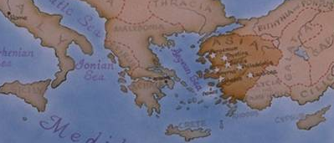
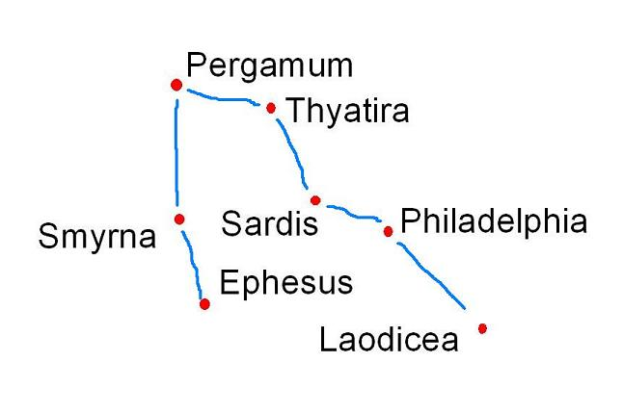
Seven Churches of Revelation

Slide 28
Jesus makes
Four observations
About His Church
At Ephesus…

Slide 29
Each Church has Unique Introduction
They are Reminded in (1) that He Has Them Safely in His Hand.
The Word “Holdeth” Speaks of…
“Being In Absolute Control”.
In a Society That Was Out Of Control, They Needed To Know…
…He Was In Control.

Slide 31
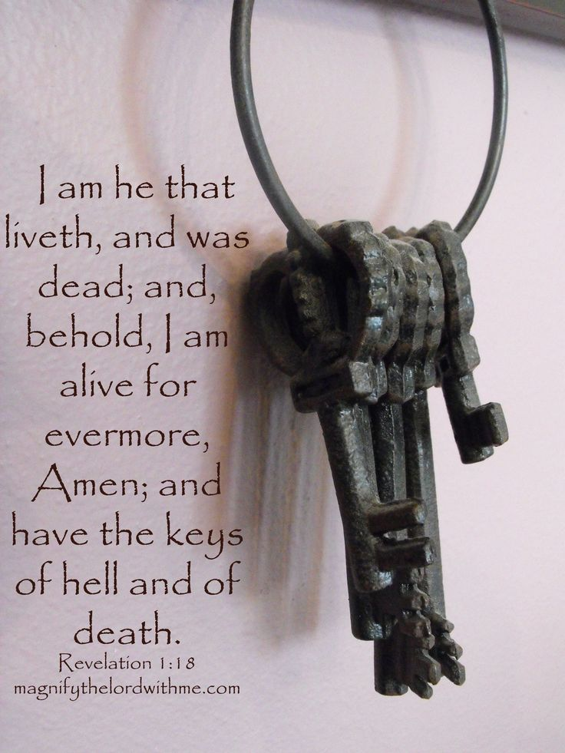
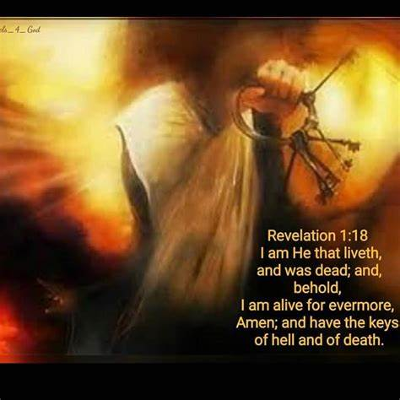
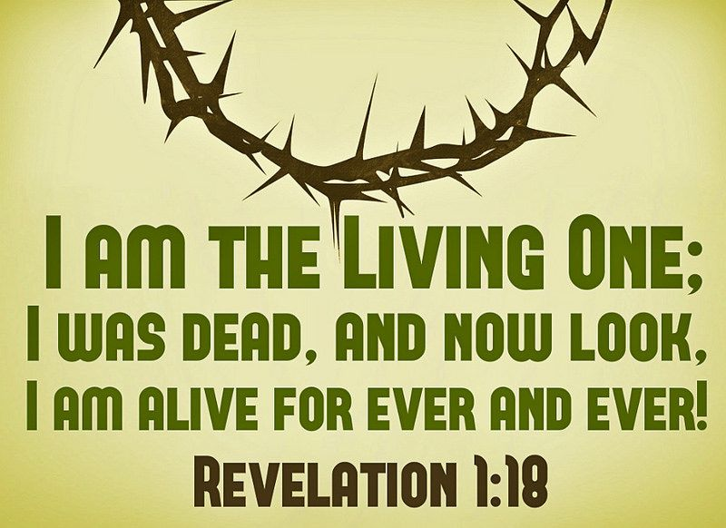
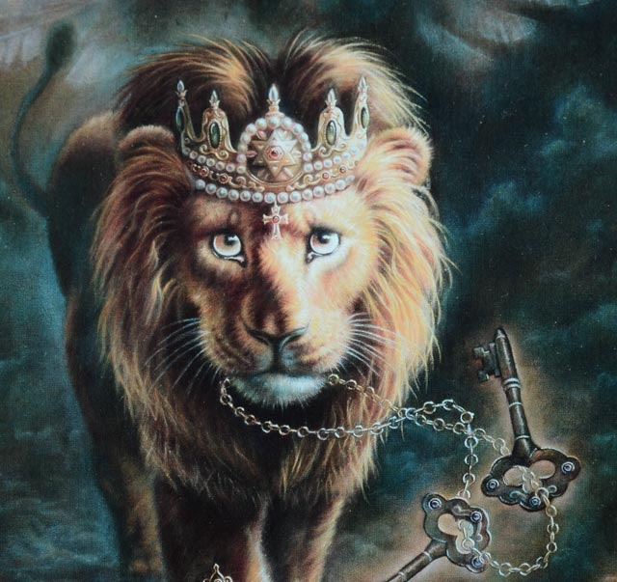
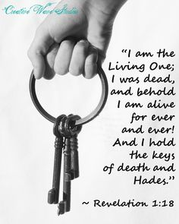
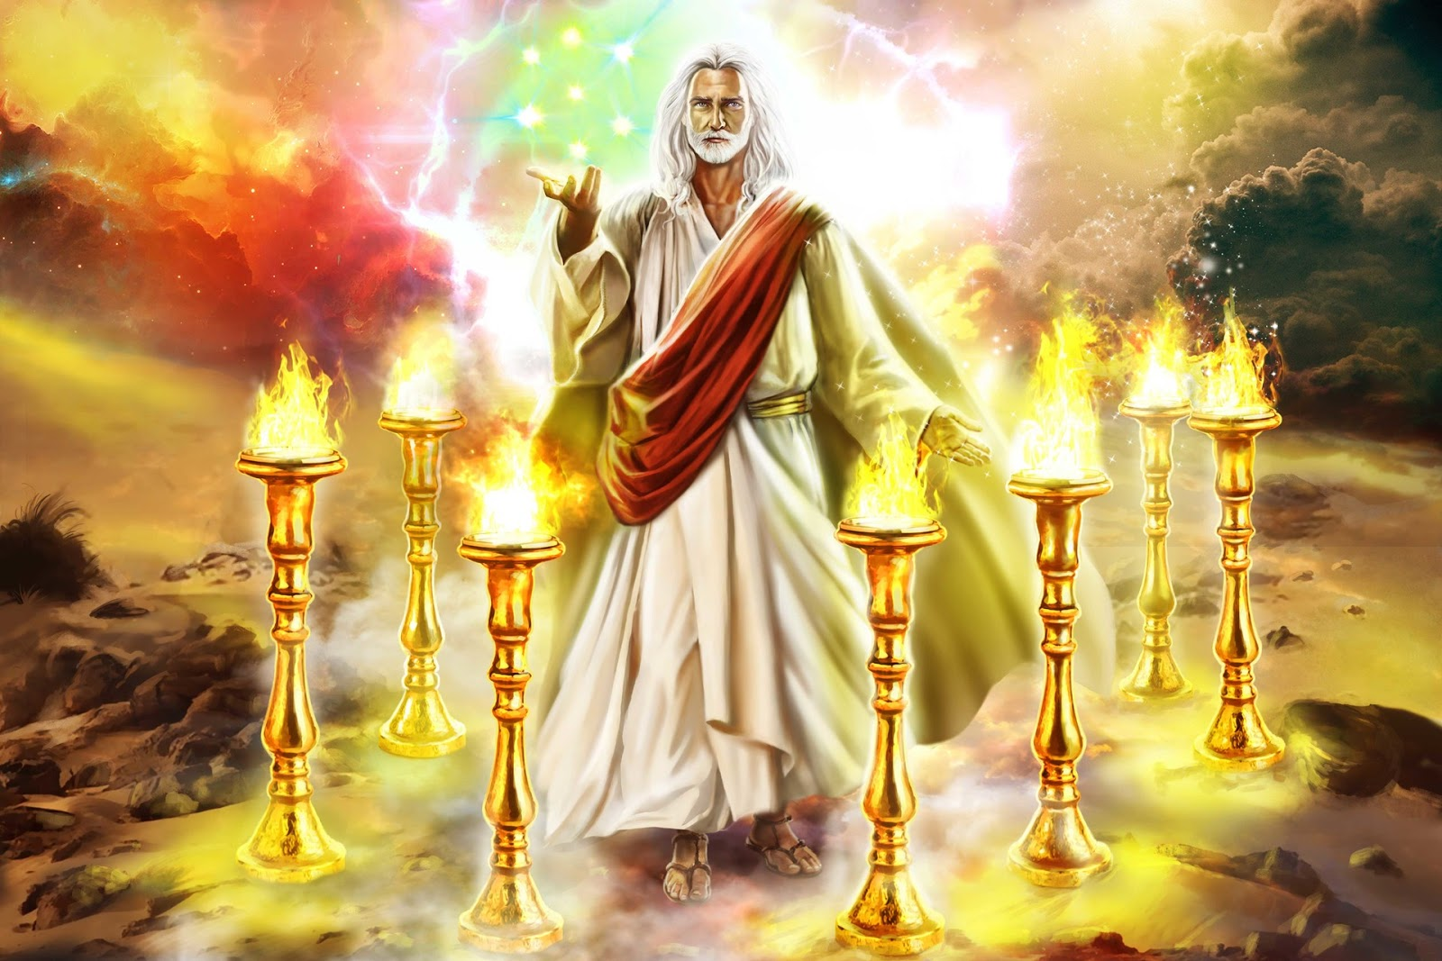

Slide 32
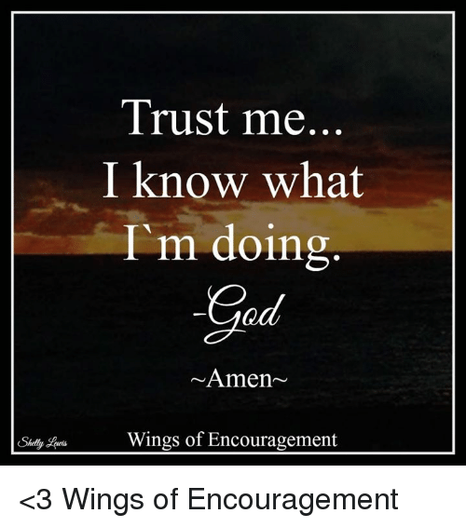

Slide 33
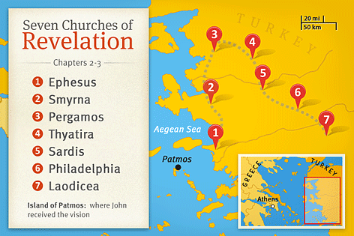
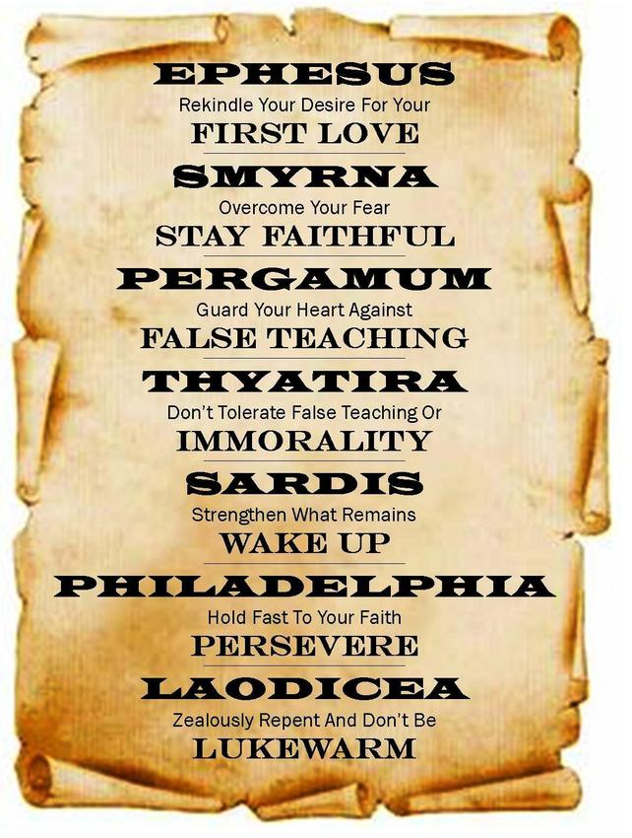
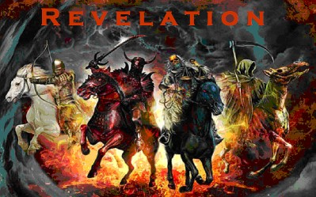
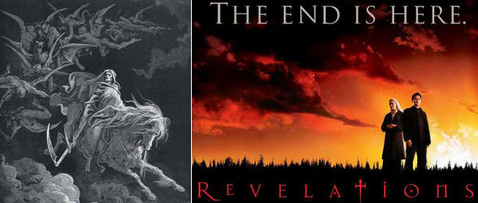

Slide 34
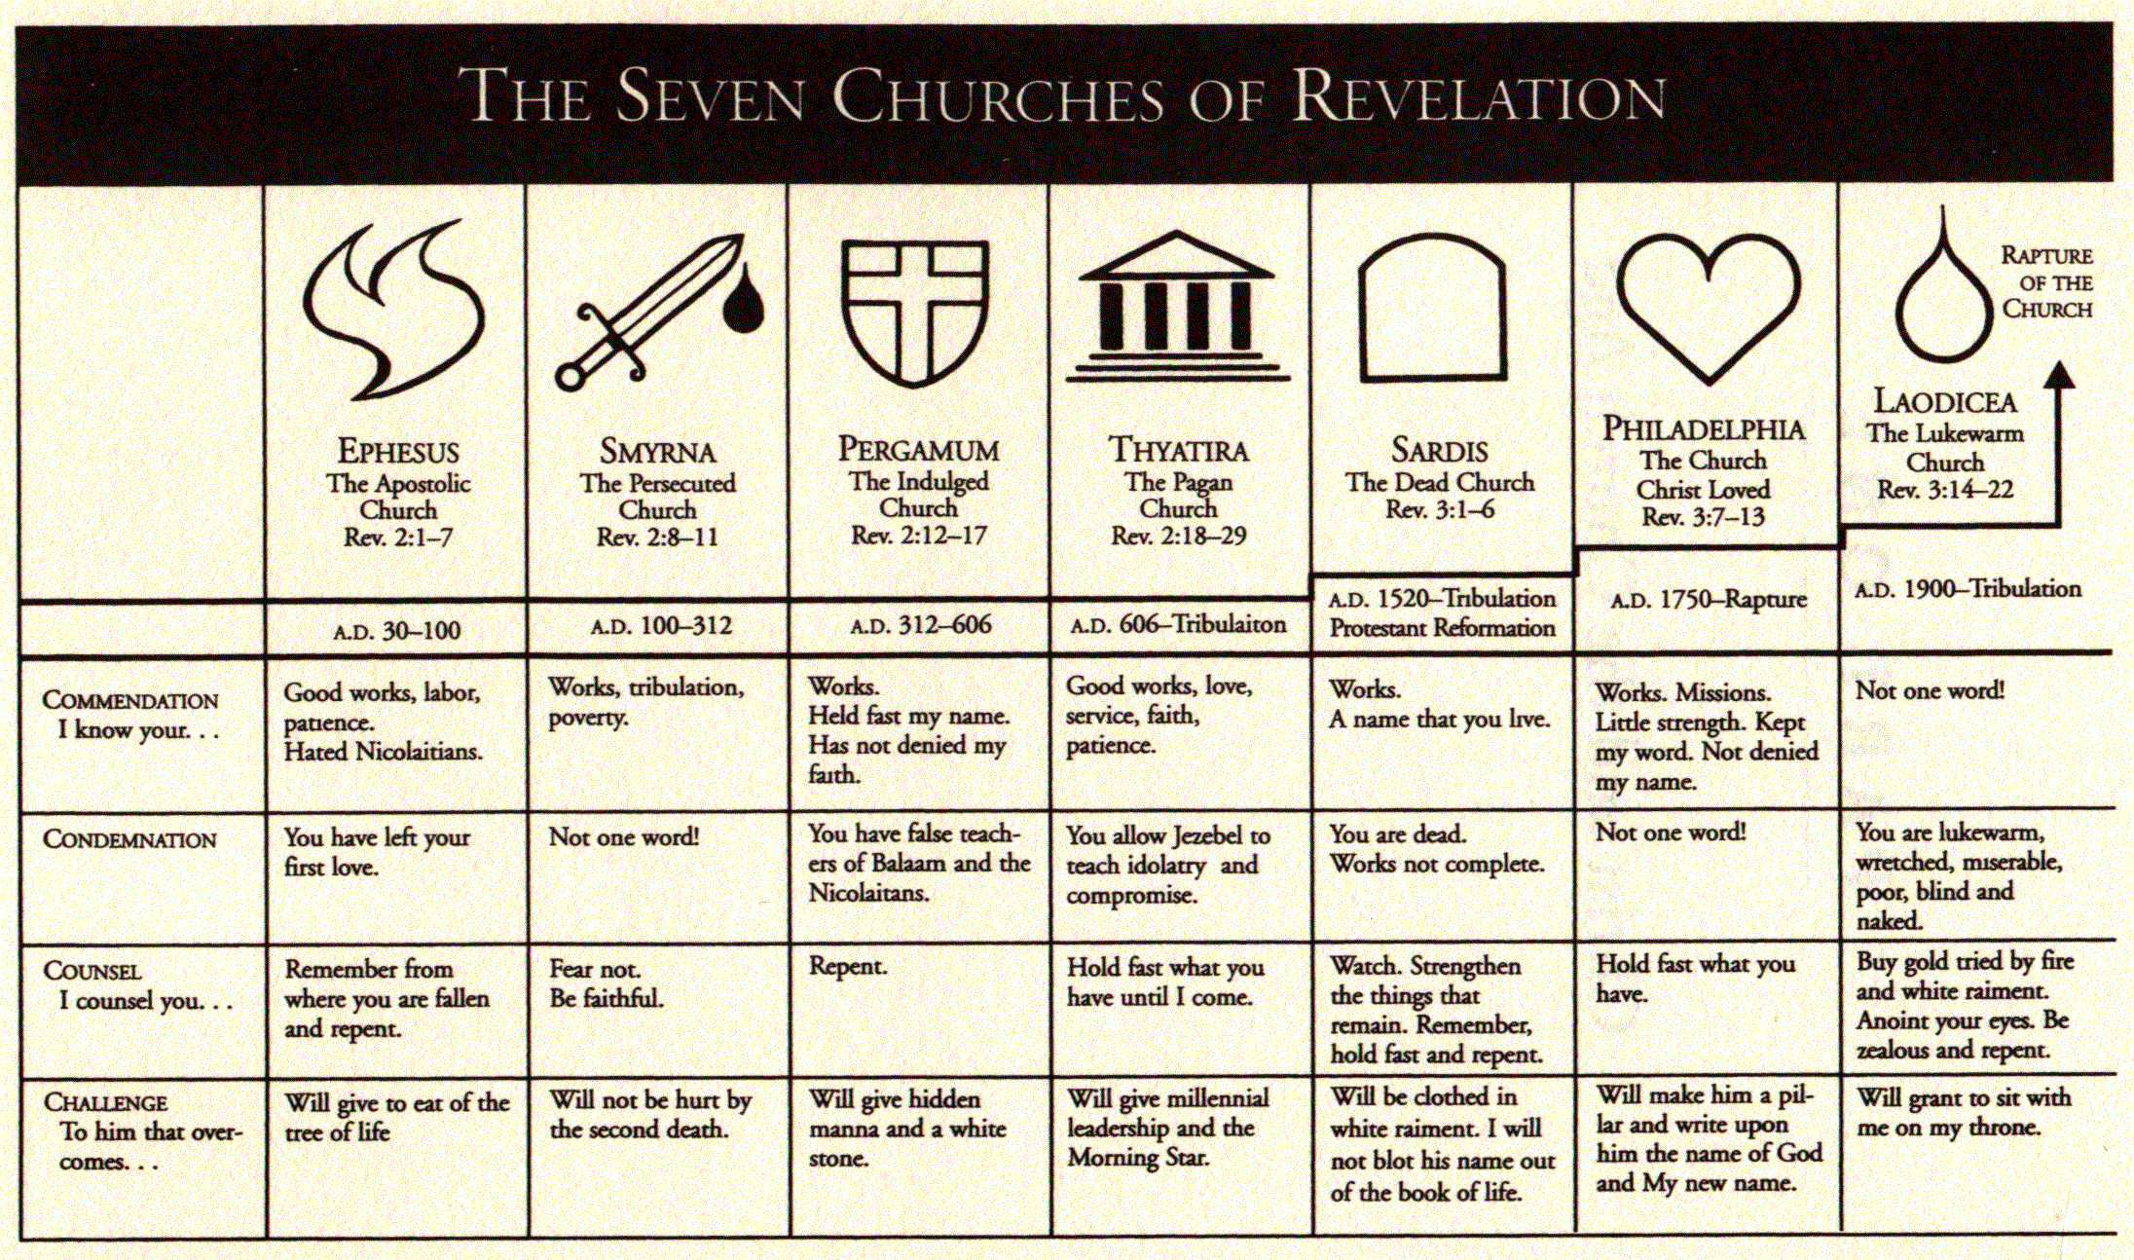
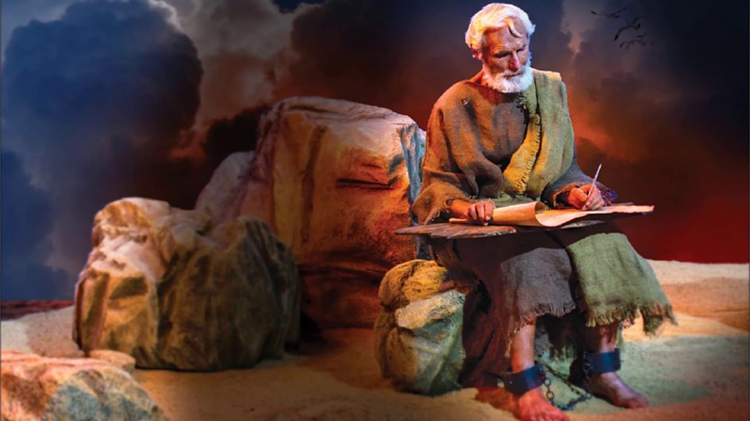

Slide 36
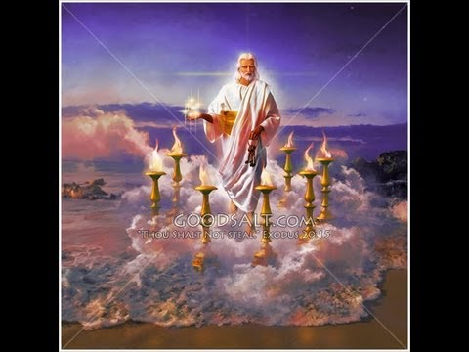
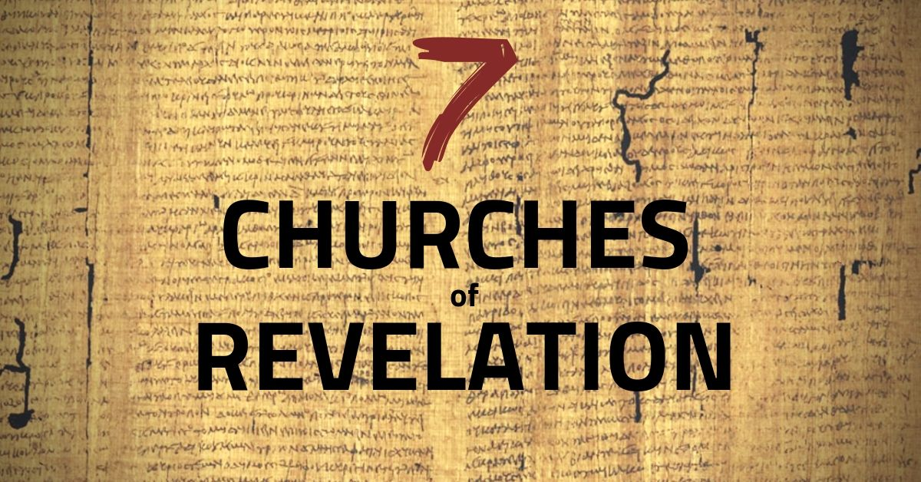
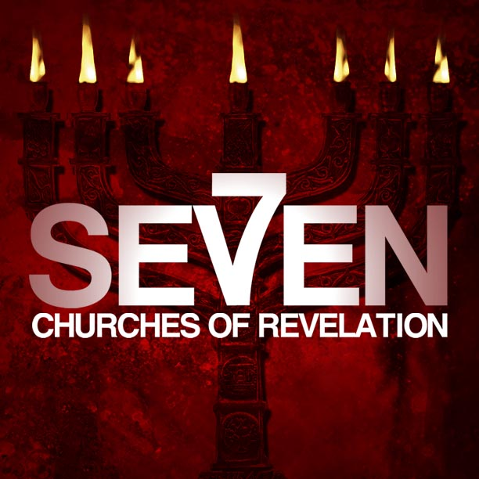
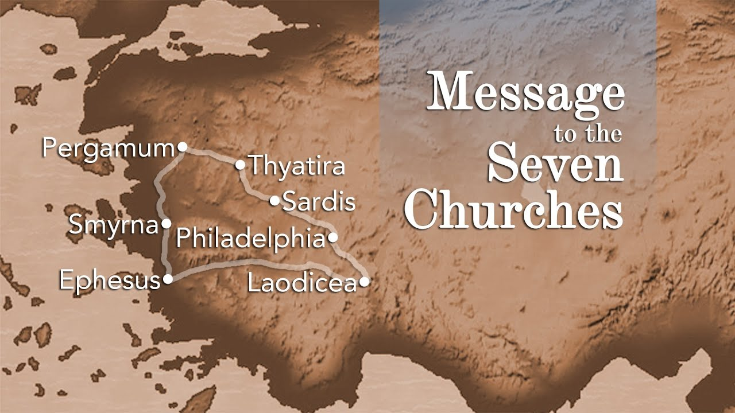

Slide 37
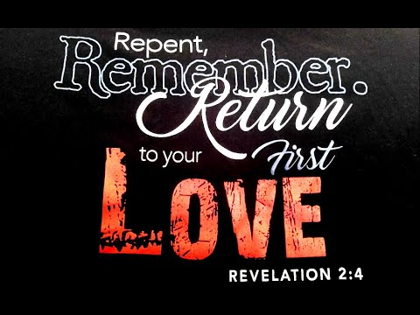

Slide 38
Discernment (2b)
“canst not bear”
Take to self -receive / practise
“them which are evil”
Worthless - of no spiritual value

Slide 39
Dedicated (2a)
Works
“that which is accomplished”
Labor
Literally= “a beating”
“intense work coupled with toil
and trouble.”
Patience
“steadfast endurance”

Slide 40
Discipline (2c, 6)
a- “hast tried/ found”
held fast to correct doctrine
They took a stand against the Nicolaitans (Nikao =to Conquer +
Laos =the People)

Slide 41
Discipline (2c, 6)
“hast borne”
…carried the load
“hast patience”
conquering endurance
“hast labored”
unto point of exhaustion
“hast not fainted”
did not give up

Slide 42
Seven Churches of Revelation
He Calls Each of These Churches
…By Name
He Gives Each Church…
…a Specific Word
He Gives Each Church…
…a Special Promise

