Slide 1
Couple successfully married for 50 years
At church anniversary party..
Someone asked the husband the secret to their success
HE said they travelled a lot
HE said on their 25th anniversary. He took her to China
Wow! What did you do for your 50th?
He said I went back and brought her back!

Slide 3
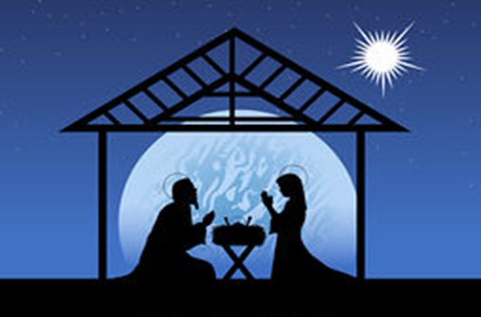
Christmas 101 –pt1 "Christmas Questions"
Edward Church
Luke 1:26-2:12
December 7, 2020

Slide 4
Proclamation
(Word)
Preparation
(Wait)
Presentation
(Work)
Principle
(Will)

Slide 5
QUESTION #1 – WHY GABRIEL? – Luke 1:26
Why Not MICHAEL, the Arch-angel … or another Angel?
Ten’s of thousands of angels to choose from.
God chose GABRIEL instead of MICHAEL … WHY?
MICHAEL was a Special Angel … sent to Israel … the Jews.
Angels are God’s “Messengers” …
Michael’s Messages were Always to the Jews.
Jesus was Born …
…NOT just for the Jews
…BUT for the Whole World

Slide 6
QUESTION #1 – WHY GABRIEL? – Luke 1:26
God Chose GABRIEL to Tell Daniel
Chap 8 of the 2nd Coming of Christ
Chap 9 of the 1st Coming of Christ
WHO BETTER to Tell Mary of the 1st COMING of Christ?
God was CONSISTENT in His MESSAGE…
…and His MESSENGER.
One Day Soon- He Will Use Gabriel Again to Announce…
…the Next Coming of the Lord
…I Thess 4:16

Slide 7
QUESTION #2 – WHY MARY? – Luke 1:27-28
WHY MARY?
1st- She was a Virgin
Seed of a Woman (Gen 3:15)
2^{nd-} She was Willing
Whatever you need me to do…(1:38)
3rd- She Believed – 1:45 What Did She Believe?

Slide 8
QUESTION #2 – WHY MARY? – Luke 1:27-28
WHAT Did She Believe?
The PROMISES of God … God would send the Messiah.
The POWER of God … to Do what He had PROMISED.
Giving PRAISE to God – 1:47
Fulfilling Her Purpose –Lineage
…to Produce / Carry the Seed
God is Looking for Willing Vessels Today to Carry His Seed
“VISION”

Slide 9
QUESTION #3 – WHY JOSEPH? Matt 1:18
God is Looking for those Willing to Face …
Not Fully Understanding
Being Misunderstood
The Fires of Trial

Slide 10
QUESTION #3 – WHY JOSEPH? Matt 1:18
Because He Was Willing to Face …
He was Chosen to Protect the Plan of God…
…to Protect the Seed of God
It was His Purpose…
…Lineage
God is Still Looking for Someone Willing…
…to Take the Bumps / Bruises
…And Protect His Seed!!!
“VISION”

Slide 11
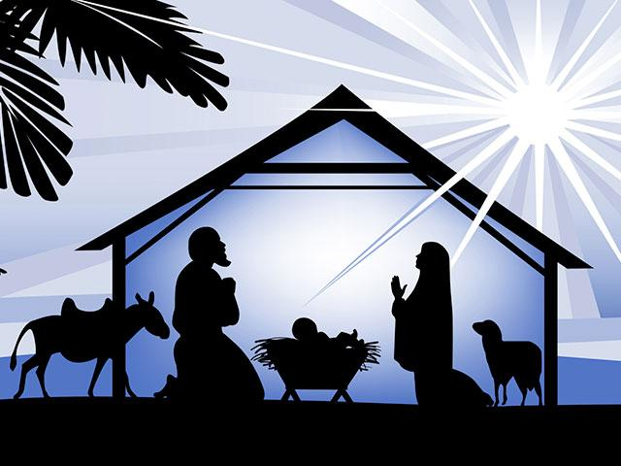
The Christmas Story Goes Way Beyond
Bethlehem / Manger
Cross / Resurrection
Goes Beyond a Yearly Celebration
It Goes Deep Within Our Hearts…
…Lived Out Daily in Our Lives

Slide 12
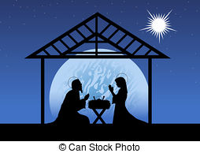

Slide 13
Matthew 1:18-21 (KJV) ¹⁸ Now the birth of Jesus Christ was on this wise: When as his mother Mary was espoused to Joseph, before they came together, she was found with child of the Holy Ghost. ¹⁹ Then Joseph her husband, being a just man, and not willing to make her a public example, was minded to put her away privily. ²⁰ But while he thought on these things, behold, the angel of the Lord appeared unto him in a dream, saying, Joseph, thou son of David, fear not to take unto thee Mary thy wife: for that which is conceived in her is of the Holy Ghost. ²¹ And she shall bring forth a son, and thou shalt call his name JESUS: for he shall save his people from their sins.

Slide 14
Purpose
Gabriel – Proclaim the Seed- announce
Mary- Produce the Seed
Joseph – Protect the Seed

Slide 15
^{Protect the Seed}

Slide 16
“Christmas Questions” about the Christmas story.
NOT … to question God or His methods.
BUT … to get a better understanding of WHY God
did what He did concerning the birth of His Son. Galatians 4:4 – “But when the fullness of the time was come,
God sent forth his Son, made of a woman, made under the law,” The time was right … the stage was set … everything was ready …
THEN Jesus was born. It was GOD’S PLAN
… GOD’S TIMETABLE … GOD’S DESIGN.
God was in charge … AMEN?
Nothing happened by accident or chance.
God had a PURPOSE in all that He did.
God had a Plan
God chose the Place
God chose the people

