Slide 1
A priest asked a little boy if he knew what "matrimony" meant. The little boy replied, Sure! It is a place between heaven and hell where a man pays for his sins.“
They have Dial-a-Prayer for atheists now. You call up and it rings and rings but nobody answers.

Slide 3
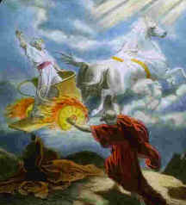
Elijah and the Rapture
February 21, 2021
Rapture 3D –pt. 2
II Kings 2:11-12
Edward Christian Church

Slide 4
Rapture
We are About to Experience One of the
Greatest Events in Human History!
Something Dramatic Will Take Place…
It Summons the End of the Church Age…
…the Age of Grace
…the Age of the Spirit

Slide 5
Pictures and Types
God Always Leaves a Trail of Prophetic Bread-Crumbs in the Form of Pictures and Types that Lead Up to the Actual Prophetic Event
Years BEFORE It Happens
It Shows that God is Always…
Control
Calling History

Slide 6
Rapture Types…
Enoch –Gen 5:24
Elijah –II Kings 2:9-12
Philip –Acts 8:39
Paul –II Cor 12:2
Jesus –Acts 1:9

Slide 7
Elijah’s Rapture…
It was the Talk of that Day
It was a…
Planned Event (1)
Promised Event (2-3)
Powerful Event (9-10)

Slide 8
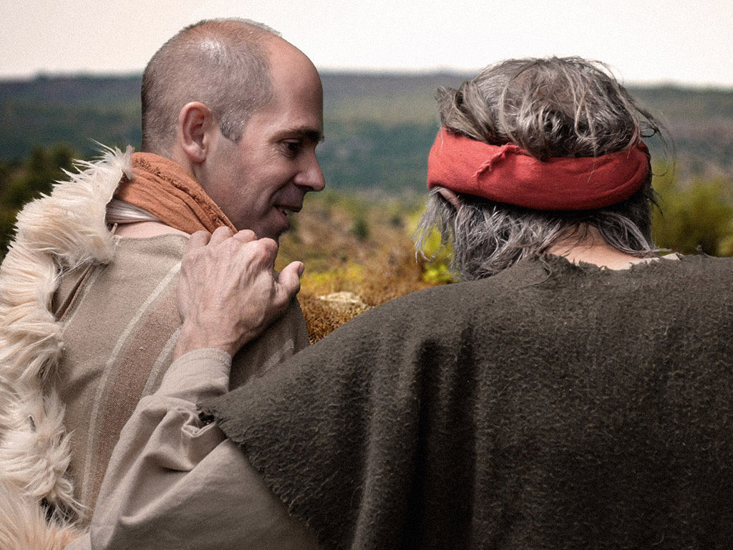
Elijah’s Rapture
IMMINENT “Walking along & talking...”
The Rapture Could Happen At Any Moment!
Luke 12:40 You also must be ready, because the Son of Man will come at an hour when you do not expect him."

Slide 9
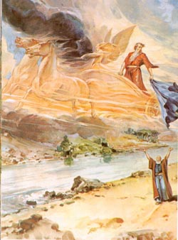
Elijah’s Rapture
SUDDEN “Suddenly a chariot of fire...”
The Rapture Will Occur Very Quickly!
1 Cor. 15:51-52 Listen, I tell you a mystery: We will not all sleep, but we will all be changed-- in a flash, in the twinkling of an eye, at the last trumpet. For the trumpet will sound, the dead will be raised imperishable, and we will be changed.

Slide 10
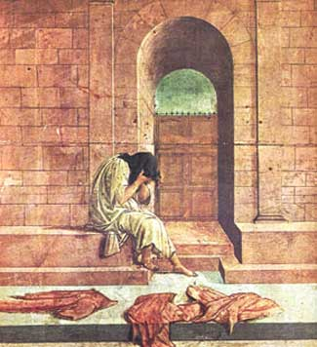
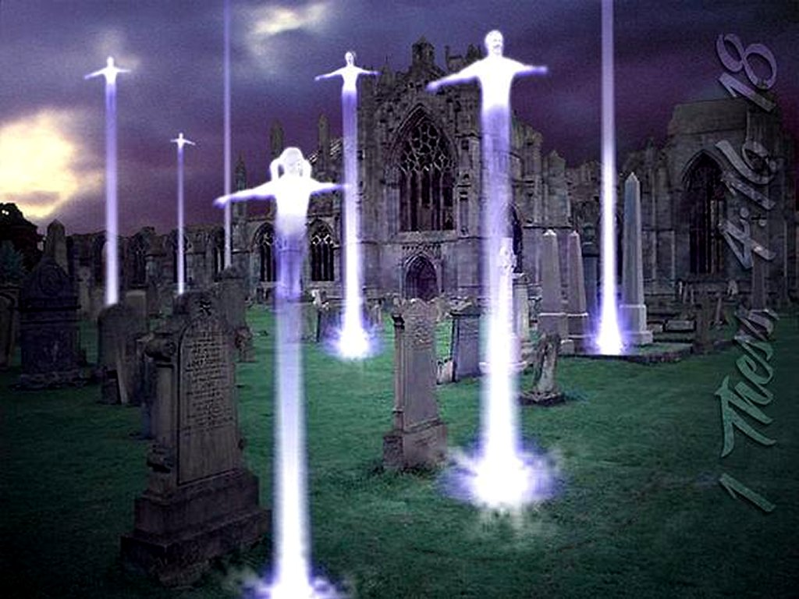
Elijah’s Rapture
SELECTIVE “Separated the two of them...”
Rapture Catches Up All True Believers!
Matthew 24:40-42 Then shall two be in the field; the one shall be taken, and the other left. Two women shall be grinding at the mill; the one shall be taken, and the other left. Watch therefore: for ye know not what hour your Lord doth come.

Slide 11
Elijah’s Rapture
GLORIOUS “Went up to heaven..
The Rapture is Beyond Human Comprehension!
1 Thes. 4:16-17 For the Lord himself will come down from heaven, with a loud command, with the voice of the archangel and with the trumpet call of God, and the dead in Christ will rise first. After that, we who are still alive and are left will be caught up together with them in the clouds to meet the Lord in the air. And so we will be with the Lord forever.

Slide 12
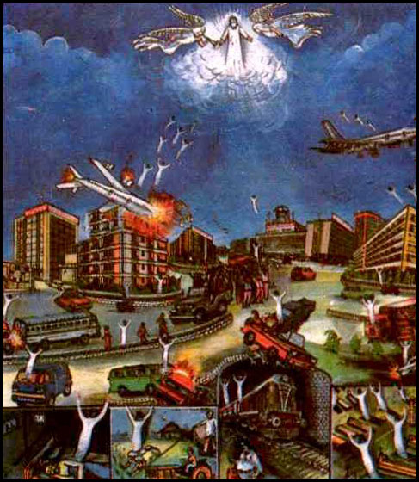
Elijah’s Rapture
CONFUSION “Cried out... tore his clothes...” Rapture Shocks the Minds of Those Left Behind!
1 Thessalonians 5:2-3 For yourselves know perfectly that the day of the Lord so cometh as a thief in the night. For when they shall say, Peace and safety; then sudden destruction cometh upon them, as travail upon a woman with child; and they shall not escape.

Slide 13
What On Earth Am I Here For? God has a purpose for your life!
Am I ready to meet Jesus? BE PREPARED!
Am I living life fully? BE EXPECTANT!
Am I concerned for others? BE SHARING!

Slide 14
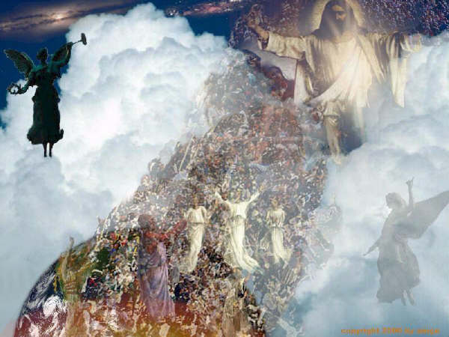
Reaching One more for Jesus...
This could be the Day!!!!

Slide 16
Reaching One more for Jesus...
Be inviting people you know to our
Church

Slide 17
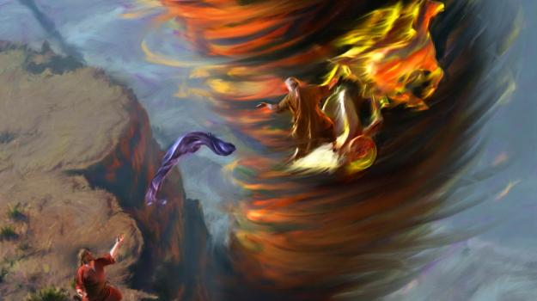

Slide 18
Elijah’s Journey of Destiny Review:
Experience a new personal relationship with Christ!
Blessings are often followed by testing - be guarding your minds!
Hear and obey the Lord as He quietly speaks to you!
Be ready to evacuate the earth at any moment!
Pack your bags with Jesus and
don’t buy any green banana’s!

Slide 19
Elijah’s RAPTURE
2 Kings 2:11-12 As they were walking along and talking together, suddenly a chariot of fire and horses of fire appeared and separated the two of them, and Elijah went up to heaven in a whirlwind. Elisha saw this and cried out, "My father! My father! The chariots and horsemen of Israel!" And Elisha saw him no more. Then he took hold of his own clothes and tore them apart.

Slide 20
Part 4 of 4
2Kings 2:11-12 and Selected
Pew Bible page 260

Slide 21
2Kings 2:11-12 and Selected

Slide 23
Reasons for Rapture
Brings His Bride Home to Heaven
Brings Believer into Eternal Fellowship
Completion of Salvation by Grace
Brings Believer into His Rewards
Removal of Restraining Ministry of
Holy Spirit
Sets Stage for the Seven Year Tribulation
Sets Stage for Anti-Christ’s
Rise to Power

Slide 24
Genesis 5:21-24 (KJV) ²¹ And Enoch lived sixty and five years, and begat Methuselah: ²² And Enoch walked with God after he begat Methuselah three hundred years, and begat sons and daughters: ³ And all the days of Enoch were three hundred sixty and five years: ²⁴ And Enoch walked with God: and he was not; for God took him.
2 Kings 2:9-12 (KJV) ⁹ And it came to pass, when they were gone over, that Elijah said unto Elisha, Ask what I shall do for thee, before I be taken away from thee. And Elisha said, I pray thee, let a double portion of thy spirit be upon me. ¹⁰ And he said, Thou hast asked a hard thing: nevertheless, if thou see me when I am taken from thee, it shall be so unto thee; but if not, it shall not be so. ¹¹ And it came to pass, as they still went on, and talked, that, behold, there appeared a chariot of fire, and horses of fire, and parted them both asunder; and Elijah went up by a whirlwind into heaven. ¹² And Elisha saw it, and he cried, My father, my father, the chariot of Israel, and the horsemen thereof. And he saw him no more: and he took hold of his own clothes, and rent them in two pieces.
Acts 8:37-40 (KJV) ³⁷ And Philip said, If thou believest with all thine heart, thou mayest. And he answered and said, I believe that Jesus Christ is the Son of God. ³⁸ And he commanded the chariot to stand still: and they went down both into the water, both Philip and the eunuch; and he baptized him. ³⁹ And when they were come up out of the water, the Spirit of the Lord caught away Philip, that the eunuch saw him no more: and he went on his way rejoicing. ⁴⁰ But Philip was found at Azotus: and passing through he preached in all the cities, till he came to Caesarea.
2 Corinthians 12:1-2 (KJV) ¹ It is not expedient for me doubtless to glory. I will come to visions and revelations of the Lord. ² I knew a man in Christ above fourteen years ago, (whether in the body, I cannot tell; or whether out of the body, I cannot tell: God knoweth;) such an one caught up to the third heaven.
Acts 1:9-10 (KJV) ⁹ And when he had spoken these things, while they beheld, he was taken up; and a cloud received him out of their sight. ¹⁰ And while they looked stedfastly toward heaven as he went up, behold, two men stood by them in white apparel;

Slide 25
Rapture Types…
Enoch
Brought into God’s Presence
Elijah
Brought Completion
Philip
A Sign -for All involved
Paul
Receive Deeper Revelation
Jesus
All of the Above

