Slide 2
Edward Christian Church
February 14, 2021
Back to Basics Sunday
“LOVE” pt2

Slide 3
10. "You know you're the only one for me!"
9. "Do you come here often?"
8. "Trust me, this was meant to be!"
7. "Look around, baby. All the other guys around here are animals!"
6. "I already feel like you're a part of me!"
5. "Honey, you were made for me!"
4. "Why don't you come over to my place and we can name some animals?"
3. "You're the girl of my dreams!" (Gen. 2:21)
2. "I like a girl who doesn't mind being ribbed!"
And the number one pick up line from Adam is:
"You're the apple of my eye!" *

Slide 4
Misrepresented
Misunderstood
Over-Used
Under-Used

Slide 5
Types of Love in Bible
“Eros" Love arises from passion, sexual attraction
It is the love (passion) of a man for a woman
It Gives and Expects to Receive
“Storge" Love arises from affection of a family
Love and natural affection between parent/ child
It Gives and Expects to Receive
“Phileo" or “Philadelphia" Love of deep affection/
feelings toward those very near your heart
It Gives and Expects to Receive

Slide 6
Types of Love in Bible
“Eros" - “Storge" - “Phileo"
All Give and Expect to Receive
“Agape" Love
Sacrificial Love that Does Well No Matter…
…the Circumstance or Cost to Self
It Demonstrates Kindness, Benevolence
…even in Midst of Stormy Situations.
Cares, Gives, / Works for Another’s Good
It Gives Without Expecting to Receive

Slide 7
Agape
(1-3) …Is Not Measured by
Words
Intentions
Actions
But By…
Attitude…
…In Action

Slide 8
John 3:16
Tells us of God’s Love…
Expressed…
...through the Life of Christ
1 Corinthians 13:4-13
Tells us of God’s Love…
Exemplified…
…through the Life of a Believer

Slide 9
Characteristics of Agape
Love is Patient
“long” and “tempered”
“power to avenge self but will not”
Love is Kind
“To show oneself useful”
“Taking patience one step further”
Love Knows No Envy
“to boil”
“what’s in it for me -it’s all about me”
Love is Not Boastful
“play the braggart”
“boasting is playing a part”

Slide 10
Characteristics of Agape
Love is Not Proud
“puffs up-to inflate”
Love is Not Rude
“unshapely”
“not pretty to look at”
Love is Not Self-Seeking
“worship yourself”
Love is Not Easily Angered
“exasperate -to sharpen alongside”
the Opposite of Patience

Slide 11
Characteristics of Agape
Love Keeps No Record of Wrongs
“dwelling on someone else as evil”
Love Does Not Delight in Evil
“be happy when an injustice occurs”
Love Rejoices with the Truth
“to sympathize with gladness”
Love Always Protects
“to roof over”

Slide 12
Characteristics of Agape
1 Cor 13:13, “And now abideth faith, hope, charity,
these three; but the greatest of these is charity”
Charity= Love (Agape)
All 3 are Import to Spiritual Life…
…But Love is the Driving Force
…Love Brings
Life
Passion
Purpose

Slide 14
What the World Needs Now is Love Sweet Love
[Chorus]
What the world needs now
Is love, sweet love
It's the only thing that there's just too little of
What the world needs now
Is love, sweet love
No, not just for some, but for everyone
Look, we don't need another mountain
There are oceans and rivers
Enough to cross, enough to last
Until the end of time
[Chorus]
Lord we dont need another meadow
There are corn fields and wheat fields enough to grow
There are sun beams and moon beams enough to shine
This I know, if you want to know
[Chorus]
What the world needs now
Is love, sweet love
What the world needs now
Is love, sweet love
What the world needs right about now
What the world needs now
Is love, sweet love
What the world needs now
Is love, sweet love

Slide 15
What a Wonderful World
I see trees of green
Red roses too
I see them bloom
For me and you
And I think to myself
What a wonderful world
I see skies of blue
And clouds of white
The bright blessed day
The dark sacred night
And I think to myself
What a wonderful world
The colors of the rainbow
So pretty in the sky
Are also on the faces
Of people going by
I see friends shaking hands
Saying how do you do
They're really saying
I love you
I hear babies cry
I watch them grow
They'll learn much more
Than I'll ever know
And I think to myself
What a wonderful world
Yes, I think to myself
What a wonderful world
Ooh, yes

Slide 16
Agape Explained
John 3:16
Agape is Compassion in Action
“For God so loved the world...”
Compassionate for Our Lost Situation
Compassionate About Our Sorrows
Agape is Committed to Giving
“…that he gave his only son”
God Committed His Son
Jesus Committed Himself

Slide 17
Agape Explained
John 3:16
Agape is Completely Forgiving
“…whosoever believes shall have…”
God Completely Saves
God Completely Satisfies
Agape is Contagious
“if I be lifted up…draw all men...”
It Can’t be Stopped
It Must be Spread

Slide 19
VIDEO –He Loved me anyway

Slide 21
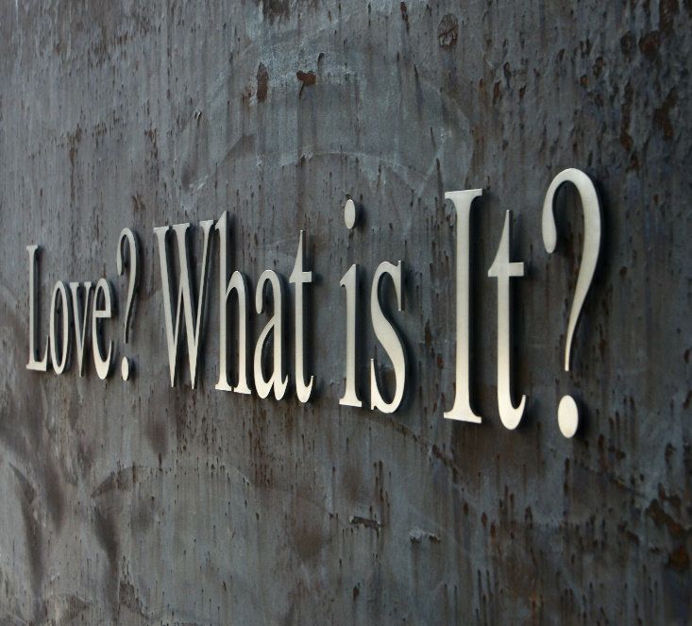
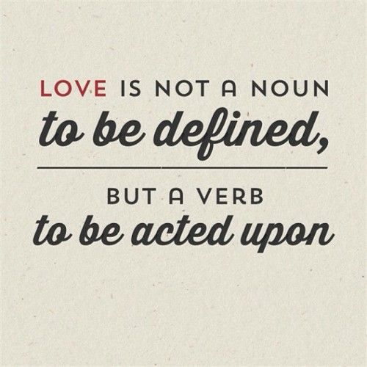

Slide 22
1 Corinthians 13:1-13 (AMP)
¹ IF I [can] speak in the tongues of men and [even] of angels, but have not love (that reasoning, intentional, spiritual devotion such as is inspired by God's
love for and in us), I am only a noisy gong or a clanging cymbal.
² And if I have prophetic powers (the gift of interpreting the divine will and purpose), and understand all the secret truths and mysteries and possess all knowledge, and if I have [sufficient] faith so that I can remove mountains, but have not love (God's love in me) I am nothing (a useless nobody). ³ Even if I dole out all that I have [to the poor in providing] food, and if I surrender my body to be burned or in order that I may glory, but have not love (God's love in me), I gain nothing. ⁴ Love endures long and is patient and kind; love never is envious nor boils over with jealousy, is not boastful or vainglorious, does not display itself haughtily. ⁵ It is not conceited (arrogant and inflated with pride); it is not rude (unmannerly) and does not act unbecomingly. Love (God's love in us) does not insist on its own rights or its own way, for it is not self-seeking; it is not touchy or fretful or resentful; it takes no account of the evil done to it [it pays no attention to a suffered wrong]. ⁶ It does not rejoice at injustice and unrighteousness, but rejoices when right and truth prevail. ⁷ Love bears up under anything and everything that comes, is ever ready to believe the best of every person, its hopes are fadeless under all circumstances, and it endures everything [without weakening]. ⁸ Love never fails [never fades out or becomes obsolete or comes to an end]. As for prophecy (the gift of interpreting the divine will and purpose), it will be fulfilled and pass away; as for tongues, they will be destroyed and cease; as for knowledge, it will pass away [it will lose its value and be superseded by truth]. ⁹ For our knowledge is fragmentary (incomplete and imperfect), and our prophecy (our teaching) is fragmentary (incomplete and imperfect). ¹⁰ But when the complete and perfect (total) comes, the incomplete and imperfect will vanish away (become antiquated, void, and superseded). ¹¹ When I was a child, I talked like a child, I thought like a child, I reasoned like a child; now that I have become a man, I am done with childish ways and have put them aside. ¹² For now we are looking in a mirror that gives only a dim (blurred) reflection [of reality as in a riddle or enigma], but then [when perfection comes] we shall see in reality and face to face! Now I know in part (imperfectly), but then I shall know and understand fully and clearly, even in the same manner as I have been fully and clearly known and understood [by God]. ¹³ And so faith, hope, love abide [faith—conviction and belief respecting man's relation to God and divine things; hope—joyful and confident expectation of eternal salvation; love—true affection for God and man, growing out of God's love for and in us], these three; but the greatest of these is love.

Slide 25
Top Ten
Pickup Lines
Used By Adam

Slide 26
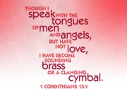

Slide 27
1. Your gifts are meaningless without love The work of the Holy Spirit brings gifts into the lives of those who place their faith in Jesus. Those gifts are given so that we are able to serve Jesus not in our ability but with the ability he instills within us. We cannot serve Jesus to the level of His strength without having His love living within us. 2. Your life is pointless without love Paul says that without love: I am nothing. In essence, if we do not possess the divine love of Christ within us, there is no point to our life. Just because you are breathing does not mean that you are really living. The sad fact is that far too many people settle for merely existing rather than living. If you do not have the love of Christ living within you, you are just existing and not really living. 3. Your efforts are fruitless without love As Christians, we are called to bear fruit and show ourselves ready to serve Jesus whenever and wherever He sends us. The reality is that our efforts will never amount to anything more than just our human work without the power of Christ’s love as a driving force in our lives.

Slide 33
Quotes by Children About Love:
Glenn, age 7 - If falling love is anything like
learning how to spell, I don’t want to do it. It takes
too long.
Tom, age 5 - Once I’m in kindergarten, I’m going to
find me a wife.
Kenny, age 7 -It gives me a headache to think about
that stuff. I’m just a kid, don’t need that kind of
trouble.
Regina, age 10 - I’m not rushing into love. I’m
finding fourth grade hard enough.

Slide 34
Quotes by Children About Love:
Angie, age 10 - Most men are brainless, so you
might have to try more than once to find a live one.
Dave, age 8 - Love will find you, even if you are
trying to hide from it. I’ve been trying to hide from
it since I was five, but the girls keep finding me.
Ava, age 8 - One of you should know how to write
a check. Because, even if you have tons of love,
there is still going to be a lot of bills.
Manuel, age 8 - I think you’re supposed to get shot
with an arrow or something, but the rest of it isn’t
supposed to be painful.

Slide 35
Agape Explained
What It is Not:
Philia - Brotherly Affection
Eros - Physical Affection
Storge - Kinship Affection
All Based Upon Emotions
and Mutual Attraction
Rise and Fall According to…
…Emotional Rationale
All are Reciprocal

Slide 36
Agape Explained
What it is:
Agape
Is an Active Determination of Your Will
to Benefit Another…
…without Regard
…for Your Own Benefit
Never Based upon Emotion
Seldom Reciprocal

Slide 37
Agape Explained
John 3:16
Agape is Compassion in Action
“For God so loved the world...”
Compassionate for Our Lost Situation
Compassionate About Our Sorrows
Agape is Committed to Giving
“…that he gave his only son”
God Committed His Son
Jesus Committed Himself

Slide 38
Agape Explained
John 3:16
Agape is Completely Forgiving
“…whosoever believes shall have…”
God Completely Saves
God Completely Satisfies
Agape is Contagious
“if I be lifted up…draw all men...”
It Can’t be Stopped
It Must be Spread

Slide 39
The Beatles had It Almost Right
All You Need Is Love…
“Agape Love”
This is the Catalyst that WILL …
…Begin to HEAL this Nation

