Slide 1
A condemned prisoner awaiting execution was granted the usual privilege of choosing the dishes he wanted to eat for his last meal. He ordered a large mess of mushrooms.
"Why all the mushrooms and nothing else?" inquired the guard.
"Well," replied the prisoner, "I always wanted to try them, but was afraid to eat them before!"
============================
If it weren't for the last minute, a lot of things wouldn't get done.

Slide 3
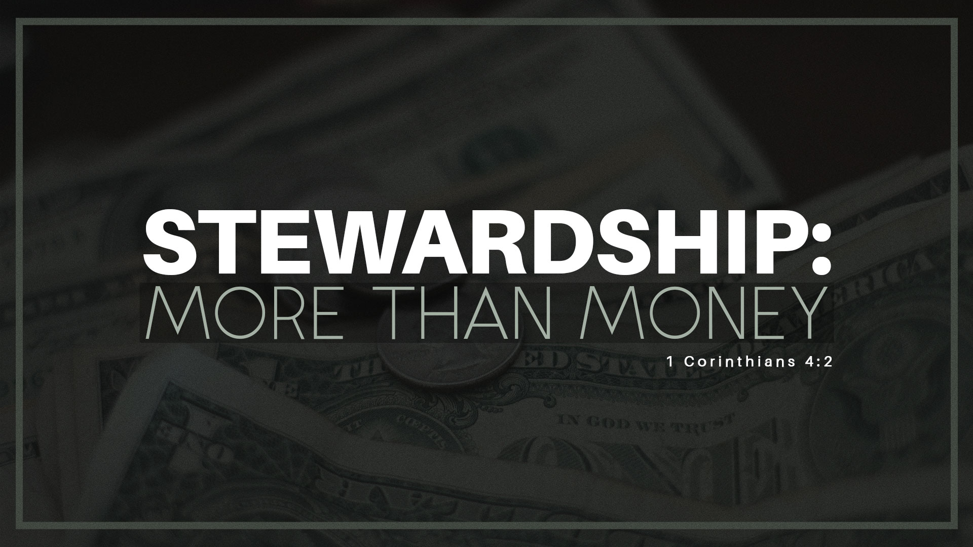
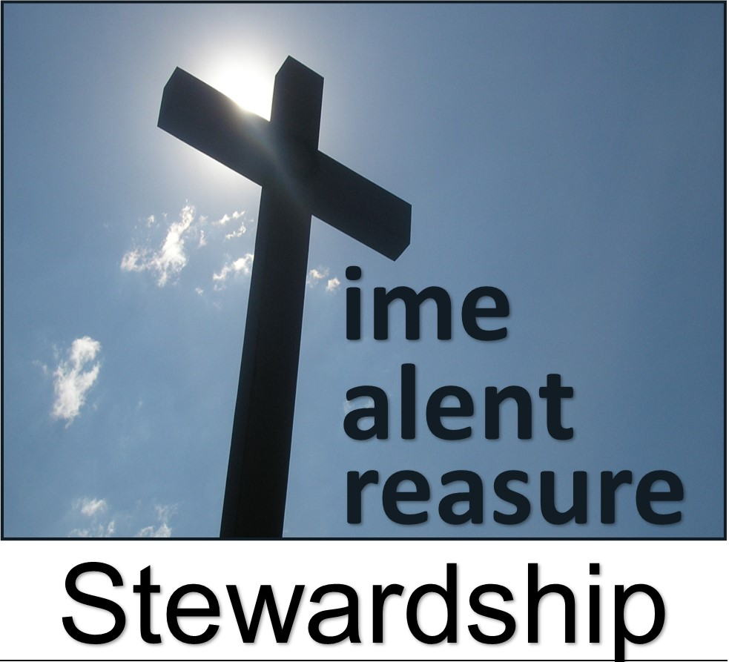
Back to Basics

Slide 4
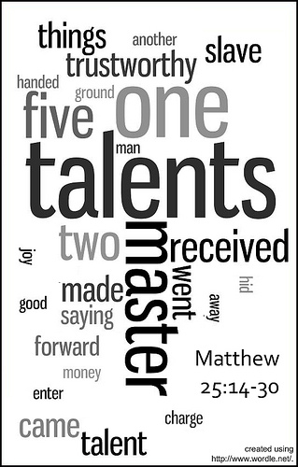
March 14, 2021
When Fear Drives …
…Our Stewardship
Pt 2
Matthew 25:14-30
Back to Basics..
…Stewardship
Edward Christian Church

Slide 5
Stewardship
Simple Definition…
…Practice of Managing
…Another’s Resources

Slide 6
Stewardship
“The earth is the LORD’s, / everything in it, the world, / all who live in it.” Psa 24:1, I Cor 10:26
Stewardship Fact #1
God Owns It All
Stewardship Fact #2
We Don’t Own Anything
Stewardship Fact #3
We are Called to Manage…
…God’s Possessions

Slide 7
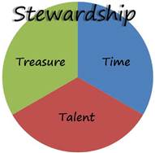
Stewardship
We Are All Stewards of the…
Time
Talent
Treasures
…the Master Has Entrusted to Us
One Day Each One of Us Will Be Called to…
…Give an Account for How We Have Managed It

Slide 8
Fear Driven Makes Us Cynical
Fear Gave Him a Negative View on Life:
"I knew that you are a hard man" (24)
The Other Two Never Saw the Master that Way
Positive About Their Relationship
Believed They Would Be Rewarded.
They Shared in His Joy
It was His Attitude
Fear is a Way of Negative Thinking
Saw the Master as a Mean Man
Let Fear Swallow Him Up!
God is a Loving Heavenly Father w- Plan for us All!

Slide 9
Fear Drives Complacency
Fear Makes us Dig a Hole / Hide…
…What Needed to Be Put to Work
“I was afraid, and went and hid thy talent in the earth: lo, there thou hast that is thine" (25)
Realize Your Life has Purpose
God has Given Us Talents/ Resources.
Its Time to Dig Up Your Talents, Gifts, Dreams, Goals, Hobbies,/ Plans, / Invest in Others
Pass On What You Have Learned to Others

Slide 10
Fear Makes Us Cop Out
Excuses Keep Us From Being Productive
He Blamed Character /Personality of the Master..
...as the Cause for His Lack of Investing
Note- 3rd Man Agreed to Take the Money / Invest It.
It was Only When Fear Set in…
…He Started to Make Excuses.

Slide 11
Five Major Excuses (24-25)
I Didn't Do It -consists of denial or blaming others “lord I knew....
It Wasn't So Bad -minimize our sins / mistakes
“I went / hid...”
Yes, but.... -Admission of guilt, followed by an excuse.
"I couldn't help it," "It wasn't really me”- "l knew...
It's Not My Fault -We shift responsibility to others, the past, or anything or anyone rather than owning up to our own responsibility. “you are a hard man...
I Can't Do It -We sell ourselves short. Fear causes the mind to shut down. Instead of seeing opportunities, we see obstacles. "I was afraid...

Slide 12
Fear Costs Us Our Potential
Take therefore the talent from him, and give it unto him which hath ten talents. For unto every one that hath shall be given, and he shall have abundance: but from him that hath not shall be taken away even that which he hath. (26-29)
There's a Price Tag Attached to Fear
What Doesn't Develop Deteriorates
In the End, He Loses the Initial Investment
Fear Diminishes us; Faith Enriches us
If You Have Buried Your Talents Because of Fear…
…Dig Them Up / Begin to Make an Investment
…of Your Life for God's Glory.

Slide 13
And God…
Responded –gained
Rewarded – eternally
The Others…
Reached Out- invested

Slide 15
The Lord’s Prayer and Stewardship
I CANNOT SAY...
"our" if i have no room in my life for others and their needs.
‘father" if i do not demonstrate this relationship in my daily living.
“who art in heaven" if all my interests and pursuits are in earthly things.
"hallowed be thy name" if i, who am called to bear his name, am not holy.
"thy kingdom come" if i am unwilling to give up my own sovereignty and accept the righteous reign of god.
"thy will be done" if I am unwilling or resentful of having god's will in my life.
"on earth as it is in heaven" unless I am truly ready to give myself to his service here and now.
"give us this day our daily bread" without expending honest effort for it, or by ignoring the genuine needs of others.

Slide 16
The Lord’s Prayer and Stewardship
I CANNOT SAY...
"forgive us our trespasses as we forgive those who trespass against us" if I continue to harbor a grudge against anyone.
"lead us not into temptation" if I deliberately choose to remain in a situation where I am likely to be tempted.
"deliver us from evil" if I am not prepared to fight in the spiritual realm with the ultimate weapon of prayer.
"thine is the kingdom" if I do not give the kind of disciplined obedience of a loyal subject.
"thine is the power" if I fear what my neighbors may say or do.
"forever" if I am too anxious about each day's events.
"amen" unless I can honestly say, "cost what it may, this is my prayer."

Slide 18
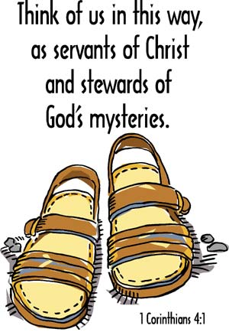

Slide 21
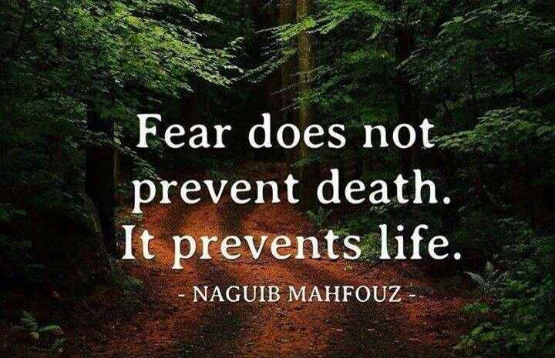
Fear Driven
Fear is..
Feeling of Dread, Alarm, Panic, / Anxiety
Learned Response but…
…Can Be Unlearned (2 Cor. 10:5).
If Not, It Produces Negative Consequences.
Eventually We Begin to Operate Driven by Fear
Paralyzes decision making, immobilizes action, hinders prayer, limits faith, restricts relationships, lowers productivity, jeopardizes health/ stifles joy
Effects Every Area of Life (Stewardship)
This Story Deals with the Danger of…
…Fear Driven Stewardship

Slide 22
Stewardship
Built on Faith
Built on Fear
Trust
Active
Increasing
Rewarded
Dis-Trust
In-Active
Decreasing
Thwarted

Slide 23
Fear Mode Causes Confusion
Faith Driven
Fear Driven
Clear
“Went” -Positive
lead over, carry over, transfer to pursue the journey on which one has
Purpose
Power
Determined to Make a Profit
Confused
“Went” -Negative
go away- sufferings of good things taken away from one
No Purpose
No Power Needed
Determined Not to Take a Loss

