Slide 1
A sweet little DC surprised me one morning / brought me a cup of coffee. He made it himself and was so proud.
He anxiously waited to hear the verdict on the quality of the coffee. I had never in my life had such a bad cup of coffee,
as I forced down the last sip I noticed three of those little green army men in the bottom of the cup. I asked, “Buddy, why would three little green army men be in the bottom of my cup?“ DC replied, "You know daddy, it's like on TV,
'The best part of waking up is soldiers in your cup.

Slide 3
March 28, 2021
Edward Church
7 Churches pt. 9
Sardis –(3:1-6)
“ Walking Dead”

Slide 4
¹ And unto the angel of the church in Sardis write; These things saith he that hath the seven Spirits of God, and the seven stars; I know thy works, that thou hast a name that thou livest, and art dead. ² Be watchful, and strengthen the things which remain, that are ready to die: for I have not found thy works perfect before God. ³ Remember therefore how thou hast received and heard, and hold fast, and repent. If therefore thou shalt not watch, I will come on thee as a thief, and thou shalt not know what hour I will come upon thee. ⁴ Thou hast a few names even in Sardis which have not defiled their garments; and they shall walk with me in white: for they are worthy. ⁵ He that overcometh, the same shall be clothed in white raiment; and I will not blot out his name out of the book of life, but I will confess his name before my Father, and before his angels. ⁶ He that hath an ear, let him hear what the Spirit saith unto the churches –Rev 3:1-6

Slide 5
The Lord Comes to His Churches…
…to Speak to Them About
Where They Are…
Where He Wants Them to Be…
He Comes to Them w-…
…a Message Of Comfort

Slide 6
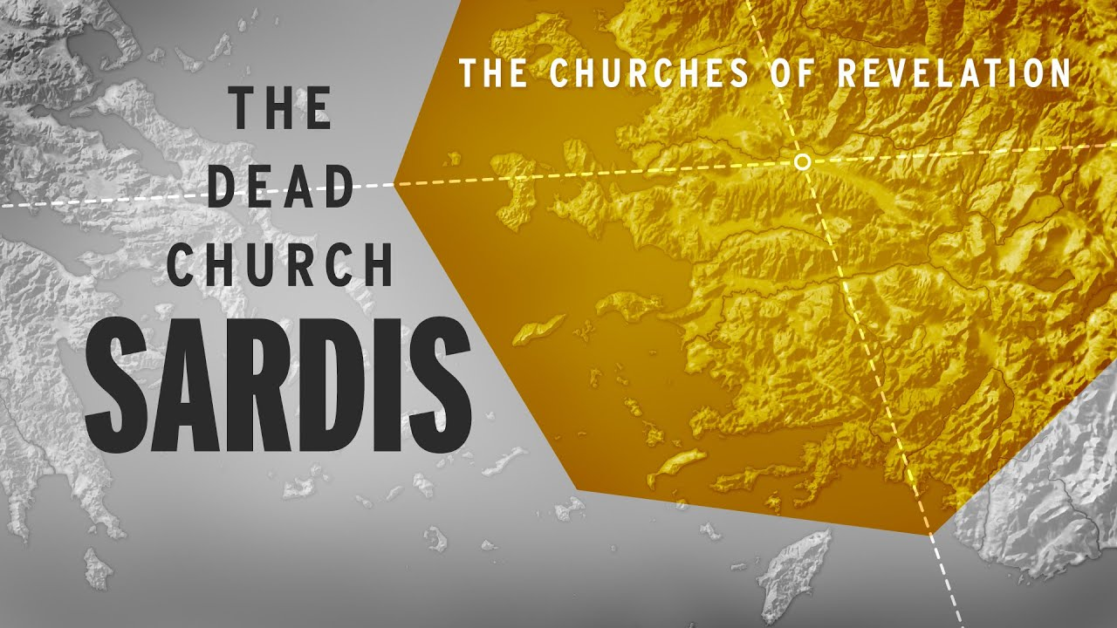

Slide 7
Jesus Eyes Sardis
…the Church of Walking Dead!

Slide 8
Sardis
Different Type of Message
Of the four examined so far, this church is in the worst shape.
The others start off with words of praise, but this church is different. There is some praise later, but the downside is greater!

Slide 9
Revelation 3:1
And unto the angel of the church in Sardis write; These things saith he that hath the seven Spirits of God, and the seven stars; I know thy works, that thou hast a name that thou livest, and art dead.
This Church had a Reputation of Being Alive
…but in Reality was Dead.
Reputation = what others thought
Appeared to Be Alive = what others see
But was Really Dead = what is not seen

Slide 10
The Sardis Church had a Great Past…
…but they were nowhere near that now.
Reputations don’t always reflect reality.
Even with past glory, a church cannot live on that past success.
The church had been great…
…but it had fallen along way.

Slide 11
Churches Often Go Through Four Stages of Life
Movement Stage
Nearly 100% Committed….
Magnificence Stage
Commitment Dips to between 50 & 70%
Monument Stage
Commitment Level Dips to between 10 to 30%.
Mausoleum Stage
Attendance Levels are 10 to 50% on any Sunday
The Mausoleum Church is Most Often…
…Identified as the “Dead Church”

Slide 12
A Church is in Danger of Death When It:
• begins to worship its own past or history,
its reputation or name in the church
• more concerned with forms than with function
• more concerned with numbers than w- the spiritual quality of life it is producing in its people
• more involved with management than with ministry or with the physical over the spiritual

Slide 13
REVIVE The RUSTY (2)
Rust indicates that most useful days are in the past.
REMEMBER what was RECEIVED (3)
Look back / remember what they received in the past.
Not to live off the past, to help growing closer to God
REPENT the WRONGDOING (3)
“Repent means a “change of mind =
Change the Inner [Person] to Meet God’s Will.”
REVEALING the REMNANT (4)
“Yet you have still a few names in Sardis, people who have not soiled their garments.”
Those Faithful to End are the Remnant.
Are You a Part of the Walking Dead…
…Or the Faithful Remnant?

Slide 14
REWARDS for REAL FAITH
White CLOTHES
God Will Clean the Slate- Count Us Blameless
Place in HEAVEN
Not Blotting Our Names Out of the Book Of Life…
…Means We Gain Entry to Heaven
This Doesn’t Mean Eternal Security
He Says We Must Be Faithful to the End
Confession Before GOD
Christ Will Confess Our Name Before God.
Confession Means “Agreement.”
He Will Agree That We Are His.

Slide 15
Time to…
Wake Up
Get Up!
Shape Up!
Show Up!

Slide 17
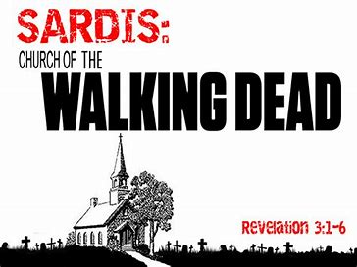

Slide 19
⁵ He that overcometh, the same shall be clothed in white raiment; and I will not blot out his name out of the book of life, but I will confess his name before my Father, and before his angels. ⁶ He that hath an ear, let him hear what the Spirit saith unto the churches –Rev 3:1-6

Slide 20
Message to the Church
²⁴ But unto you I say, and unto the rest in Thyatira, as many as have not this doctrine, / which have not known the depths of Satan, as they speak; I will put upon you none other burden. ²⁵ But that which ye have already hold fast till I come. Revelation 2:24-25
Restraining Power of Grace
Take Comfort Because…
Satan May Have His Finger on the Trigger…
…But God Has His Hand on the Throttle

Slide 21
Message to the Conquerors
²⁶ And he that overcometh, and keepeth my works unto the end, to him will I give power over the nations: ²⁷ And he shall rule them with a rod of iron; as the vessels of a potter shall they be broken to shivers: even as I received of my Father. ²⁸ And I will give him the morning star. ²⁹ He that hath an ear, let him hear what the Spirit saith unto the churches. Revelation 2:26-29
Promotion of Grace
Stay True and God’s Grace Will…
…Lift You to New Heights

Slide 22
I know thy works,/ charity,/ service,/ faith,/ thy
patience,/ thy works;/ the last to be more than
the first. (2:19)
Loving Church
Laboring Church
Loyal Church
Longsuffering Church
Lifting, Growing Church

Slide 23
Lessons from Thyatira
Keep Up Good Work
Keep God First
Watch God Work
And Put You First
Don’t Be Afraid to Stand Out

Slide 24
Revelation 2:18-29 (KJV) ¹⁸ And unto the angel of the church in Thyatira write; These things saith the Son of God, who hath his eyes like unto a flame of fire, and his feet are like fine brass; ¹⁹ I know thy works, and charity, and service, and faith, and thy patience, and thy works; and the last to be more than the first. ²⁰ Notwithstanding I have a few things against thee, because thou sufferest that woman Jezebel, which calleth herself a prophetess, to teach and to seduce my servants to commit fornication, and to eat things sacrificed unto idols. ²¹ And I gave her space to repent of her fornication; and she repented not. ²² Behold, I will cast her into a bed, and them that commit adultery with her into great tribulation, except they repent of their deeds. ²³ And I will kill her children with death; and all the churches shall know that I am he which searcheth the reins and hearts: and I will give unto every one of you according to your works. ²⁴ But unto you I say, and unto the rest in Thyatira, as many as have not this doctrine, and which have not known the depths of Satan, as they speak; I will put upon you none other burden. ²⁵ But that which ye have already hold fast till I come. ²⁶ And he that overcometh, and keepeth my works unto the end, to him will I give power over the nations: ²⁷ And he shall rule them with a rod of iron; as the vessels of a potter shall they be broken to shivers: even as I received of my Father. ²⁸ And I will give him the morning star. ²⁹ He that hath an ear, let him hear what the Spirit saith unto the churches.

Slide 26
Revelation 2:12-27 (KJV) ¹² And to the angel of the church in Pergamos write; These things saith he which hath the sharp sword with two edges; ¹³ I know thy works, and where thou dwellest, even where Satan's seat is: and thou holdest fast my name, and hast not denied my faith, even in those days wherein Antipas was my faithful martyr, who was slain among you, where Satan dwelleth. ¹⁴ But I have a few things against thee, because thou hast there them that hold the doctrine of Balaam, who taught Balac to cast a stumblingblock before the children of Israel, to eat things sacrificed unto idols, and to commit fornication. ¹⁵ So hast thou also them that hold the doctrine of the Nicolaitans, which thing I hate. ¹⁶ Repent; or else I will come unto thee quickly, and will fight against them with the sword of my mouth. ¹⁷ He that hath an ear, let him hear what the Spirit saith unto the churches; To him that overcometh will I give to eat of the hidden manna, and will give him a white stone, and in the stone a new name written, which no man knoweth saving he that receiveth it.

Slide 28
The
Best

Slide 29
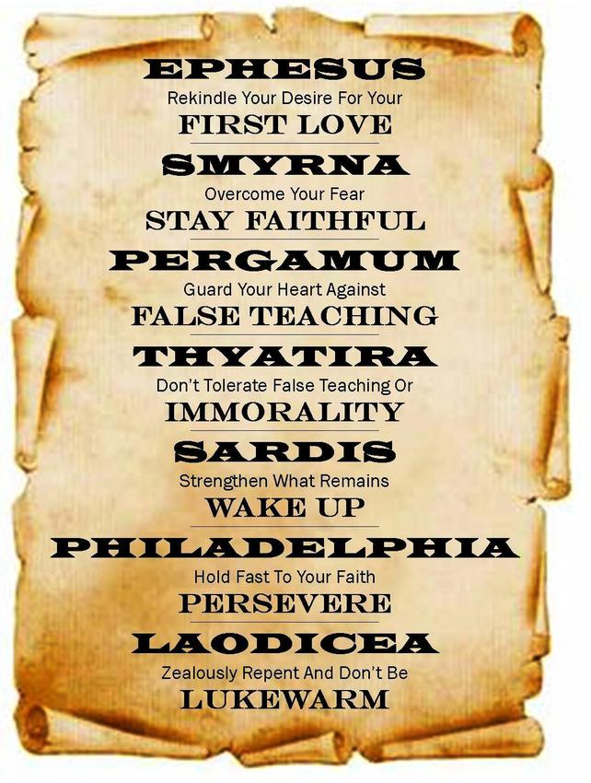

Slide 30
Pergamum
Odd Diagnosis
Four-Fold
Three Good
One Bad
Jesus was Saying…
3 out of 4
Is Bad!

Slide 31
Thyatira was the Smallest…
of the Seven Churches…
…But Received the longest Letter!

