Slide 2
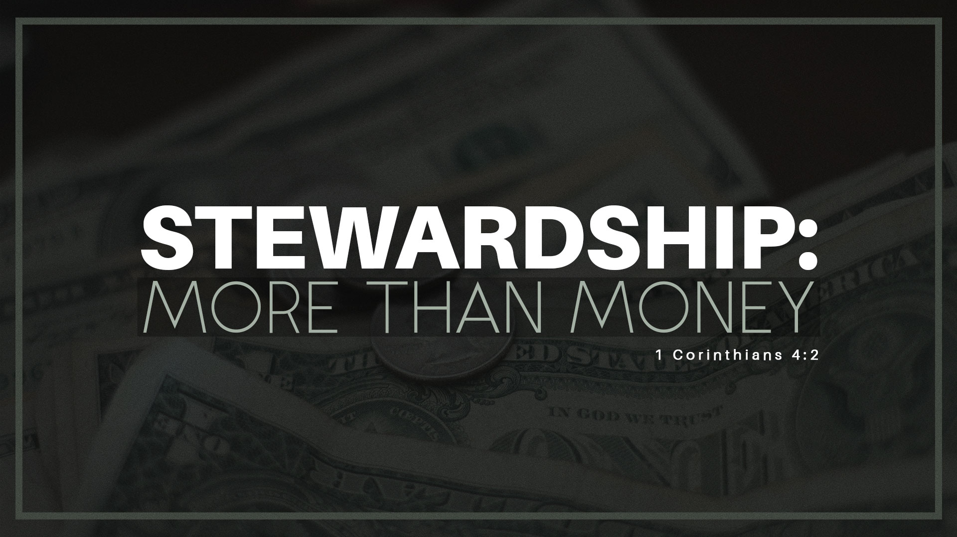
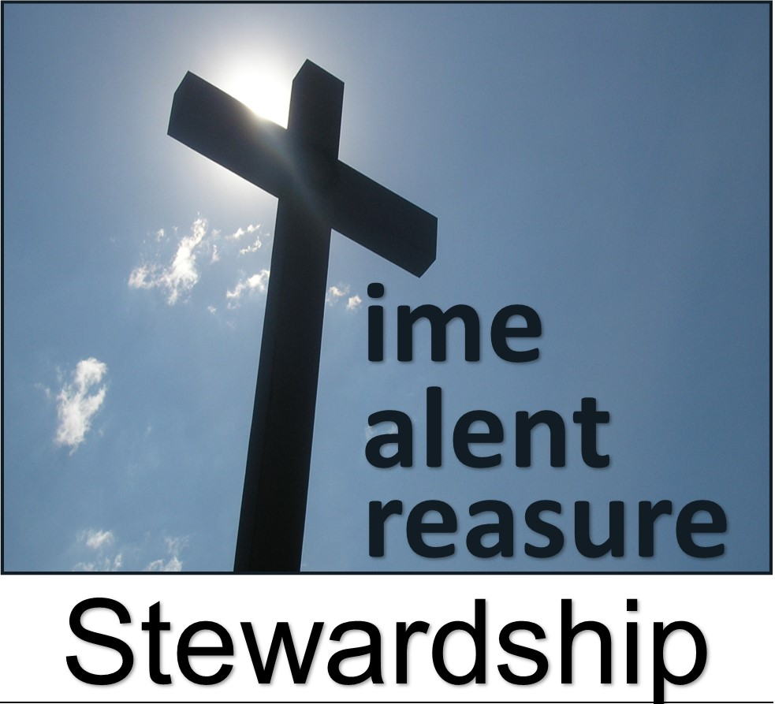
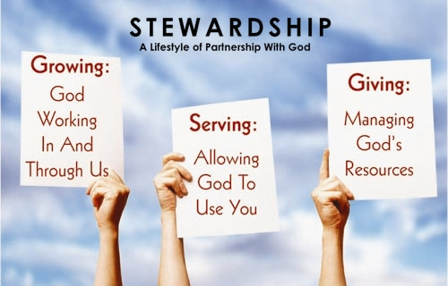
Back to Basics

Slide 3
Back to Basics

Slide 4
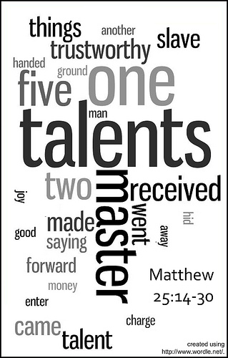
March 7, 2021
When Fear Drives …
…Our Stewardship
Matthew 25:14-30
Pt 1
Back to Basics..
…Stewardship
Edward Christian Church

Slide 5
Stewardship
Simple Definition…
…Practice of Managing
…Another’s Resources

Slide 6
Stewardship
“The earth is the LORD’s, / everything in it, the world, / all who live in it.” Psa 24:1, I Cor 10:26
Stewardship Fact #1
God Owns It All
Stewardship Fact #2
We Don’t Own Anything
Stewardship Fact #3
We are Called to Manage…
…God’s Possessions

Slide 7
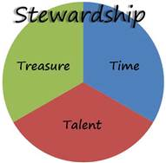
Stewardship
We Are All Stewards of the…
Time
Talent
Treasures
…the Master Has Entrusted to Us
One Day Each One of Us Will Be Called to…
…Give an Account for How We Have Managed It

Slide 8
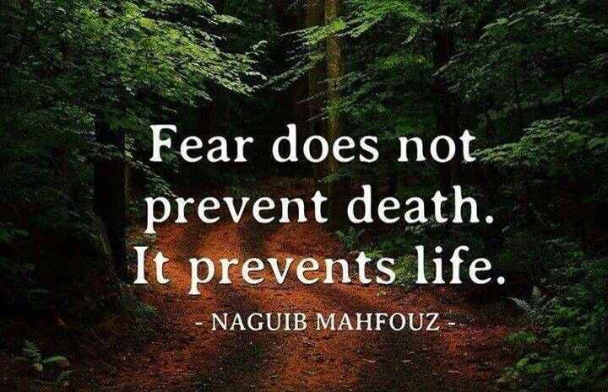
Fear Driven
Fear is..
Feeling of Dread, Alarm, Panic, / Anxiety
Learned Response but…
…Can Be Unlearned (2 Cor. 10:5).
If Not, It Produces Negative Consequences.
Eventually We Begin to Operate Driven by Fear
Paralyzes decision making, immobilizes action, hinders prayer, limits faith, restricts relationships, lowers productivity, jeopardizes health/ stifles joy
Effects Every Area of Life (Stewardship)
This Story Deals with the Danger of…
…Fear Driven Stewardship

Slide 9
Fear Driven
Fear is..
Feeling of Dread, Alarm, Panic, / Anxiety
Learned Response but…
…Can Be Unlearned (2 Cor. 10:5).
If Not, It Produces Negative Consequences.
Eventually We Begin to Operate Driven by Fear
Paralyzes decision making, immobilizes action, hinders prayer, limits faith, restricts relationships, lowers productivity, jeopardizes health/ stifles joy
Effects Every Area of Life (Stewardship)
This Story Deals with the Danger of…
…Fear Driven Stewardship

Slide 10
Stewardship
Built on Faith
Built on Fear

Slide 11
Stewardship
Built on Faith
Built on Fear
Trust
Active
Increasing
Rewarded

Slide 12
Stewardship
Built on Faith
Built on Fear
Trust
Active
Increasing
Rewarded
Dis-Trust
In-Active
Decreasing
Thwarted

