Slide 1
Why
Back to Basics
the
Cross?
Easter 2021

Slide 2
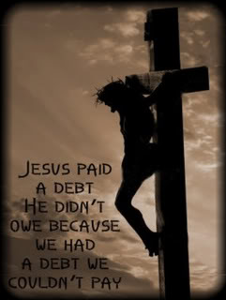
Why the Cross?
This Moment in Time…
…Forever Changed Humanity.
Until this Moment…
Man’s Sin Alienated Him From God
It was there that the Sin of Mankind…
…Met Redemption
Psalm 85:10 (KJV) ¹⁰ Mercy and truth are met together; righteousness and peace have kissed each other.

Slide 4
Jesus the Most Controversial Person in History
He was a Man of Extremes…
The Son of God and Son of Man
Lamb and Lion
Alpha and Omega
It was Hard for the Earthly Minded, Religious Minded,
…Politically Minded To Comprehend
…They Saw Him as the Carpenters Son

Slide 5
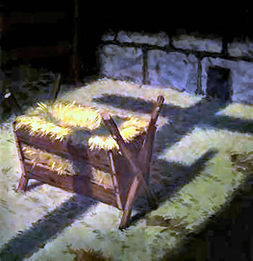
“Mary Did You Know”

Slide 6
The Cross
It seemed that Death Upon the Cross would be the End of Him
it would Finally Still His Voice and End His Message
But they had No Idea that they were Only Making Him Stronger
The Cross didn’t Silence Him
Even in Dark Hours that He was Dying…
…Seven Sayings
Seven Words that Rang thru the Ages…
…Even Now!
…the Basics of the Cross

Slide 8
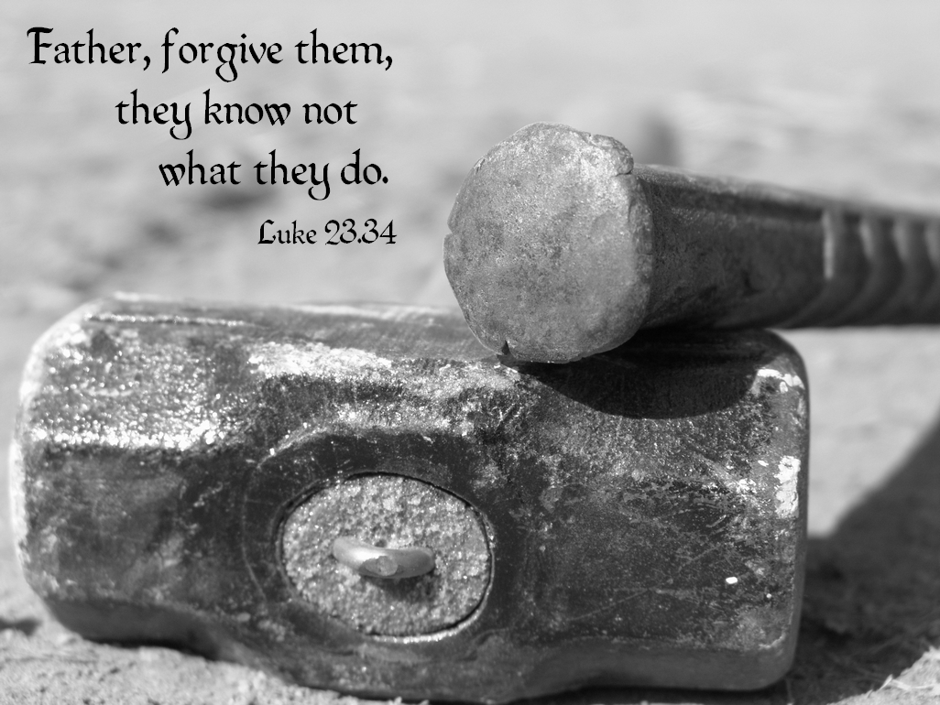
Forgiveness
“Father, forgive them, for they do not know what they are doing" - Luke 23:34
Words of Sovereignty
Unnatural Request
Unselfish Request
Unhindered Request
Words of Sincerity
Man's Ignorance
Man's Indifference
Man's Inadequacy
Psalm 85:10 (KJV) ¹⁰ Mercy and truth are met together; righteousness and peace have kissed each other.

Slide 9
Our Greatest Need
If our greatest need had been Information, God would have sent us an Educator
If our greatest need had been Technology, God would have sent us a Scientist
If our greatest need had been Money, God would have sent us an Banker
If our greatest need had been Pleasure, God would have sent us an Entertainer
But our greatest need was Forgiveness, So God sent us a Savior

Slide 11
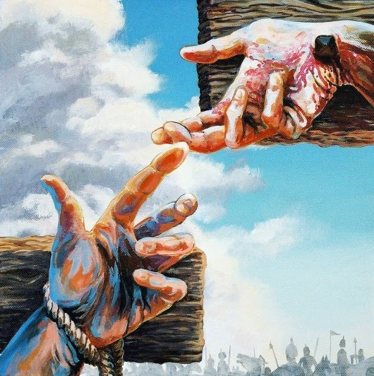
HOPE
"I tell you the truth today you will be with me in paradise" -Luke 23:43
3 Crosses that Day…
…Represents 3 Events/ Attitudes
1- Redemption, 2- Rejection, 3- Repentance
Both Thieves Mocked Jesus but then Change
One Only to Escape “Temporary Pain”
The Other to Escape “Eternal Pain”
Words of Hope
#1- It’s Never Too Bad - Malefactor
#2- It’s Never Too Late - On Cross

Slide 13
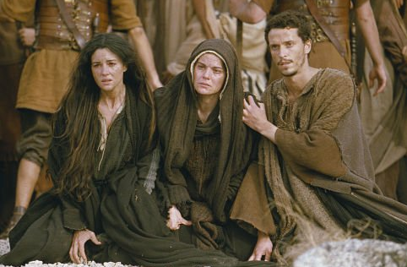
CARE
“He said to His mother, 'Woman, behold your son!' Then He said to the disciple, 'Behold your mother!'” -John 19:26
Mary had Four Other Sons - James, Joses, Simon and Judas… …where were they?
John 7:5 says that during His ministry Jesus' brothers did not believe in Him.
instead of being consumed with his own pain and misery, Jesus cared for those around Him
He cares for You!!!
A man that hath friends must shew himself friendly: and there is a friend that sticketh closer than a brother. -Proverbs 18:24 (KJV)

Slide 15
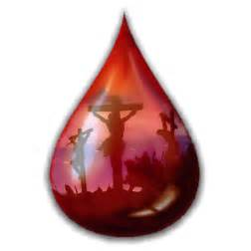
LONELINESS
'Eloi, Eloi, lama sabachthani?' = 'My God, my God, why have you forsaken me?"' -Matt 27:46; Mark 15:34
2 Cor 5:21: “For He made Him who knew no sin to be sin for us, that we might become the righteousness of God in Him.”
At this moment the Father placed on Him the sins of humanity to be paid and Break the Chains
The Power of Sin
Separates
Invites
Heb 4:15-16 (NLT)¹⁵ This High Priest of ours understands our weaknesses, for he faced all of the same testings we do, yet he did not sin. ¹⁶ So let us come boldly to the throne…

Slide 17
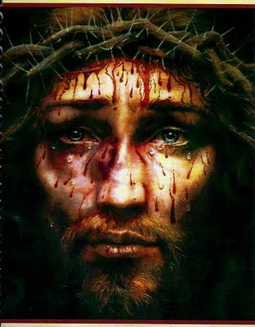
SUFFERING
“I am thirsty” -John 19:28
The End was Close. Jesus had Endured/ Overcome the Heat, Pain, Rejection/ Loneliness
The Living Water was Now Thirsty
"Knowing that all was now completed, / so that the Scripture would be fulfilled, Jesus said, 'I am thirsty"' (John 19:28).
This Phrase Points to His:
Humanity – “…I Thirst”
Divinity – “Knowing that all was Completed…”
Ps.69:21— They gave me also gall for my meat; and in my thirst they gave me vinegar to drink

Slide 19
TRIUMPH
“It is finished” -John 19:30
The Word of Christ on the Cross is one of Triumph.
He Triumphantly announced, for all to hear,
"It is finished”
Jesus had Completed…
His Work
His Mission
His Task
He was Not Crying the Cry of a Defeated Martyr…
…But of a Victorious Conqueror.

Slide 21
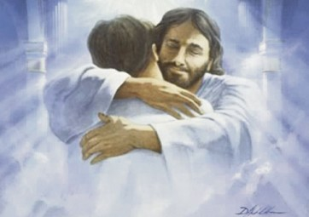
REUNION
“Father, into your hands I commit my spirit” -Luke 23:46
“Jesus called out with a loud voice,
'Father, into your hands I commit my spirit.'
When he had said this, He breathed his last".
He looked forward to being fully reunited w- His Father
At that moment Jesus died for you and me…
He became the True Passover Sacrifice every one

Slide 23
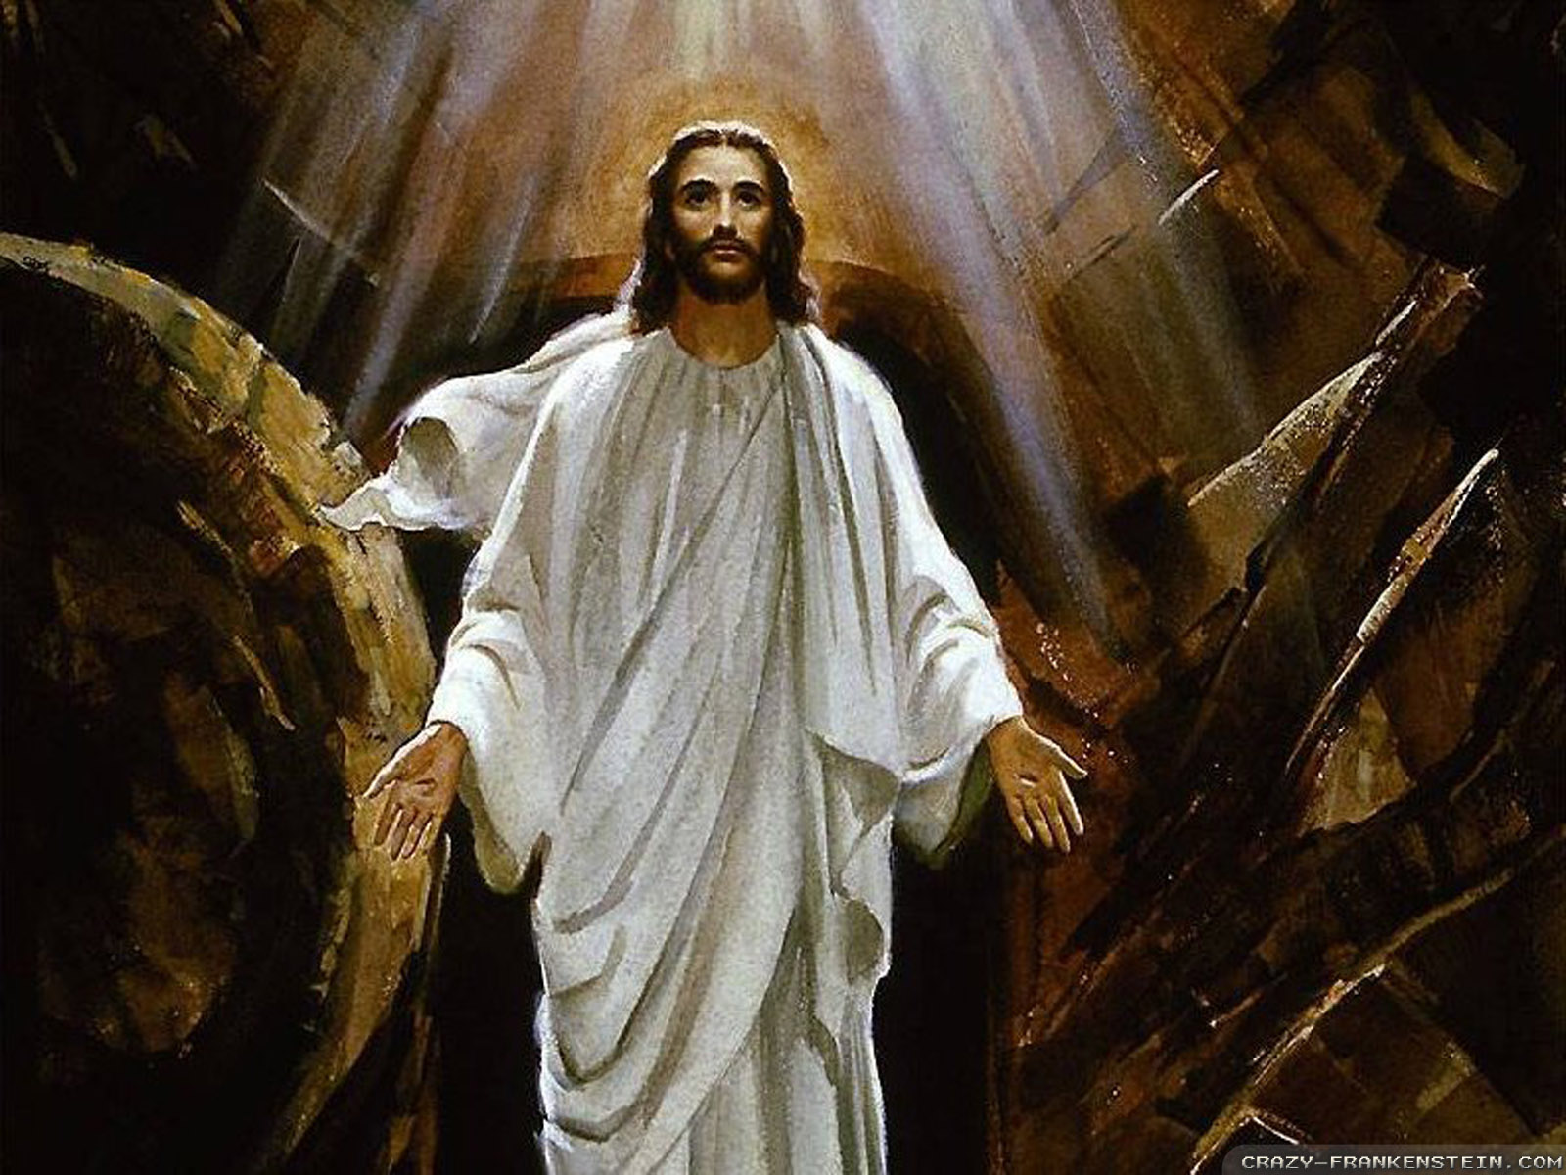
The Cross was Not the End!
Jesus Died! A Most Horrible Death! –he wanted to feel death in its worst horror so he could say…
I have been Tempted as you are and Overcame!!!!
They Buried him in a Borrowed Grave
They Sealed the Tomb / Set a Watch
All that was to Keep His Disciples Out!
Nothing Could Keep Him In!!!!
He Overcame Death – Hell and the Grave
He can Help You Overcome Any Problem, Addiction,

Slide 26
Marina and teens and young adults
“set me free”

Slide 27
12 Benefits of the Blood of Jesus
The Blood of Jesus inaugurates the New & Everlasting Covenant. NKJ Luke 22:19-20 And He took bread, gave thanks and broke it, and gave it to them, saying, “This is My body which is given for you; do this in remembrance of Me.” 20 Likewise He also took the cup after supper, saying, “This cup is the new covenant in My blood, which is shed for you. (Matt 26:26-28 / Mark 14:22-24) NKJ Hebrews 13:20-21 Now may the God of peace who brought up our Lord Jesus from the dead, that great Shepherd of the sheep, through the blood of the everlasting covenant, 21 make you complete in every good work to do His will, working in you what is well pleasing in His sight, through Jesus Christ, to whom be glory forever and ever. Amen.
The blood of Jesus purchases me. NKJ Acts 20:28 Therefore take heed to yourselves and to all the flock, among which the Holy Spirit has made you overseers, to shepherd the church of God which He purchased with His own blood.
The blood of Jesus atones for me. NKJ Romans 3:24-25 Being justified freely by His grace through the redemption that is in Christ Jesus, 25 whom God set forth as a propitiation by His blood, through faith…
The blood of Jesus justifies me. NKJ Romans 5:8-9 God demonstrates His own love toward us, in that while we were still sinners, Christ died for us. 9 Much more then, having now been justified by His blood, we shall be saved from wrath through Him.
The blood of Jesus redeems & forgives me. NKJ Ephesians 1:7 In Him we have redemption through His blood, the forgiveness of sins, according to the riches of His grace NKJ Colossians 1:13-14 He has delivered us from the power of darkness and conveyed us into the kingdom of the Son of His love, 14 in whom we have redemption through His blood, the forgiveness of sins. NKJ 1 Peter 1:18-19 knowing that you were not redeemed with corruptible things, like silver or gold, from your aimless conduct received by tradition from your fathers, 19 but with the precious blood of Christ, as of a lamb without blemish and without spot. NKJ Revelation 5:9-10 And they sang a new song, saying: “You are worthy to take the scroll, And to open its seals; For You were slain, And have redeemed us to God by Your blood Out of every tribe and tongue and people and nation, 10 And have made us kings and priests to our God; And we shall reign on the earth.”
The blood of Jesus brings me closer. NKJ Ephesians 2:13 But now in Christ Jesus you who once were far off have been brought near by the blood of Christ.
The blood of Jesus brings peace. NKJ Colossians 1:19-20 For it pleased the Father that in Him all the fullness should dwell, 20 and by Him to reconcile all things to Himself, by Him, whether things on earth or things in heaven, having made peace through the blood of His cross.
The blood of Jesus cleanses my conscience. NKJ Hebrews 9:13-14 For if the blood of bulls and goats and the ashes of a heifer, sprinkling the unclean, sanctifies for the purifying of the flesh, 14 how much more shall the blood of Christ, who through the eternal Spirit offered Himself without spot to God, cleanse your conscience from dead works to serve the living God?
The blood of Jesus grants me confidence. NKJ Hebrews 10:19 Therefore, brethren, having boldness to enter the Holiest by the blood of Jesus,
The blood of Jesus sanctifies me. NKJ Hebrews 13:12 Therefore Jesus also, that He might sanctify the people with His own blood, suffered outside the gate.
The blood of Jesus cleanses & washes me. NKJ 1 John 1:7 But if we walk in the light as He is in the light, we have fellowship with one another, and the blood of Jesus Christ His Son cleanses us from all sin. NKJ Revelation 1:5-6 …To Him who loved us and washed us from our sins in His own blood, 6 and has made us kings and priests to His God and Father, to Him be glory and dominion forever and ever. Amen.
The blood of Jesus overcomes Satan, the accuser. NKJ Revelation 12:10-11 Then I heard a loud voice saying in heaven, “Now salvation, and strength, and the kingdom of our God, and the power of His Christ have come, for the accuser of our brethren, who accused them before our God day and night, has been cast down. 11 “And they overcame him by the blood of the Lamb and by the word of their testimony, and they did not love their lives to the death.

Slide 30
