Slide 2
Repeat
These are the 2 Most Important Hours of My Week – Help Me to Cherish Them
I Am Here Today to Worship
Not to Be Entertained
I Am Singing to An Audience of One
Accept My Worship Oh Lord!

Slide 3
Praise Time!!

Slide 4
I just keep falling in love with Him Over and over, and over, and over, again I keep falling in love with Him, Over and over, and over and over again He gets sweeter and sweeter as the days go by, Oh, what a love between my Lord and I I keep falling in love with Him Over and over, and over, and over, again

Slide 5
Repeat
I Lift My Offering to You
Let It Please You Oh Lord
This is My Seed
Although It Leaves My Hand
It will Never Leave My Life
You Will Multiply It!
Accept My Seed Oh Lord!

Slide 6
I asked DC to give me the phone book.
He laughed at me, called me a dinosaur, and lent me his iPhone.
So the spider is dead, the iPhone is broken, and DC is furious.

Slide 8
May 23, 2021
Edward Church
Heaven’s Door
Revelation (4:1-4)
“ The Throne” -pt1

Slide 9
Up til Now…
Vision of the
Glorified Christ (1)
Seven Churches (2-3)
Rapture of the Church (4:1)
Now We Get Our First Glimpse of Heaven
“On the Other Side of the Rapture”

Slide 10
Revelation 4:1-11 (KJV) ¹ After this I looked, and, behold, a door was opened in heaven: and the first voice which I heard was as it were of a trumpet talking with me; which said, Come up hither, and I will shew thee things which must be hereafter. ² And immediately I was in the spirit: and, behold, a throne was set in heaven, and one sat on the throne. ³ And he that sat was to look upon like a jasper and a sardine stone: and there was a rainbow round about the throne, in sight like unto an emerald. ⁴ And round about the throne were four and twenty seats: and upon the seats I saw four and twenty elders sitting, clothed in white raiment; and they had on their heads crowns of gold.

Slide 11
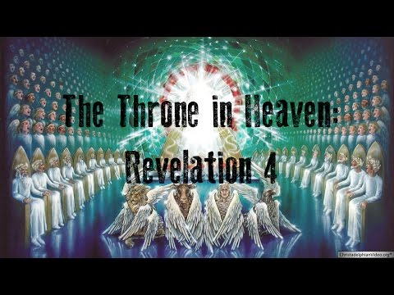
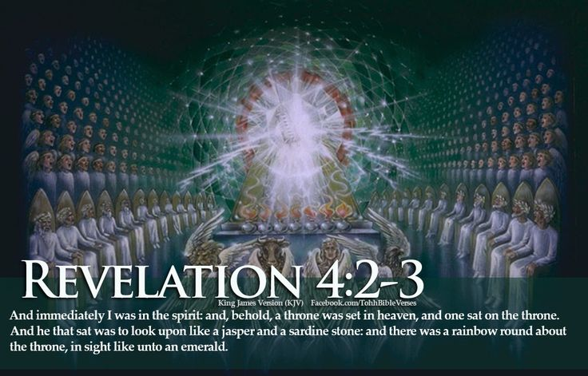
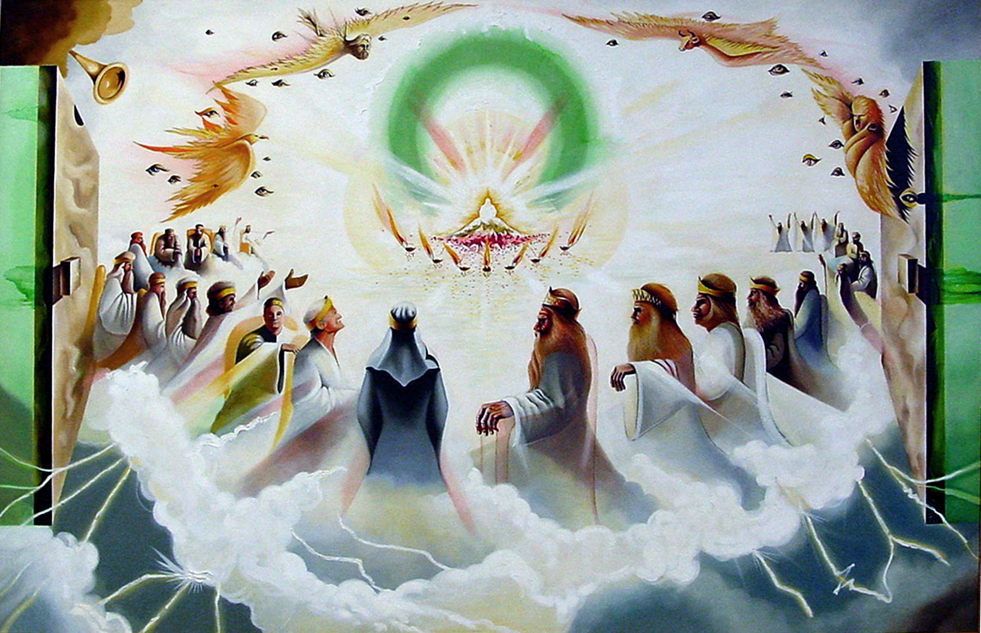
Behold the Throne

Slide 12
The Throne of God
Referred to 8 times in 4:1-6
18 Times in chap 4-5
It is a Fixed Point…
…Immovable Point of Reference
Everything Else in Heaven
…Located In Relationship to It

Slide 13
Seated Upon the Throne (2-3)
“Triune God”
Only Way to Describe His Beauty
Compare to Earths Beautiful Objects
Precious Stones …
Jasper and Sardis

Slide 14
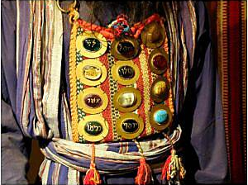
Jasper and Sardius
The First and Last Stones
On High Priests Breastplate
A Picture of the One…
Who Says..
He is the First and the Last

Slide 15
“a Throne”
speaks of..
“Sovereignty + Authority”
“a Throne Set”
speaks of..
“Stability, Firmness, Durability”

Slide 16
Surrounding the Throne (3b)
“Rainbow”
Signals the Storm has Ended…
…for Us
Reminds us that God Will
Judge the Earth In Line
with His…
…Covenants and Promises

Slide 17
Surrounding the Throne (3b)
“Rainbow”
Emerald Green
The Rainbow is a Symbol of Gods Mercy in Genesis
While Judgement is Taking Place
Church is Safe in Heaven

Slide 18
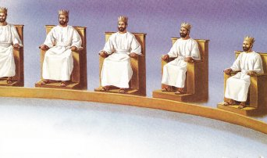
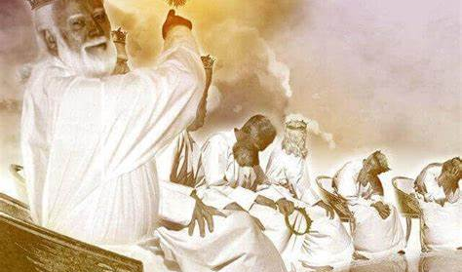
Sitting Around the Throne (4:4)
“Twenty-Four Elders”
“Elders”
Not Angels but…the Redeemed
24 = Completion
OT + NT Representatives
“Seats” (thrones)
We will Reign with Him!!
“Sitting”
Signifies Rest…
Their Labors are Over!

Slide 19
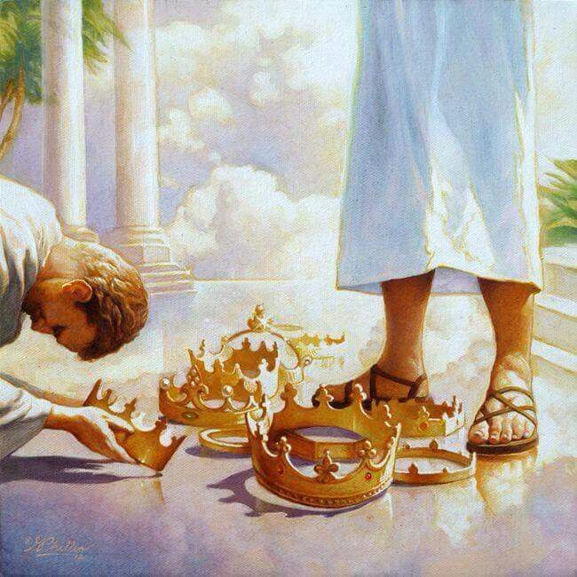
Sitting Around the Throne (4:4)
“Twenty-Four Elders”
“Clothed in White Raiment”
They are Forgiven…
..Sin Now Can No Longer Stain!
“Crowns of Gold”
Stephanos = Victor’s Crown
“Cast Crowns”
At His Feet
He Gives Us the Victory!!

Slide 20
What a Sight to Behold
Soon!
Surrendered?
Sorry!

Slide 23
