Slide 2
Repeat
These are the 2 Most Important Hours of My Week – Help Me to Cherish Them
I Am Here Today to Worship
Not to Be Entertained
I Am Singing to An Audience of One
Accept My Worship Oh Lord!

Slide 3
Praise Time!!

Slide 4
Repeat
I Lift My Offering to You
Let It Please You Oh Lord
This is My Seed
Although It Leaves My Hand
It will Never Leave My Life
You Will Multiply It!
Accept My Seed Oh Lord!

Slide 5
HUSBAND: When I get mad at you, you never fight back. How do you control your anger?
WIFE: I clean the toilet.
HUSBAND: How does that help?
WIFE: I use your toothbrush.

Slide 7

Getting Past Your Past -pt2
Independence Week
2021
Edward Church
July 11, 2021

Slide 8

Philippians 3:13, 14 instructs us to focus on the future, not the past: “One thing I do, forgetting those things which are behind and reaching forward to those things which are ahead, I press toward the goal for the prize of the upward call of God in Christ Jesus”
One Thing (First, Primary)
In Order to Move Forward…
…You Have to Let Go of the Past

Slide 9
Instead Of Focusing Our Thoughts/ Energies
  On the Opportunities of Today…
  …We Allow Painful Memories to Fill Our Minds
  …And Sap Our Strength.
  We Simply Can’t Seem to Let Go of Our Pain…
…So We Relive It Again and Again . . .
…With Predictably Unfortunate Consequences.
Thankfully, God Has Other Plans
This is the day which the LORD hath made; we will rejoice and be glad in it. Psa 118:24

Slide 10

Focusing Too Intently On the Past Is, Almost Without Exception, Futile
No Amount of Anger or Bitterness…
…Can Change What Happened Yesterday.
    Tears Can’t Change the Past;
    Regrets Can’t Change It.
    Our Worries Won’t Change the Past,
    Our Complaints Wont Either

Slide 11
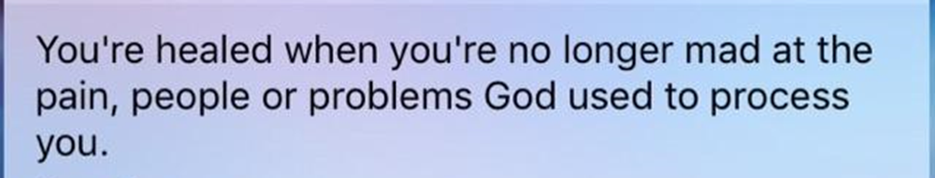
When We Find Ourselves Focusing Too Intently On the Past…
…It’s a Sign That We Need To Focus on
…Moving Forward
…Through Forgiveness
…Beyond the Pain
…Reaching unto a New S.T.A.R.T.

Slide 12

S= Stop Making Excuses

Slide 13
S= Stop Making Excuses
A Man Good At Making Excuses is Seldom Good at Anything Else
Ben Franklin
Excuses are the Nails that Build a House of Failure
Abe Lincoln
There are Only Two Options: Make Progress…
…or Make Excuses

Slide 14

T - Take An Inventory Of My Life

Slide 15
T - Take An Inventory Of My Life
I Need to Evaluate All My Assets, Abilities / Experiences
What’s Left Over After I’ve Discarded What Needs to Be Behind
We Get So Busy Focusing On What We Lost…
…We Lose Sight of What We Have and Even Gained
Galatians 3:4, "You have experienced many things. Were all those experiences wasted? I hope not."
Challenge- Make 3 Columns: 1-(Lost) 2-(Kept) 3-(Gained)
After Proper Inventory…
…See How Things Really Look

Slide 16

Move Forward
Therefore, if anyone is in Christ, he is a new creation. The old has passed away; behold, the new has come. -2 Corinthians 5:17
Let your eyes look directly forward, and your gaze be straight before you. -Proverbs 4:25
It May Take a While
You May Feel Stuck
Can’t Go By Feelings
It Requires Acting by
    Hope
    Faith
    Courage

Slide 17
A - Act in faith
  We Need to Look Up / Look Out.
  Launch Out Into New Territory.
  If We Don’t Grow/ Move Ahead, We Get Stagnant
  The Key to Changing Anything is Faith.
  If We Want to Change Our Circumstances It Will Take Faith.
R - Refocus
  I Need to Refocus My Thoughts If I Want to Change My Life.
  Proverbs 4:23, “Keep vigilant watch over your heart…
  …that’s where life starts”

Slide 18

S - Stop Making Excuses
T - Take An Inventory Of My Life
A - Act in faith
R - Refocus
T – Trust
  Trust God to Help Us Succeed.
  Depend On Him, Not Ourselves.
  We’ve Already Proven that We Can’t Do It On Our Own.
  That’s Why We’ve Failed.
  We Can’t Change Who, What, When- Only God Can Do That.
  Giving God Control Of My Life.
Isa 26:4 Trust in the LORD forever, for the LORD, the LORD himself, is the Rock eternal.

Slide 19
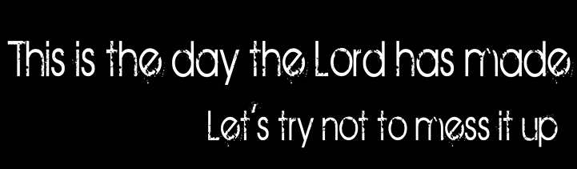
Accepting The Past
Three Things You Can Do with Mistakes or Hurts:
Resolve…
  To Never Make Another Mistake or Be Hurt Again.
  That Is Impossible.
Retreat
  Let Mistakes and Hurts Make a Coward Of You.
  That is Foolish.
Rebound
  Learn from Your Mistakes, Move Beyond Your Hurts
  This is Profitable.

Slide 20

Simply Put…
The Past Is…
…And Always Will Be
…the Past
…Forever!
The Lord says, “Forget what happened before, and do not think about the past. Look at the new thing I am going to do. It is already happening. Don’t you see it? I will make a road in the desert and rivers in the dry land.” ISA 43:18, 19 NCV

Slide 22
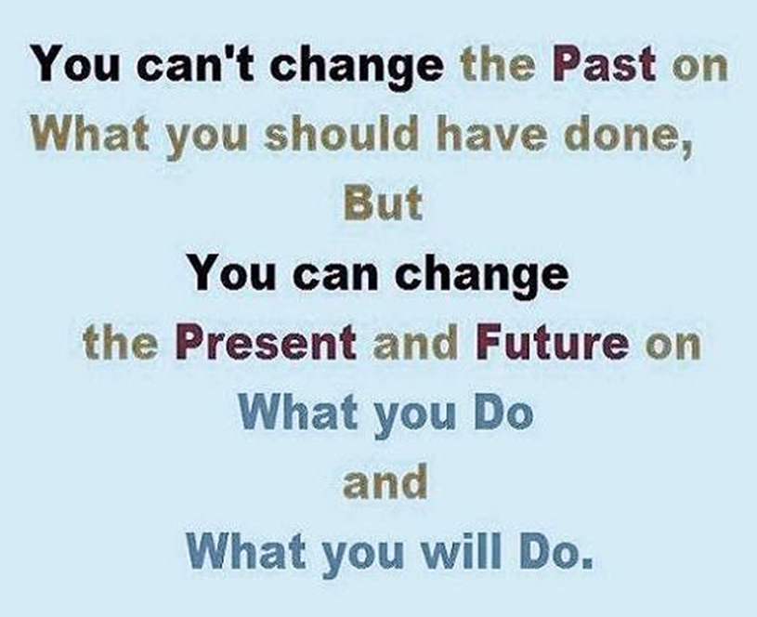
The Lord says, “Forget what happened before, and do not think about the past. Look at the new thing I am going to do. It is already happening. Don’t you see it? I will make a road in the desert and rivers in the dry land.” ISA 43:18, 19 NCV

