Slide 1
When little DC received his plate he started eating right away.
"DC, wait until we say our prayer."
"I don't have to," the boy replied.
"Of course, you do," his mother insisted. "We say a prayer before eating at our house."
"That's our house," DC explained. "But this is Grandma's house, and she knows how to cook!"

Slide 3
Edward Christian Church
August 1, 2021
Overcoming…
…Deflated
…Attitude
-pt 1
…Deflated
II Chron 20

Slide 4
God Promises
God Never Promises a Stress Free…
…Problem Free Life
John 16:33
We would have Tribulation…But be of Good Cheer (Courage) for His has Overcome the World
“Walk in His Victory”
Romans 8
Walk in His Love and Presence
“Walk in More than Victory”

Slide 5
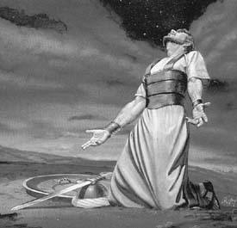
Deflated Spirit
Jehoshaphat was Facing a…
…Real Threat
Moab Once Defeated by Him Now
Triples Strength
Comes Back
Unexpected Threat Produced
Real Fear
Fear Deflated His Spirit

Slide 6
What is a Deflated Spirit(Attitude)?
Fear Rises Up in Your Life…
…Usually from Unexpected Circumstances
…It Takes the Wind Out of Your Sail
It Exaggerates Your Problem
It Minimizes Your Power (Confuses Your Faith)
It Deflates Your Faith, Hope, Expectation
If Left Unattended it Drives Depression
It Forces You to a Decision Point
Stay in the Confusion Looking for an Answer
Or Take It To the One Who is The Answer !

Slide 7
“The tongue has power of life / death” Prov 18:21
What Does a Deflated Attitude say about Yourself?
"I can't do anything right!"
"Why should I even try?"
"My usefulness is over!"
"I hate myself!"
"Look at so-and-so" (in comparison).
"I must have done something wrong!"
"Nobody loves me!”
This is Far from God’s Truth

Slide 8
What Does a Deflated Attitude Say…
…About Your Situation?
"I don't see any way out!"
"It didn't matter anyway!"
"This is intolerable!"
"It's not fair!"
"I'm helpless to change it!"
"I can't do anything about it!"
"I can't bear it!“
This is Far from God’s Truth

Slide 9
What Does Your Deflated Attitude say…
…About Your Future?
"So what!"
"Nothing will ever change."
"No one will ever love me!"
"I'll be too old."
"That was my last chance for happiness!"
"I have nothing to live for."
"It's hopeless!“
This is Far from God’s Truth

Slide 10
Inflating a Deflated Spirit?
How Do We…
Get Beyond a Deflated Attitude?
Get Our Wind Back?
Find the Strength…
…to Get Back into the Battle?
It Starts With…

Slide 11
The Preparation (3)
3 Ways to Handle Deflated Spirit
#1- Deny…
…Act Like Not Exist
#2- Fry…
…Overcome by Fear
…Take Matters Own Hands
#3- Rely… “Set Self Seek Lord”
…Respond Properly
…Go to God!

Slide 12
“The tongue has power of life / death” Prov 18:21
What is the Light of Truth Say about Yourself?
“Though the mountains be shaken / the hills be removed, yet my unfailing love for you will not be shaken nor my covenant of peace be removed, ' says the Lord, who has compassion on you" -Isa 54:10
What is the Light of Truth About Your Situation?
"I can do all things through Christ who strengthens me" -Phil 4:13 NKJV
What Does the Light of Truth Say …Your Future? God says...'"I know the plans I have for you,' declares the Lord, 'plans to prosper you and not to harm you, plans to give you hope and a future’” -Jeremiah 29:11

Slide 13
The Preparation (3)
Let Everything
Begin
and End
with God’s Word

Slide 15
End pt 1
Deflated Attitude Lies

Slide 16
The Preparation (3)
If you are walking in darkness, then cherish these words from the Lord...
"I will lead the blind by ways they have not known, along unfamiliar paths I will guide them; I will turn the darkness into light before them and make the rough places smooth. These are the things I will do; I will not forsake them." (Isaiah 42:16

Slide 17
3 Ways
to Handle a
Deflated Spirit

Slide 18
The Preparation (5)
Surrender- (3),“..fasted..”
Serves as Sign to Flesh
Serves as Sign to God
Search- (5),“..prayed..”
Serves as Sign of Communication
Serves as Sign of Dependence
Sum- (13),“..all Judah stood..”
it was a Community Problem
it req’d Community Effort
Time for All of Us to Get in the Fight!

Slide 19
The Prophesy v14
1. the Problem
a. Flesh Not Sufficient -Not Equipped
Eph. 6:12,“..wrestle not against flesh/ blood..”
b. Needed to Move Into a Higher Realm
(17)-Stand Still(Raise Up/ Repair)
2. the Presence
a. Lord(Self-Exist/ Eternal One)
He’s Been There Too- Before You
Exo. 33 -Moses Refused to Go…
…w/ Out God’s Presence

Slide 20
The Prophesy v14
1. the Problem
2. the Presence
3. the Power - See Diff When God Speaks
a. 1st- w/ In…
Fear- (3)
Boldness- (20)
Stood Battleground/ Spoke
b. 2nd- w/ Out…
See(look upon/ Anticipate w/ Great Joy)
Salvation(Deliverance-Breakthrough)

Slide 21
The Praise v22
1. the Place of Praise (21)
a. Up Front in Wilderness- Judah ..Praise!!!!!!
b. Before Army Shows.. 1-Faith, 2-Attitude
2. the Progression of Praise (19-22)
a. 19 -Haw-lal (celebrate-be foolish-make show-
have party-thx for harvest)
b. 21 -Yadah (palm/hands-hands raised)
1- Surrender
2- Intimacy
3- Receiving
c. 22 -Teh-hil-law (to sing about Completed Work)
It Was Good As Done

Slide 22
The Praise v22
1. the Place of Praise (21)
2. the Progression of Praise (21)
3. the Power of Praise (22)
a. Jericho
Problem - Walls
Plan- Surround with Praise
Power- Flat(underneath-fr. foundation)
b. Jehoshaphat
Problem- Outnumbered
Plan- Enter w- Praise
Power- Lord Set (recompense)
Prov.6:31,“if thief be found, restore 7-fold..”

Slide 23
Seven Things God Says To You In Your Battle
1. Do Not Fear! (15) “…Be Not Afraid…”
Check Your Emotions
2. Do Not Be Dismayed! (15) “…nor Dismayed…”
Check Yourself Mentally
3. The Battle Isn’t Yours! (15)
“…for the Battle isn’t Yours, But Mine.”
Check Your Position
4. Position Yourself! (17) “…Set Yourself…”
Check Your Courage

Slide 24
Seven Things God Says To You In Your Battle
5. Remain in Your Position! (17) “…Stand Still…”
Check Your Stedfastness
6. Watch God Work! (17) “..See Salvation of Lord”
Check Your Faith
7. Face the Enemy with Confidence! (17) “…tomorrow go out against them;
…for the Lord Will Be with You.”
Check Your Obedience

Slide 27
Seven Things God Says To You In Your Battle
1. Do Not Fear! -v15 “…Be Not Afraid…”
2. Do Not Be Dismayed! -v15 “…nor Dismayed…”
3. The Battle Isn’t Yours! -v15 “…for the Battle
isn’t Yours, But Mine.”
4. Position Yourself! -v17 “…Set Yourself…”
5. Remain in Your Position! -v17 “…Stand Still…”
6. Watch God Work! -v17 “..See Salvation of Lord”
7. Face the Enemy with Confidence! -v17 “…tomorrow go out against them;
…for the Lord Will Be with You.”

Slide 29
The Praise v22
1. the Place of Praise v21
a. up front in wilderness- Judah - you may be in wild. tonight...praise!!!!!!
b. before army - 1-faith, 2-attitude
2. the Progression of Praise v21
a. 19 -Haw-lal(celebrate-be foolish-make show-have party-thx for harvest)
b. 21 -Yadah(palm/hands-hands raised) 1-surrender, 2-intimacy, 3-place of rec.
c. 22 -Teh-hil-law(hymn-to sing about a completed work) -it was good as done
3. the Power of Praise v22
a. Jericho - walls- compass- flat(underneath-fr. foundation)- shout
b. Lord set(recompense) Prov.6:31,“if thief be found, restore 7-fold..”

Slide 30
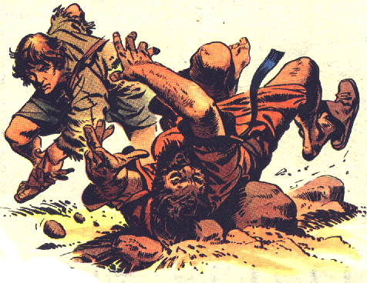

Slide 31
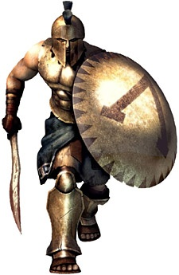

Slide 32
Rise Up!!!
…Declare Defeat is Not an Option!!!
…In Christ
…We Are More than Conquerors!!!

Slide 33
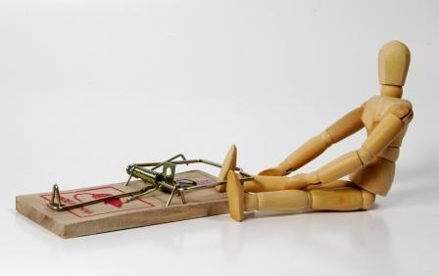
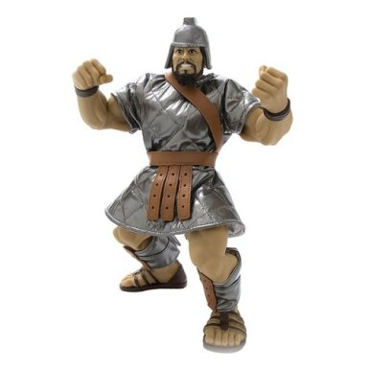

Slide 35
Transition sermon from Emotions to
What top do when don’t know what to do
DEFLATED Spirit (adjective) brought low in spirit
All the air has been taken
How to Inflate Spirit!!!

Slide 36
What is a Defeated Spirit?
Defeat Means To Be Overcome…
…In a Contest, Battle, or Difficulty of Life
…Usually It Affects One Or More
…Areas Of Your Life Temporarily
Temporary Setback
A Defeated Attitude Means To Be Overcome…
…Before The Contest, Battle, Or Difficulty Of Life
…Ever Takes Place
…Eventually it will Affects Every Area of Your Life
Total Setback

Slide 37
Defeating Defeat
Rise Up!
Refuse to be Defined by Defeat!
We Are More than Conquerors in Christ!
After We Rise Up…
… What Do We Do
… When We Don’t Know
… What to Do?

Slide 38
Difference in Deflated Spt/ Depression
A Deflated Spirit can be a Normal Reaction to Loss, Life's Struggles, or an Injured Self-esteem.
It is the Initial Feeling of Loss that Can Cause Emptiness W/in as We Ponder Our Present Problem
But when Feelings of Intense Loss/ Sadness -- including Feeling Helpless, Hopeless, And Worthless -- Last for Days to Weeks and …
Keeps You from Functioning…
…It May Have Turned Into Depression

