Slide 1
This is the Day that the Lord Hath Made
We Will Rejoice and Be Glad in It!!
Glory

Slide 2
Repeat
These are the 2 Most Important Hours of My Week – Help Me to Cherish Them
I Am Here Today to Worship
Not to Be Entertained
I Am Singing to An Audience of One
Accept My Worship Oh Lord!

Slide 3
Praise Time!!

Slide 4
Repeat
I Lift My Offering to You
Let It Please You Oh Lord
This is My Seed
Although It Leaves My Hand
It will Never Leave My Life
You Will Multiply It!
Accept My Seed Oh Lord!

Slide 5
A guy comes into a coffee shop and places his order: "I want three flat tires and a pair of headlights."
The waitress, not wanting to appear stupid, goes to the kitchen and asks the cook, "This guy out there just ordered three flat tires and a pair of headlights. What does he think, this is an auto parts store
"No," the cook says. "Three flat tires means three pancakes and a pair of headlights is two eggs sunny side up."
"Oh," says the waitress. She thinks about this and then she spoons up a bowl of beans and gives it to the customer.
The guy says, "What are the beans for?"
The waitress replies, "I thought that, while you're waiting for the flat tires and headlights, you might want to gas up."

Slide 7
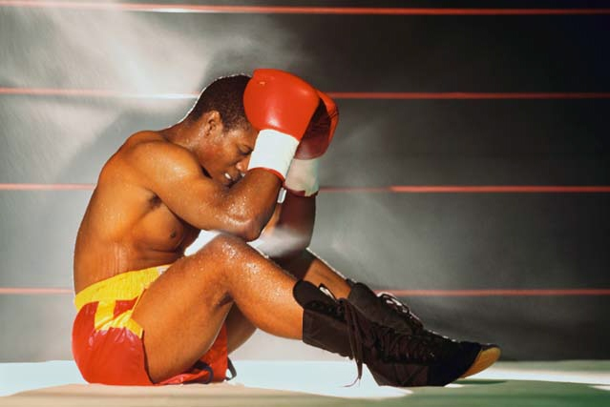
Edward Christian Church
August 8, 2021
Overcoming…
…Deflated
…Attitude
-pt 2
…Deflated
II Chron 20

Slide 8
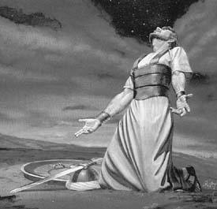
Deflated Spirit
Jehoshaphat was Facing a…
…Real Threat
Moab Once Defeated by Him Now
Triples Strength
Comes Back
Unexpected Threat Produced
Real Fear
Fear Deflated His Spirit

Slide 9
What is a Deflated Spirit(Attitude)?
Fear Rises Up in Your Life…
…Usually from Unexpected Circumstances
…It Takes the Wind Out of Your Sail
It Exaggerates Your Problem
It Minimizes Your Power (Confuses Your Faith)
It Deflates Your Faith, Hope, Expectation
If Left Unattended it Drives Depression
It Forces You to a Decision Point
Stay in the Confusion Looking for an Answer
Or Take It To the One Who is The Answer !

Slide 10
Inflating a Deflated Spirit?
How Do We…
Get Beyond a Deflated Attitude?
Get Our Wind Back?
Find the Strength…
…to Get Back into the Battle?

Slide 11
The Preparation (3)
3 Ways to Handle Deflated Spirit
#1- Deny…
…Act Like Not Exist
#2- Fry…
…Overcome by Fear
…Take Matters Own Hands
#3- Rely… “Set Self Seek Lord”
…Respond Properly
…Go to God!

Slide 12
Prep – He Called…
Fast- diff- loosing appetite -/ fasting+ (3)
Upon God (5)
He Involved the Right People (13)
Prophesy – God Called Back (14)
You Don’t Have to
Be Afraid or Deflated (15)
Struggle (17)
Go It Alone (17)
Praise – He Called His Enemy
Order (21)
Action (22)
Reaction (23)

Slide 13
Progression of Praise (19-22)
(19) Haw-lal (celebrate-be foolish-make show-
have party-thx for harvest)
(21) Yadah (palm/hands-hands raised)
Surrender
Intimacy
Receiving
(22) Teh-hil-law (to sing about Completed Work)
It Was Good As Done

Slide 14
Seven Things God Says to You in Your Battle
Do Not Fear! (15) “…Be Not Afraid…”
Check Your Emotions
Do Not Be Dismayed! (15) “…nor Dismayed…”
Check Yourself Mentally
The Battle Isn’t Yours! (15)
“…for the Battle isn’t Yours, But Mine.”
Check Your Position
Position Yourself! (17) “…Set Yourself…”
Check Your Courage

Slide 15
Seven Things God Says to You in Your Battle
Remain in Your Position! (17) “…Stand Still…”
Check Your Stedfastness
Watch God Work! (17) “..See Salvation of Lord”
Check Your Faith
Face the Enemy with Confidence! (17) “…tomorrow go out against them;
…for the Lord Will Be with You.”
Check Your Obedience

Slide 17
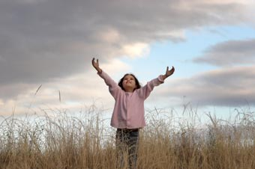
The Praise v22
1. the Place of Praise (21)
2. the Progression of Praise (21)
3. the Power of Praise (22)
a. Jericho
Problem - Walls
Plan- Surround with Praise
Power- Flat(underneath-fr. foundation)
b. Jehoshaphat
Problem- Outnumbered
Plan- Enter w- Praise
Power- Lord Set (recompense)
Prov.6:31,“if thief be found, restore 7-fold..”

Slide 18
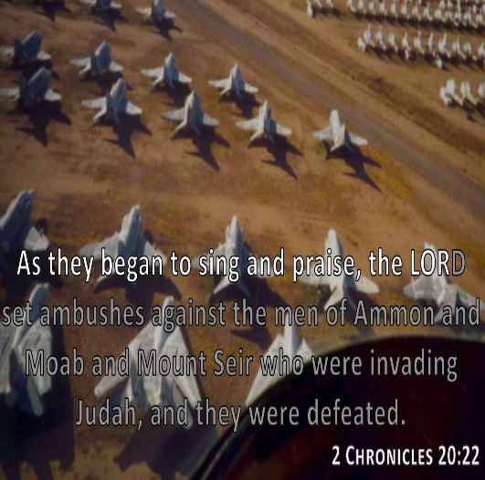

Slide 19
Seven Things God Says To You In Your Battle
1. Do Not Fear! -v15 “…Be Not Afraid…”
2. Do Not Be Dismayed! -v15 “…nor Dismayed…”
3. The Battle Isn’t Yours! -v15 “…for the Battle
isn’t Yours, But Mine.”
4. Position Yourself! -v17 “…Set Yourself…”
5. Remain in Your Position! -v17 “…Stand Still…”
6. Watch God Work! -v17 “..See Salvation of Lord”
7. Face the Enemy with Confidence! -v17 “…tomorrow go out against them;
…for the Lord Will Be with You.”

Slide 21
The Praise v22
1. the Place of Praise v21
a. up front in wilderness- Judah - you may be in wild. tonight...praise!!!!!!
b. before army - 1-faith, 2-attitude
2. the Progression of Praise v21
a. 19 -Haw-lal(celebrate-be foolish-make show-have party-thx for harvest)
b. 21 -Yadah(palm/hands-hands raised) 1-surrender, 2-intimacy, 3-place of rec.
c. 22 -Teh-hil-law(hymn-to sing about a completed work) -it was good as done
3. the Power of Praise v22
a. Jericho - walls- compass- flat(underneath-fr. foundation)- shout
b. Lord set(recompense) Prov.6:31,“if thief be found, restore 7-fold..”

Slide 22
3 Ways
to Handle a
Deflated Spirit

Slide 23
The Prophesy v14
1. the Problem
a. Flesh Not Sufficient -Not Equipped
Eph. 6:12,“..wrestle not against flesh/ blood..”
b. Needed to Move Into a Higher Realm
(17)-Stand Still(Raise Up/ Repair)
2. the Presence
a. Lord(Self-Exist/ Eternal One)
He’s Been There Too- Before You
Exo. 33 -Moses Refused to Go…
…w/ Out God’s Presence

Slide 24
The Preparation (5)
Surrender- (3),“..fasted..”
Serves as Sign to Flesh
Serves as Sign to God
Search- (5),“..prayed..”
Serves as Sign of Communication
Serves as Sign of Dependence
Sum- (13),“..all Judah stood..”
it was a Community Problem
it req’d Community Effort
Time for All of Us to Get in the Fight!

Slide 26
The Prophesy v14
1. the Problem
2. the Presence
3. the Power - See Diff When God Speaks
a. 1st- w/ In…
Fear- (3)
Boldness- (20)
Stood Battleground/ Spoke
b. 2nd- w/ Out…
See(look upon/ Anticipate w/ Great Joy)
Salvation(Deliverance-Breakthrough)

