Slide 2
August 15, 2021
Edward Church
Revelation (6:1-2) pt.1
“ White Horse”

Slide 3
Revelation 6:1-2 (KJV) ¹ And I saw when the Lamb opened one of the seals, and I heard, as it were the noise of thunder, one of the four beasts saying, Come and see. ² And I saw, and behold a white horse: and he that sat on him had a bow; and a crown was given unto him: and he went forth conquering, and to conquer.

Slide 4
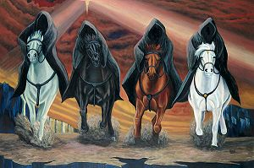
Tribulation
The Tribulation Period is one of the…
…Most Significant Periods of
…God’s Dealing with Mankind
It Occupies a Prominent Place in His…
…Prophetic Plan
Mentioned over 50 times in Old Test
…Over 12 times in New Test

Slide 5
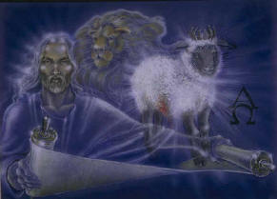
Revelation Chapter 5… …All is Ready
#1- Church is in Position
Rapture has Taken us Away
Church is Forever Safe in His Presence
#2- Jesus is in Position
Place of
Victory
Majesty
Power
#3- World is in Position
Holy Spirit Out of the Way –II Thes 2:6-7
Tribulation is about to Start

Slide 6
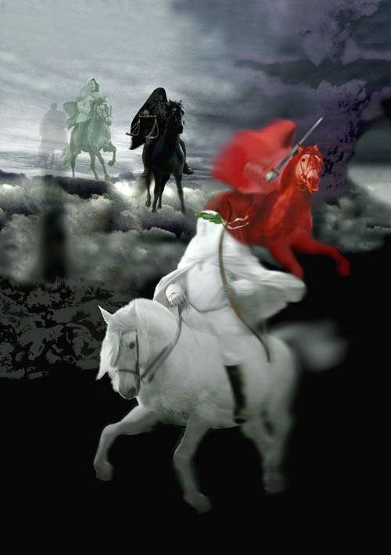
Revelation chapter six is a…
…Shock to the Senses.
In the past two chapters, we have been allowed to witness scenes of Heavenly Worship.
In this passage, we are going to see images of Divine Wrath.

Slide 7
Reason for the Tribulation Period Daniel 9:24
Finish transgression
Put an end to sin
Atone for wickedness
Bring everlasting righteousness
Seal up vision and prophecy
Anoint the Most Holy

Slide 8
Jesus breaks the seven seals on the book one by one.
As the seals are opened, a series of Divine Judgments are poured out upon the earth and those who dwell on the earth.
The four seals describe events that will take place during the…
…First 21 months of Tribulation.

Slide 9
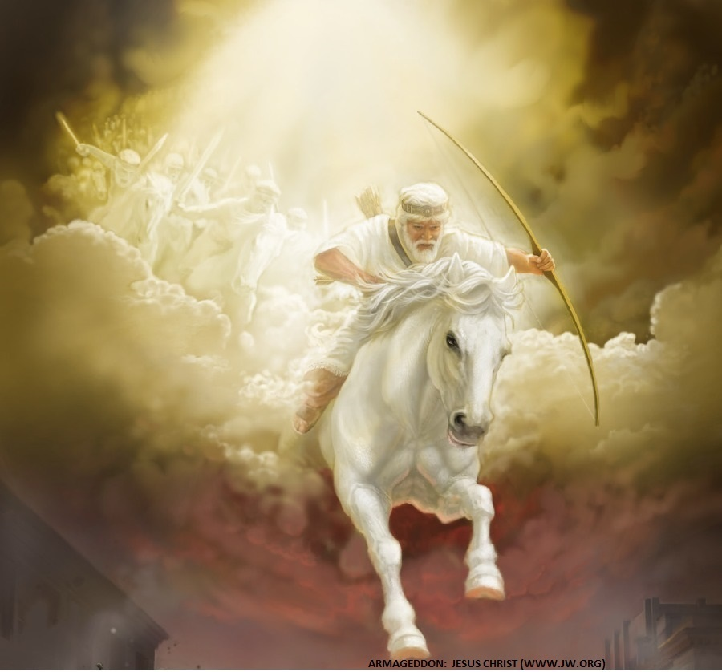
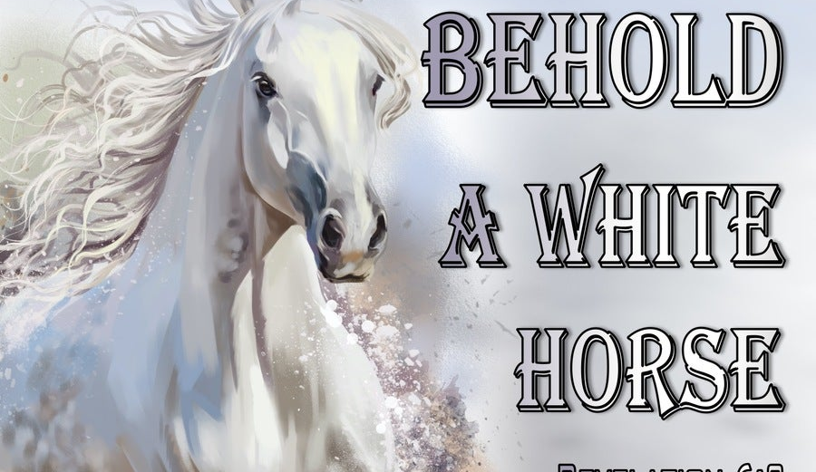
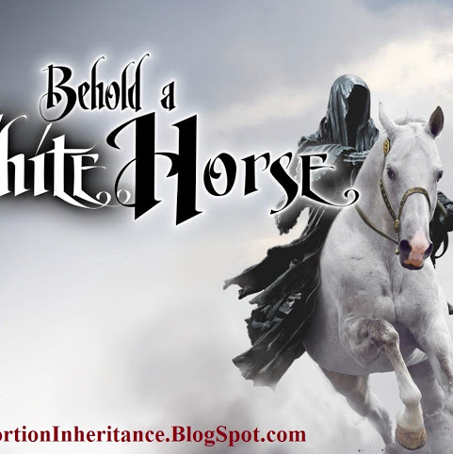
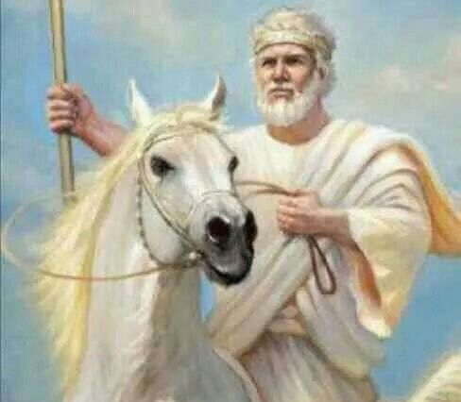
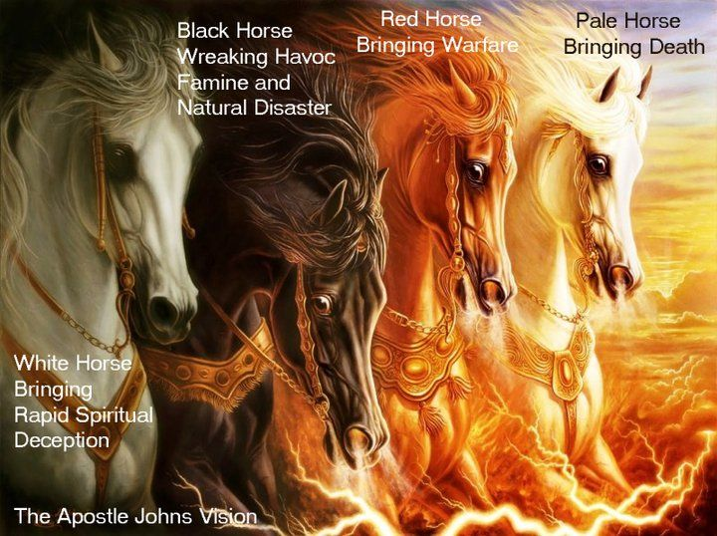
When The Lamb Opens First Seal,
…“The Noise Of Thunder” in Heaven
Signals the Approach of a Storm
What Is About To Be Unleashed…
…On This World Is
…Beyond Description.

Slide 10
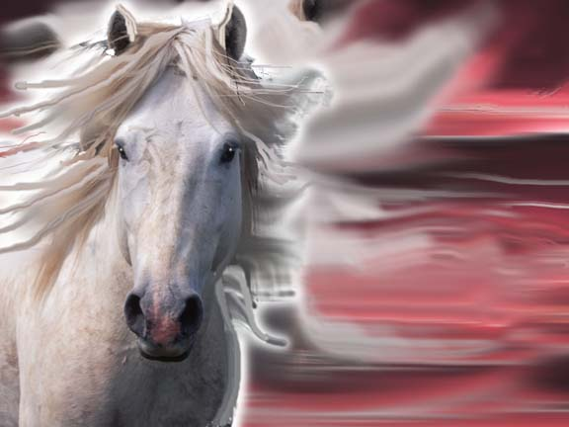
Revelation 6:2…
The White Horse of Deception
Notice Similarities in
Chapters 6 and…
…Chapters 19

Slide 11
This Rider…
Wears a “crown”
Wears a “stephanos”, a victor’s crown.
has his crown “given unto him”.
Carries a Bow.
Appearing Signals Beginning Tribulation
Jesus…
Wears “many crowns”
Wears many “diadems”, crowns of
…the King of Kings.
Wears His Crowns because “Who He is”
Carries a Sword.
Appearing Signals
End of Tribulation

Slide 12
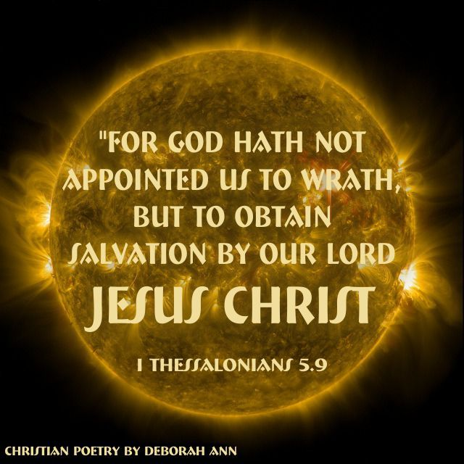
Hell is on the Horizon
But …
It Hasn’t Broke Loose Yet!
2 Thessalonians 2:6-7 (KJV) ⁶ And now ye know what withholdeth that he might be revealed in his time. ⁷ For the mystery of iniquity doth already work: only he who now letteth will let, until he be taken out of the way.

