Slide 2
“Storms of Life” Out of Nowhere
Job 1-2
Part 1
Edward Church
August 22, 2008

Slide 3
Three Great Trials in Bible
First, the Trial of Christ
Started in Gethsemane…
…ended on the Cross
Second, the Trial of Abraham
Offer up Isaac on Mount Moriah
Third, the Trial of Job
Who was delivered into the hand of Satan

Slide 4
Job 5:7 “Yet man is born to trouble as
surely as sparks fly upward.”
Job 14:1 “Man born of woman is of few
days and full of trouble.”

Slide 5
“Out of Nowhere”
Trials…
…Troubles,
…Problems,
…Persecution,
…Powerful Pain
…Came to Job

Slide 6
Out of Nowhere
Since 2020
Life has Come At Us
Out of Nowhere
Covid 19
Calamity
Catastrophes
Forecast…
More to Come

Slide 7
Out of Nowhere Storm Facts:
Storms Come…
Every Person –Common
Often Unexpected
Many Shapes and Sizes
Sometimes for a Season
Beyond Our Understanding
Making Us Bitter Or Better
Never Beyond God’s Control

Slide 8
Season of Storms:
Storms
Starting Point
Source…
…Singular
Manageable
Stopping Point
Season of Storms
Starting Point
Source…
…Multiple
Out of Control
No End in Sight

Slide 9
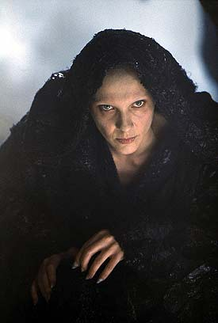
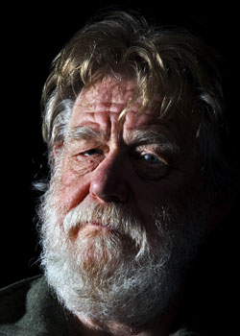
The Reason for the Storm (Job 1:6-11; 2:1-5)
Satan “adversary”
Person – he is real, not just an evil
influence or force
Intellect – he communicated with the Lord
Emotions – he was antagonistic toward Job
Will – he planned to destroy Job while dishonoring God’s Plan
Satan May Not Be Responsible
…for Starting Your Storm
But He is Responsible
…for Stirring it!

Slide 10
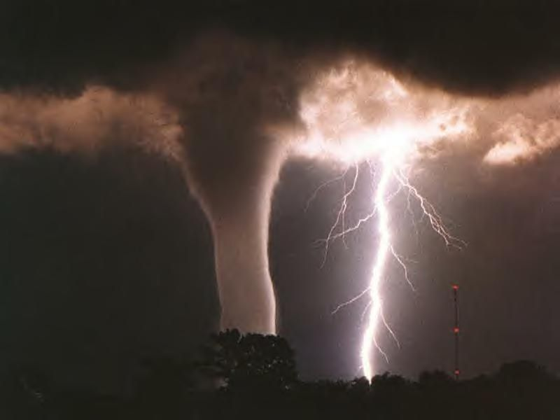
The Ruler of the Storm (Job 1:6-19; 2:7-8)
God… Sovereign and in Total Control
Instigated (6-8)
Regulated (9-12)

Slide 11
The Hedge (Job 1:10)
2 Corinthians 12:6-10
My Grace
Sufficient
Strength
Made Perfect
Weakness

Slide 12
The Ruler of the Storm (Job 1:6-19; 2:7-8)
God… Sovereign and in Total Control
Instigated (6-8)
Regulated (9-12)
Rewarded (42:10-16)

Slide 13
The Resources of the Storm:
Satan’s Resources:
People Conflict (15, 17)
Supernatural (16)
Weather (19)
Personal Conflict -friends; Wife
Sickness (2:7)

Slide 14
The Reach of the Storm:
Affected All Areas of Life:
Ability to…
Re-Produce (living)
Livestock Destroyed
Produce (living)
Servants Destroyed
Re-Produce (legacy)
Children Destroyed
Produce (leadership)
Health Destroyed

Slide 15
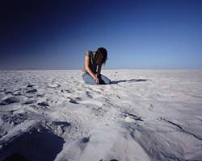
The Reaction in the Storm (Job 1:20-22)
Choice: Grow bitter or better
Arose - establish, stand again
Rent Mantle + Shave Head –outward sign
of mourning
Fell down - overthrow, overwhelm, die
Worshipped - fall down, humble reverence
Recognized - God’s Sovereignty (21-22)

Slide 16
The Reaction in the Storm (Job 1:20-22)
Job 1:21-22 ²¹ And said, Naked came I out of my mother's womb, and naked shall I return thither: the LORD gave, and the LORD hath taken away; blessed be the name of the LORD. ²² In all this Job sinned not, nor charged God foolishly.
God is…
…Sovereign
…Source

