Slide 2
August 29, 2021
Edward Church
Revelation (6:1-2) pt.2
“ White Horse”

Slide 3
Revelation 6:1-2 (KJV) ¹ And I saw when the Lamb opened one of the seals, and I heard, as it were the noise of thunder, one of the four beasts saying, Come and see. ² And I saw, and behold a white horse: and he that sat on him had a bow; and a crown was given unto him: and he went forth conquering, and to conquer.

Slide 4
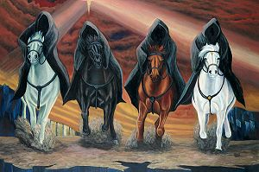
Tribulation
The Tribulation Period is one of the…
…Most Significant Periods of
…God’s Dealing with Mankind
It Occupies a Prominent Place in His…
…Prophetic Plan
Mentioned over 50 times in Old Test
…Over 12 times in New Test

Slide 5
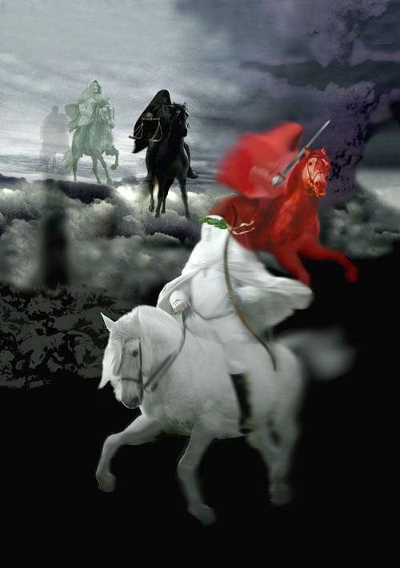
Revelation chapter six is a…
…Shock to the Senses.
In the past two chapters, we have been allowed to witness scenes of Heavenly Worship.
In this passage, we are going to see images of Divine Wrath.

Slide 6
Jesus breaks the seven seals on the book one by one.
As the seals are opened, a series of Divine Judgments are poured out upon the earth and those who dwell on the earth.
The four seals describe events that will take place during the…
…First 21 months of Tribulation.

Slide 7
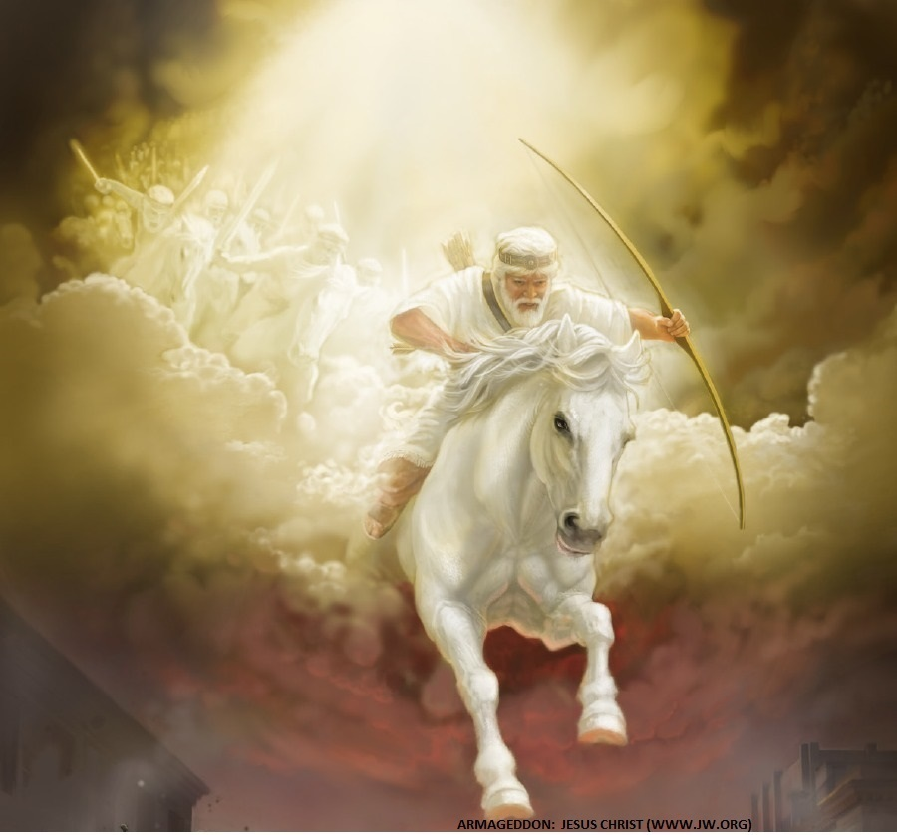
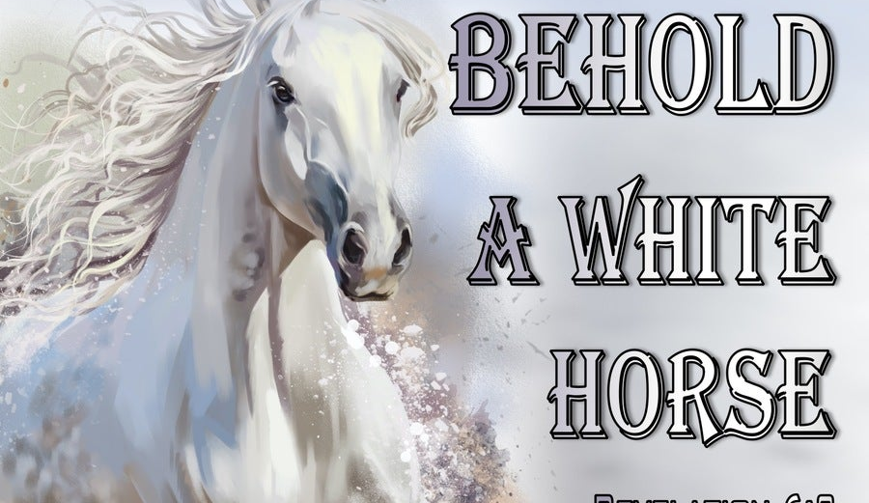
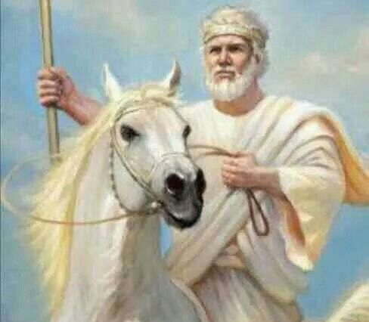
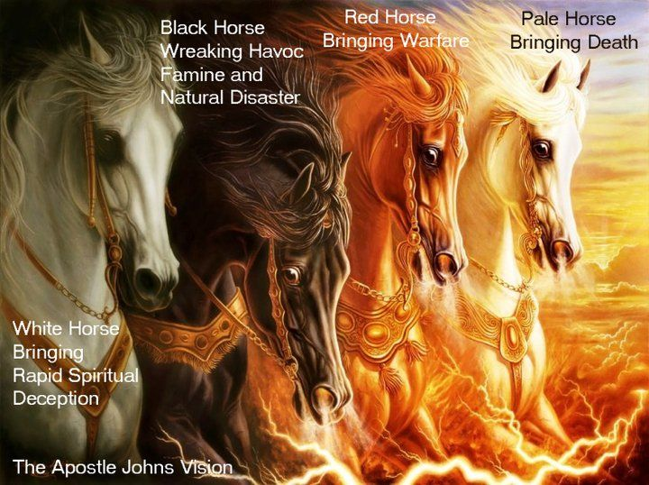
When The Lamb Opens First Seal,
…“The Noise Of Thunder” in Heaven
Signals the Approach of a Storm
What Is About To Be Unleashed…
…On This World Is
…Beyond Description.

Slide 8
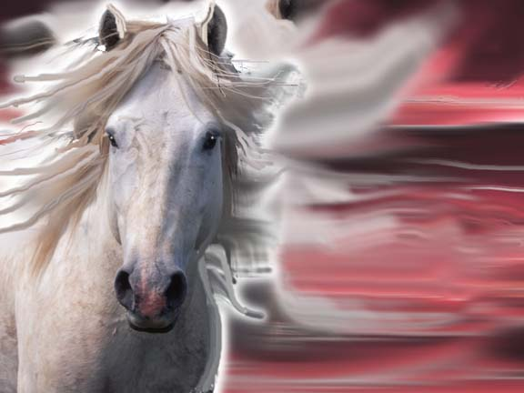
Revelation 6:2…
The White Horse of Deception
Notice Similarities in
Chapters 6 and…
…Chapters 19

Slide 9
This Rider…
Wears a “crown”
Wears a “stephanos”, a victor’s crown.
has his crown “given unto him”.
Carries a Bow.
Appearing Signals Beginning Tribulation
Jesus…
Wears “many crowns”
Wears many “diadems”, crowns of
…the King of Kings.
Wears His Crowns because “Who He is”
Carries a Sword.
Appearing Signals
End of Tribulation

Slide 10
The Similarities…
…Indicate
…this Man is
The Anti-Christ!

Slide 11
The White Horse of Deception
He is a…
“Man of Peace”
This rider has a “bow” in his hand…
…but he has
…No Arrows.
He rides in on the Platform of Peace –Daniel 9:27
He wins his Crown through Diplomacy

Slide 12
The White Horse of Deception
He is a…
“Man of Power”
“He went forth conquering, and to conquer”.
His sole purpose was to obtain power
“A crown was given to him”.
The world gladly gives him power

Slide 13
The White Horse of Deception
He’s a…
“Man of Pretense”
He is not the man he appears to be.
He comes promising peace, but….
- I Thess. 5:3
He will be the most evil dictator the world has ever seen

Slide 14
The White Horse of Deception
He’s the…
“Great Counterfeiter”
Does all to Imitate Christ…
…to Deceive the Masses
Jews will Believe He is
…the True Messiah
…Until
Satan Inhabits Him Midway
..of the
…Tribulation Period

Slide 15
Then All Hell
Breaks Loose!
You Don’t Have to…
…Experience What’s Coming
“Today is the Day of Salvation”

