Slide 2
August 29, 2021
Edward Church
Revelation (6:1-4) pt.3
“ Red Horse”

Slide 3
Revelation 6:3-4 (KJV) ³ And when he had opened the second seal, I heard the second beast say, Come / see. ⁴ And there went out another horse that was red: and power was given to him that sat thereon to take peace from the earth, and that they should kill one another: and there was given unto him a great sword.

Slide 4
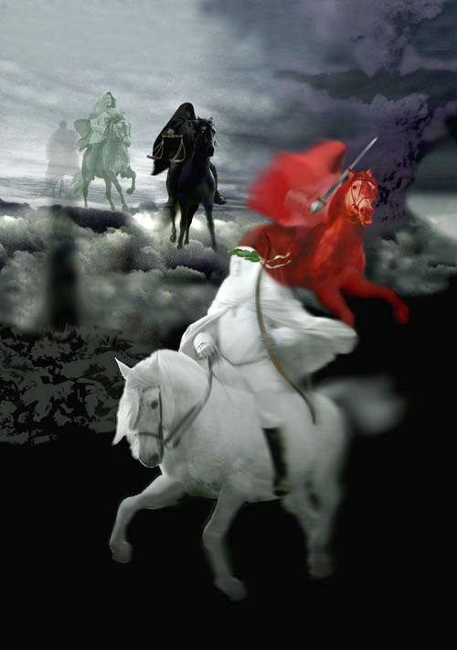
Jesus breaks the seven seals on the book one by one.
As the seals are opened, a series of Divine Judgments are poured out upon the earth and those who dwell on the earth.
The four seals describe events that will take place during the…
…First 21 months of Tribulation.

Slide 5
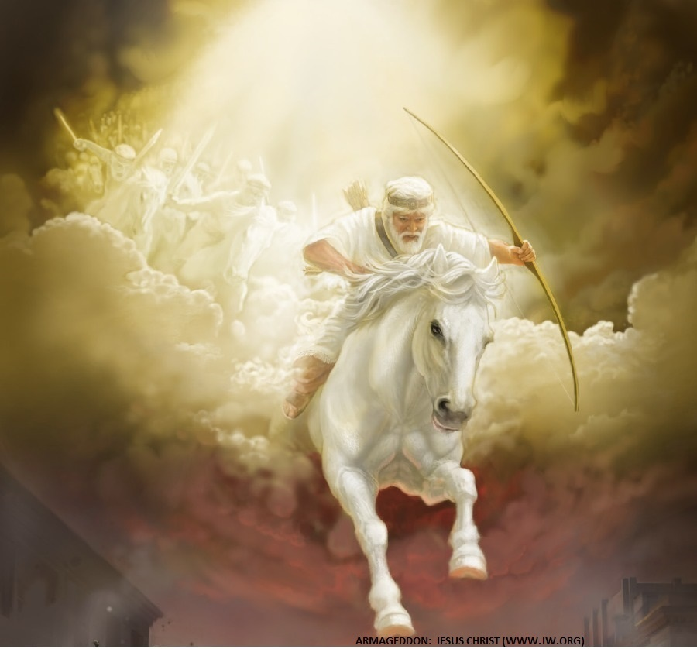
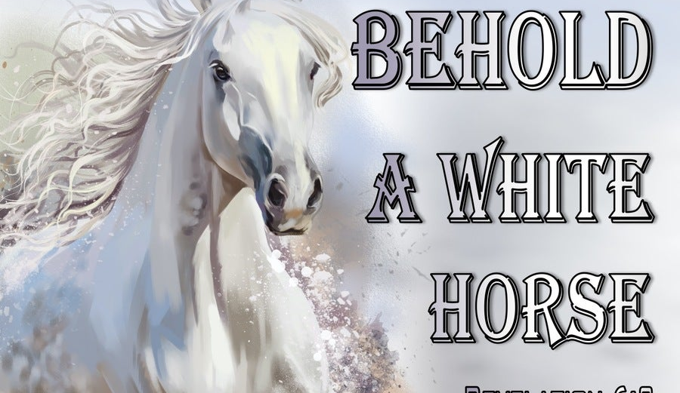
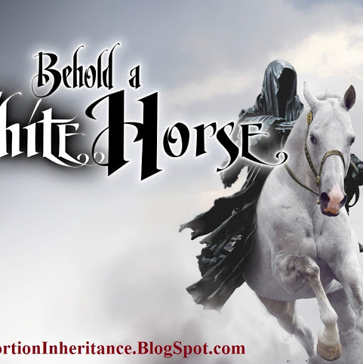
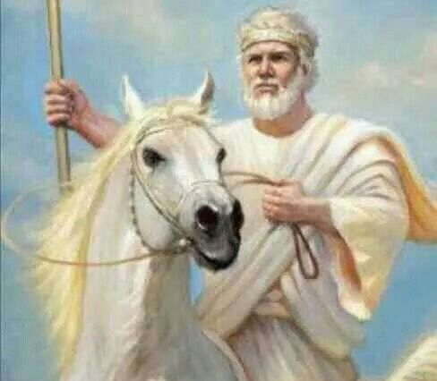
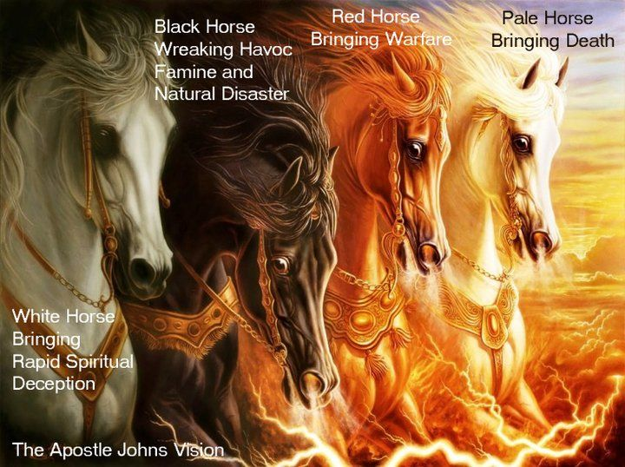
When The Lamb Opens First Seal,
…“The Noise Of Thunder” in Heaven
Signals the Approach of a Storm
What Is About To Be Unleashed…
…On This World Is
…Beyond Description.

Slide 6
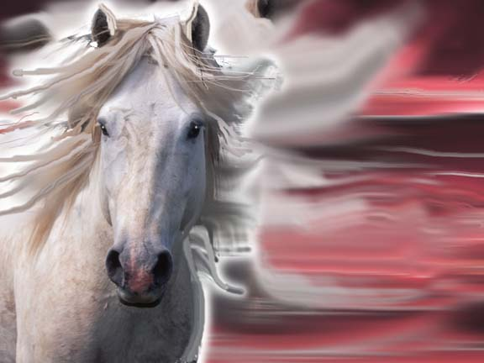
The White Horse of Deception
He’s the…
“Great Counterfeiter”
Does all to Imitate Christ…
…to Deceive the Masses
Jews will Believe He is
…the True Messiah
…Until
Satan Inhabits Him Midway
..of the
…Tribulation Period

Slide 7
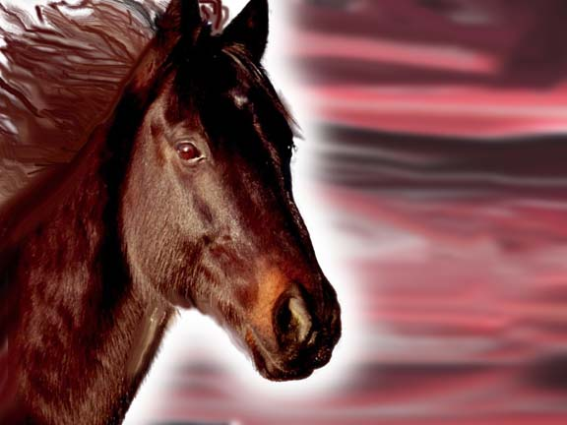
Revelation 6:3-4
2nd Seal
Red Horse
of Destruction
“War”
Notes:
2. Think of the word Division—red horse

Slide 8
Red Horse Of Destruction
Red symbolizes “War”
Speaks of shed Blood/ Fire
In 6000 years of Recorded History:
14,550 wars
2 ½ per year
130+ in 20th century
75 of them since WWII
Notes:
2. Think of the word Division—red horse

Slide 9
Red Horse Of Destruction
The Peace Is Broken
Anti-Christ's Peace is…
…Short lived
War Breaks Out Worldwide
World-Wide Revolt
⁴ And there went out another horse that was red: and power was given to him that sat thereon to take peace from the earth, and that they should kill one another: and there was given unto him a great sword. (6:4)
Notes:
2. Think of the word Division—red horse

Slide 10
Red Horse Of Destruction
The Planet Is Brutalized
“Great”
–refers to the extent
In every aspect that we can comprehend
“Sword”
–refers to short sword
…used in
Assassinations
The World is…
…Ripe for War
Notes:
2. Think of the word Division—red horse

Slide 11
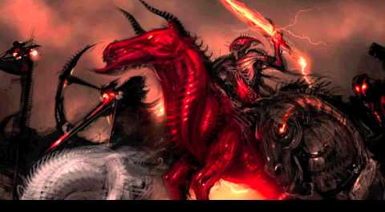
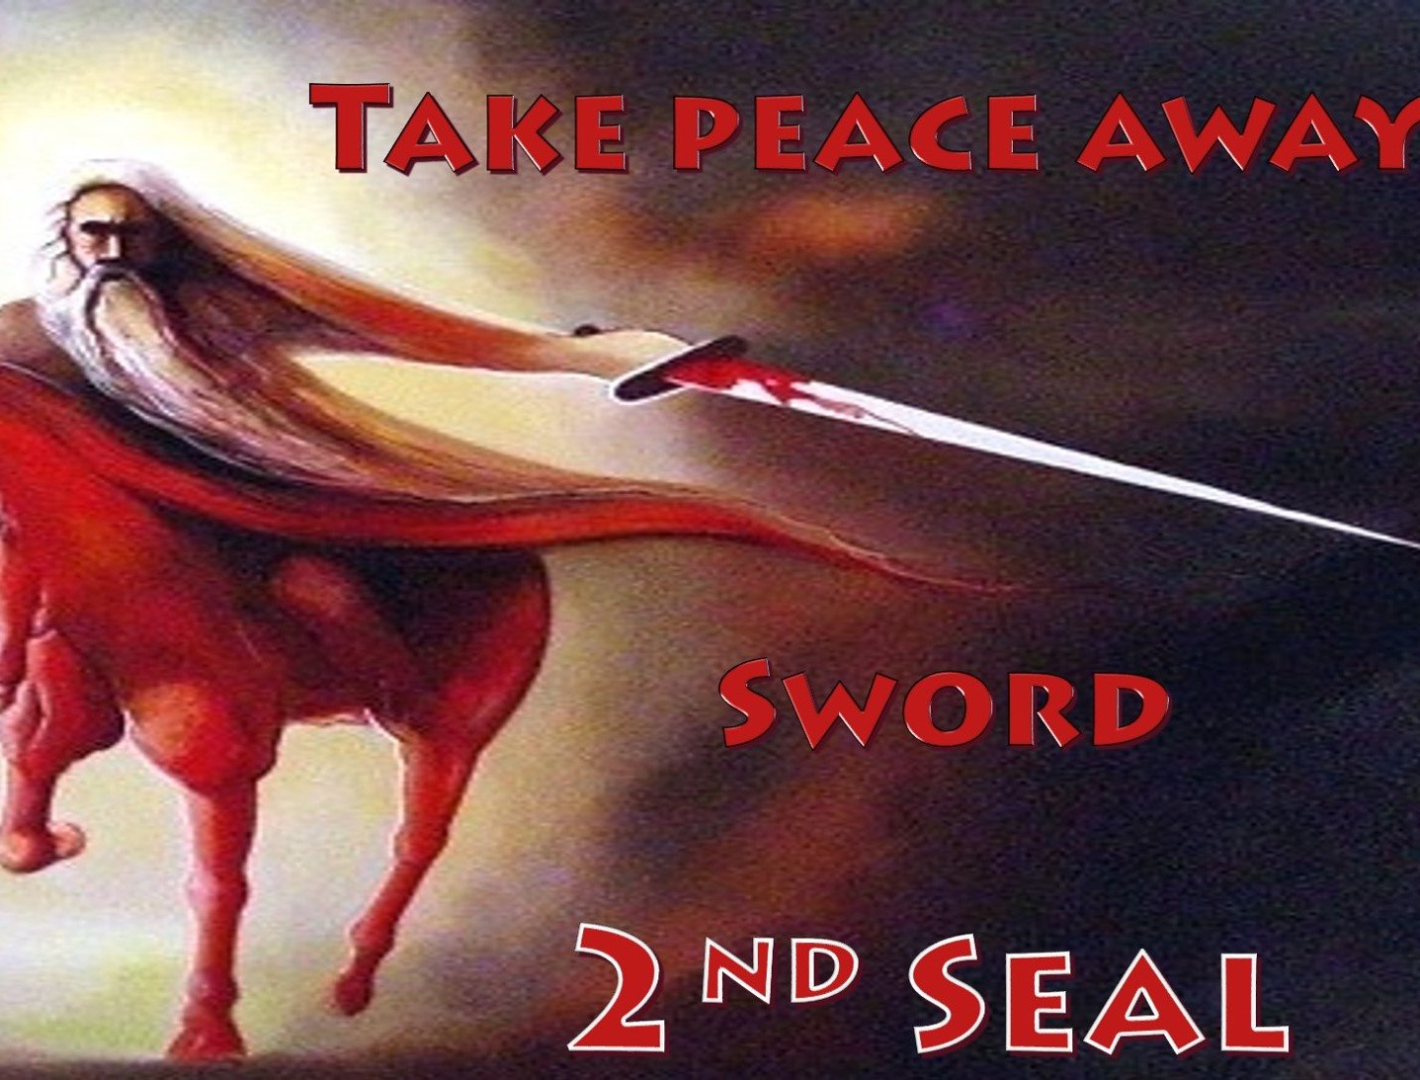
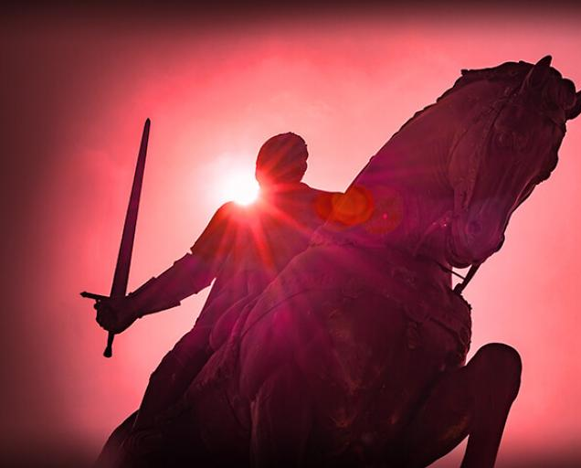
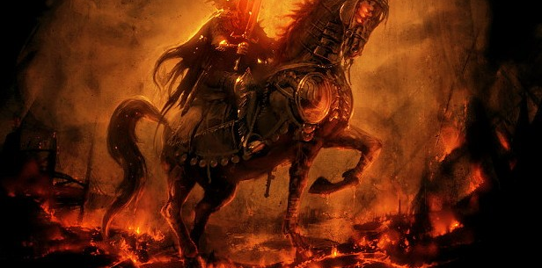
All Hell is about to
Break Loose!
You Don’t Have to…
…Experience What’s Coming
“Today is the Day of Salvation”

