Slide 2
“Storms of Life” Out of Nowhere
Job 1-2
Part 2
Edward Church
Sept. 12, 2021

Slide 3
Three Great Trials in Bible
First, the Trial of Christ
Started in Gethsemane…
…ended on the Cross
Second, the Trial of Abraham
Offer up Isaac on Mount Moriah
Third, the Trial of Job
Who was delivered into the hand of Satan

Slide 4
“Out of Nowhere”
Trials…
…Troubles,
…Problems,
…Persecution,
…Powerful Pain
…Came to Job

Slide 5
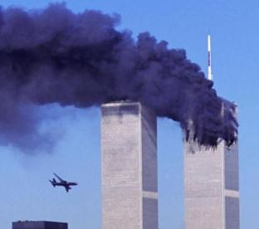
Out of Nowhere
Since 2020
Life has Come At Us
Out of Nowhere
Covid 19
Calamity
Catastrophes
Forecast…
More to Come

Slide 6
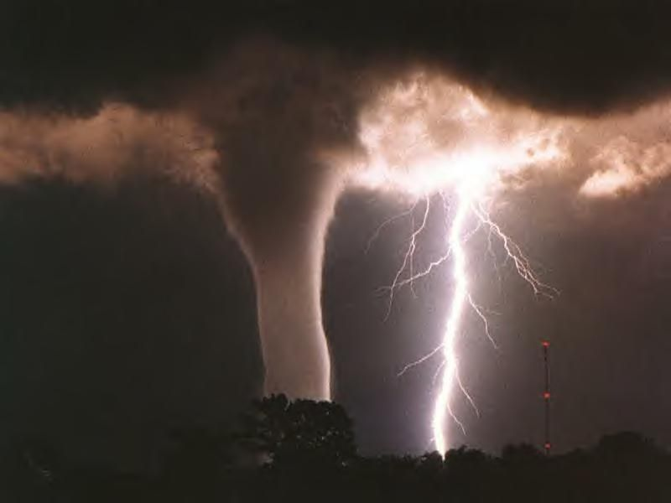
Discoveries From Chapter 1
Ruler of the Storm -God (Job 1:6-19; 2:7-8)
Reason for the Storm -Satan (Job 1:6-11; 2:1-5)
Reach of the Storm –All Possessed
Reaction in the Storm -Praise (Job 1:20-22)

Slide 7
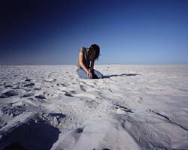
The Reaction in the Storm (Job 1:20-22)
Choice: Grow Bitter or Better
Arose - establish, stand again
Rent Mantle + Shave Head –outward sign
of mourning
Fell Down - overthrow, overwhelm, die
Worshipped - fall down, humble reverence
Recognized - God’s Sovereignty (21-22)

Slide 8
The Reaction in the Storm (Job 1:20-22)
Job 1:21-22 ²¹ And said, Naked came I out of my mother's womb, and naked shall I return thither: the LORD gave, and the LORD hath taken away; blessed be the name of the LORD. ²² In all this Job sinned not, nor charged God foolishly.
God is…
…Sovereign
…Source

Slide 9
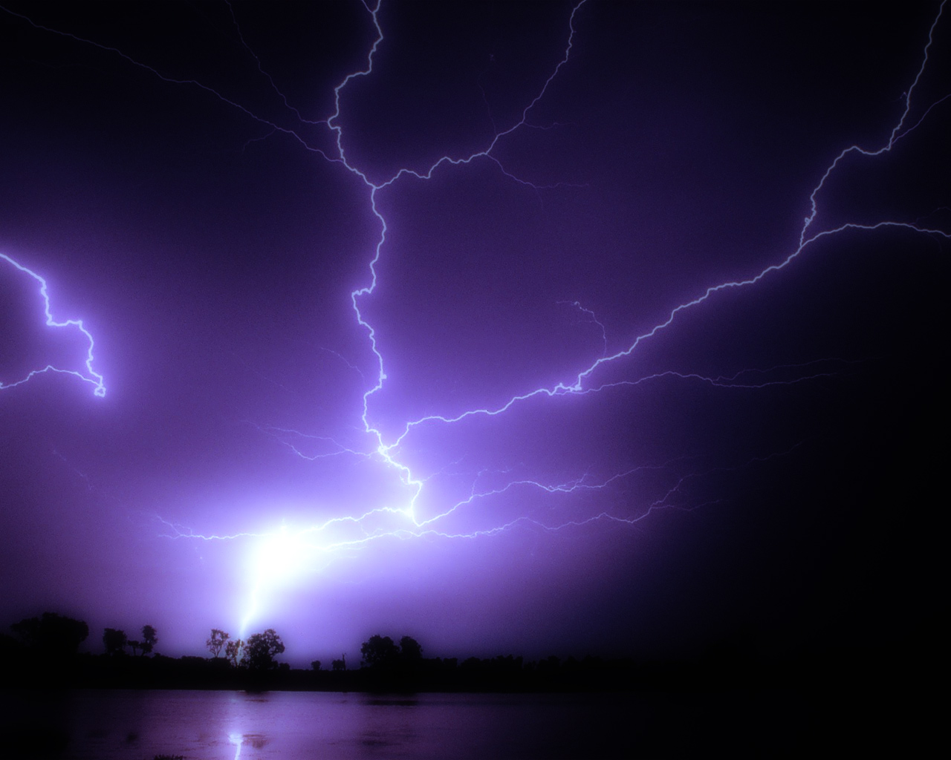
Just When You Thought…
…It Can’t Get Any Worse
It Got Worse!

Slide 10
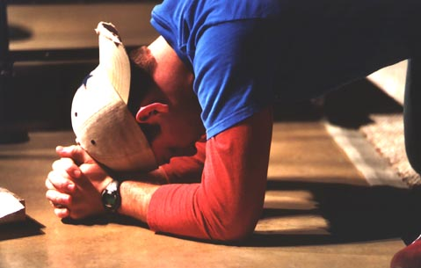
The Timing (Job 2:1)
Turn for the Worse Came at Time of…
Restlessness
Readjustment
Rebuilding

Slide 11
The Turn (Job 2:3)
Job’s Whole World was About to…
…Crumble Again

Slide 12
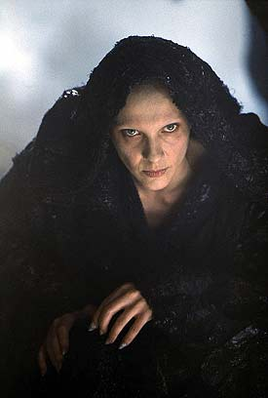
A Turn for the Worse … (Job 2:1-7)
Because
Satan is Continuously on the Prowl (1-2)
Searching Ways to…
Intrude in Your Life (4a)
Weaken Your Trust in God (4b)
Ultimately Destroy You (3)

Slide 13
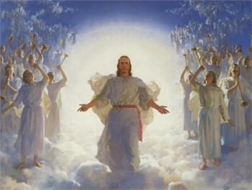
A Turn for the Worse … (Job 2:1-7)
But
God is Continuously in Control (3, 6)
Satan Still Has to Answer to Him (4a)
He Still Sets Limits on Satan (6)
He Will Not Allow Him to Destroy You (6b)

Slide 14
Storms…
Are Sovereignly Designed for My Benefit.
Promotes an Environment for Spiritual Growth.
Helps Me to Refocus My Attention Toward God.
Draw Me Into a Personal Relationship With Christ.

Slide 15
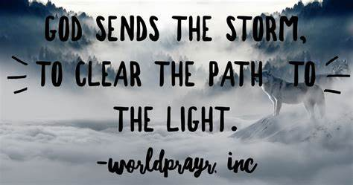
2 Corinthians 4:17 (AMP) ¹⁷ For our light, momentary affliction (this slight distress of the passing hour) is ever more and more abundantly preparing and producing and achieving for us an everlasting weight of glory [beyond all measure, excessively surpassing all comparisons and all calculations, a vast and transcendent glory and blessedness never to cease!]

Slide 18
Season of Storms:
Storms
Starting Point
Source…
…Singular
Manageable
Stopping Point
Season of Storms
Starting Point
Source…
…Multiple
Out of Control
No End in Sight

Slide 19
The Hedge (Job 1:10)
2 Corinthians 12:6-10
My Grace
Sufficient
Strength
Made Perfect
Weakness

Slide 20
The Reaction in the Storm (Job 1:20-22)
Choice: Grow bitter or better
Arose - establish, stand again
Rent Mantle + Shave Head –outward sign
of mourning
Fell down - overthrow, overwhelm, die
Worshipped - fall down, humble reverence
Recognized - God’s Sovereignty (21-22)

Slide 21
The Reaction in the Storm (Job 1:20-22)
Job 1:21-22 ²¹ And said, Naked came I out of my mother's womb, and naked shall I return thither: the LORD gave, and the LORD hath taken away; blessed be the name of the LORD. ²² In all this Job sinned not, nor charged God foolishly.
God is…
…Sovereign
…Source

