Slide 2
September 26, 2021
Edward Church
Revelation (6:7-8) pt.5
“ Pale Horse”

Slide 3
Revelation 6:7-8 (KJV) ⁷ And when he had opened the fourth seal, I heard the voice of the fourth beast say, Come and see. ⁸ And I looked, and behold a pale horse: and his name that sat on him was Death, and Hell followed with him. And power was given unto them over the fourth part of the earth, to kill with sword, and with hunger, and with death, and with the beasts of the earth.

Slide 4
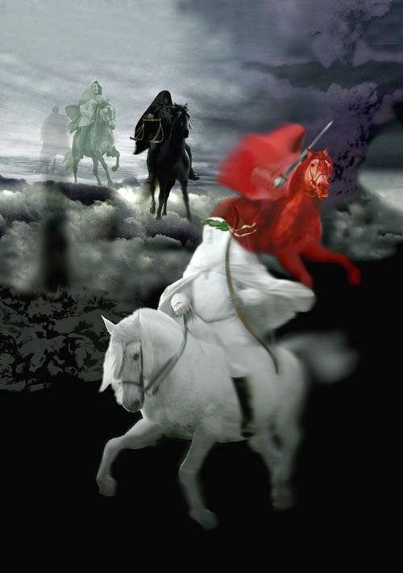
Jesus breaks the seven seals on the book one by one.
As the seals are opened, a series of Divine Judgments are poured out upon the earth and those who dwell on the earth.
The four seals describe events that will take place during the…
…First 21 months of Tribulation.

Slide 5
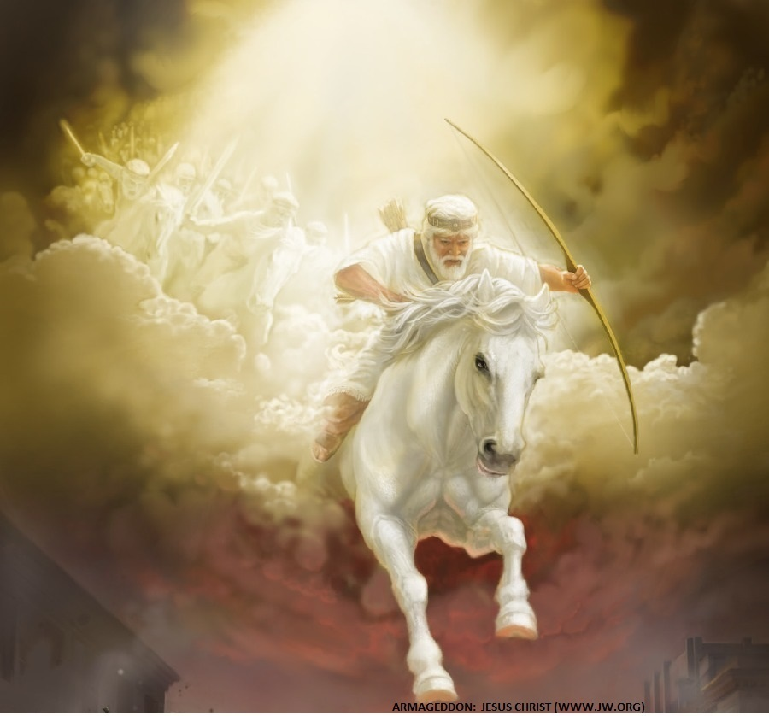
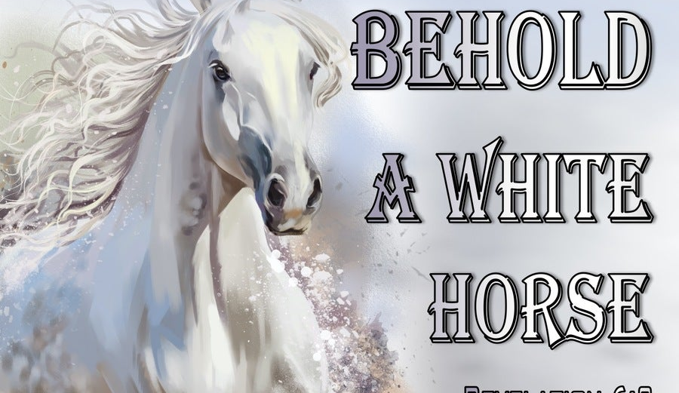
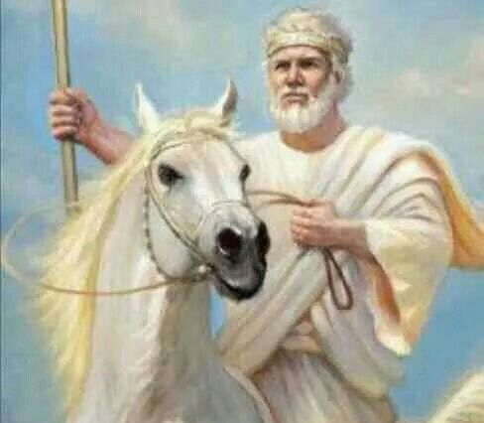
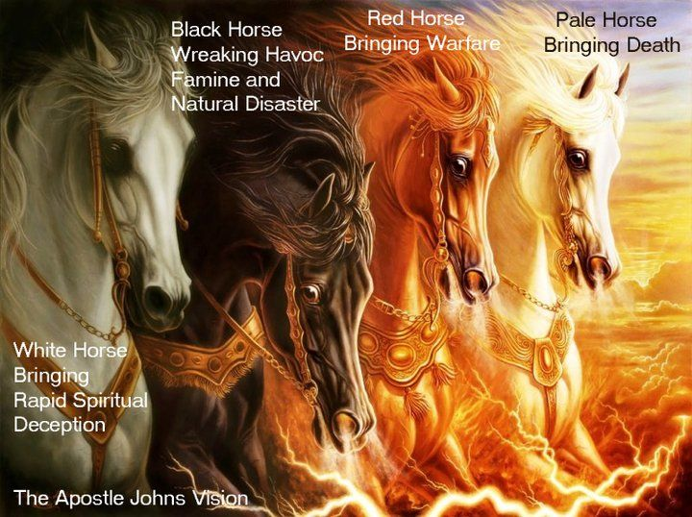
When The Lamb Opens First Seal,
…“The Noise Of Thunder” in Heaven
Signals the Approach of a Storm
What Is About To Be Unleashed…
…On This World Is
…Beyond Description.

Slide 6
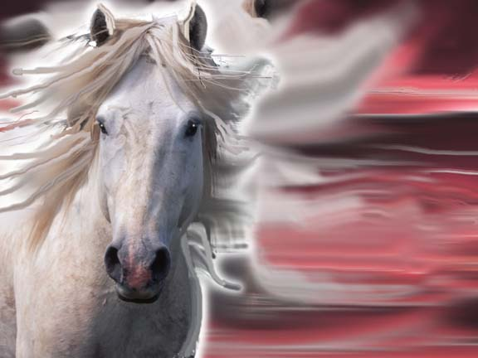
The White Horse of Deception
He’s the…
“Great Counterfeiter”
Does all to Imitate Christ…
…to Deceive the Masses
Jews will Believe He is
…the True Messiah
…Until
Satan Inhabits Him Midway
..of the
…Tribulation Period

Slide 7
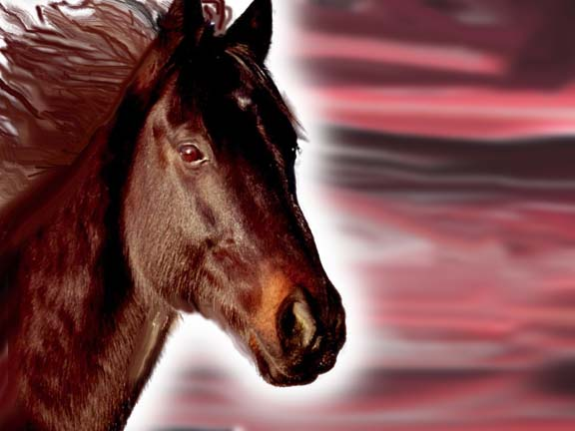
Revelation 6:3-4
2nd Seal
Red Horse
of Destruction
“War”
Notes:
2. Think of the word Division—red horse

Slide 8
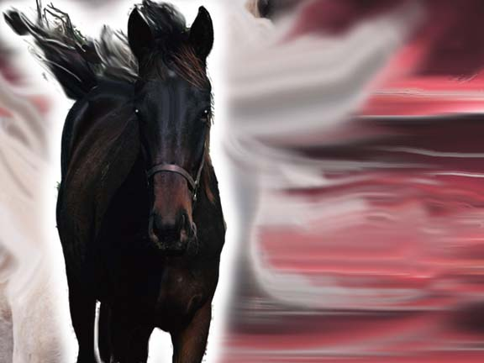
Revelation 6:5-6
3rd Seal
Black Horse Of Destitution
War and Famine
are
Evil Companions
Notes:
3. Depravation…as the black horse rides by. Then click again at “Balances” to add scales pic.

Slide 9
Black Horse Of Destitution
Marked by Shortages
Set of Scales = Rations
Indicates Tribulation marked by…
…Severe Shortages
So Severe…
…Basic Necessities
…are Rationed
Notes:
3. Depravation…as the black horse rides by. Then click again at “Balances” to add scales pic.

Slide 11
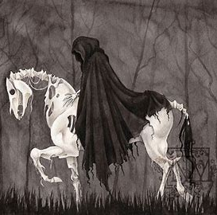
Revelation 6:7-8
4th Seal
Pale Horse
of
Devastation

Slide 12
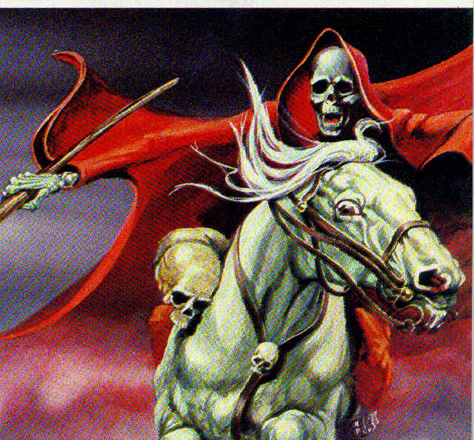
Pale Horse= Devastation
Breadth of Devastation
Pale (sick yellow-green of corpse)
Death (death of the Body)
Hell follows (death of the Spirit)
Death will claim ¼ of the population
One out of Four People…
…Will Die

Slide 13
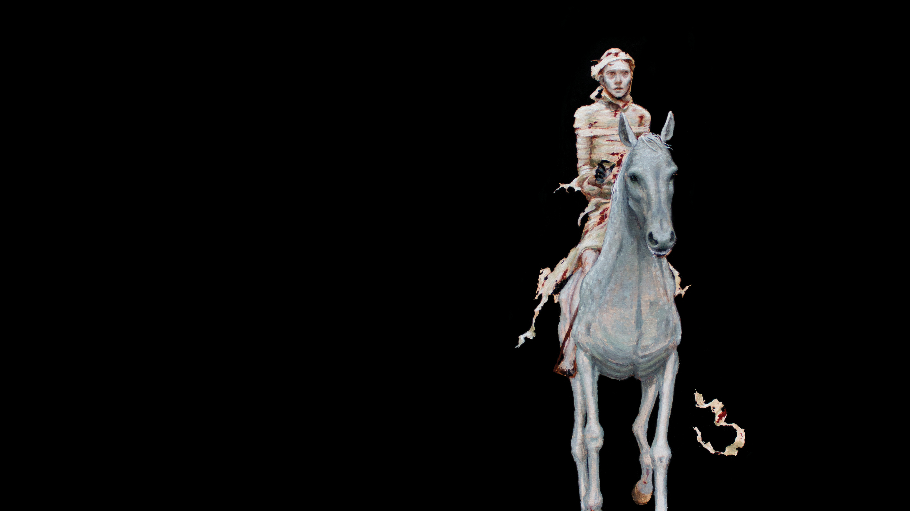
Pale Horse= Devastation
Brutality of Devastation
Sword – warfare
Famine –starvation
Death –
apart from
warfare and famine
Pestilence
(epidemic)
Beasts –
“Small Animals- Rodents”

Slide 14
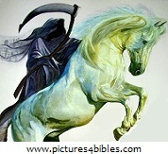
With all the warfare, the death /carnage, the rat pop. of this world will explode.
One breeding pair can prod. 5 litters of between 8 and 9 offspring per year.
If 95% of the rat pop. in a given area is destroyed..
…they can replenish their numbers within one year.

Slide 15
Rats are nasty animals.
They carry some 35 diseases.
They were responsible for killing 1/3 of the pop. of Europe during the Middle Ages of
“Bubonic Plague”
Rats carry typhus, which killed nearly 200 million people during 400 yr pd.
Rats destroy $1 billion
in food in the US ea yr.

Slide 16
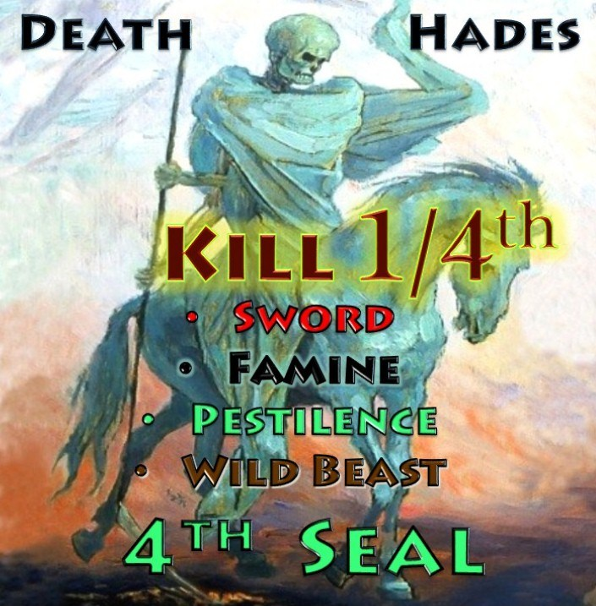
During this Time…
You are Either Found in…
Chapter 4/5
…In Heaven
…with the Saints
or
Chapter 6
…In Hell on Earth
So far Covid has claimed
3.4 % of the worlds pop
That is terrible
Makes it the worse
But nothing compared to White Horse

Slide 17
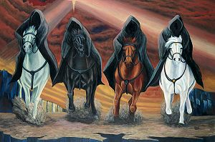
Matthew 24:3-8
Depicts the…
“Four Horsemen”
“White Horse” (5)
“Red Horse” (6)
“Black Horse” (7a)
“Pale Horse” (7b)
He Warns…
….Just the Beginning (8)

