Slide 2
“Storms of Life” Out of Nowhere
Job 1-2
Part 3
Edward Church
October 3, 2021

Slide 3
“Out of Nowhere”
Trials…
…Troubles,
…Problems,
…Persecution,
…Powerful Pain
…Came to Job

Slide 4
Out of Nowhere
Since 2020
Life has Come At Us
Out of Nowhere
Covid 19
Calamity
Catastrophes
Forecast…
More to Come

Slide 5
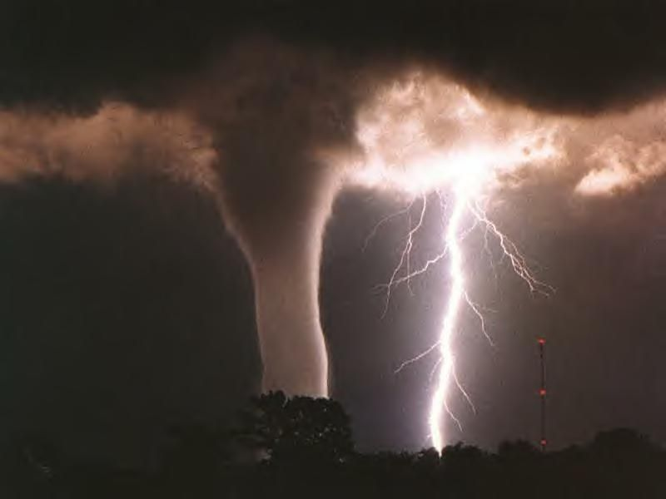
Discoveries From Chapter 1
Ruler of the Storm -God (Job 1:6-19; 2:7-8)
Reason for the Storm -Satan (Job 1:6-11; 2:1-5)
Reach of the Storm –All Possessed
Reaction in the Storm -Praise (Job 1:20-22)

Slide 6
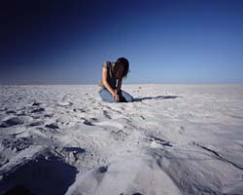
The Reaction in the Storm (Job 1:20-22)
Job 1:21-22 ²¹ And said, Naked came I out of my mother's womb, and naked shall I return thither: the LORD gave, and the LORD hath taken away; blessed be the name of the LORD. ²² In all this Job sinned not, nor charged God foolishly.
God is…
…Sovereign
…Source

Slide 7
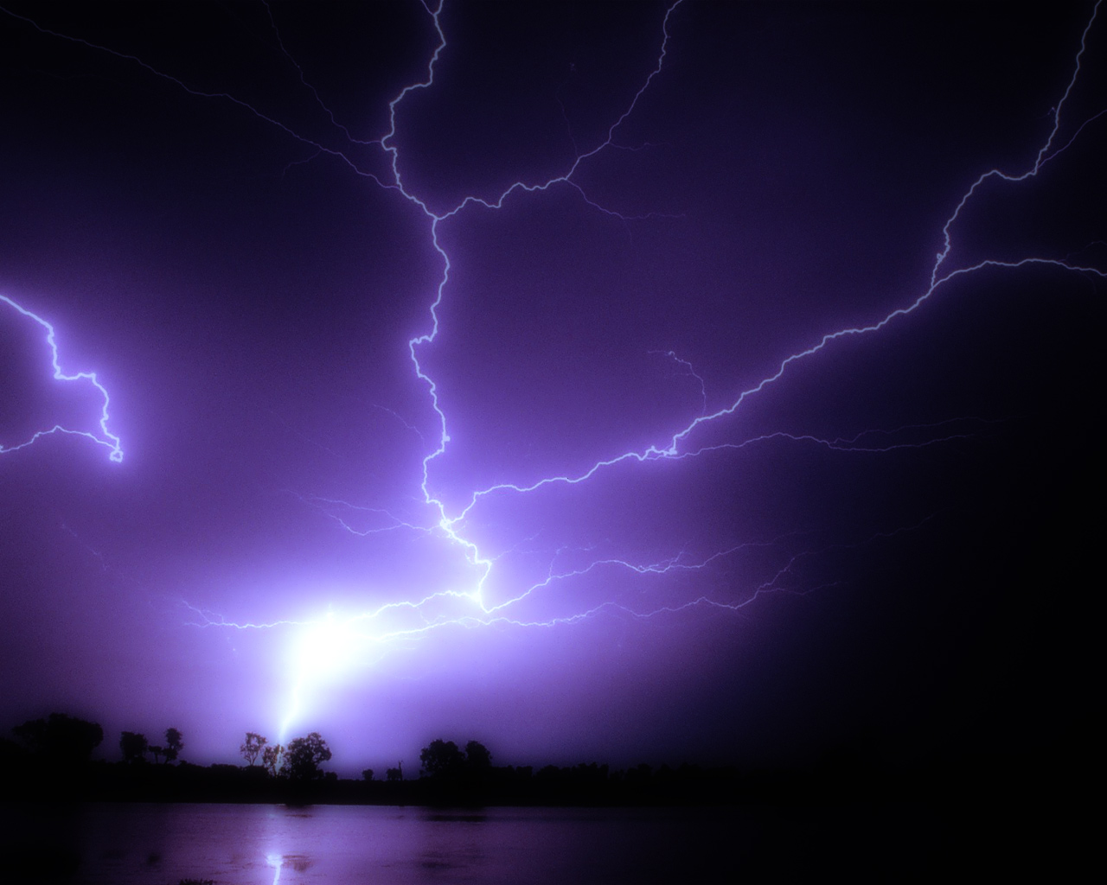
Just When You Thought…
…It Can’t Get Any Worse
It Got Worse!

Slide 8
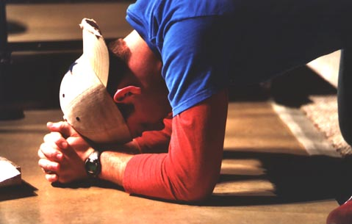
The Timing (Job 2:1)
Turn for the Worse Came at Time of…
Restlessness
Readjustment
Rebuilding

Slide 9
The Turn (Job 2:3)
Job’s Whole World was About to…
…Crumble Again

Slide 10
The Reach of the Storm:
Satan Can’t Stand Or Tolerate a
God-Attitude
In Trial
1st Attack Lead to…
Financial Crisis
Employment Crisis
Family Crisis
2nd Attack Lead to…
Physical Crisis
Relational Crisis
Don’t Expect Him to
Accept Defeat

Slide 11
Satan’s Touch
Boils (2:7)
Itching (2:8)
Drastic Change in Appearance (2:12)
Difficulty Eating (3:24)
Mental Depression (3:25)
Worms and Running Sores (7:5)

Slide 12
Satan’s Touch
Shortness of Breath (9:18)
Darkness of Eyes (16:16)
Odorous Breath (19:17)
Loss of Weight (19:20)
Corroding of Bones / Gnawing Pain (30:17)
Blackened Skin / Fever (30:30)

Slide 13
The Testimony
Choice…
Grow Bitter or Better
Job
…Grew Better
His Wife
…Grew Bitter

Slide 14
The Testimony (Job 2:9-10)
⁹ Then said his wife unto him, Dost thou still retain thine integrity? curse God, and die.
¹⁰ But he said unto her, Thou speakest as one of the foolish women speaketh.
What? shall we receive good at the hand of God, and shall we not receive evil?
In all this did not Job sin with his lips.

Slide 15
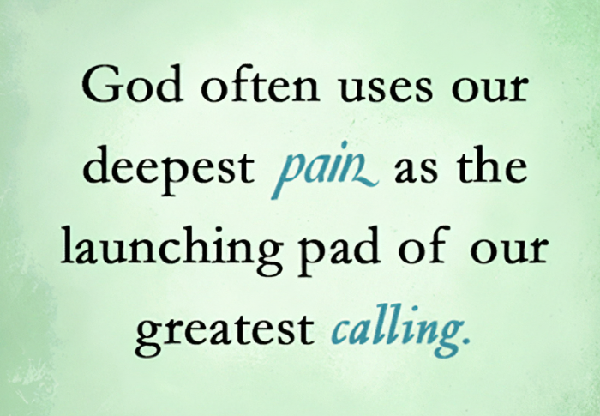
Storms…
Are Sovereignly Designed for My Benefit.
Promotes an Environment for Spiritual Growth.
Helps Me to Refocus My Attention Toward God.
Confirms Me Into the Image of Christ.

Slide 16
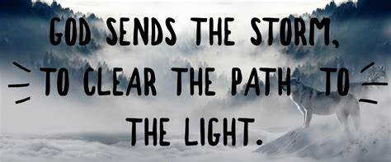

Slide 17
2 Corinthians 4:7-10
⁷ But we have this treasure in earthen vessels, that the Excellency of the power may be of God, and not of us. ⁸ We are troubled on every side, yet not distressed; we are perplexed, but not in despair; ⁹ Persecuted, but not forsaken; cast down, but not destroyed; ¹⁰ Always bearing about in the body the dying of the Lord Jesus, that the life also of Jesus might be made manifest in our body.

