Slide 1
October 17, 2021
Edward Church
Revelation (6:9-11) pt.7
“ Martyrs”

Slide 2
Revelation 6:9-17 (KJV)
⁹ And when he had opened the fifth seal, I saw under the altar the souls of them that were slain for the word of God, and for the testimony which they held: ¹⁰ And they cried with a loud voice, saying, How long, O Lord, holy and true, dost thou not judge and avenge our blood on them that dwell on the earth? ¹¹ And white robes were given unto every one of them; and it was said unto them, that they should rest yet for a little season, until their fellow servants also and their brethren, that should be killed as they were, should be fulfilled.

Slide 3
Revelation 20:4 And I saw thrones, and they sat upon them, and judgment was given unto them: and I saw the souls of them that were beheaded for the witness of Jesus, and for the word of God, and which had not worshipped the beast, neither his image, neither had received his mark upon their foreheads, or in their hands; and they lived and reigned with Christ a thousand years.

Slide 4
Matthew 24:3-8
(8) Jesus Warns this is Just the Beginning
(9) Shows the Results of…
…the Fury of the Four Seals
…Unleashed Upon the Earth
The Tense Scene Now Shifts from…
…Events on Earth
to
…Events in Heaven

Slide 5
Revelation 6:9
Here a Picture of…
The Tribulation Saints
It shows us:
Promise
People Will Be Saved…
…During the Tribulation
Price
Martyrdom

Slide 6
Revelation 6:9
Position (9)
It was a place of:
Sacrifice
slain (to butcher, or slaughter)
“for the word of God…”
“for the testimony they held..”

Slide 7
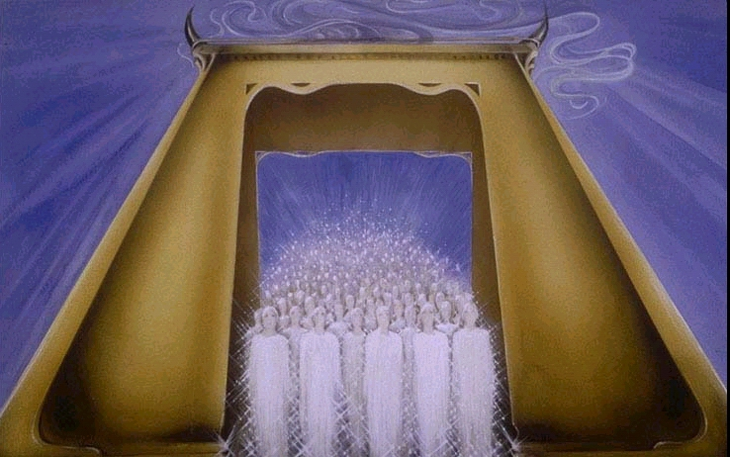
Position (9)
it was a place of…
Safety
in Heaven
under Altar

Slide 8
Revelation 6:10
Their Plea (10)
Urgent Prayer
Cried(strong emotions)
How Long Til You Judge?
Judge(for injustice against God)

Slide 9
Revelation 6:10
Their Plea (10)
Old Testament Prayer
Age of Grace Over
Acts 7:60, “lay not …charge..”
How Long Til Avenge?
Avenge(injustice against them)

Slide 10
Revelation 6:11
Their Pleasure (11)
Covering
White Robes
white = righteousness
Given (minister)
traded for Pain
Everyone (none left out)

Slide 11
Revelation 6:11
Their Pleasure (11)
Their Comfort
Rest Awhile
Struggles are over
Little Season
Their reward is soon
Satan’s punishment is soon!

Slide 12
Revelation 6:11
Their Pleasure (11)
Their Consolation
“yet a little while”
Fellowservants
Same Work
Brethren
Same Family
Killed
Same Fate

Slide 13
Revelation 6:11
They Were Faithful…
…Unto Death
…God Gave Them
Refuge
Rest
Robes

Slide 14
Remember a Life Lesson Bethany Talked About All of the Time…
“God’s Got This”
And
“Either Way We Win!”

