Slide 2
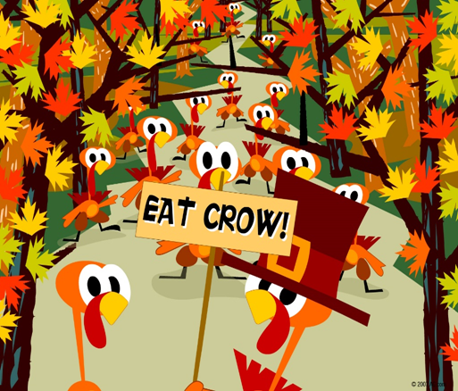
Thanksgiving Commands
Edward Christian Church
November 21, 2021
Psalm 100

Slide 3

Ever Feel Stuck?
Depressed Saddened Hopeless…
…No Way Out!
The Pilgrims Could Have Feft That Way
104 Passengers…
  Ship as Big as Volleyball Court
  2 Died on the Trip
  45 Died the 1st Winter
  A Grave was Opened Every 3 Days for 4 mths
  Graves were Hid in Sand from Indians
  No Formal Funerals
Yet They Rejoiced in the Lord !!!

Slide 4
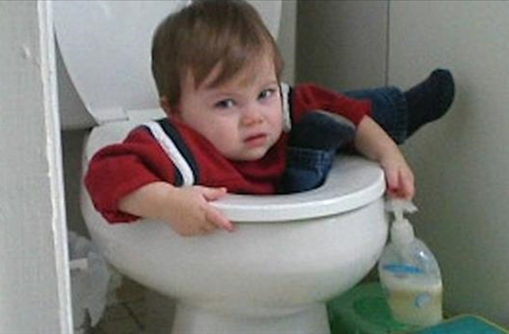
Ever Feel Stuck?
Depressed Saddened Hopeless…
…No Way Out!
The Pilgrims Could Have Feft That Way
Yet Rejoiced in the Lord !!!
Good News!!!!
We Also Can Find Relief and Release
This Psalm Guides Us Thru this Process

Slide 5
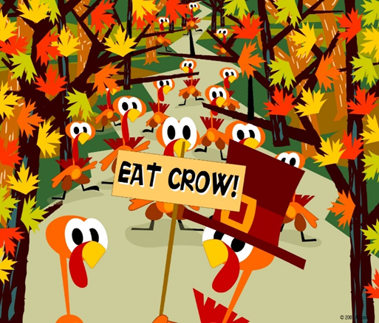
Thanksgiving Commands
¹ Shout joyfully to the LORD, all the earth. ² Serve the LORD with gladness; Come before Him with joyful singing. ³ Know that the LORD Himself is God; It is He who has made us, and not we ourselves; We are His people and the sheep of His pasture. ⁴ Enter His gates with thanksgiving, And His courts with praise. Give thanks to Him; bless His name. ⁵ For the LORD is good; His loving kindness is everlasting, And His faithfulness to all generations. -Psa 100:1-5 (NASB)
Condensed into 5 Commands

Slide 6
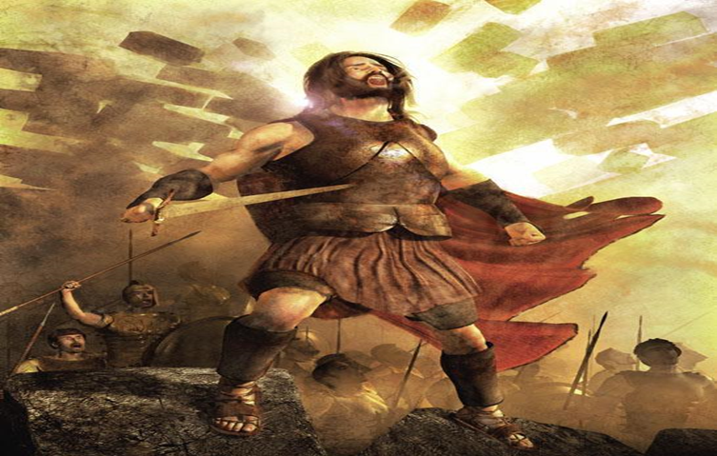
Shout
Make a joyful noise to the LORD, all the earth!
Josh 6:10 NLT
"Do not shout; do not even talk," Joshua commanded. "Not a single word from any of you until I tell you to shout. Then shout!“
  Respond to Very Presence/ Power of God.
  The Voice of Defeat in Your Head is Loud!
  Solution…Get Louder!!!!

Slide 7

Serve
Serve the LORD with gladness!
  Serve =work
    bond-service
    worship

Slide 8
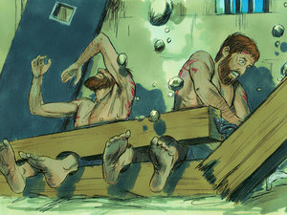
Sing
Come into his presence with singing!
Sing- to creak i.e. to shout (usually for joy)
sing (aloud, for joy, out), triumph.
Singing…
  Builds Faith
  Lifts Mood
  Attracts God
  Acts 16:25, “But at midnight Paul and Silas were praying and singing hymns to God, and the prisoners were listening to them”

Slide 9
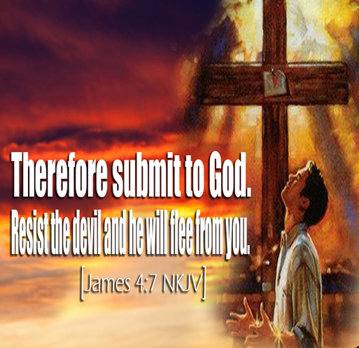
Submit
Know that the LORD, he is God! It is he who made us, and we are his; we are his people, and the sheep of his pasture.
Know =to know, be sure, understand
  kinsman
  have respect
  skillfully teach
Submit(applicable)= trust enough to give control

Slide 10
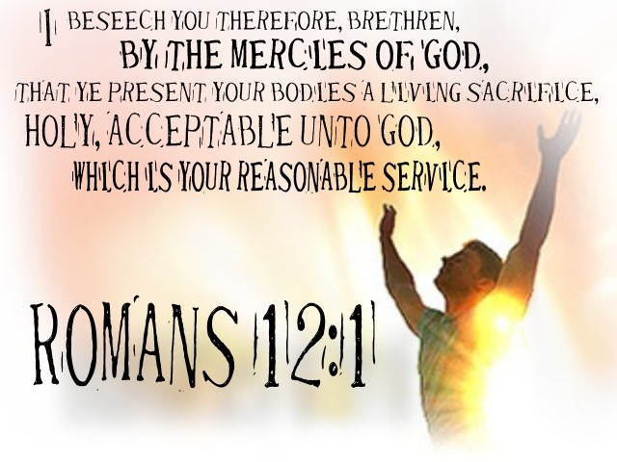
Sacrifice
Enter his gates with thanksgiving, and his courts with praise! Give thanks to him; bless his name!
  Praise =Halal – clear loud boast; celebrate
  Thanksgiving = extension of the hand,
    adoration; a choir of worshippers
    confession,
    (sacrifice of) praise

Slide 11

¹ Shout with joy to the Lord, all the earth!
² Worship the Lord with gladness. Come before him, singing with joy. ³ Acknowledge that the Lord is God! He made us, and we are his.We are his people, the sheep of his pasture. ⁴ Enter his gates with thanksgiving; go into his courts with praise. Give thanks to him and praise his name.
⁵ For the Lord is good. His unfailing love continues forever, and his faithfulness continues to each generation.

