Slide 4
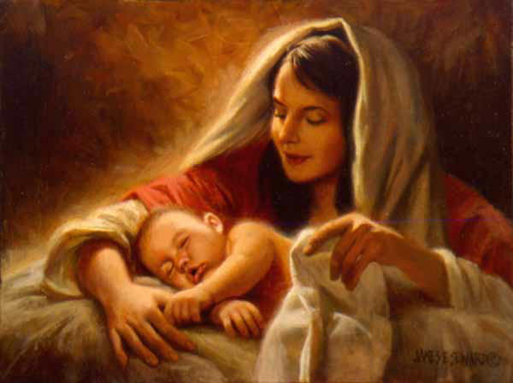
Christmas Outside the Box Christmas 2021
Edward Christian Church
December 19, 2021
Grace Gifts
Gifts that Keeps on Giving
John 3:16

Slide 5
COVID Christmas
COVID has Affected
Assets
Attitudes
Actions
Black Friday was Once Known for
Deals
Destitute
We Hear the New Covid Term
“New Normal”
Means= “No More Normal”

Slide 6
Christmas Out of the Box
No Other Story in the Bible speaks with such
Clarity about the Power
and the Purpose of God
God Stepped Out of Eternity Into Time
John 1:14 ¹⁴ And the Word was made flesh, and dwelt among us, (and we beheld his glory, the glory as of the only begotten of the Father) full of grace and truth.
The Manger was a Picture of Grace

Slide 7
Grace = Undeserved Favor
John 3:16
We Receive Grace from God
Our Response Should Be…
Gratitude to God
Grace Given to Others

Slide 8
Unnecessary COVID Stress
Has Caused…
Lost Meaning of Christmas
Littered Families
Lack of Money

Slide 9
Unnecessary COVID Stress
How Many Have Money to Burn this Year?
Sometimes the Lack of Money/ Time (inability) to Do All Would Like to Do
Causes Us to...
Hide (passive)
Scrooge (aggressive)
What Ever (defeated -depressed -debt)

Slide 10
Grace Gifts
The Economy has had an Impact on…
…Christmas / Gift Giving
But it has NO EFFECT on the…
…Meaning of Christmas or the Best Gifts
Grace Gifts
Affordable
Available
Have Voice
Echoes

Slide 11
Grace Gifts Have a Loud Voice
They Speak to the Needs of Man…
Survival -I want to live and be healthy
Security –I want my needs met
Social –I want to be loved
Significance –I want to be heard (life to count)
Success –Growth –I want to keep growing
Other Gifts Come and Go…Fade Away
Grace Gifts Have Great Impact…Loud

Slide 12
G. R. A. C. E. Gifts
G- Godly Reach
Prayer
Pray for your loved ones/ let them know you do
Eph 6:18 - Praying always with all prayer and
supplication in the Spirit, and watching thereunto w- all perseverance and supplication for all
saints;
Forgiveness
Matt 6:14-15, “For if ye forgive men their
trespasses, your heavenly Father will also forgive
you”

Slide 13
G. R. A. C. E. Gifts
R- Reach “Personal”
Favor
Help with the Dishes, Run an Errand, Babysit
Romans 15:1(KJV) -We then that are strong
ought to bear the infirmities of the weak,
and not to please ourselves.

Slide 14
G. R. A. C. E. Gifts
R- Reach “Personal”
Time
Offer to play your loved one’s favorite game
Sit and Talk…not Preach!
Hebrews 13:16 (KJV) But to do good and to
communicate forget not: for with such sacrifices God is well pleased.
Leaving Alone… There are times in our lives when we want nothing better than to be left alone. Become more sensitive to those times and give solitude.

Slide 15
G. R. A. C. E. Gifts
A- Affection
Affection… Be generous with your hugs/ Handshakes/ Signs
Tiny actions demonstrate the love inside
Romans 12:10 (Phillips NT) ¹⁰ Let us have real warm affection for one another as between brothers, and a willingness to let the other man have the credit.

Slide 16
G. R. A. C. E. Gifts
C- Communication
Listening…
Try giving this to someone in need.
Really listen.
No interrupting, planning responses.
Just listen.
James 1:19(NIV)¹⁹ My dear brothers and sisters, take note of this: Everyone should be quick to listen, slow to speak and slow to become angry

Slide 17
G. R. A. C. E. Gifts
E- Encouragement
Edify… A simple “Good Job” or “Good supper” can be
of greatest value to those who may feel they are
being taken for granted.
GOD'S WORD Prov 25:11[Like] golden apples in
silver settings, [so] is a word spoken at the
right time.
Laughter/ Cheerfulness
Prov 17:22, a Merry heart doeth good like a
medicine: a broken spirit drieth up the bones

Slide 18
Grace Gifts Have a Loud Voice
These Gifts Are…
Personal
Powerful
Plentiful
1 Thessalonians 5:11 (KJV) Wherefore comfort yourselves together,/
edify one another, even as also ye do.

Slide 19
Things are Hard…
But the Question to Ask…
W W J D
You Can Believe…
It Would Involve Grace

