Slide 1
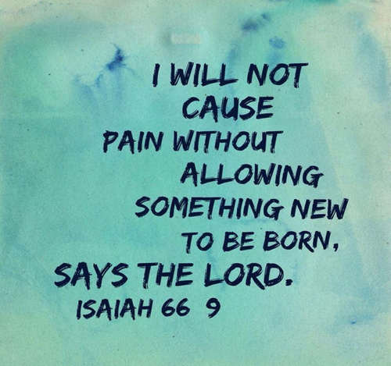
Turning Our Pains into Praises -p1
Edward Church
II Cor 12:7-10
March 6, 2022

Slide 2
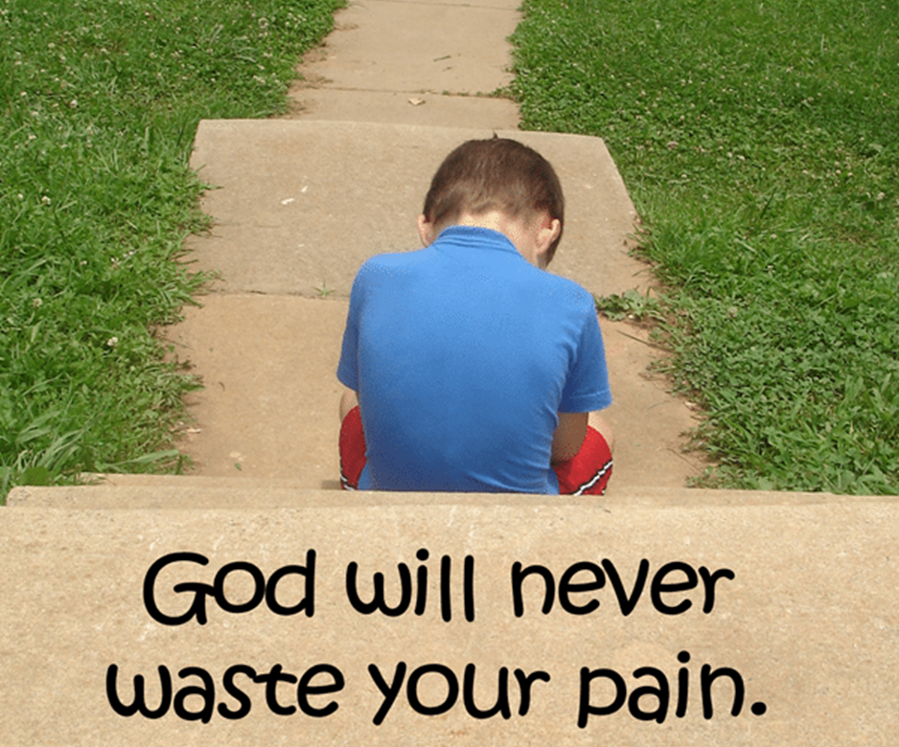
God Never Allows
PAIN
Without a…
Plan
Path
Promise
Romans 8:28 (NLT2)
²⁸ And we know that God causes everything to work together for the good of those who love God and are called according to his purpose for them.

Slide 3

Does It Ever Feel Like the Heartbreak In Your Life Is Trying to Break You?
God Has Been Tenderly Reminding Me that Pain Itself Is Not the Enemy.
Pain Is the Indicator that Brokenness Exists.
Pain is the Reminder That the Real Enemy is Trying to Take Us Out…
…and Bring Us Down By Keeping Us Stuck In Broken Places.
Pain Is the Gift that Motivates Us to Fight W- Tenacity/ Determination
…Knowing There’s Healing On the Other Side.
In the In-between? In that Desperate Place Where We Aren’t Quite On the Other Side of It All Yet, / Our Heart Still Feels Quite Raw?
Pain is the Invitation for God to Move In and…
…Replace Our Faltering Strength with His.

Slide 4
God Promises an Exchange

Slide 5

Paul’s “thorn in the flesh” has had a Lot of Interpretations
“Skolop” = a Pointed Thing.
Something
  of a Bodily Annoyance/ Disability.
  Pain that Bothers us….
  …Physically, Mentally, Emotionally, Spiritually
Paul Prayed that His “Thorn” Be Taken Out.
But God Responded…
“Let the Pain Remain, Paul, it’s Good for You”.

Slide 6

Raise a
Barrier
Shield
Defend
Make More than Enough

Slide 7
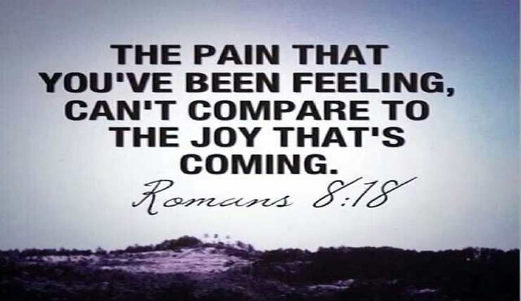
Paul Learned God Can Turn Our Pains Into Praises
We Too Must Allow God to Transform Our “Thorns of Pains”
…Into “Horns of Praises”
There are a Few Steps to Undertake…
…then We Can Open Our Lives And Allow God to Accomplish
…His Work, Transforming Our Pains Into Praises.

