Slide 2
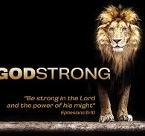
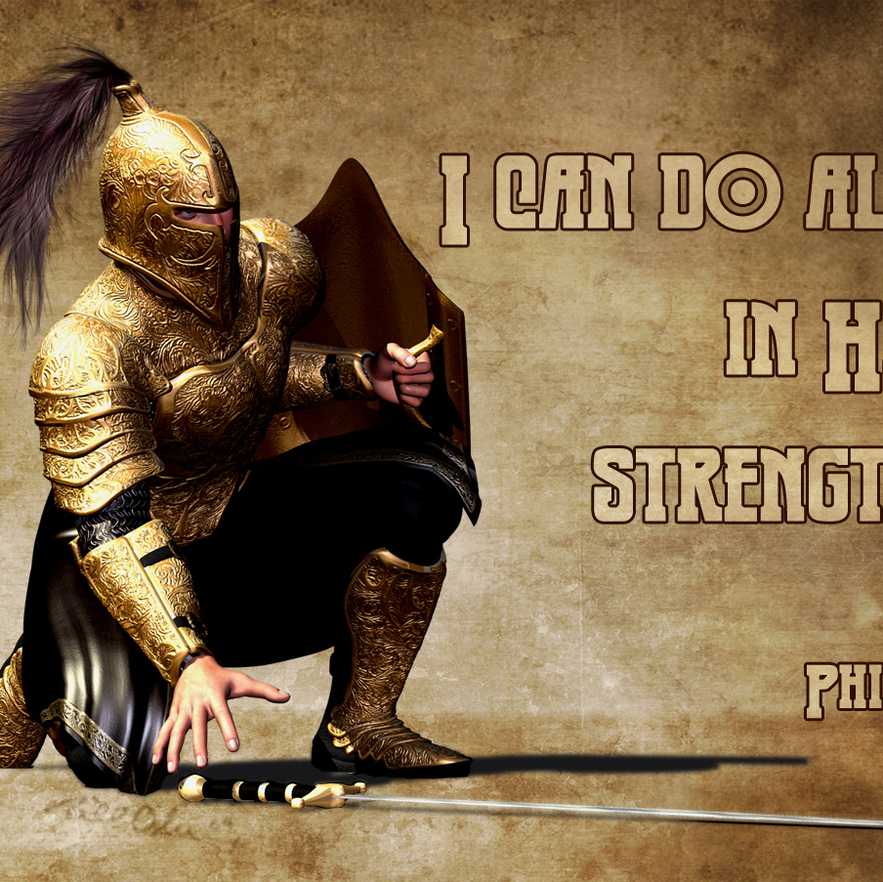
March 20, 2020
Positive
Spiritual
Attitude
Pt1
Joshua 1
Edward Church

Slide 3
Luke 21:26 (AMP) ²⁶ Men swooning away or expiring with fear and dread and apprehension and expectation of the things that are coming on the world; for the [very] powers of the heavens will be shaken and caused to totter.
Luke 21:26 (MSG) ²⁶ in an uproar and everyone all over the world in a panic, the wind knocked out of them by the threat of doom, the powers-that-be quaking.
languish :- cover (over), fail, faint, feebler,
hide self, be overwhelmed, swoon

Slide 4
Overwhelmed
Psalm 61:2 (KJV) From the end of the earth will I cry unto thee, when my heart is overwhelmed: lead me to the rock that is higher than I.
Heart – mind, will, emotions
Overwhelmed – faint, fail, swoon, cover
Lead – to transport, bring, lead
Rock – Solid, Refuge
Higher - to rise above

Slide 5
Joshua
If Ever a Person Was Overwhelmed…
He was Called to…
Take Mose’s Place
…Big Shoes to Fill
Take the Land
…Big Job to Complete
Both Seemed Impossible
…Too Big Without God

Slide 6
Being Overwhelmed Happens in Many Ways
When You Focus on the Past
Sometimes a reminder of a Difficult Past Overwhelms Our Emotions.
You can’t change your past, but you can Change how you Respond to it!
Josh 1:2- Moses my servant is dead; now therefore arise,….
When You Don’t Feel Prepared
Josh 1:2- …arise, go over this Jordan, thou, and all this people…
When You Feel Out of Control
Your Future is Unknown, and Change is Scary, you Feel Out Of Control.
Josh 1:2- …thou, and all this people, unto the land…
When You Have No Explanation
Sometimes there is No Warning or Explanation Leads to Overwhelmed
Overwhelmed speaks false beliefs to us that leave us paralyzed.

Slide 7
Dangers of Being Overwhelmed
Danger of Looking Back (1:2)
“Moses My servant is dead. Now therefore, arise, go over this
Jordan, you and all this people, to the land….”
Moses is Mentioned (6x) in vs 1-9 (57x) Rest of Book
It is very easy to look at what God has done in the Past/ Think...
…I Cannot Move Forward
Danger of Standing Still (1:3)
“Every place that the sole of your foot will tread I have given..”
Fulfilling the Promises of God Requires…
…that we Walk by Faith.

Slide 8
Dangers of Being Overwhelmed
The Danger of Giving Up (1:5) “No man shall be able to stand before you all days of your life; as I was with Moses..will be with you. I will not leave you nor forsake …”
Seems They May Have Given Up, But God Reassured Them.
The Danger of Falling Short (1:6) “Be strong /good courage, for to this people you shall divide as an inheritance the land which I swore to their fathers to give them”
The Inheritance is the Land that God Promised.

Slide 9
Overcoming Being Overwhelmed
Joshua 1:8 (KJV) This book of the law shall not depart out of thy mouth; but thou shalt meditate therein day and night, that thou mayest observe to do according to all that is written therein: for then thou shalt make thy way prosperous, and then thou shalt have good success.
The Power of …
Meditation = to mutter under breath- talk to self
Healthy Self-Talk (builds faith)
Reverse Meditation = Worry
Unhealthy Self-Talk (deteriorates faith)
Learn the Word
Lean on the Word

Slide 10
