Slide 2
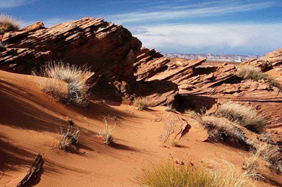
Psalm 84
Edward Christian Church
April 3, 2022
Valley of Baca
Sometimes…
You Have to Go Through…
…To Go Up pt1

Slide 3
Psalm 84:1-7 (KJV) ¹ How amiable are thy tabernacles, O LORD of hosts! ² My soul longeth, yea, even fainteth for the courts of the LORD: my heart and my flesh crieth out for the living God. ³ Yea, the sparrow hath found an house, and the swallow a nest for herself, where she may lay her young, even thine altars, O LORD of hosts, my King, and my God. ⁴ Blessed are they that dwell in thy house: they will be still praising thee. Selah. ⁵ Blessed is the man whose strength is in thee; in whose heart are the ways of them. ⁶ Who passing through the valley of Baca make it a well; the rain also filleth the pools. ⁷ They go from strength to strength, every one of them in Zion appeareth before God.

Slide 4
¹ How lovely is your dwelling place, O LORD of Heaven’s Armies. ² I long, yes, I faint with longing to enter the courts of the LORD. With my whole being, body and soul, I will shout joyfully to the living God. ³ Even the sparrow finds a home, and the swallow builds her nest and raises her young at a place near your altar, O LORD of Heaven’s Armies, my King and my God! ⁴ What joy for those who can live in your house, always singing your praises. Interlude ⁵ What joy for those whose strength comes from the LORD, who have set their minds on a pilgrimage to Jerusalem. ⁶ When they walk through the Valley of Weeping, it will become a place of refreshing springs. The autumn rains will clothe it with blessings. ⁷ They will continue to grow stronger, and each of them will appear before God in Jerusalem. Psalm 84:1-7 (NLT2)

Slide 5
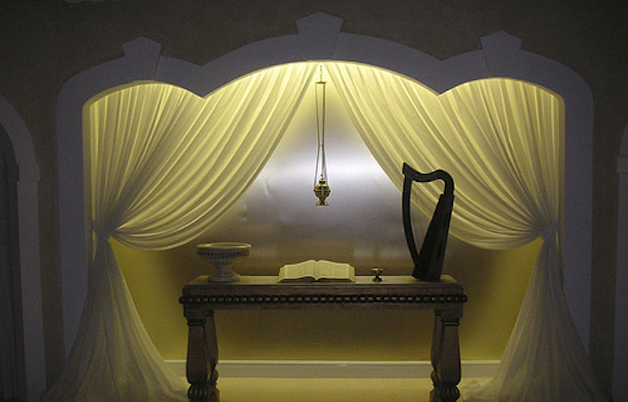
The Place of the Tabernacle
It is a Place Of…
Great Beauty and is Well Beloved (1)
“How amiable are thy tabernacles..!”
Desire and Worship (2)
“My soul longeth..fainteth..heart..flesh crieth out.”
Nesting and Sacrifice (3)
“Yea, the sparrow hath found an house, and the swallow a nest for herself, where she may lay her young, even thine altars”

Slide 6
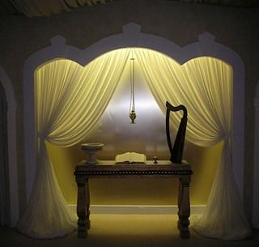
The Place of the Tabernacle
It is a Place Of…
Great Beauty and is Well Beloved (1)
Desire and Worship (2)
Nesting and Sacrifice (3)
Continuance and Glory (4)
“Blessed are they that dwell in thy house: they will be still praising thee. Selah.”
Blessing and Strength (5)
“Blessed .man whose strength is in thee; ..heart are ways of them.”

Slide 7
The Path to the Tabernacle
God’s City was:
Situated on a Hill
Surrounded by Valleys
The Only Way to Go Up…
…was to Go Through

Slide 8
Jerusalem Surrounded by Valleys
Rephaiam- Shadows
Valley of Giants
Stitch -Heal
Hinnom- Wailing
Satan Seemed To Win
Trash Heap
Baca- Weeping
Trapped
Despair
It Can Be a Place and/or Condition

Slide 9
The Necessary Passage “through the valley of Baca”
Jerusalem=
The Place to Find…
His Presence
His Power
His Praise
His Position
There Can Be No Jerusalems…
…Without Valleys

Slide 10
He Restores My Soul…
…Sets me Back Up on My Feet
In Your Valley…
…You Will Have His
Presence
Power
Promise

