Slide 2
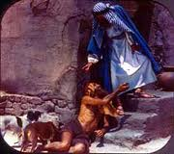
Edward Christian Church
May 1, 2022
Seven Things in Hell…
…Every Church Needs
Luke 16:19
Tell Me About Hell –pt1

Slide 3
Hell is a Tough Subject
Why?
It is…
Uncomfortable
Unimaginable –some don’t believe
Unthinkable –why would loving God send?

Slide 4
Hell is a Tough Place
It is Real!
It was Created for the Devil and His Angels
If We Go There …
We are Trespassers
Holy Spirit’s Convicting Ignored
Grace was Refused

Slide 5
Two Different Kinds of Lives
Richman (19)
One has Everything
Wealthy
Healthy
Fared Sumptuously
Unnamed
Lazarus (20)
One has Nothing
Poor
Disabled
Beg Helpless
Named
Lazarus means God is my Help or Helper

Slide 6
Two Different Kinds Of Death
(22) Richman…
Died -Buried
In Hell
Only Saw Glory
Painfully Alone
Tormented
(22) Lazarus…
Died-Escorted
In Paradise
Experiencing Glory
Had Companionship
Comforted

Slide 7
Two Different Kinds of Resurrection
Hell Resurrected to:
Physical Suffering
Place of Need
Begs Drop of Water
Emotional Suffering
Memory of Life
Saw Foolishness
Separated fr God
Spiritual Suffering
Could See Glory
Never Experience
Heaven Resurrected to:
Physical Peace
All Needs Met
Sores-Sickness Gone
Emotional Peace
Focus..new life
Comfort was great
Drawn Close to God
Spiritual Peace
Will Be with God
Christ for Eternity

Slide 8
Good Lessons
from a
Bad Example

Slide 9
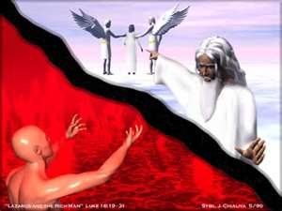
Things in Hell the Church Needs
Vision (23)
We Need a Vision…
of Heaven and Hell
the Lost
What God Can Do Through Us
….Through This Church

Slide 10
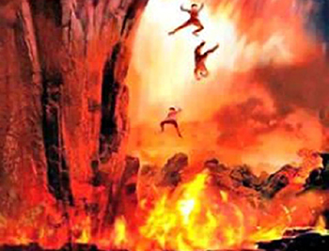
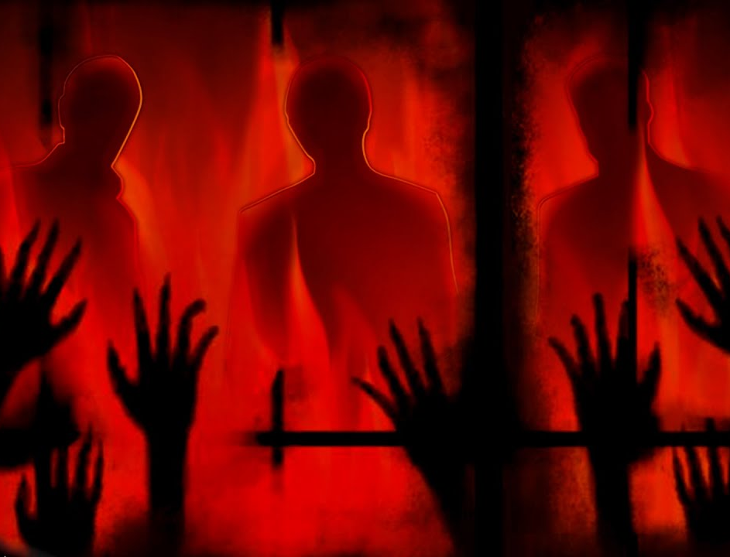
Awareness
Avoidance
Acceptance
Alarm

