Slide 1
Part 1

Slide 2
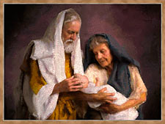
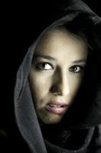
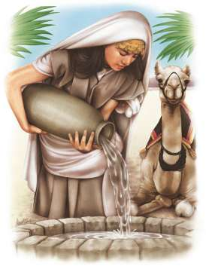
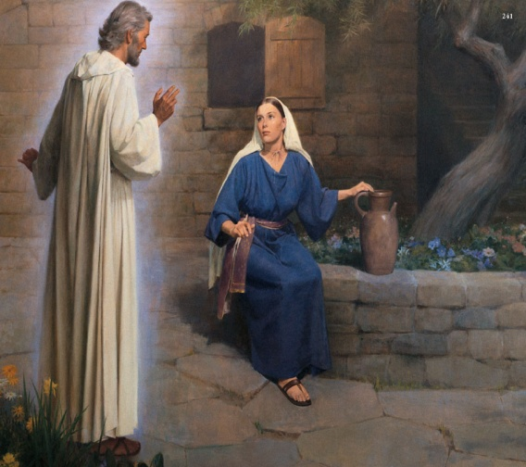
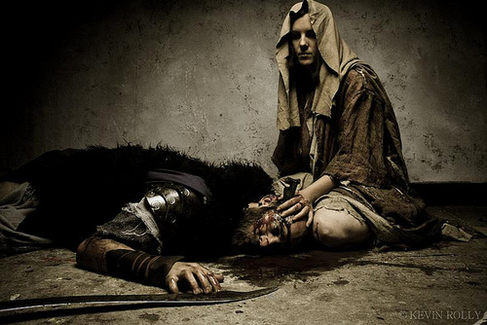
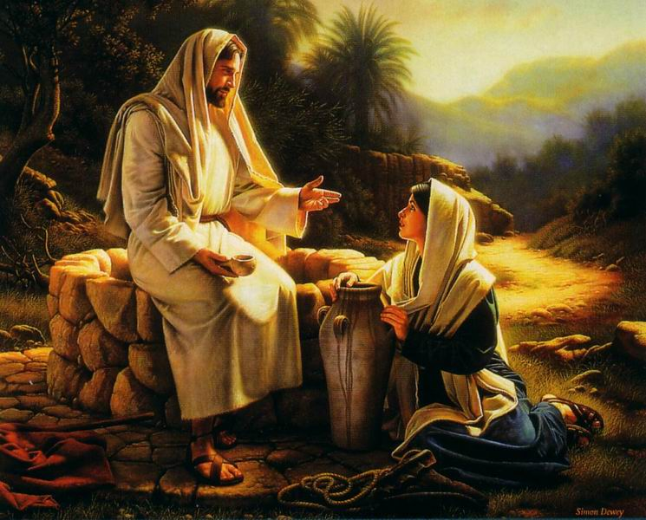
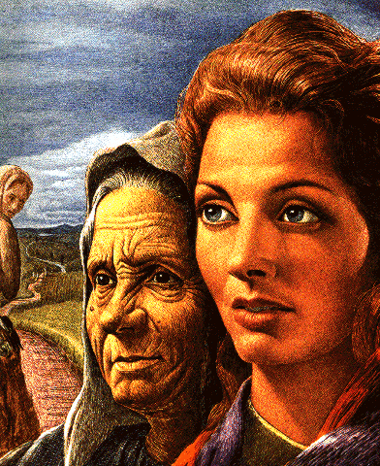
Mother’s Day 2022
Life
Lessons
from
Women of the Bible

Slide 3
We Can Learn Some…
…Rich Life Lessons from People in the Bible
...Especially the Women
Some are Well Known...
…Others Not So
Let’s Mention a Few
…and a Life Lesson They Teach

Slide 4
Eve
Genesis 3:6-8
What You Do or Don't Do Effects More …
…Than You Can Imagine
Thank God for Gen 3:15

Slide 5
Sarah
Gen 21:1-11
Don’t Ever Think Its Too Late…
…for God to Keep His Promise
Quit Trying to Help Him

Slide 6
Hagar
Gen 21:12-21
Even When You Feel Rejected
...and Cast Away
…God Sees and Responds
He's Been There
Isa 53

Slide 7
Rebekah
Gen 24
God Blesses those Who…
…Give it All they Got
For it is a Being Most Like Your Savior

