Slide 2
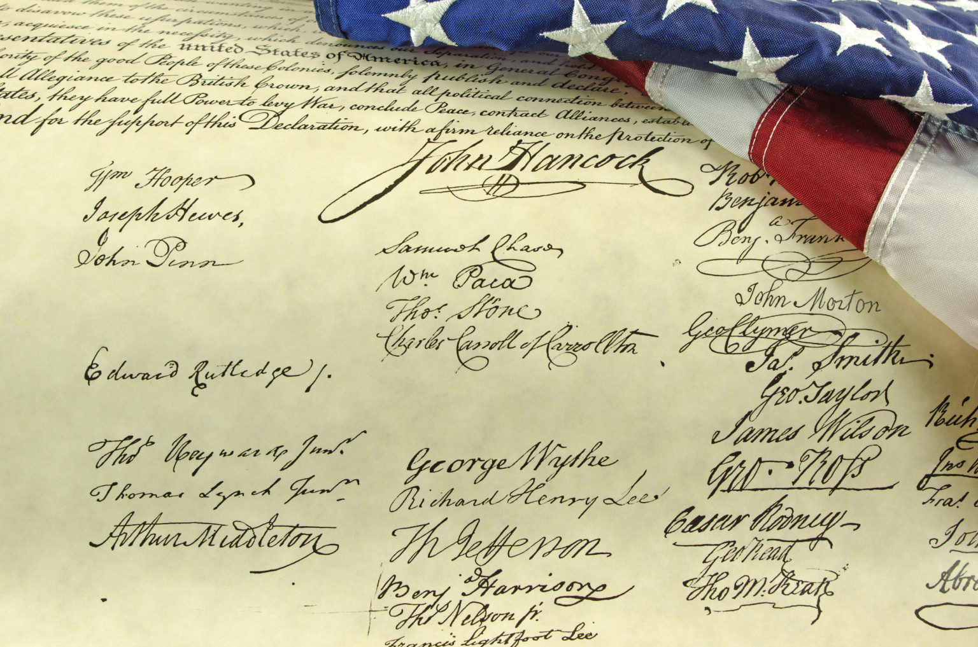
Declaration of Independence
“Declaring Independence From Unforgiveness”
Matthew 18:21-35
July 10, 2022
Edward Church

Slide 3
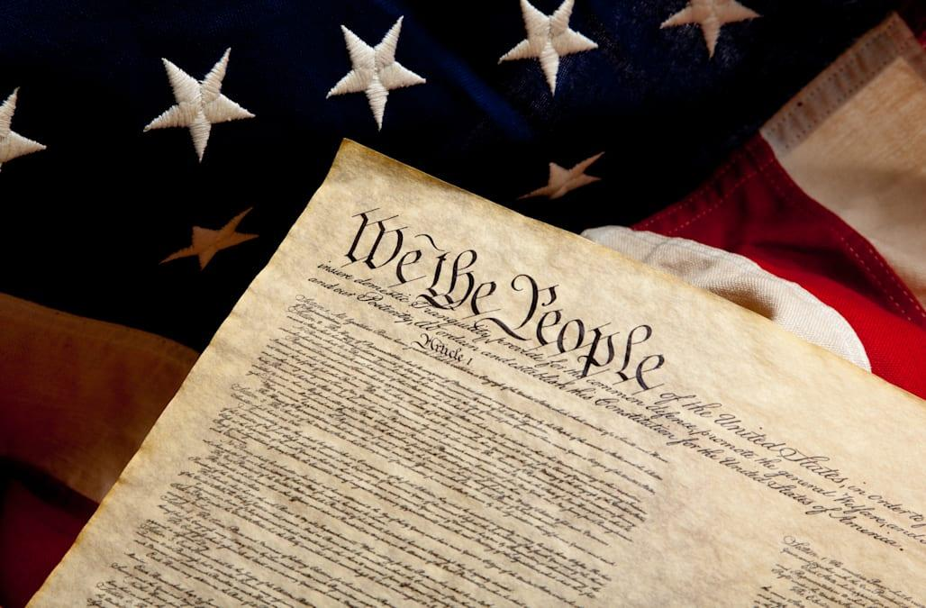
On July 4, 1776
  13 Colonies
  Out Manned
  Out Gunned
  Declared Enough is Enough!
With God’s Help those Colonies Broke Free
Today
  In Our Own Strength
  Out Manned
  Out Gunned
  Time to Declare Enough is Enough!
With God’s Help We Can Brake Free

Slide 4

One of the Most Effective Doors Satan Uses
to Enter Our Lives is…
It Starts as Subtle as Whisper…
…Then it Explodes into Our Lives Like a Tidal Wave
It Locks us Down
Knocks Out of Spiritual Balance
Although it Starts with One …
…It Affects Every Relationship

Slide 5

It is a Hinge to Total Healing
All Healing Begins with Forgiveness
Matthew 18:21-35
Unforgiveness Binds (22)
  Command –State of Spt Revolt
  Matt 6:12, “Forgive debts as we forgive”
Unforgiveness Blinds (31)
  Hinders our Relationship w- God / Others
  Matt 6:15, “if not forgive, he will not forgive”
Unforgiveness Grinds (34)
  Torment

Slide 6
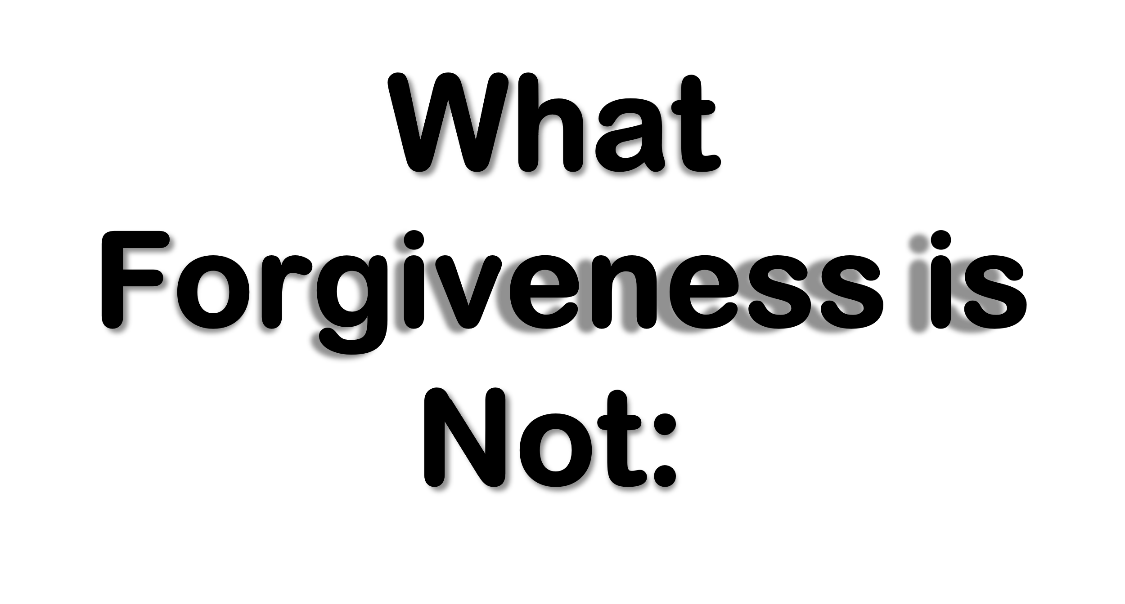
Forgiveness is Not Denying the Offense
“it never really happened”
Forgiveness is Not Forgetting Offense
“I can just forget it happened”
Forgiveness is Not Excusing Offense
“Others still acct for their actions or lack of actions”
Forgiveness Doesn't Mean Things Go Back As Before
It Doesn't Always Lead to Reconciliation

Slide 7
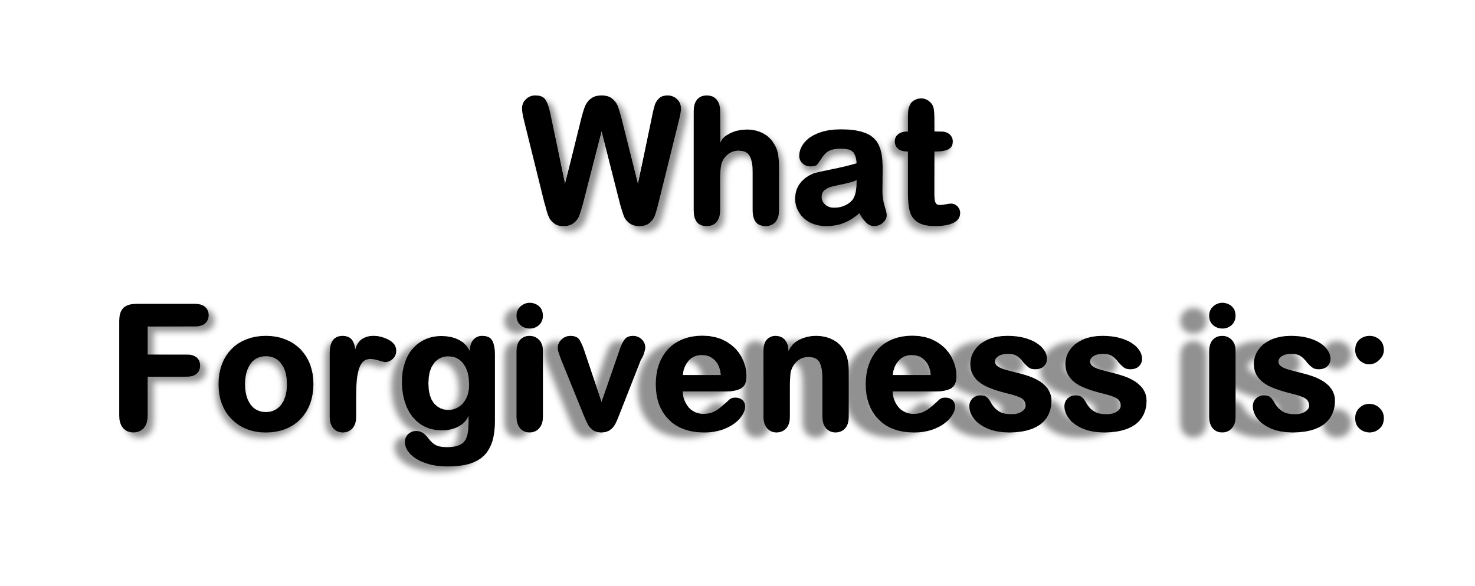
To Forgive = “Release”
"to let go" and "to cancel a debt"
Forgiveness is an “Act of the Will”
    never accidental
Forgiveness is a “2 Step Process”
    Immediate -decision
    On-Going -process
Forgiveness is Truly “Modeling Christ”
Forgiveness Works “Beyond Reconciliation”

Slide 8
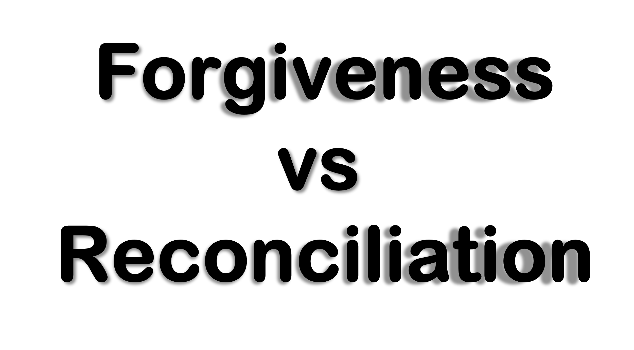
Forgiveness Can Take Place w- Only One Person
Reconciliation requires 2 persons
Forgiveness is Directed One-Way
Reconciliation is Reciprocal... Two-Ways
Forgiveness is a Decision to Release Offender
-Rec’n is the Effort to Rejoin the Offender
Forgiveness is Unconditional, Regardless of a Lack of Repentance of the Other
…Reconciliation is Conditional Based on
…Repentance and
…Change of Behavior

Slide 9
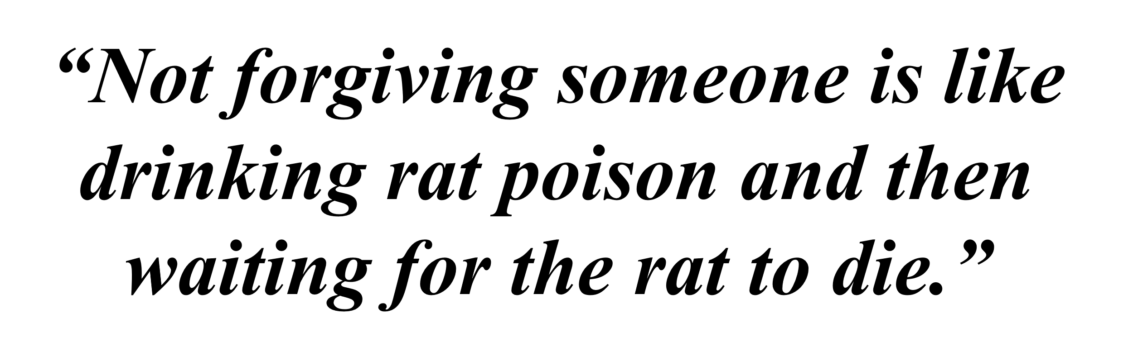
Forgiveness Brings Doubt
Fear - “What If”
  They Do Not Acknowledge
  They Do Not Change
Pride - “Why”
  They Don’t Deserve Release
  They Deserve Pain
Unforgiveness Brings Danger
Leads to Anger -
Unresolved Anger Leads to Bitterness
Be ye angry, and sin not: let not the sun go down upon your wrath:
Neither give place to the devil. Ephesians 4:26-27
            Battle –all become angry
            Bottled –sun go down wrath(rage> bitterness)
            Blown Out –Place to Devil(diablos-accuser)

Slide 10
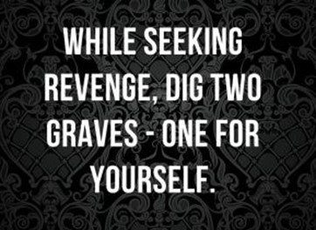
Unforgiveness Builds a Wall
…Forgiveness Builds a Bridge
Changes Our Status from
…Victim to Victor

Slide 11
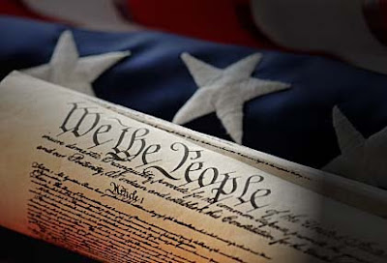
We, God’s People, Declare
Independence From Unforgiveness
AMEN

