Slide 2
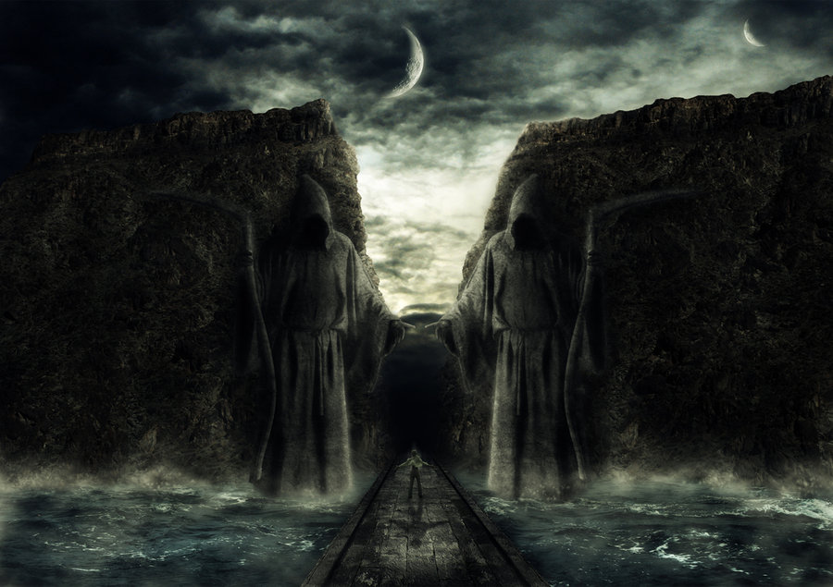
Passing Through Dark Valleys pt 1
(Dealing with Adversity)
Psalms 23:4
Edward Church
July 24, 2022

Slide 3
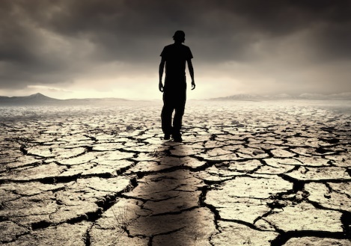
What Do You Get in a Land Where All You Have Is…
…Sunshine Every Day
…and No Rain?
“a Desert”
Balance -none
Blocked- growth stunted
Blank- Unthankful
Bland- boring

Slide 4
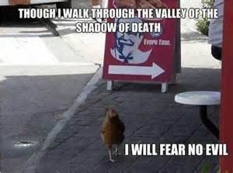
Examples of Life's Valleys
The Valley of…
Trouble -Josh. 7:26
Weeping -Psa. 84:6
Deep Darkness -Ps. 23:4

Slide 5
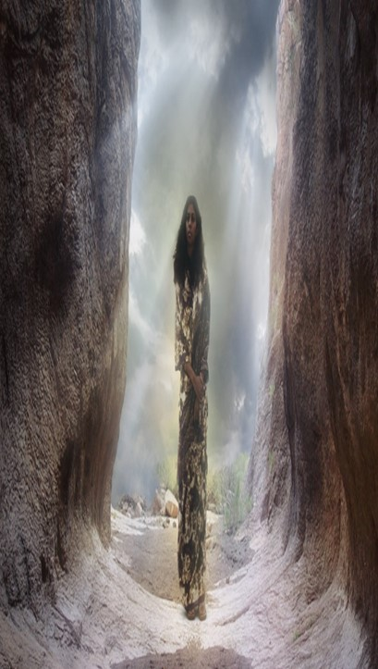
Dark Valleys Are…
Unavoidable "Mankind is born for trouble as surely as sparks fly upward." Job 5:7
Unpredictable
You can’t plan them or time them (usually worst poss time)
"Disaster after disaster is reported, for the whole land is destroyed. Suddenly my tents are destroyed, my tent curtains, in a moment." -Jeremiah 4:20 (HCSB)
Impartial "He causes His sun to rise on the evil and the good, and sends rain on the righteous and the unrighteous." -Matt 5:45 (HCSB)

Slide 6
Dark Valleys Are…
Unavoidable
Unpredictable
Impartial
Temporary
Valleys…
Have a Beginng also an End
Don’t Last Forever
Are Not Our Permanent Residence
"The suffering won’t last forever. It won’t be long before this generous God who has great plans for us in Christ—eternal and glorious plans they are!—will have you put together and on your feet for good" -1 Peter 5:10 (MSG)

Slide 7
Dark Valleys Are…
Unavoidable
Unpredictable
Impartial
Temporary
Have a Purpose "You rejoice in this, though now for a short time you have had to be distressed by various trials so that the genuineness of your faith—more valuable than gold, which perishes though refined by fire—may result in praise, glory, and honor at the revelation of Jesus Christ." -1 Peter 1:6-7 (HCSB)

Slide 8
Dark Valleys Are…
Have a Purpose
God has a reason for taking you through dark valleys.
valley full of doubt, despair, discouragement, or defeat
financial valleys, relationship, emotional, spiritual valleys
God Promises .. You will get through them in time
Every Problem Has a Purpose
little ones, inconsequential ones, irritating ones.
God can teach you character
He wants to change you, mature you
Faith is Built in the Valleys of Life

Slide 9
Psalm 23:4 (NLT2) ⁴ Even when I walk through the darkest valley, I will not be afraid, for you are close beside me. Your rod and your staff protect and comfort me.

