Slide 2
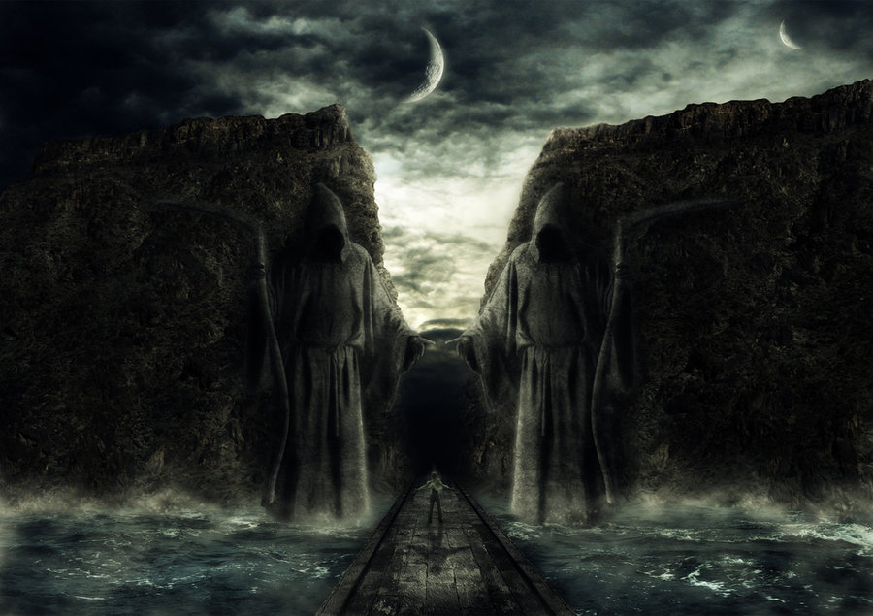
Passing Through Dark Valleys pt 2
(Dealing with Adversity)
Psalms 23:4
Edward Church
July 31, 2022

Slide 3
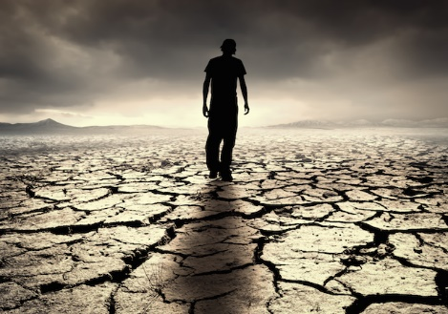
What Do You Get in a Land(life) Where All You Have Is…
…Sunshine Every Day
…and No Rain?
“a Desert”

Slide 4
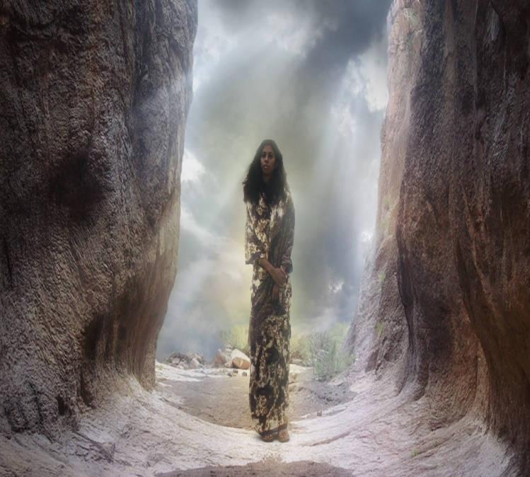
Dark Valleys Are…
Unavoidable "Mankind is born for trouble as surely as sparks fly upward." Job 5:7
Unpredictable
You can’t plan them or time them (usually worst poss time)
"Disaster after disaster is reported, for the whole land is destroyed. Suddenly my tents are destroyed, my tent curtains, in a moment." -Jeremiah 4:20 (HCSB)
Impartial "He causes His sun to rise on the evil and the good, and sends rain on the righteous and the unrighteous." -Matt 5:45 (HCSB)

Slide 5
Dark Valleys Are…
Temporary
Valleys…
have an end
don’t last forever
are not our permanent residence
"The suffering won’t last forever. It won’t be long before this generous God who has great plans for us in Christ—eternal and glorious plans they are!—will have you put together and on your feet for good" -1 Peter 5:10 (MSG)

Slide 6
Dark Valleys Are…
Have a Purpose
"You rejoice in this, though now for a short time you have had
to be distressed by various trials so that the genuineness of
your faith—more valuable than gold, which perishes though
refined by fire—may result in praise, glory, and honor at the
revelation of Jesus Christ." -1 Peter 1:6-7 (HCSB)
God Can Teach You Character
He Wants To Change You, Mature You
Faith Is Built In The Valleys Of Life

Slide 7
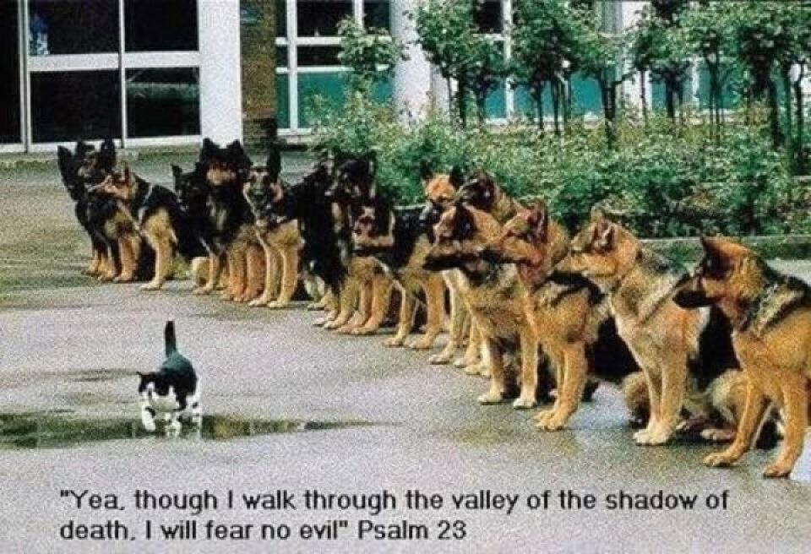
What Do You Do When… …You Go Through Dark Valleys? (4)
Remain Calm- “Even though I walk through the valley...”
"I walk" - not "I run through it" or "I panic/ run the other way“
John 14:27 (AMP) ²⁷ Peace I leave with you; My [own] peace I now give and bequeath to you. Not as the world gives do I give to you. Do not let your hearts be troubled, neither let them be afraid. [Stop allowing yourselves to be agitated and disturbed; and do not permit yourselves to be fearful and intimidated and cowardly and unsettled.]

Slide 8
What Do You Do When… …You Go Through Dark Valleys? (4)
Remain Calm- “Even though I walk through the valley...”
"I walk" - not "I run through it" or "I panic/ run the other way“
Refuse To Be Discouraged- “I will fear no evil”
Will implies a Choice, a Decision.
Focus on God's Power Rather than on your Valley (problem)
Psalm 91:5-7 (KJV)⁵ Thou shalt not be afraid for the terror by night; nor for the arrow that flieth by day; ⁶ Nor for the pestilence that walketh in darkness; nor for the destruction that wasteth at noonday. ⁷ A thousand shall fall at thy side, and ten thousand at thy right hand; but it shall not come nigh thee.

Slide 9
What Do You Do When… …You Go Through Dark Valleys? (4)
Remain Calm- “Even though I walk through the valley...”
Refuse To Be Discouraged- “I will fear no evil”
Rest In God’s Presence- “For You are with me”
God Promises to be with you every step of the way
Exodus 33:14 (KJV) ¹⁴ And he said, My presence shall go with thee, and I will give thee rest.
Rely on God’s Protection/ Guidance-“Your rod /staff comfort me”
Joshua 1:9 (KJV) ⁹ Have not I commanded thee? Be strong and of a good courage; be not afraid, neither be thou dismayed: for the LORD thy God is with thee whithersoever thou goest.

Slide 10
Shadows…
are always Bigger Than Reality
Fear is always greater than the problems you face
cannot Hurt You
Shadows can not hurt you – they can only scare you
only appear when there is a Light Source
there is light at the end of the tunnel
God is light – and in Him there is no darkness
Trust Him

Slide 11
God’s Got This!
God’s Got Me!!
When I Can’t See…
His Vision is Strong!!

