Slide 2
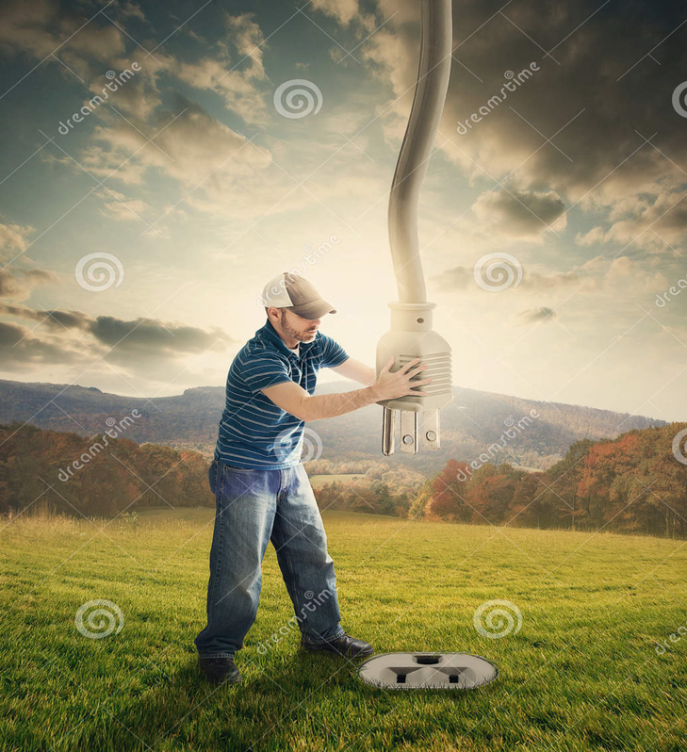
Plug Into the Power of
Praise
Edward Church
August 7, 2022

Slide 3
Praise
Powerful-
  Never leaves situation the same
Positive-
  Hard to praise and pout at same time
Predictor-
  It effectively predicts the outcome
Productive-
  It can do what nothing else can…
We Plug Into………..

Slide 4

…Gets Our Focus Off Ourselves… Back On God
  In“selfie” focused world, we need this reminder…
  …life is not all about us.
  When We Get Eyes on Self… “Hurt” is Magnified
  When Our Eyes are On Him … “Hope” is Magnified
He is Worthy of Our Praise…
…No Matter What We Face From Day to Day.
“Praise him for his mighty deeds; praise him according to his excellent greatness!” Psa. 150:2
"And my tongue shall speak of your righteousness and of your praise all the day long." Psa. 35:28

Slide 5
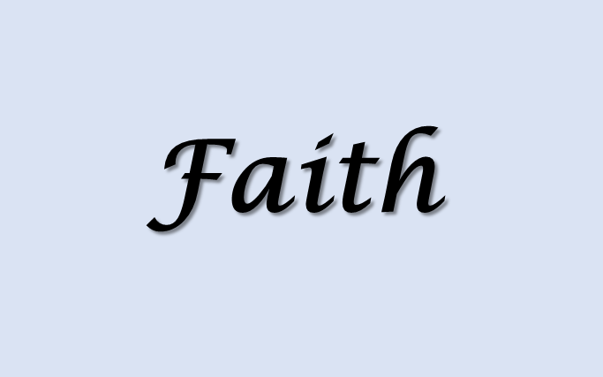
…Brings Us to a Place of Humility
We remember our dependency on God, as we acknowledge our need for Him.
As we praise Him as Creator/ King of this world…
…we recognize that we’re not in control, but He is!
“Let us come into his presence with thanksgiving; let us make a joyful noise to him with songs of praise! For the Lord is a great God, and a great King above all gods” Psa. 95:2-3
"I will give you thanks in the great congregation: I will praise you among much people" Psa. 35:18

Slide 6
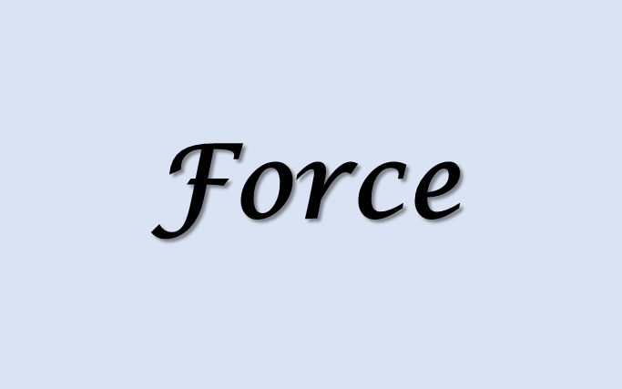
…Makes the Enemy Flee
  It pushes back the darkness that surrounds
  Evil will not stick around if we’re praising our God…
…who will fight our battles for us.
Jehoshaphat, saw God miraculously defeat the enemy
“As they began to sing and praise, the Lord set ambushes against the men of Ammon and Moab and Mount Seir who were invading Judah, and they were defeated” 2 Chron. 20:22

Slide 7

…Leaves No Room For Complaining and Negativity
  Sometimes Problems Overwhelm Us
  Prayers Become Complaints
  Problems Become Set In
Praise Reminds Us Of…
  What He Has Already Done In Our Lives.
  He Can Do It Again
“Bless The Lord, O My Soul, And Forget Not All His Benefits, Who Forgives All Your Iniquity, Who Heals All Your Diseases, Who Redeems Your Life From The Pit, Who Crowns You With Steadfast Love And Mercy.” Psa. 103:2-4
"By Him Therefore Let Us Offer The Sacrifice Of Praise To God Continually, That Is, The Fruit Of Our Lips Giving Thanks To His Name." Heb. 13:15

Slide 8
..Leaves No Room For Complaining and Negativity.
Luke 24:50-53
⁵¹ And it came to pass, while he blessed them, he was parted from them, and carried up into heaven. ⁵² And they worshipped him, and returned to Jerusalem with great joy: ⁵³ And were continually in the temple, praising and blessing God. Amen.
Acts 2:1-2
¹ And when the day of Pentecost was fully come, they were all with one accord in one place. ² And suddenly there came a sound from heaven as of a rushing mighty wind, and it filled all the house where they were sitting.

Slide 9
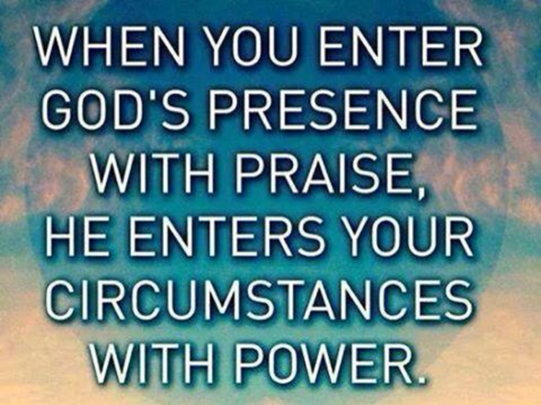
They Didn’t Focus on the Crucifixion
But their Focus was on the Resurrection
Changing Your Focus …
May NOT Change Your Circumstance
It Will Change Your Attitude IN the Circumstance

Slide 10
Pt 2

