Slide 2
Plug Into the Power of Praise 2
Edward Church
August 14, 2022

Slide 3
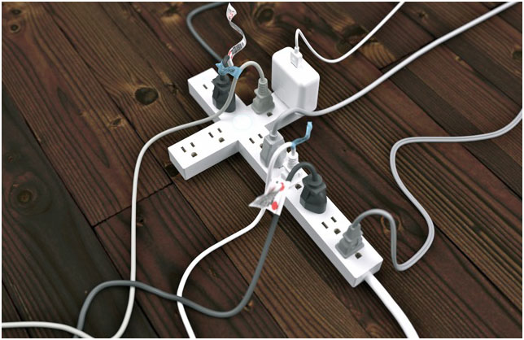
Powerful-
Never leaves situation the same
Positive-
Hard to praise and pout at same time
Predictor-
It effectively predicts the outcome
Productive-
It can do what nothing else can…
We Plug Into………..

Slide 4
Gets Our Focus Off Ourselves… Back On God
When We Get Eyes on Self… “Hurt” is Magnified
When Our Eyes are On Him … “Hope” is Magnified
He is Worthy of Our Praise…
…No Matter What We Face From Day to Day
Brings Us to a Place of Humility
We remember our dependency on God, as we acknowledge our need for Him.
As we praise Him as Creator/ King of this world…
…we recognize that we’re not in control, but He is!
Praise Dare!

Slide 5
…Makes the Enemy Flee
It pushes back the darkness that surrounds
Evil will not stick around if we’re praising our God…
…who will fight our battles for us
…Leaves No Room For Complaining and Negativity
Sometimes Problems Overwhelm Us
Prayers Become Complaints
Problems Become Set In
Praise Reminds Us Of…
What He Has Already Done In Our Lives.
He Can Do It Again
Praise Dare!

Slide 6
Praise Makes Room For God’s Blessings Over Our Lives
He Will Not Hold Back His Goodness,
Praise Opens the Gateway of Blessing…
…as We Come into His Presence
“Enter his gates with thanksgiving, and his courts with praise!
Give thanks to him; bless his name!” Psa. 100:4
"Blessed be the God and Father of our Lord Jesus Christ,
who has blessed us with all spiritual blessings in
heavenly places in Christ:" Eph. 1:3
Praise Dare!

Slide 7
Praise Invites His Presence
God dwells close to us when we praise Him
He Lives There
He Looks For It
“He inhabits the praises of His people.” Psa. 22:3
"But you are a chosen generation, a royal priesthood, an holy nation, a peculiar people; that you should show forth the praises of him who has called you out of darkness into his marvelous light;"
1 Pet. 2:9
Praise Dare!

Slide 8
Our Spirits are Refreshed and Renewed in His Presence
We're strengthened by His peace and refueled by His joy.
Through a Heart of Praise…
…We Realize that God Doesn’t Just Change Our Situations
…and Work Through Our Problems,
…He Changes Our Hearts.
“In His presence, there is fullness of joy.” Psa. 16:11
"Because your love is better than life, my lips will glorify you.
I will praise you as long as I live, and in your name
I will lift up my hands." Psa. 63:3-4
Praise Dare!

Slide 9
It Paves the Way for God’s Power Displayed- Miracles
People’s Lives are Affected and Changed.
God Shakes Things Up Through Praise.
As Paul and Silas sat in prison, shackled, but praising God.
Praise Moved God
God Moved Heaven /Earth -God sent an earthquake
Power Moved Hearts –jailer/ all his family saved-
“About midnight Paul and Silas were praying and singing hymns to God, and the prisoners were listening to them, and suddenly there was a great earthquake, so that the foundations of the prison were shaken. And immediately all the doors were opened, and everyone's bonds were unfastened.” Acts 16:25-26
Praise Dare!

Slide 10
It Paves the Way for God’s Power Displayed- Miracles
We Have a Choice Every Day in this Life.
live absorbed in worry and stress…
…focused only on what surrounds us
We Can Ask God to Help Us Take Our Eyes Off All the…
Problems and Mess, or the Voices of Others…
…look up...to the One Who Holds It All Together
God Desires Our Whole Heart.
He longs for us to know the power of His presence
…He desires to bless us more than we could imagine
…His Spirit urges us onward, calling us closer
Praise Dare!

Slide 11
They Didn’t Focus on the Crucifixion
But their Focus was on the Resurrection

Slide 12
We praise you today with our hearts and songs, we praise you
for your faithfulness, we praise you for your great power and
love. We confess our need for you, our lives don't go so well
when we just spin around on our own. We struggle and worry,
get weary and worn. Yet you never leave us. Thank you for
your presence. Thank you for your care over us, thank you that
you breathe renewal right into our souls. We ask for your spirit
to fill us, to draw us close to yourself, and to work your
purposes through us, as we set our eyes on you.

Slide 13
Praise Dare!
When You Do…
…You Make Room
…For Him to Move

Slide 14
