Slide 1
This is the Year that the Lord Hath Made!!
This is the Day that the Lord Hath Made
We Will Rejoice and Be Glad in It!!
Glory

Slide 2
Repeat
These are the 2 Most Important Hours
of My Week
– Help Me to Cherish Them
I Am Here Today to Worship
Not to Be Entertained
I Am Singing to An Audience of One
Accept My Worship Oh Lord!

Slide 3
Praise Time

Slide 4
Soon and very soon we are going to see the King. Soon and very soon we are going to see the King. Soon and very soon we are going to see the King. Hallelujah, hallelujah, we’re going to see the King.

Slide 5
No more crying there we are going to see the King. No more crying there we are going to see the King. No more crying there we are going to see the King. Hallelujah, hallelujah, we’re going to see the King.

Slide 6
No more dying there we are going to see the King. No more dying there we are going to see the King. No more dying there we are going to see the King. Hallelujah, hallelujah, we’re going to see the King.

Slide 7
Repeat
I Lift My Offering to You
Let It Please You Oh Lord
This is My Seed
Although It Leaves My Hand
It will Never Leave My Life
You Will Multiply It!
Accept My Seed Oh Lord!

Slide 8
Amazing grace, how sweet the sound. That saved a wretch like me. I once was lost, but now I’m found. Was blind, but now I see.

Slide 9
I get a peaceful, easy feeling. I know you won’t let me down. ‘Cause I’m already standing, On solid ground.

Slide 10
Thru many dangers, toils and snares. I have already come. His grace has brought me safe thus far. And grace will lead me home.

Slide 11
I get a peaceful, easy feeling. I know you won’t let me down. ‘Cause I’m already standing, On solid ground.

Slide 12
When we’ve been there 10,000 years. Bright shining as the sun. We’ve no less days, to sing God’s praise, then when we first begun.

Slide 13
All to Jesus I surrender
All to Him I freely give
I will ever love and trust him,
In His presence daily live
[Chorus]
I surrender all, I surrender all
All to thee, my blessed Savior, I surrender all.

Slide 15
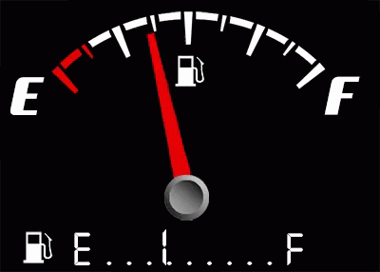
Edward Church
Aug 28-2022
Edward Christian Church
7- 26-2020
Running On Empty
1 Kings 19
Pt 2

Slide 16
Running on Empty
Have You…
Gone as Far as You Can Go
Taken All You Can Take
Given All You Can Give
Welcome to…
…Running on Empty!

Slide 17
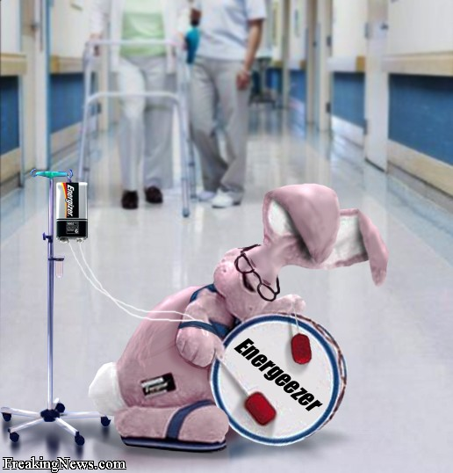
Running on Empty
Mentally
Physically
Spiritually
Exhausted

Slide 18
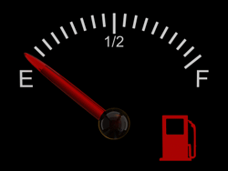
The Danger of
Running on Empty…
Empty Leads to Burnout
Burnout Creates Brokenness
Brokenness Drives Depression

Slide 19
The Bible is Full of God’s People
Facing Empty Tanks
But Had to Keep Going
Let’s Focus on One…
Elijah – I Kings 19

Slide 20
Running on Feeling (Spt High)
1 Kings 18:46
One of the Greatest MOVES of God
Elijah was Running On Emotions
Running on Fear (Spt Low)
1 Kings 19:1-3
One of the Greatest Threats of Satan
This Time, Elijah Is Running On Fear
Running on Empty (Spt Exhaustion)
1 Kings 19:4-5
One of the Greatest Moves of Fear
Elijah Has Run Out Of Gas.

Slide 21
The Key To Elijah’s Life Drain (3,4) “When He Saw That ….”
Elijah Changed…
His Focus -Ceased to Walk by Faith
“And when he saw that…”
His Force -Boldness to Fear
“he arose, and went for his life…”
His Feelings -Became Depressed
“came to Beersheba, …belongeth to Judah,
and left his servant there. ..Juniper Tree…”

Slide 22
Life Drainers…
Elijah Faced…
Physical Exhaustion (5)
Intense Activity-chap 18
Rebuilt Altar - Showdown
Killed 850 False Prophets
Prayed Intensely for Rain
Ran for Over 20 Miles
Emotional Exhaustion (3a, 4)
He’s on Emotional Roller Coaster
Arose and Ran for His Life (3)
Take My Life -Kill Me! (4)

Slide 23
Life Drainers…
Elijah Faced…
Physical Exhaustion (5)
Emotional Exhaustion (4)
Social Exhaustion (1, 2)
Relationship Conflict
Confronted / killed 850 prophets
Jezebel sent out Death Threats
Spiritual Exhaustion (10, 14)
Down Played His Work
Exaggerated His Situation
Lord Just Take Me!!!

Slide 24
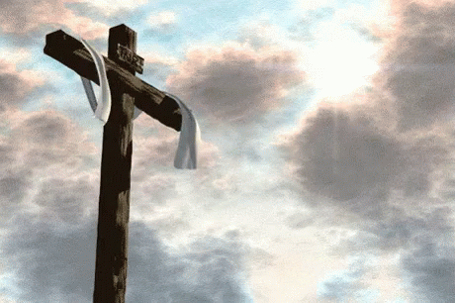
Why Does God Allow Us to… …Get to this Point?
Points to Power of the Cross…
We All Need His Help
Brings Message of Grace/ Mercy to Life
Now It’s Personal
Prompts Reliance upon Him/ Others
We Can’t Do It Alone
Show Us/ Others We Can Still Be Used
Even in the Worst of Situations
Move Beyond Guilt to Usefulness Again!

Slide 25
Isaiah 40:29 (AMP) He gives power to the faint and weary, and to him who has no might He increases strength [causing it to multiply and making it to abound].
Matthew 11:28 (AMP) Come to Me, all you who labor and are heavy-laden and overburdened, and I will cause you to rest. [I will ease and relieve and refresh your souls.]

Slide 27
1. Running on Feeling. (1 Ki 18:46 KJV) And the hand of the LORD was on Elijah; and he girded up his loins, and ran before Ahab to the entrance of Jezreel. After the seventh prayer, the rain came in the shape of a man’s hand. Suddenly the sky was black, and the thundering rains came. In our text, Elijah is running in the rain. What is his motivation? He was sure that revival had indeed come to Israel. He outran the chariot of King Ahab. He came to the entrance of the palace. No doubt, he must of thought, I will be an invited honored guest? After all, his God had won the contest of fire! Elijah was running on the emotion of hope. He was running on feelings. He felt good about his victory. Have you ever had your hopes suddenly dashed? Elijah was about to! 2. Running on Fear. (1 Ki 19:1 KJV) And Ahab told Jezebel all that Elijah had done, and withal how he had slain all the prophets with the sword. (1 Ki 19:2 KJV) Then Jezebel sent a messenger unto Elijah, saying, So let the gods do to me, and more also, if I make not thy life as the life of one of them by to morrow about this time. (1 Ki 19:3 KJV) And when he saw that, he arose, and went for his life, and came to Beersheba, which belongeth to Judah, and left his servant there. Queen Jezebel was not about to repent. She wanted the life of Elijah, and meant to do it by days end! Elijah is up and running again. This time, Elijah is running on fear. Fear will motivate a man. Fear sells. Everyone wants to be safe. Some people only to come to Church, because, they feel safe there. Unfortunately, for those who seek only safe harbors, God has called us to minister into the world of Jezebels! We are to take up a cross and the message of the gospel and launch out into the deep. And Jezebel wants to take your life from you! 3. Running on Fumes. (1 Ki 19:4 KJV) But he himself went a day’s journey into the wilderness, and came and sat down under a juniper tree: and he requested for himself that he might die; and said, It is enough; now, O LORD, take away my life; for I am not better than my fathers. (1 Ki 19:5 KJV) And as he lay and slept under a juniper tree, behold, then an angel touched him, and said unto him, Arise and eat. In this text, Elijah has run out of gas. He is fully immersed in depression. And so will you be, if you do not find the proper fuel source of the Christian life! A Christian is not to live by feelings. A Christian is not to live by fear. A Christian is to live by… 4. Running on Faith! (1 Ki 19:8 KJV) And he arose, and did eat and drink, and went in the strength of that meat forty days and forty nights unto Horeb the mount of God.

Slide 28
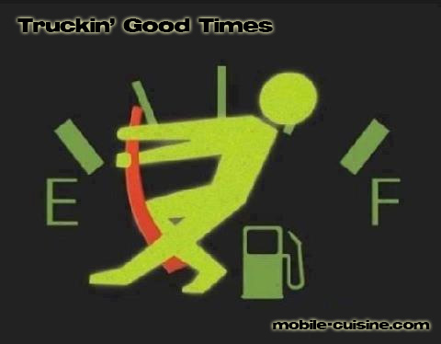
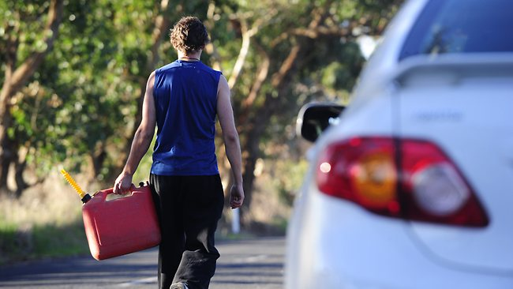
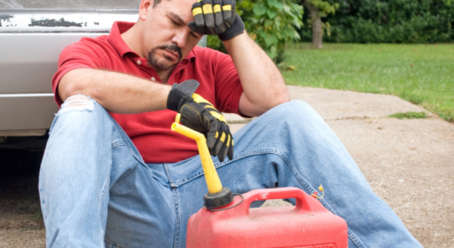
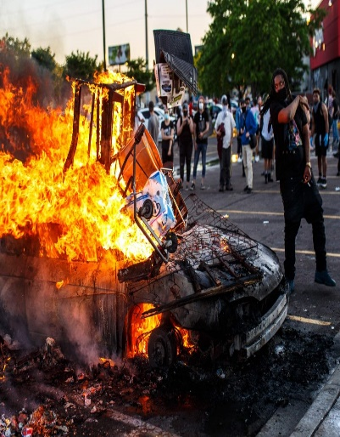
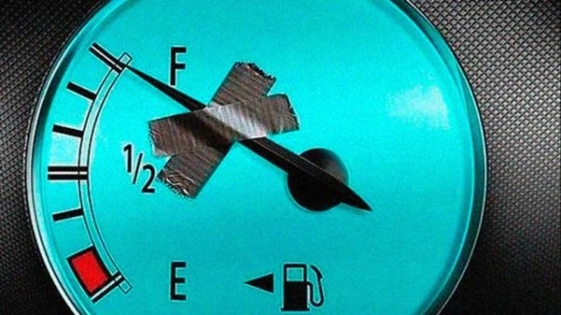
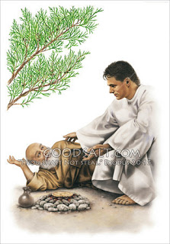
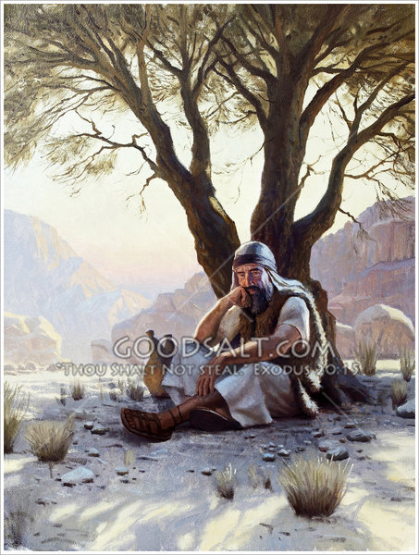

Slide 29
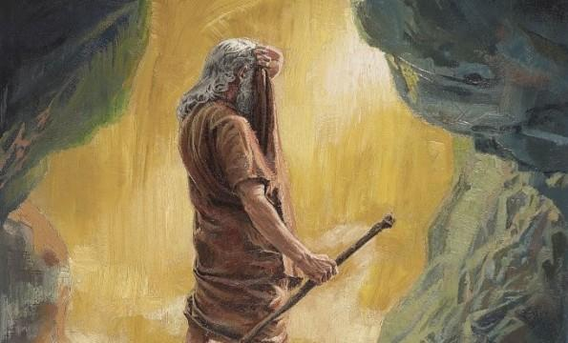
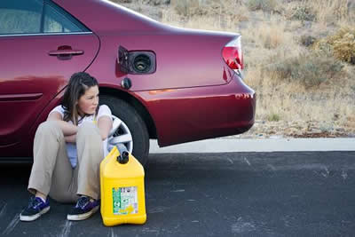

Slide 30
Symptoms of emotional exhaustion can manifest in emotional, physical and behavioral ways
Feeling a sense of failure and self-doubt
Feeling helpless, trapped and defeated
Feeling detached and alone in the world
Feeling unmotivated
Feeling negative, cynical and dissatisfied
Feeling tired and drained most of the time
Feeling sick a lot, and having a lowered immunity to illness
Frequent headaches and other aches and pains
Changes in sleep or appetite
Withdrawing from responsibilities
Isolating yourself from others
Procrastinating or taking longer than usual to get things done
Using food, drugs, alcohol, shopping to cope with feelings, or avoid feelings
Irritability, or taking frustrations out on others
Missing work, or coming in late and leaving early

Slide 31
An oak tree is the perfection of an acorn. And somebody has written these words:
When you’re discouraged and feeling a little blue, take a look at a mighty oak and see what a nut can do (Laughter).
That oak tree is the perfection of an acorn. It is, it means maturity. We grow under stress.

Slide 32
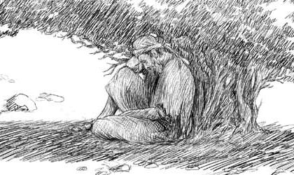
Four Factors of Elijah’s Depression
Elijah Faced…
Physical Exhaustion (5)
Intense Activity-chap 18
Emotional Exhaustion (3a, 4)
He’s on Emotional Roller Coaster
Social Exhaustion (1, 2)
Relationship Conflict
Spiritual Exhaustion (10, 14)
Down Played His Work
Exaggerated His Situation
Lord Just Take Me!!!

