Slide 2
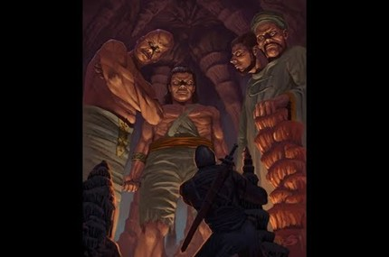
Just When You Thought it was Over
Edward Church
Oct. 9, 2022
Giants Still Fall
Part 4
II Samuel 21:15-21

Slide 3
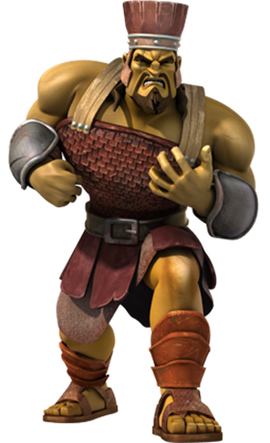
Giants
A Giant is Anything that…
…Intimidates with it’s Size
…Threatens with it’s Power
…Seeks to Take Away
Stands between You and Victory

Slide 4
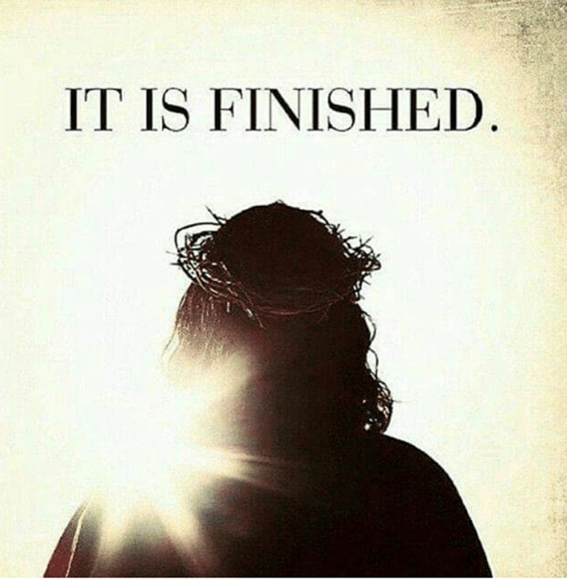
We Know that Christ Cried “It Is Finished”
…Satan was Defeated
Didn’t Mean That Satan Was…
…Going to Accept It

Slide 5
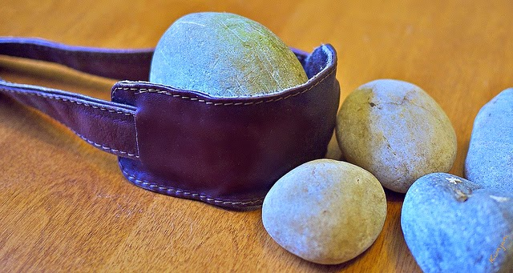
David is Near the End of His Ministry
David Realized that…
Goliath was Not His Only Giant
David was Responsible for Four More
Each One Describes Satan’s Tactics…
in
Progressive Spiritual Warfare

Slide 6
Life Lessons in Spiritual Warfare
As Long as there is Life In You…
…there will be a Fight For You
Satan Won’t Quit
But…

Slide 7
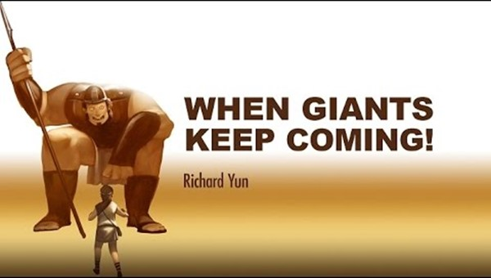
Goliath (beheader)
“Distort Thinking”
He Keeps Coming and Telling You …
…You Cannot Win
Always Rem. You’ve Survived Everything You Thought You Wouldn’t

Slide 8
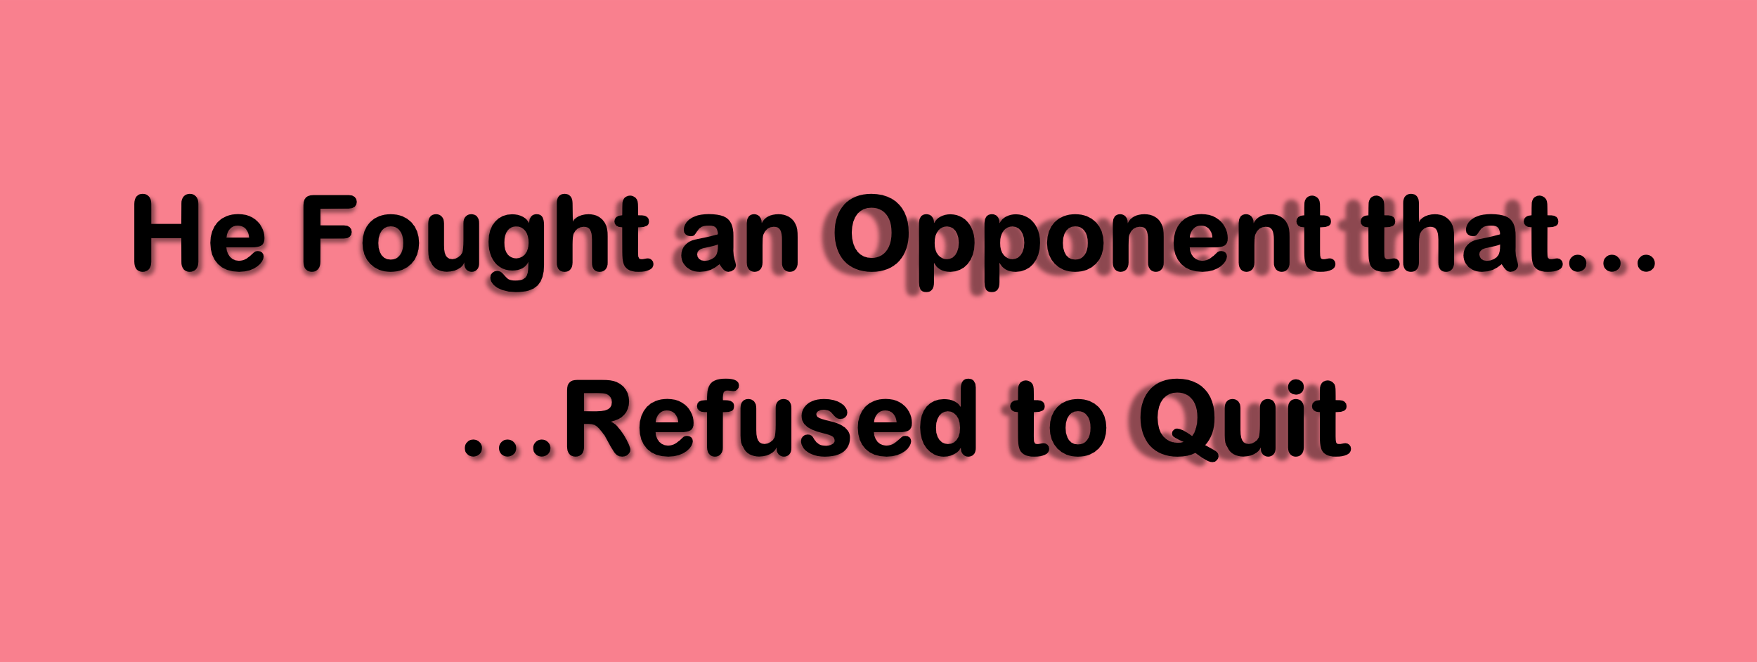
Goliath (beheader)
“Distort Thinking”
Ishbibenob (to dwell + on high) -Isaiah 14
“Pride”
  Genesis 3 - Adam & Eve Garden
  Man had the position Satan wanted
  Luke 4:5-8,“...High mountain… show kingdoms of the world at one time; all yours if you worship me...”
  He wanted the Position that Christ Had

Slide 9
Saph (contain, limit; snatch away, terminate)
“Trials”
  Zec 3:1,“Satan stood (ready for action)
by Right Hand (power, fellowship)
to Resist (satan)

Slide 10
Lahmi (to feed on, consume, devour, overcome, make war)
“Strongholds”
Powerful Presence -magnify
  No name but physical description
  “Confident Boast”
  Isaiah 59:19 - comes in like a flood (stream/flow)…
  …the Spirit will raise up a standard

Slide 11
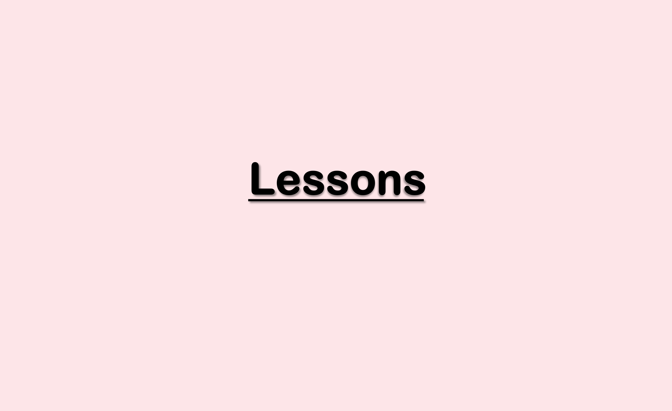
(15) You Are Never Too Old to Be Attacked
(15-16) He Could not Trust in Arm of the Flesh
His State “...he grew weak…”
  Devil thought good time to destroy David
(17) We Need Each Other-Can’t Go It Alone
His Safety
Succoured (surround, protect, aid)
Smote (go forward/ attack)
Romans 15: 1,“…stronger bear infirmity weak...”
Ecc 4:10,“When one falls they lift...”

Slide 12
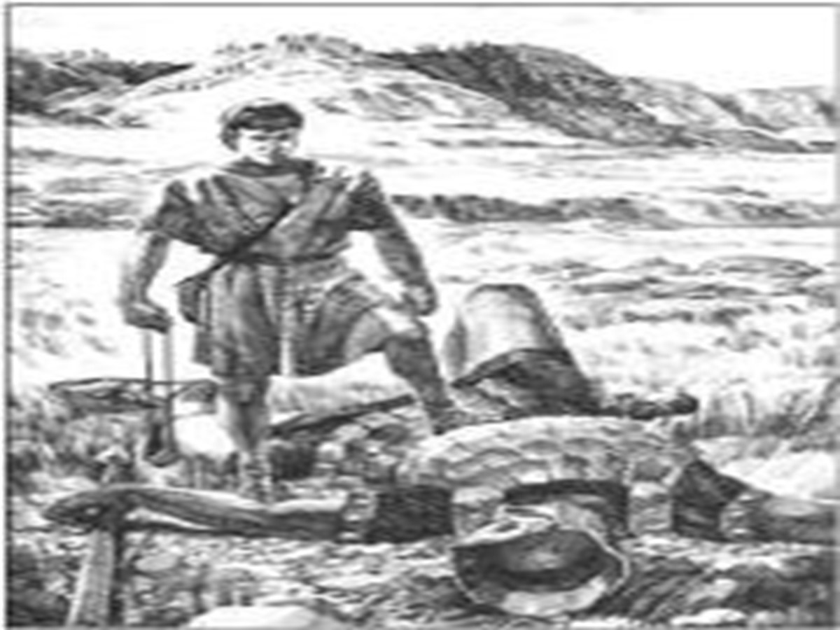
Giants Still Fall
Each Giant Showed…
…A Different Side Of Devil’s Tactics
“Focus on Giant and Trust Own Strength”
Each Person Who Defeated Him Shows…
…How To Handle Them
Counter-Spiritual Warfare

Slide 13
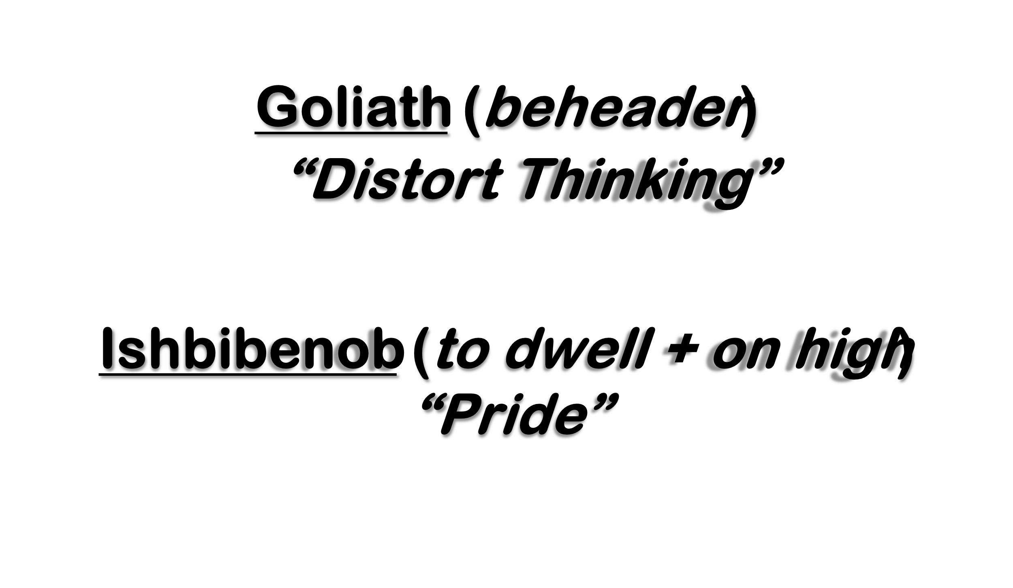
Giants Still Fall
David (burning, fervent love)…
…from Judah (praise)
“Celebrate the Cross”
Abisha (Grace) …
…son of Zeruiah (wounded; to leak/flow)
“Look to the Cross”
  Isaiah 53:1-12
  Nothing I do can I do on my own!!

Slide 14
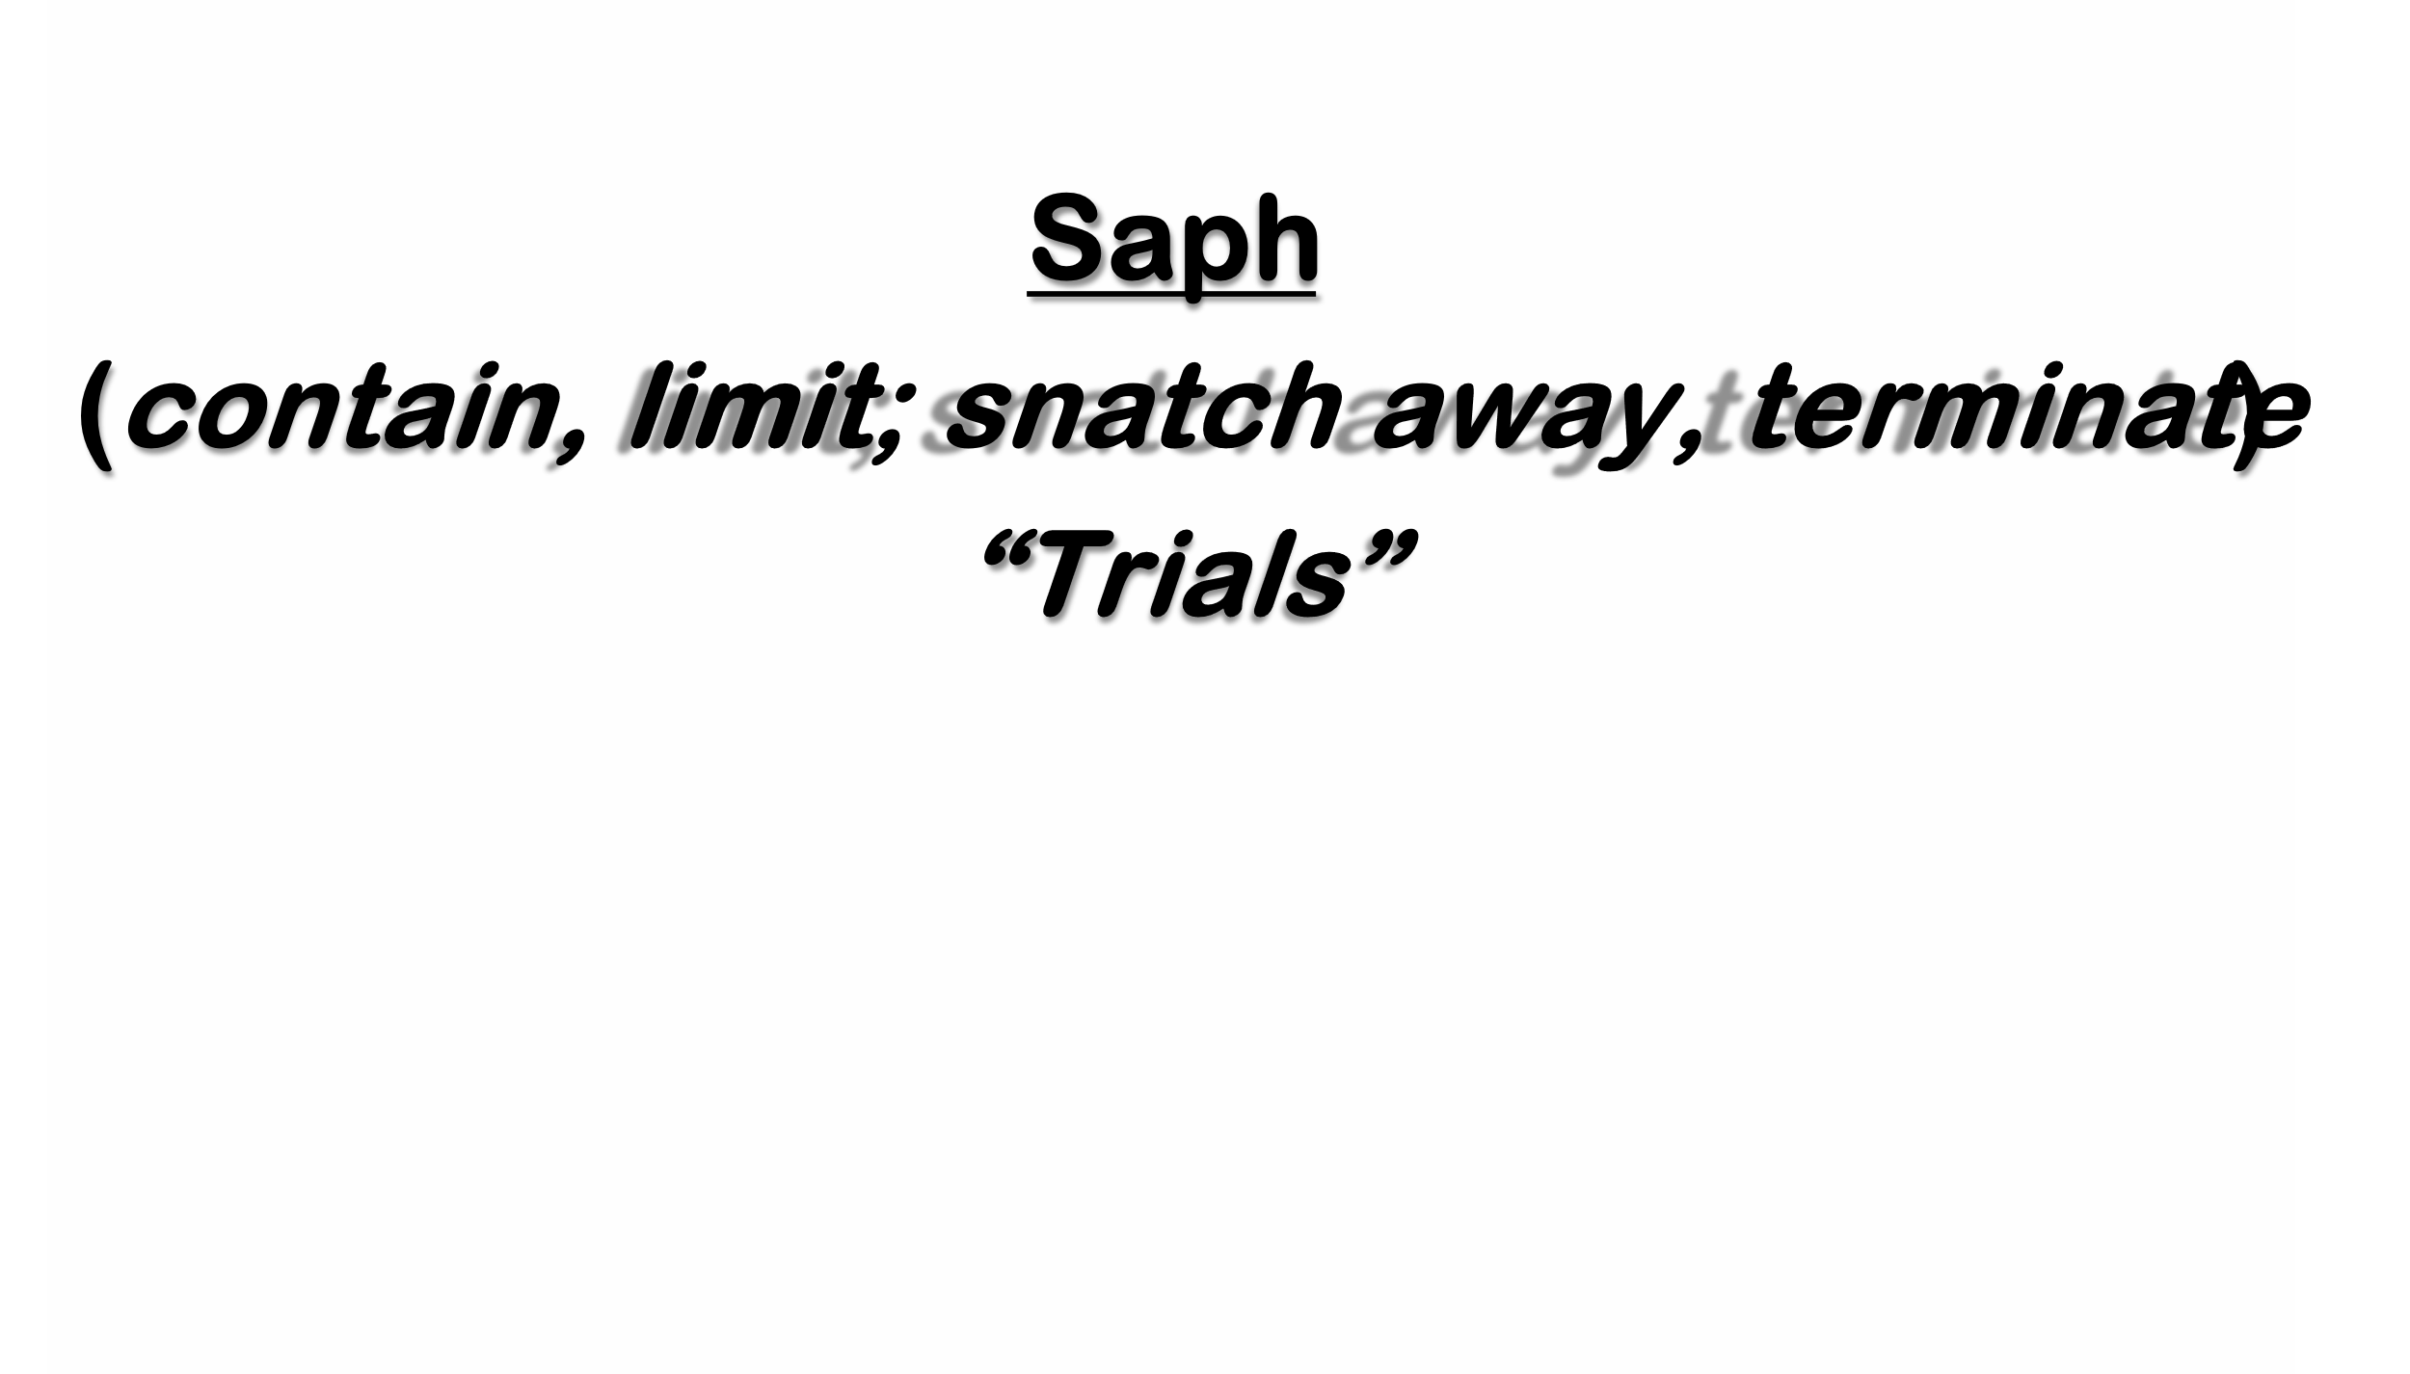
Elhanan (stoop down) son of
Jaare Oregim (mighty + fruitful)
“Apply the Cross”
  Psalm 91:1 (AMP)
HE WHO dwells in the secret place of the Most High shall remain stable and fixed under the shadow of the Almighty [Whose power no foe can withstand].
Isaiah 55:11,
“..shall My Word go forth... not return void... shall acc. I please... prosper thing I sent…”

Slide 15
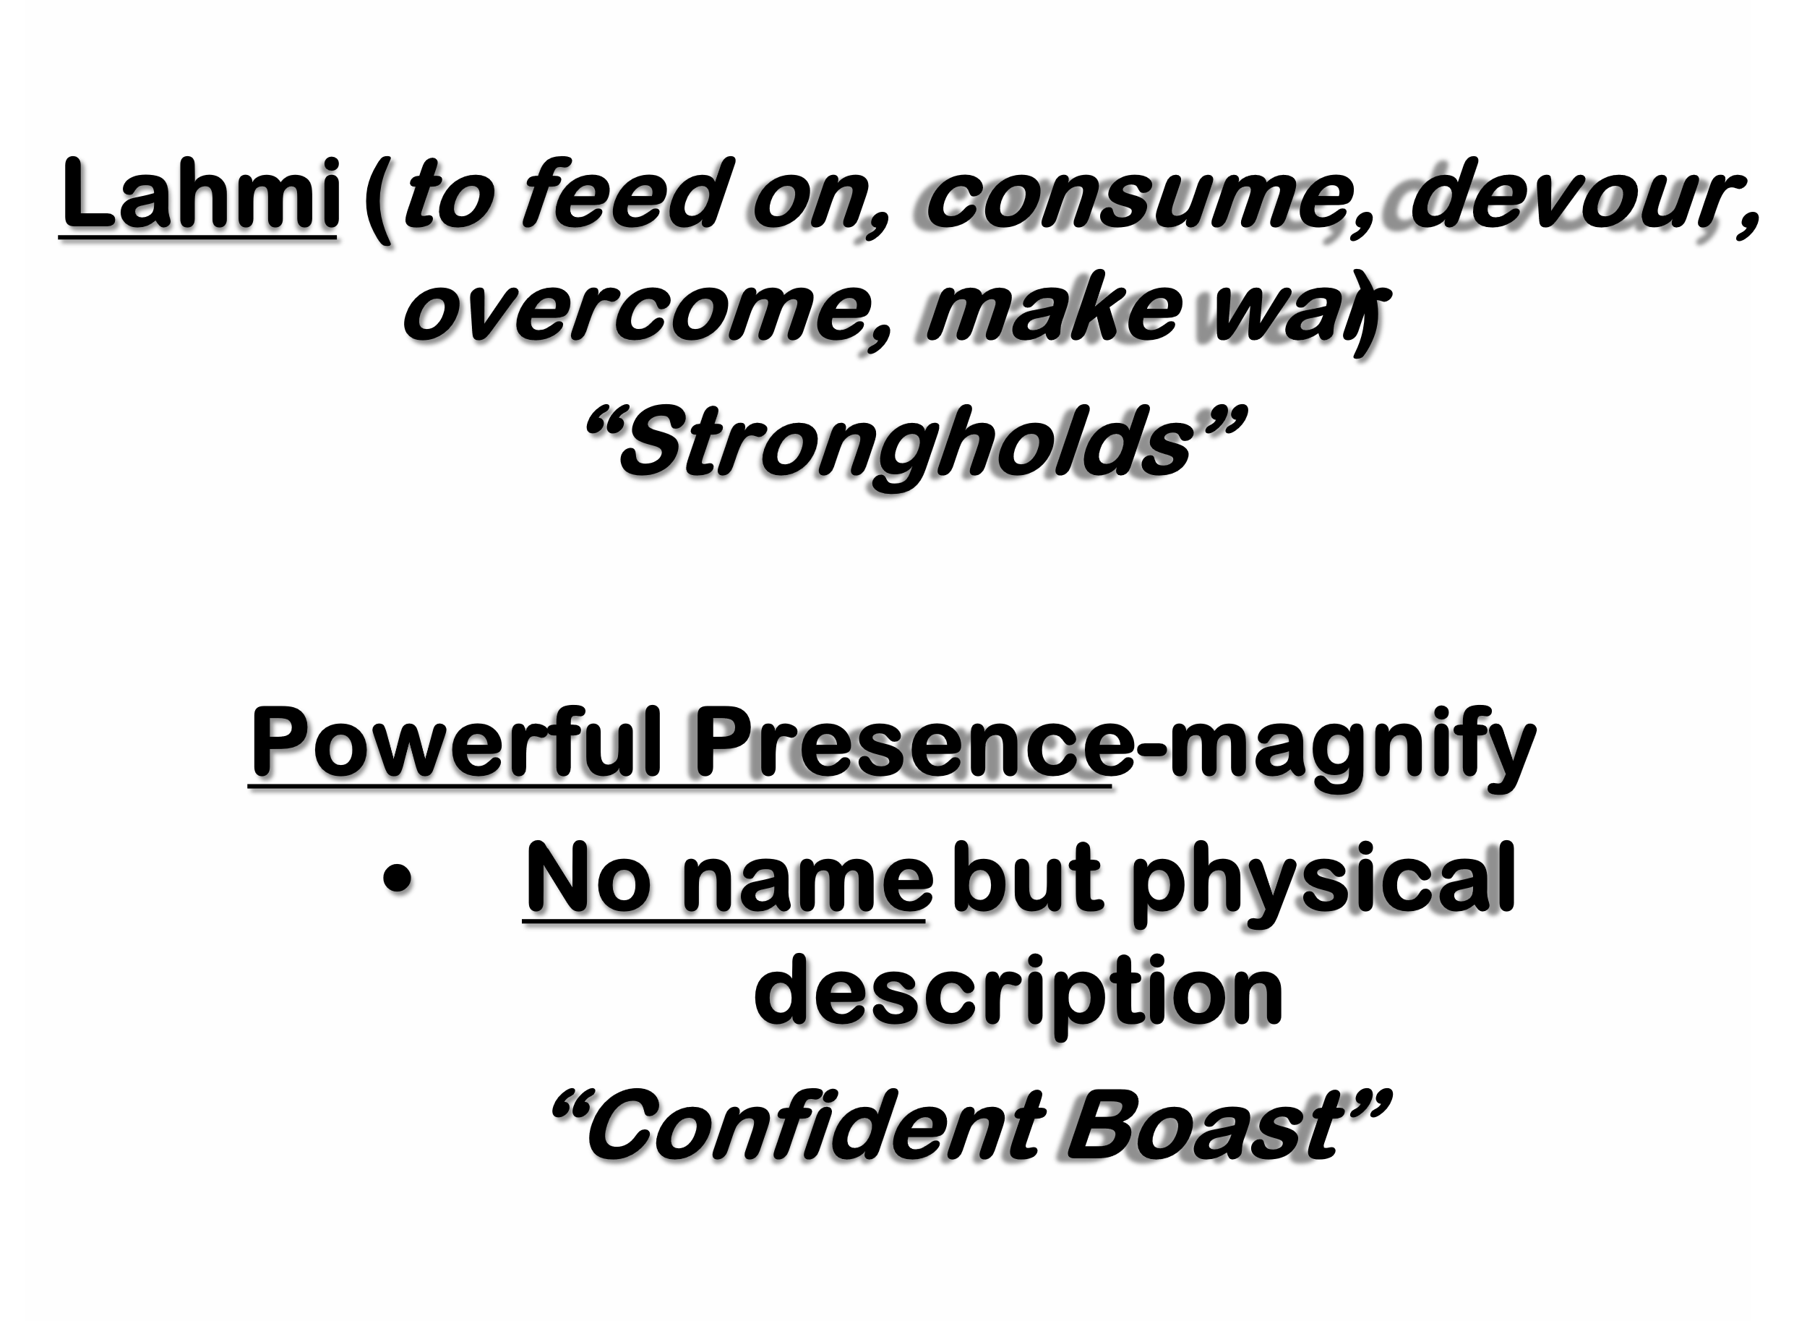
Sibbechai (to entwine)
  The Hushathite (to cover; bury)
“Hide in the Cross”
  Galatians 2:20,“I...crucified with Christ... I live... in flesh live by faith”
Jonathan (to build up as mountain)
  Son of Shammah (he is there)
“Trust the Cross”
  I Peter 5:6, “Humble selves under M. Hand God... exalt (elevate) in due time”

Slide 16
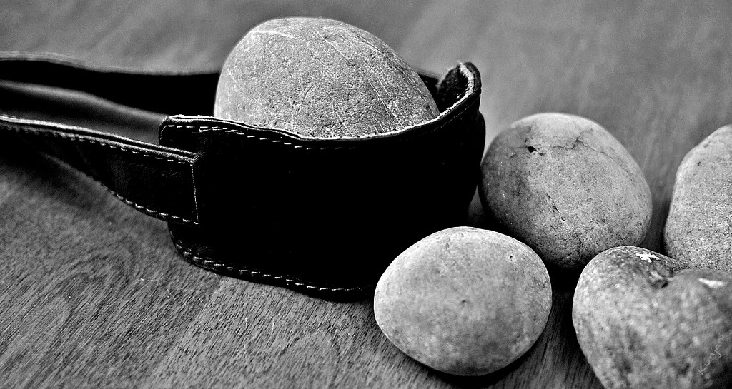
2 Samuel 21:22 (KJV)
These four were born to the giant in Gath, / fell by the hand of David, and by the hand of his servants.

Slide 17
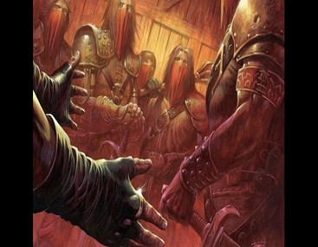
Giants Still Fall
No Giant is a Match for the Cross
Nothing in My Hands I Bring…
…Only to the Cross I Cling
The Cross is Our Assurance…
…We Win!

Slide 18
