Slide 2
Dealing With Difficult People Pt 3
November 13, 2022
Edward Church
The “Do’s”
Philippians 2:3-4

Slide 3
How Many Know People Who… …Remind You of This?
We All Have Them…
…in Our
Past
Present
Future
Can’t Always Avoid…
..but Can Learn How to Handle

Slide 4
All of Us Can Be Grumpy & Difficult to Deal With
From Time to Time We Will…
…Encounter Folks Who Behave in the Same Way, or Worse
When You to Deal With Difficult People (And You Will)…
…The Following Tips Should Help:

Slide 5
Realize
Difficult People Are a Part of Life
You Can’t Always Avoid them
If You Don’t Deal w- Them Correctly
They Will Sap Your Energy
Weigh You Down
But Dealt With Correctly
Both Will Be Bettered

Slide 6
Check Self - Don’t Be the One Being Difficult
Don’t Try to Change the Other Person
That's why we can be so sure that every detail in our lives of love for God is worked into something good. -Romans 8:28 (MSG)
Don’t Lecture
Do Not Protect Them from Consequences
Don’t Allow Yourself to Become Caught Up in the Other Person’s Emotional Outbursts

Slide 7
Do Stand Up for Yourself
If You’re Being Mistreated…
Physically
Emotionally
It’s Time to Start Taking Care of Yourself.
It Doesn’t Require an Angry Outburst
But in a Calm, Mature, Resolute Manner.
For He Himself has said, “I will never leave you nor forsake you.” 6So we may boldly say: “The LORD is my helper; I will not fear. What can man do to me?” -Heb 13:5

Slide 8
Do Forgive
If You Can’t Forgive Those Who Have Hurt You,
You’re Hurting Yourself More Than You’re Hurting Anyone Else.
Forgiveness Should Not Be Confused With Enabling
After You’ve Forgiven The Difficult Person In Your Life…
…You Are Not Compelled To Accept Continued Mistreatment
14“ For if you forgive men their trespasses, your heavenly Father will also forgive you. 15“ But if you do not forgive men their trespasses, neither will your Father forgive your trespasses. –Matt 6:14-15

Slide 9
Do Learn to Laugh in the Difficult Times
Life Has a Lighter Side—Look For It…
…Especially When Times are Tough.
Laughter is medicine for the soul, so take your medicine early and often. (Proverbs 17:22)

Slide 10
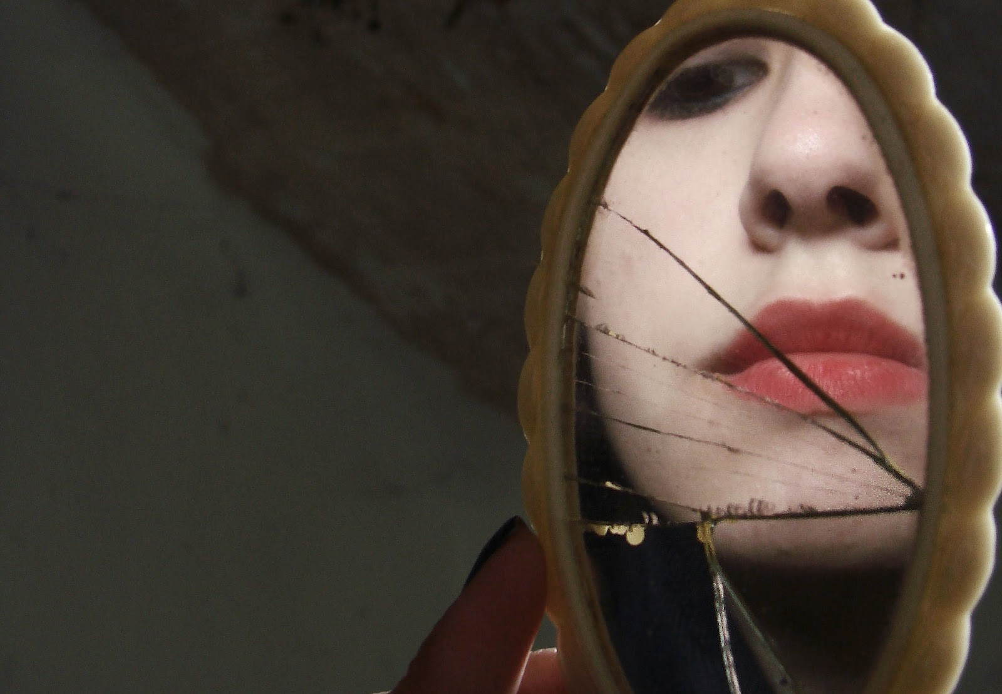
Do Accept Personal Responsibility…
Make Your Own Corner of the World Peaceful, Productive, Purposeful
If Your World Is a Little Crazy…
…Perhaps It’s Time to Consult Who You See in the Mirror.

