Slide 2
Thanksgiving

Slide 3
Dealing with TOXIC
Edward Church
November 20, 2022
Pt 1

Slide 4
It’s that Time of the Year
The Holidays Are Filled with Family
Fun
Meals
Celebrations
Memories Made and Remembered
Also Opportunities to Be Exposed to …
TOXIC

Slide 6
Key Traits of a Toxic
Negativity
Blaming others
Being critical and judgmental
A lack of empathy
A sense of entitlement
Manipulativeness
Exploiting Others
Difficulty regulating unwanted emotional states
Using guilt as "emotional blackmail" to get what they want
Assuming the victim role
Being passive-aggressive
Hostility
Being untrustworthy.

Slide 7
Does Any of These…
Sound Familiar?
Remind You of Someone?
Ever See Any of These in Mirror?
How Do You Handle These People?
How Do You Deal w- Attitudes?
Especially When You Can’t Walk Away
Does the Bible Teach Us How To
Handle these Kind of People?

Slide 8
Romans 12:17-21 (NLT2) ¹⁷ Never pay back evil with more evil. Do things in such a way that everyone can see you are honorable. ¹⁸ Do all that you can to live in peace with everyone. ¹⁹ Dear friends, never take revenge. Leave that to the righteous anger of God. For the Scriptures say, “I will take revenge; I will pay them back,” says the LORD. ²⁰ Instead, “If your enemies are hungry, feed them. If they are thirsty, give them something to drink. In doing this, you will heap burning coals of shame on their heads.” ²¹ Don’t let evil conquer you, but conquer evil by doing good.
Romans 12:17-21 (MSG) ¹⁷ Don't hit back; discover beauty in everyone. ¹⁸ If you've got it in you, get along with everybody. ¹⁹ Don't insist on getting even; that's not for you to do.
"I'll do the judging," says God. "I'll take care of it." ²⁰ Our Scriptures tell us that if you see your enemy hungry, go buy that person lunch, or if he's thirsty, get him a drink. Your generosity will surprise him with goodness. ²¹ Don't let evil get the best of you;
get the best of evil by doing good.

Slide 9
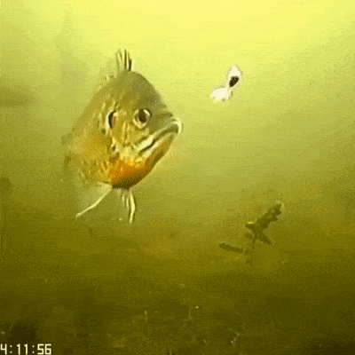
Don’t Take the Bait! (17)

Slide 10
(17) Don’t Take the Bait
Do Not Let Ourselves Be Contaminated With Their Toxic Emotions By Replicating Their Actions Against Them.
If we let the actions or attitudes of the other generate in us the same negative responses, we are giving that person a power that they should not have.
The power to transform us into what that person is.
We are letting ourselves be overcome by evil, and we ourselves are becoming part of the problem.

Slide 11
Don’t BE Overwhelmed By Negative… …Overwhelm the Negative w- Positive (19-21)
Choosing a Better Path Than Paying Them Back.
It is overcoming evil with good.
We can choose the path of freedom.
The way of forgiveness, the way of healing.
Giving a positive response to a negative stimulus will always be more difficult, but you will be taking care of your mind and soul.
You will be doing what is best for yourself and for each other.
Overcome Evil With Good
Heaps Fires of Coals On Head

Slide 12
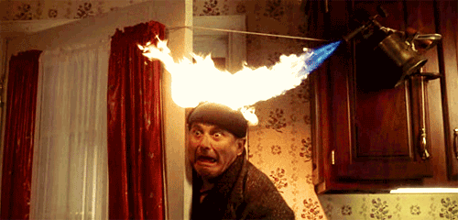

Slide 13
Do Build Bridges w- Proper Boundaries (18)
Set Proper Boundaries or Limits in Your Relationships
No Boundaries = No Bridges
When Dealing w- Toxic, it is Necessary to Set Boundaries
For Our Own Good and Theirs…
Boundaries Keep Us…
Safe
Secure
Strong
Sane!

Slide 14
Do Build Bridges w- Proper Boundaries (18)
Boundaries Should Be Decided Between You and God
They Should Be Exposed Only When You Feel Their Challenged
Not because we hate that person or because we want to repay them the same way, but because we must be wise in our actions and guard ourselves against being exposed to situations in which others hurt us.

Slide 15
Remember It is Temporary!!
Happy Thanksgiving
Enjoy the Moment and Make Memories
Don’t Take the Bait
Pour Out Positive
Set and Keep Boundaries
Remember Your Family…
…Is Not the Manson Family!!
…or the Addams Family!!

Slide 17
Part 2

Slide 18
Who are the toxic people in your life –
Maybe they are like Judas –
lying thieves, betrayers of trust. People who take advantage of every opportunity to get ahead on the backs of who ever gets in the way.
Maybe they are people that you have to rely on,
but they continually let you down.
Maybe you share the toxicity – you have a great need to please,
and they are impossible to please!
Maybe they are hateful people;
who pour their hate out on whoever is around or
the one who should show you love, but they show hate.
Maybe they have a bent, twisted negative view of the world
they share that twisted negative view with who ever will listen
Maybe they have power that they use to grind you down.
How do you deal with them?
How does Jesus deal with Judas?

Slide 19
Toxic Can Be an Attitude or Personality
Jesus Had to Confront TOXIC
Within –
Judas
Disciples
Without –
Religion
Satan
Broken
How Did He Do This…
…Effectively/ Positively?
Sometimes You Are
Confronted By Toxic Without
Confronted By Toxic Within

Slide 20
John 13:1-6 (MSG) ¹ Just before the Passover Feast, Jesus knew that the time had come to leave this world to go to the Father. Having loved his dear companions, he continued to love them right to the end. ² It was suppertime. The Devil by now had Judas, son of Simon the Iscariot, firmly in his grip, all set for the betrayal. ³ Jesus knew that the Father had put him in complete charge of everything, that he came from God
and was on his way back to God. ⁴ So he got up from the supper table, set aside his robe,
and put on an apron. ⁵ Then he poured water into a basin and began to wash the feet of the disciples, drying them with his apron.

Slide 21
Jesus was Secure in HIS
Assignment

Slide 22
Jesus’ Service
Eating with him – Middle east – to eat with is to accept – Jesus is accused of eating with sinners & thus accepting them.
Jesus ate with Judas – every day, but this special meal – the Passover, the Last Supper, the “do this in remembrance of me” meal. He shares this meal with toxic Judas.
They share the same dipping bowl: “The one who dipped his bread with me…” He shares his dipping bowl with the one who is in the midst of betraying him – and Jesus knows it – he in not unaware.
Jesus washes Judas’ feet
It is Peter he has the argument with.
Lowest service
Intimate service – two men who would not participate in the foot washing – one would leave and then the other.
Jesus way of dealing with toxic people is to serve them, show them love, and welcome them in.
If we are to follow Jesus, this is how we should deal with toxic peple!

Slide 23
You might say, that will never work!
What is our purpose? Is it to change the toxic person or is it to be like Jesus?
This is not to change Judas – it is right after this that Jesus frees him to betray Him.
It is our goal to be like Jesus, and let God change people.
Jesus’ Strength
Jesus loves & Serves Judas, not to placate him, or even to change him – we often try to placate toxic people, dance around them, avoid them.
Jesus gets in his face and serves him.
You might say, “I could never do that.” Neither could I.
Jesus does it because of the power within him.
Jesus knows who he is…
John 13:1&3
1 It was just before the Passover Festival. Jesus knew that the hour had come for him to leave this world and go to the Father. Having loved his own who were in the world, he loved them to the end.
…. 3 Jesus knew that the Father had put all things under his power, and that he had come from God and was returning to God;
We need to meditate on who we are in Christ. – that way we will not try to build our self worth by trying to please, or change, or defeat the toxic people in our lives.
Meditate on who you are in Christ – Loved, accepted, adopted, forgiven.

Slide 24
Jesus’ call
Matthew 5:43-44 "You have heard that it was said, ’Love your neighbor and hate your enemy.’ But I tell you, love your enemies and pray for those who persecute you, that you may be children of your Father in heaven. He causes his sun to rise on the evil and the good, and sends rain on the righteous and the unrighteous.”
Luke 6:27,28 &36
"But to you who are listening I say: Love your enemies, do good to those who hate you, bless those who curse you, pray for those who mistreat you. … Be merciful, just as your Father is merciful.”
Paul’s call
Romans 12:14-21
Bless those who persecute you; bless and do not curse. …
Do not repay anyone evil for evil. …Do not take revenge, my dear friends, but leave room for God’s wrath, for it is written: "It is mine to avenge; I will repay," says the Lord. On the contrary:
If your enemy is hungry, feed him; if he is thirsty, give him something to drink. In doing this, you will heap burning coals on his head." (and they will be ashamed of what they have done to you – NLT)
Do not be overcome by evil, but overcome evil with good.

Slide 26
Toxic Can Be an Attitude or Personality
Jesus Had to Confront TOXIC
Within –
Judas
Disciples
Without –
Religion
Satan
Broken
How Did He Do This…
…Effectively/ Positively?
Sometimes You Are
Confronted By Toxic Without
Confronted By Toxic Within

Slide 27
Don’t
…Be Contaminated With Their Toxic Emotions
Do
…Give A Positive Response To A Negative Stimulus
Do
…Set Boundaries When Dealing With Toxic People

Slide 28
Do not let yourself be overcome by evil; on the contrary, overcome evil with good.
It’s giving us a very interesting principle for dealing with toxic people.
These people who hate us or hurt us.

Slide 29
How to Deal with Difficult People Biblically
Jesus suffered significantly at the hands of sinners, toxic people, religious people, and difficult people. As His followers, we should learn from Him how to handle difficult situations better.
Jesus prayed beforehand (Matthew 26:44).
A lifestyle of prayer gives us the grace to deal with difficult people in a way that glorifies God.
Jesus caused others to marvel because of His silence (Mark 14:61).
James 1:19 reveals the secret to dealing with difficult people, “slow to speak, slow to anger, and swift to hear”.
Jesus took the beating.
He wasn’t a pacifist; He was powerful. 2 Timothy 2:3 says, “Endure hardship as a good soldier of Jesus Christ.”
Jesus poured out His heart to the Father (Mark 15:34).
It’s okay to have doubts, fears, and complaints, but open up to the right people, like Jesus with His Father.
Jesus forgave before they apologized (Luke 22:34).
If you’re hurting, quickly forgive for your own sake. “Do not let the sun go down on your wrath” (Ephesians 4:26b).
Jesus responded to the Father; He did not react to people (Luke 23:46).
Focus on living in obedience to God. Pause and ponder, what would He want you to do in this situation?
Jesus ministered while suffering (Luke 22:49-51).
Don’t let pain stop your purpose, minister to someone who is going through worse situations than you.
Jesus received ministry from others.
Mary poured anointing oil on Him, and Simon helped carry His cross. God will use people to heal and minister to you in your suffering.
Jesus didn’t associate with the Pharisees after His resurrection.
Learn to set distance and boundaries with people who are toxic.
Jesus rose again, so will you.
Difficult people may repent, so no matter how much pain people caused you, your greatest ministry and pleasures will also involve people.

Slide 30
Toxic People and Attitudes in the Bible
Judas
Saul/ Paul
James/ John- sons of thunder
Peter – when you are converted
The Twelve
Demas
Saul
Samson
Eve

Slide 31
How do we handle the toxic people in our lives?
Or even just the regular folks who might have toxic behaviors (attitudes)?
Love them from your heart – ask God to give you this love. Do acts of love and service for them with out expecting a positive response. Pray prayers of blessing for them rather than prayers of change.
Ask God if you are the one to confront them, what is his timing,
what are his words?
Do it soon. Speak before things “come to a head.” This might help you with your frustration.
Do it privately – this is not to shame your friend.
Express as much hope and care as you can in ways that they can receive.
Pray Hard!

Slide 33
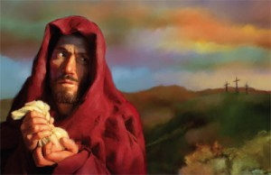
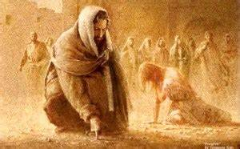

Slide 34
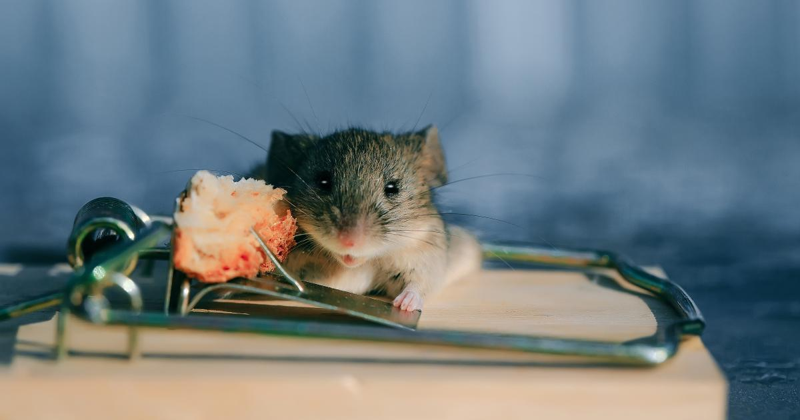
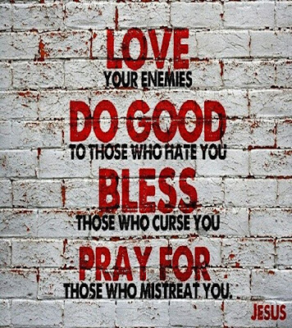

Slide 36
Do Build Bridges w- Proper Boundaries (18)
Set Proper Boundaries or Limits in Your Relationships
No Boundaries = No Bridges
When Dealing with Toxic, it is Necessary to Set Boundaries.
For Our Own Good and Theirs…
Boundaries Keeps Us…
Safe
Secure
Strong
Sane!

