Slide 2
The Miserable Blessing
Luke 1
Part 1
December 4, 2022
Edward Church

Slide 3
The Message of Prosperity…
…Has Not Only Softened
…the Gospel Message
…it has Softened Many Pilgrims

Slide 4
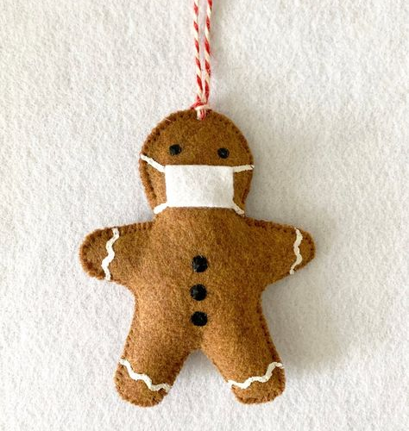
22
Plus

Slide 5
This Mindset has Crept into the Church
We Want to Be An Overcomer…
..With Out the Challenge of Overcoming
We Want the Spoils of Victory …
…Without the Scars of the Battle
That Has Never Been God’s Plan

Slide 6
That Has Never Been God’s Plan
He is Raising Up a Mighty Army…
…Not Afraid to Face the Challenge
…Not Afraid to Collect Scars
…to Stand in this Last Generation
…and Declare…
We Will Not Go Silently in the Night!

Slide 7
Easy to Lose Sight of REAL BLESSINGS
Real Blessings Don’t Always Come…
without Struggle
without Pain
with Answers
Often Leaves You Asking..
Lord…
If I Am SO BLESSED…
…Then Why Am I So Miserable?

Slide 8
Blessing = Building
Building = Struggle
Struggle = Misery (temporary)
Misery = Blessing
2 Corinthians 4:17
For our light affliction, which is but for a moment, worketh for us a far more exceeding and eternal weight of glory;
Affliction=tribulation, distress, misery

Slide 9
The Promise - Time
Abraham Seed
The Problem - Test
Barren
The Path - Testimony
Let Go and Let God
Not Matter of Earning Blessing
But Matter of Letting God
Build You to Be Able to Handle Blessing
Rem the Blessing Glorifies God

Slide 10
⁵ There was in the days of Herod, the king of Judaea, a certain priest named Zacharias, of the course of Abia: and his wife was of the daughters of Aaron, and her name was Elisabeth. ⁶ And they were both righteous before God, walking in all the commandments and ordinances of the Lord blameless. ⁷ And they had no child, because that Elisabeth was barren, and they both were now well stricken in years. ⁸ And it came to pass, that while he executed the priest's office before God in the order of his course, ⁹ According to the custom of the priest's office, his lot was to burn incense when he went into the temple of the Lord. ¹⁰ And the whole multitude of the people were praying without at the time of incense. ¹¹ And there appeared unto him an angel of the Lord standing on the right side of the altar of incense. ¹² And when Zacharias saw him, he was troubled, and fear fell upon him. ¹³ But the angel said unto him, Fear not, Zacharias: for thy prayer is heard; and thy wife Elisabeth shall bear thee a son, and thou shalt call his name John. ¹⁴ And thou shalt have joy and gladness; and many shall rejoice at his birth.

Slide 11
¹⁵ For he shall be great in the sight of the Lord, and shall drink neither wine nor strong drink; and he shall be filled with the Holy Ghost, even from his mother's womb. ¹⁶ And many of the children of Israel shall he turn to the Lord their God. ¹⁷ And he shall go before him in the spirit and power of Elias, to turn the hearts of the fathers to the children, and the disobedient to the wisdom of the just; to make ready a people prepared for the Lord. ¹⁸ And Zacharias said unto the angel, Whereby shall I know this? for I am an old man, and my wife well stricken in years. ¹⁹ And the angel answering said unto him, I am Gabriel, that stand in the presence of God; and am sent to speak unto thee, and to shew thee these glad tidings. ²⁰ And, behold, thou shalt be dumb, and not able to speak, until the day that these things shall be performed, because thou believest not my words, which shall be fulfilled in their season. ²¹ And the people waited for Zacharias, and marvelled that he tarried so long in the temple. ²² And when he came out, he could not speak unto them: and they perceived that he had seen a vision in the temple: for he beckoned unto them, and remained speechless. ²⁴ And after those days his wife Elisabeth conceived, and hid herself five months, saying, ²⁵ Thus hath the Lord dealt with me in the days wherein he looked on me, to take away my reproach among men. Luke 1:5-39 (KJV)

Slide 12
The Miserable Blessing Starts…
Zacharias and Elisabeth
Zacharias Doubts Message -Miserable
Zacharias Stricken Dumb -Miserable
Elisabeth Happy but Hiding -Miserable
Baby Not Moved til Mary Arrives - -Miserable
Zacharias Mouth Opens When Delivers Name

Slide 13
Know …
He is Still IN Charge
He Has Your Best Interest at Heart
His Timing is Always Perfect
When You Can’t See His Plan
When You Can’t See His Hand
You Can Trust His Heart!

