Slide 1
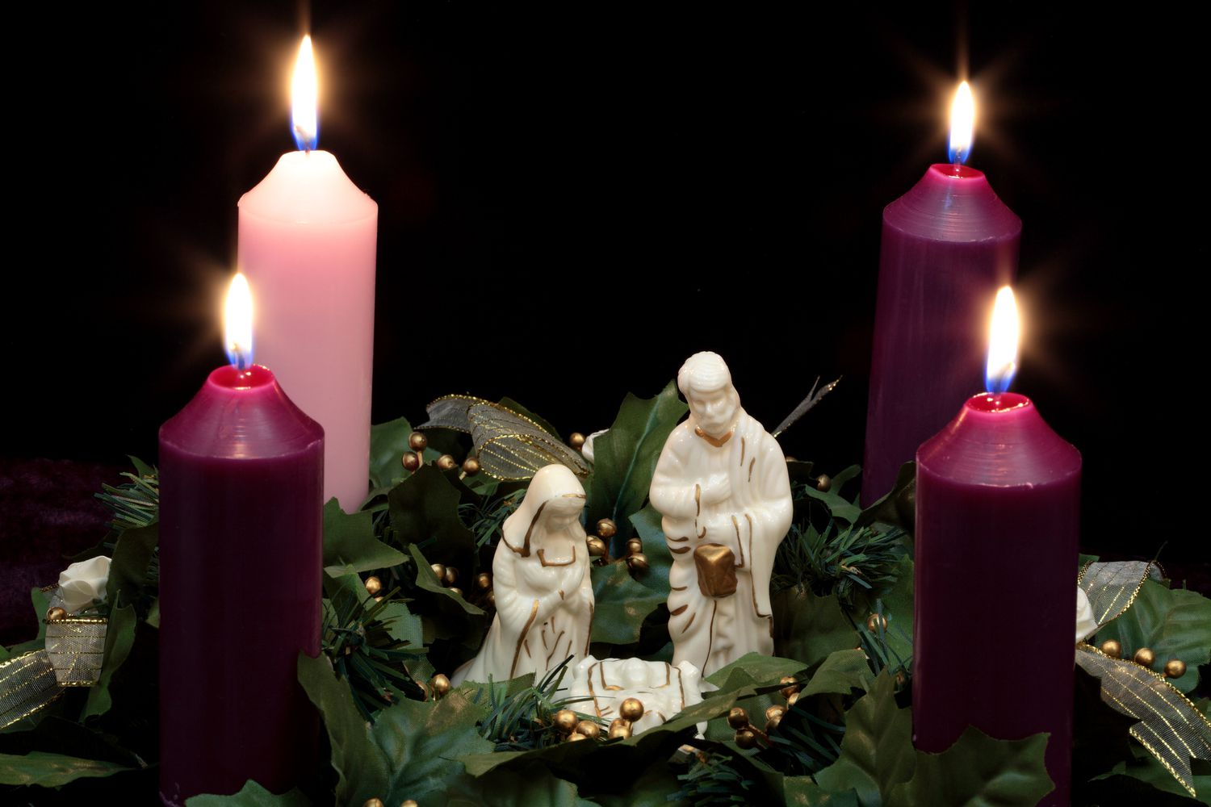
Jesus is Born
Praise God!

Slide 3
Christmas 2022 Isaiah 9:4-7
Pt 1

Slide 4
Unrest
Most Sought Word of this Day
“Rest”
Real Rest
Only Found with…
God’s Rest
“Not Cessation from Activity
but Relief in the Midst of It”
Watch Word of this Day
“Unrest”
Civil Unrest
Racial Unrest
Economic Unrest
Health Care Unrest
Global Unrest

Slide 5
This Problem has Been Around for Thousands of Years
Although the Causes are Many
The Solution isn’t…
Isaiah 9:4-7 (AMP) ⁴ For the yoke of [Israel's] burden, and the staff or rod for [goading] their shoulders, the rod of their oppressor, You have broken as in the day of [Gideon with] Midian. ⁵ For every [tramping] warrior's war boots and all his armor in the battle tumult and every garment rolled in blood shall be burned as fuel for the fire. ⁶ For to us a Child is born, to us a Son is given; and the government shall be upon His shoulder, and His name shall be called Wonderful Counselor, Mighty God, Everlasting Father [of Eternity], Prince of Peace. ⁷ Of the increase of His government and of peace there shall be no end, upon the throne of David and over his kingdom, to establish it and to uphold it with justice and with righteousness from the [latter] time forth, even forevermore. The zeal of the Lord of hosts will perform this.

Slide 6
Isaiah’s Day
Tough Time for God’s People
Captivity
Suffering
Pain
Some for What “They Did”
Some for What “Others Did”
No Matter Reason
Pain was Still the Same
Cure was Still Same
A Child
Emmanuel(God with Us!)

Slide 7
Turn Around was Coming!
9:1-5 Sums Up…
It Will Not Always Be Like This
Better Days are Ahead
God has a Plan
Give Him a Chance to Work!
It May Not Come…
When you Expect
Like you Expect
How you Expect -but
Always on Time – (fullness of time)

Slide 8
He Saw a Cradle-
“Unto us a child is born”
His Humanity
Job 9:33 NLT-
If only there were a mediator between us, someone who could bring us together.
John 1:14 –
the Word was made flesh, / dwelt among us…

Slide 9
He Saw a Cross
"Unto us a son is given”
His Deity
Rom 5:6- When we were utterly helpless, Christ came at just the right time and died for us sinners.
Final Word- It is Finished! –
God For Us
Satan thought he had Won!
But on that Cross was Our Mighty God!!

Slide 10
He Saw a Crown
"The government shall be upon His shoulders”
His Lordship
In the Beginning is the Word
John 1:1, In the beg was the Word,/
the Word was w- God, / the Word was God.
In the End is the Word
Rev 19:16, on his thigh a name written, KING OF KINGS, AND LORD OF LORDS

Slide 11
When the Word Became a Child
The Creator of the universe became one of us.
He became one of us to die for us.
He became like us to free us.
He walked among us to guide us.
He stayed with us, to teach us.
He Rose from the Dead to set us free
TRUE REST is not the absence of Conflict
But God’s Presence/ Power in It’s Midst

