Slide 2

From Surviving to Thriving
New Year – New ________________

Slide 3
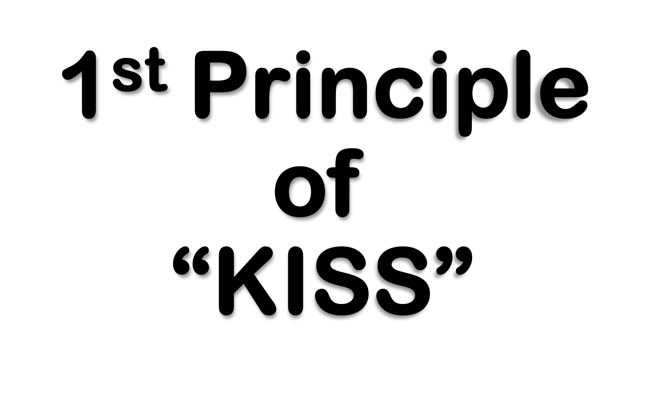
Focus On What You Can Do
Instead of
What You Can’t Do
Focus On What You Do Have
Instead of
What You Don’t Have

Slide 4

Come they told me, pa rum pum pum pum A new born King to see, pa rum pum pum pum Our finest gifts we bring, pa rum pum pum pum To lay before the King, pa rum pum pum pum, Rum pum pum pum, rum pum pum pum,
So to honor Him, pa rum pum pum pum, When we come.
Baby Jesus, pa rum pum pum pum I am a poor boy too, pa rum pum pum pum I have no gift to bring, pa rum pum pum pum That's fit to give the King, pa rum pum pum pum, Rum pum pum pum, rum pum pum pum,
Focus “Don’t Haves”
Self
What He Has
What He Has to Give

Slide 5
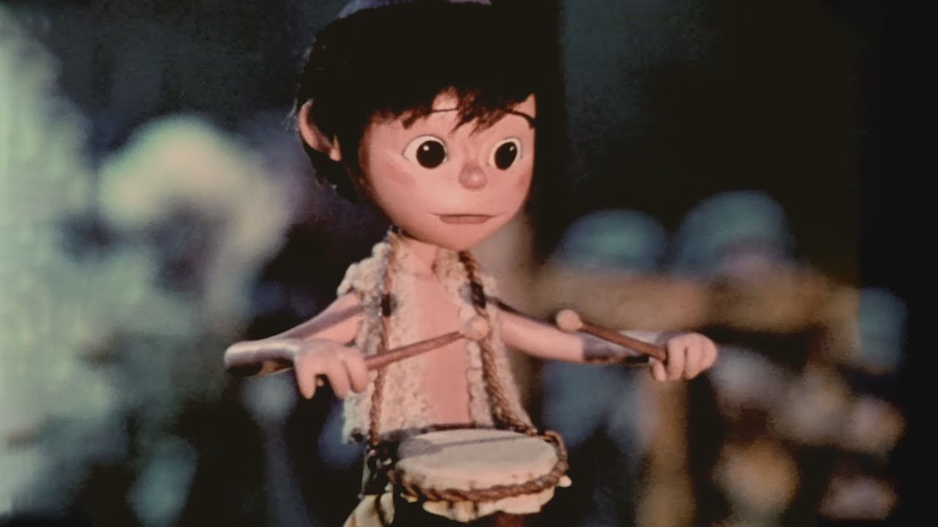
Shall I play for you, pa rum pum pum pum, On my drum?
Mary nodded, pa rum pum pum pum The ox and lamb kept time, pa rum pum pum pum I played my drum for Him, pa rum pum pum pum I played my best for Him, pa rum pum pum pum, Rum pum pum pum, rum pum pum pum,
Then He smiled at me, pa rum pum pum pum Me and my drum.
Focus “Do Haves”
What He Can Do
What He Does Have
It IS Noticed
Did it w- All Heart
It Pleased God

Slide 6
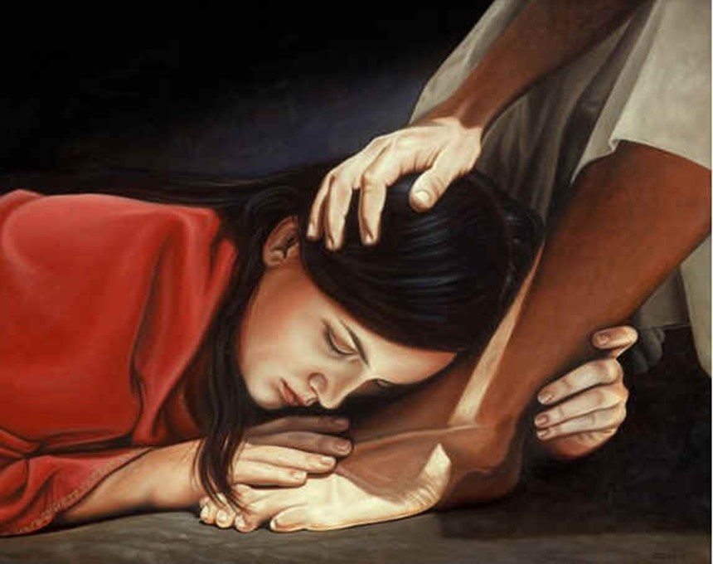
¹ It was now two days before Passover and the Festival of Unleavened Bread. The leading priests and the teachers of religious law were still looking for an opportunity to capture Jesus secretly and kill him. ² “But not during the Passover celebration,” they agreed, “or the people may riot.” ³ Meanwhile, Jesus was in Bethany at the home of Simon, a man who had previously had leprosy. While he was eating, a woman came in with a beautiful alabaster jar of expensive perfume made from essence of nard. She broke open the jar/ poured the perfume over his head. ⁴ Some of those at the table were indignant. “Why waste such expensive perfume?” they asked. ⁵ “It could have been sold for a year’s wages and the money given to the poor!” So they scolded her harshly. ⁶ But Jesus replied, “Leave her alone. Why criticize her for doing such a good thing to me? ⁷ You will always have the poor among you, and you can help them whenever you want to. But you will not always have me. ⁸ She has done what she could and has anointed my body for burial ahead of time. ⁹ I tell you the truth, wherever the Good News is preached throughout the world, this woman’s deed will be remembered and discussed.” - Mark 14:1-9 (NLT2)

Slide 7
She Recognized Her Opportunity… (3)
Some Often..
“Think” …of what They Would Do
Their Life Overshadowed by “What If ?”
If I had certain talent, skill, ability
“Complain” …about what Others Do
Their Life Overshadowed by “Why Them?”
“Complain” …about what Others Don’t Do
Their Life Overshadowed by…
…“Why Not Someone Else?”

Slide 8
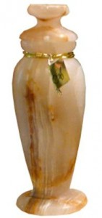
She Recognized...She Couldn’t Do All
…But She Could Do Something (3)
This Woman Did Something.
She:
“Sought out” of her Best
Alabaster Box (Spikenard)
“Counted out” the Cost
300 denari –yrs wage
“Gave out” Freely
Broke/ Poured

Slide 9

She Did What She Could Do...
…While She Could Do It (3, 8)
Church Paralyzed by Procrastination
3 Signs:
Some are Going to Do Something…
Sometime
Ecc 11:4, “..observeth wind..not sow..”
Tomorrow
Matt 6:33-34, “seek 1st..not thought ..”
Waiting for Right Time
II Cor 6:2, “now accepted time..”

Slide 10
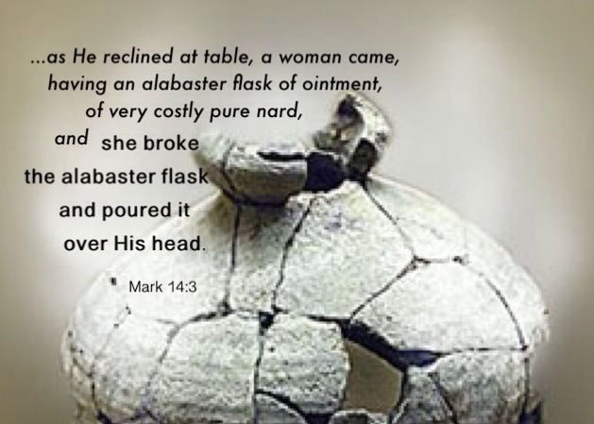
Jesus Recognized Her Effort
Recognized the Timing (1-3)
Rebuked Her Critics (4-6)
Recognized Her Effort (7-8)
Rewarded Her Sacrifice (9)

Slide 11

For God
In 2023
This Year of
Transition
Colossians 3:23-24 Whatever you do, work heartily, as for the Lord and not for men, knowing that from the Lord you will receive the inheritance as your reward. You are serving the Lord Christ.

