Slide 1
Repeat
These are the 2 Most Important Hours of My Week – Help Me to Cherish Them
I Am Here Today to Worship
Not to Be Entertained
I Am Singing to An Audience of One
Accept My Worship Oh Lord!

Slide 2
Thank You God
For This NEW…
Year
Start
Opportunities
Challenges
Victories
Help Me to Take Advantage of These New Opportunities

Slide 4

From Surviving to Thriving P2
New Year – New ________________

Slide 5
2nd Principle
of
“KISS”
Give God Your Best
Refuse to Give Him Leftovers

Slide 6

Anybody Notice How Hard Things Have Been Lately ?
“Challenge” is the Word of this Season
Satan Sends Challenges to Break Us
Break Our Commitment, Calling, Concentration
God Allows Challenges to Build Us
Build Our Commitment, Calling, Concentration
The Final Decision is Always Ours
One Way to Discover Which Way We Are Leaning?
Are We Giving God Leftovers…
Is Our Commitment Waning?
Our Calling Doubted?
Our Concentration Broken?

Slide 7
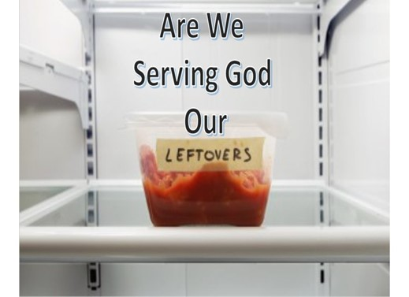
A Good Way to Build vs Break Our…
Commitment, Calling, Concentration
Starts By Refusing to Give God Our Leftovers
When You Start Giving God Your Best …
You Will Start Building/ Rebuilding Your
Commitment, Calling, Concentration

Slide 8

God exhorts us to do all for the glory of God- 1 Cor. 10:31
To work at whatever we do with all our heart- Col. 3:23
Do it all in the name of the Lord Jesus- Col. 3:17
Do your best to present yourself to God as one approved-
2 Tim 2:15
“run in such a way as to get the prize … not like
someone running aimlessly” - 1 Cor. 9:24-27

Slide 9

¹ It was now two days before Passover and the Festival of Unleavened Bread. The leading priests and the teachers of religious law were still looking for an opportunity to capture Jesus secretly / kill him. ² “But not during the Passover celebration,” they agreed, “or the people may riot.” ³ Meanwhile, Jesus was in Bethany at the home of Simon, a man who had previously had leprosy. While he was eating, a woman came in with a beautiful alabaster jar of expensive perfume made from essence of nard. She broke open the jar/ poured the perfume over his head. ⁴ Some of those at the table were indignant. “Why waste such expensive perfume?” they asked. ⁵ “It could have been sold for a year’s wages / the money given to the poor!”
So they scolded her harshly. ⁶ But Jesus replied, “Leave her alone. Why criticize her for doing such a good thing to me? ⁷ You will always have the poor among you, and you can help them whenever you want to. But you will not always have me. ⁸ She has done what she could and has anointed my body for burial ahead of time. ⁹ I tell you the truth, wherever the Good News is preached throughout the world, this woman’s deed will be remembered and discussed.” - Mark 14:1-9 (NLT2)

Slide 10
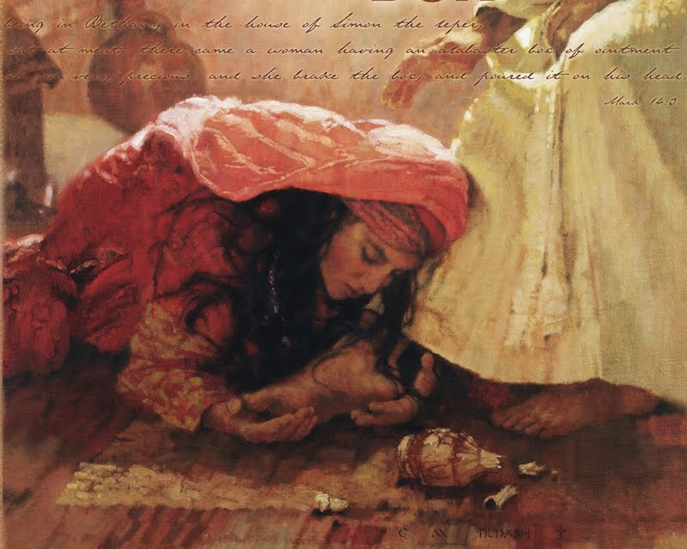
Alabaster Box
“She Had Little (ONE Thing)”
She Focused on What She Had
Verses
What She Didn’t Have
She Didn’t Hesitate to Give Him Her Best
Jesus Responded with His Best
“Remembered and Discussed”

Slide 11

Mark 12:41-44 (KJV) ⁴¹ And Jesus sat over against the treasury, and beheld how the people cast money into the treasury: and many that were rich cast in much. ⁴² And there came a certain poor widow, and she threw in two mites, which make a farthing. ⁴³ And he called unto him his disciples, and saith unto them, Verily I say unto you, That this poor widow hath cast more in, than all they which have cast into the treasury: ⁴⁴ For all they did cast in of their abundance; but she of her want did cast in all that she had, even all her living.
Mark 12:41-44 (MSG) ⁴¹ Sitting across from the offering box, he was observing how the crowd tossed money in for the collection. Many of the rich were making large contributions. ⁴² One poor widow came up and put in two small coins—a measly two cents. ⁴³ Jesus called his disciples over and said, "The truth is that this poor widow gave more to the collection than all the others put together. ⁴⁴ All the others gave what they'll never miss; she gave extravagantly what she couldn't afford—she gave her all."

Slide 12
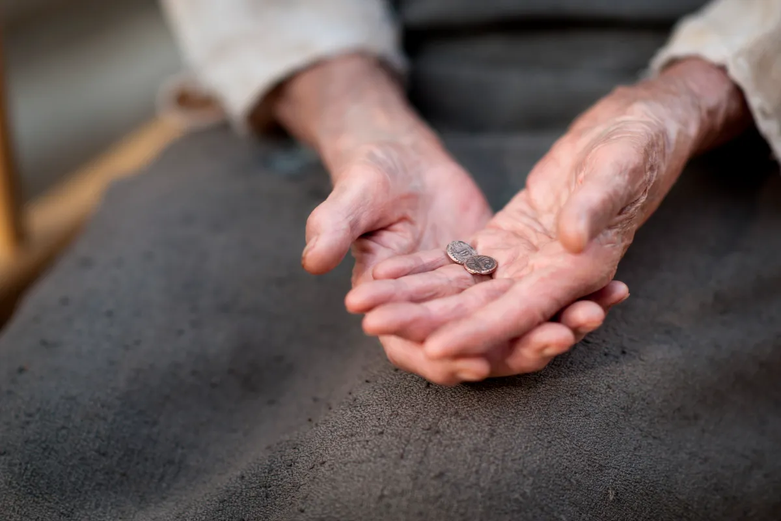
Widow’s Mite
“She Had Very Little”
Two Mites, Together Worth Half a Cent
Smallest Copper Coins In Circulation
Represented The Smallest Contribution Lawful to Make Jesus Said She Gave More than the Others
Her Attitude was Greater than Her Actions
God Loves a “Cheerful Giver”
2 Corinthians 9:6-7 (KJV) ⁶ But this I say, He which soweth sparingly shall reap also sparingly; and he which soweth bountifully shall reap also bountifully. ⁷ Every man according as he purposeth in his heart, so let him give; not grudgingly, or of necessity: for God loveth a cheerful giver.

Slide 13

2 Samuel 24:24-25 (KJV) ²⁴ And the king said unto Araunah, Nay; but I will surely buy it of thee at a price: neither will I offer burnt offerings unto the LORD my God of that which doth cost me nothing. So David bought the threshingfloor and the oxen for fifty shekels of silver. ²⁵ And David built there an altar unto the LORD, and offered burnt offerings and peace offerings. So the LORD was intreated for the land, and the plague was stayed from Israel.
2 Samuel 24:24-25 (MSG) ²⁴ But the king said to Araunah, "No. I've got to buy it from you for a good price; I'm not going to offer GOD, my God, sacrifices that are no sacrifice." So David bought the threshing floor and the ox, paying out fifty shekels of silver. ²⁵ He built an altar to GOD there and sacrificed burnt offerings and peace offerings. GOD was moved by the prayers and that was the end of the disaster.

Slide 14
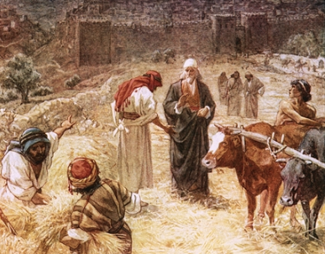
David’s Powerful Choice
“He Had Everything”
But Peace
His Kingdom had a Problem
God Said He Could Have Peace w- a Sacrifice
God Named the Place, the Plan…
But David Named the Price
“I Refuse to Offer that which Costs Me Nothing”
The Plague was Stayed

Slide 15
What it Means to Give God Your Best
Your Best Involves Giving God Your Total Being
“Widow and Her Mite”
Greatest Commandment “love the Lord with all your heart / with all your soul / with all your mind” -Matt. 22:37
Your Best Involves Giving God Your First of Everything
“Mary / Alabaster Box”
Israelites giving God the first fruits/best of the flock.
We serve the same God, still worthy of the first / best of our time, efforts, and resources.
Your Best Involves Giving God Your Most Superior Work “David”
To give God a half-hearted or sloppy effort falls short of…
“doing whatever we do for the glory of God” -1 Cor. 10:31

Slide 16
In Order to Give God our Best,
We Can’t Compartmentalize Our Lives —
God Time, Me Time, Work Time, Family Time.
All of Our Lives..
…At All Times and In Every Way
…Must Be Seen as God Time
Col 3:23 (AMP) ²³ Whatever may be your task,
work at it heartily (from the soul),
as [something done] for the Lord and not for men

Slide 17


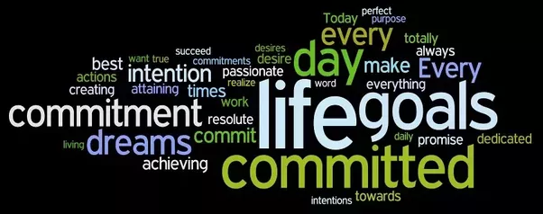

Slide 19
Stewardship Involves…
Powerful
Awareness
God is-------
Acknowledge
God is Our Source
Attitude
God is Our Example
Action
God is Pleased

Slide 20
Mark 12:41-44 (KJV) ⁴¹ And Jesus sat over against the treasury, and beheld how the people cast money into the treasury: and many that were rich cast in much. ⁴² And there came a certain poor widow, and she threw in two mites, which make a farthing. ⁴³ And he called unto him his disciples, and saith unto them, Verily I say unto you, That this poor widow hath cast more in, than all they which have cast into the treasury: ⁴⁴ For all they did cast in of their abundance; but she of her want did cast in all that she had, even all her living.
Mark 12:41-44 (MSG) ⁴¹ Sitting across from the offering box, he was observing how the crowd tossed money in for the collection. Many of the rich were making large contributions. ⁴² One poor widow came up and put in two small coins—a measly two cents. ⁴³ Jesus called his disciples over and said, "The truth is that this poor widow gave more to the collection than all the others put together. ⁴⁴ All the others gave what they'll never miss; she gave extravagantly what she couldn't afford—she gave her all."

Slide 21
2 Corinthians 9:6-7 (KJV) ⁶ But this I say, He which soweth sparingly shall reap also sparingly; and he which soweth bountifully shall reap also bountifully. ⁷ Every man according as he purposeth in his heart, so let him give; not grudgingly, or of necessity: for God loveth a cheerful giver.
2 Corinthians 9:6-7 (AMP) ⁶ [Remember] this: he who sows sparingly and grudgingly will also reap sparingly and grudgingly, and he who sows generously [that blessings may come to someone] will also reap generously and with blessings. ⁷ Let each one [give] as he has made up his own mind and purposed in his heart, not reluctantly or sorrowfully or under compulsion, for God loves (He takes pleasure in, prizes above other things, and is unwilling to abandon or to do without) a cheerful (joyous, "prompt to do it") giver [whose heart is in his giving].

Slide 22
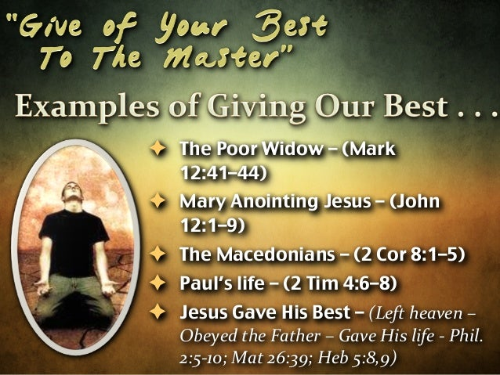
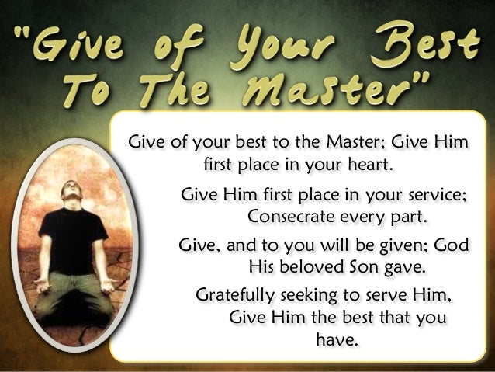
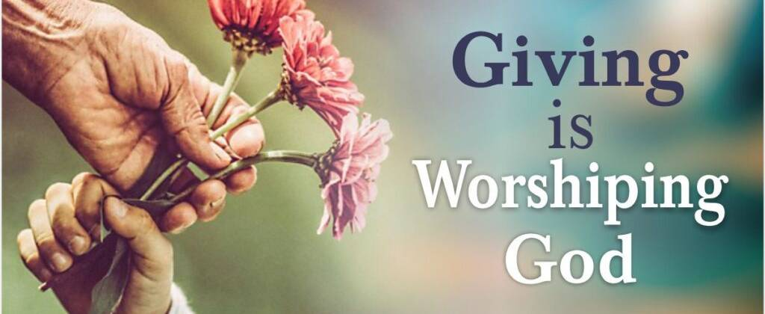
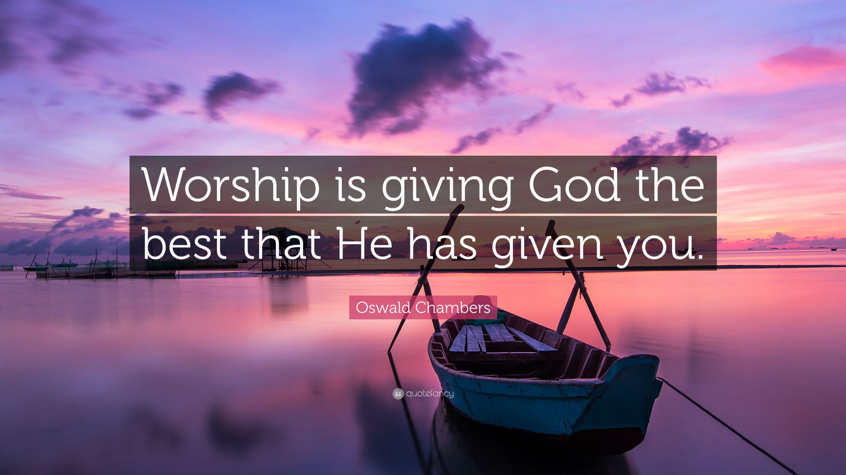



Slide 23
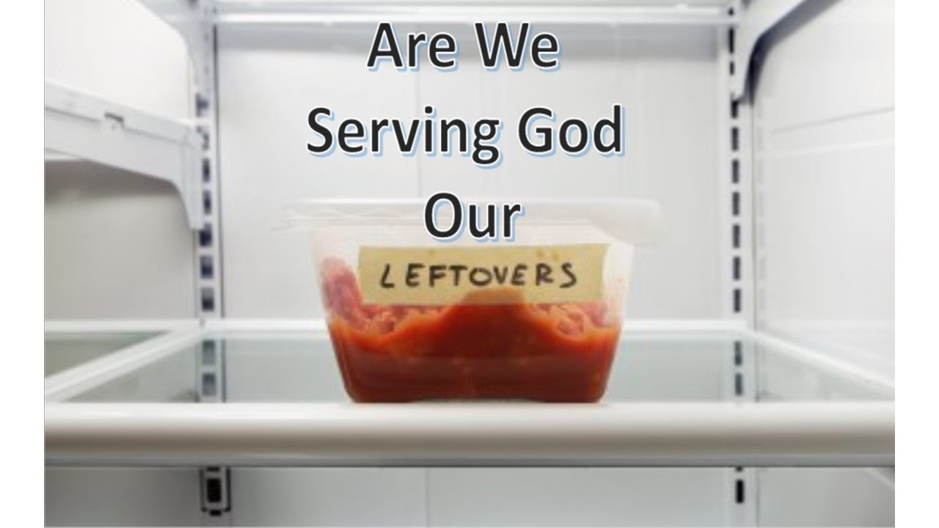
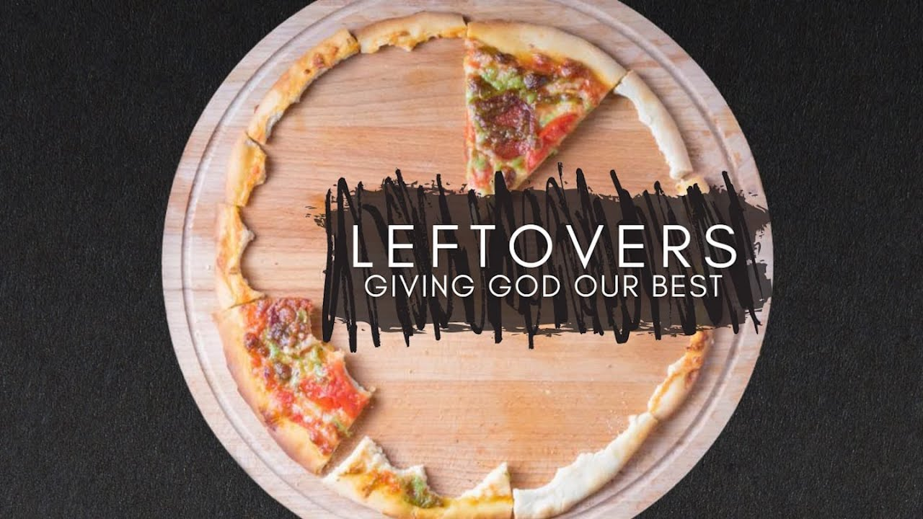

Slide 25
Biblical Examples
Mary and alabaster box ( action / attitude)
Widows Mite
David

Slide 26
“I insist on buying it, for I will not present burnt offerings to the Lord my God that have cost me nothing.” 2 Sam 24:24 NLT

Slide 27
Put God first
Refuse to give Him left overs – time, talent, treasure
replace wishbone with backbone
listen to understand. Resist the urge to listen to respond
be the _______(spouse, friend, … you would like your _______(spouse, friend,…) to be

Slide 28
3rd Principle
of
“KISS”

Slide 29
4th Principle
of
“KISS”

Slide 31
Biblical Examples
Mary and alabaster box ( action / attitude)
Widows Mite
David

Slide 32
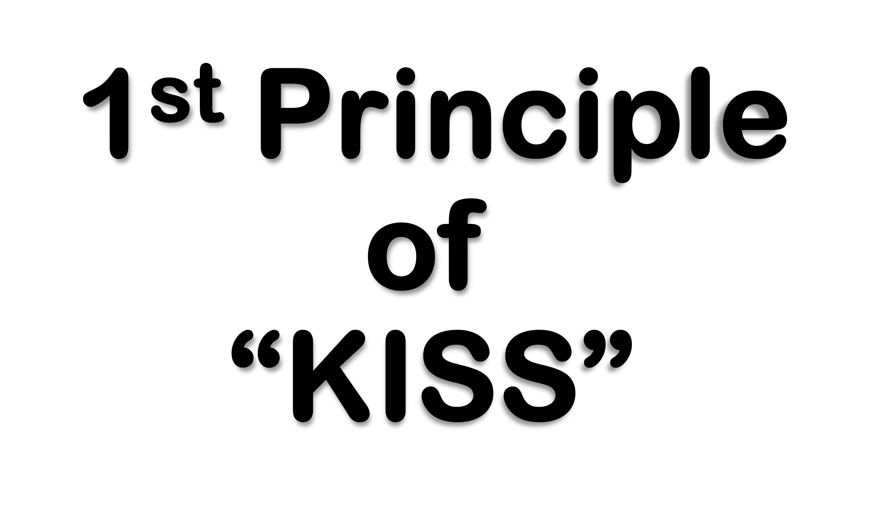
Focus On What You Can Do
Instead of
What You Can’t Do
Focus On What You Do Have
Instead of
What You Don’t Have

Slide 33
2 Samuel 24:24-25 (KJV) ²⁴ And the king said unto Araunah, Nay; but I will surely buy it of thee at a price: neither will I offer burnt offerings unto the LORD my God of that which doth cost me nothing. So David bought the threshingfloor and the oxen for fifty shekels of silver. ²⁵ And David built there an altar unto the LORD, and offered burnt offerings and peace offerings. So the LORD was intreated for the land, and the plague was stayed from Israel.
2 Samuel 24:24-25 (MSG) ²⁴ But the king said to Araunah, "No. I've got to buy it from you for a good price; I'm not going to offer GOD, my God, sacrifices that are no sacrifice." So David bought the threshing floor and the ox, paying out fifty shekels of silver. ²⁵ He built an altar to GOD there and sacrificed burnt offerings and peace offerings. GOD was moved by the prayers and that was the end of the disaster.

Slide 34
Giving God Your Best Is . . .
God exhorts us to do all for the glory of God (1 Cor. 10:31) and to work at whatev ver we do with all our heart (Col. 3:23). And, we are to “do it all in the name of the Lord Jesus” (Col. 3:17). 2 Timothy 2:15 says, “Do your best to present yourself to God as one approved …” We read of our need to test our own actions (Gal. 6:4) and to “run in such a way as to get the prize … not like someone running aimlessly” (1 Cor. 9:24-27). Certainly verses like these suggest that we give God our best.
Before continuing on, please be sure to read the previous post for some clarification of what it does not mean to do or give our best to God. What follows must be read with an understanding that this is not about gaining merit or applause but rather honoring God and doing whatever we do through His grace, power, and strength, not self-effort.
What it Means to Give God Your Best
1) Your best involves giving God your total being. –”Widow and Her Mite”
Jesus quoted the greatest commandment as loving the Lord “with all your heart and with all your soul and with all your mind” (Matt. 22:37). The whole of who we are is the best we can give Him which is why this site refers to our best fit in ministry as that which involves all of who we are. To give God only a part of ourselves falls short of loving Him with “all” of who we are. To present ourselves to “as a living sacrifice, holy and pleasing to God” as commanded in Romans 12:1, is only reasonable in light of whx3at God has done for us.
2) Your best involves giving God your first of everything. – “Mary and Her Alabaster Box
Throughout the Old Testament we read of the Israelites giving God the first fruits and the best of the flock. We serve the same God, still worthy of the first and best of our time, efforts, and resources. To give Him leftover or misdirected time and energy isn’t giving Him the best He deserves.
3) Your best involves giving God your most superior work. - David
To give God a half-hearted or sloppy effort falls short of doing whatever we do “for the glory of God” (1 Cor. 10:31). How can we be “a workman who does not need to be ashamed” if we inaccurately represent Him (2 Tim. 2:15) because we didn’t take the time required to get it right?
In light of these three points, we must conclude that to give God our best, we can’t compartmentalize our lives — God time, me time, work time, family time. All of our lives, at all times and in every way, must be seen as God time. Wherever we are and in whatever we do, we do it all to th e glory of God!

Slide 35

Come they told me, pa rum pum pum pum A new born King to see, pa rum pum pum pum Our finest gifts we bring, pa rum pum pum pum To lay before the King, pa rum pum pum pum, Rum pum pum pum, rum pum pum pum,
So to honor Him, pa rum pum pum pum, When we come.
Baby Jesus, pa rum pum pum pum I am a poor boy too, pa rum pum pum pum I have no gift to bring, pa rum pum pum pum That's fit to give the King, pa rum pum pum pum, Rum pum pum pum, rum pum pum pum,
Focus “Don’t Haves”
Self
What He Has
What He Has to Give

Slide 36
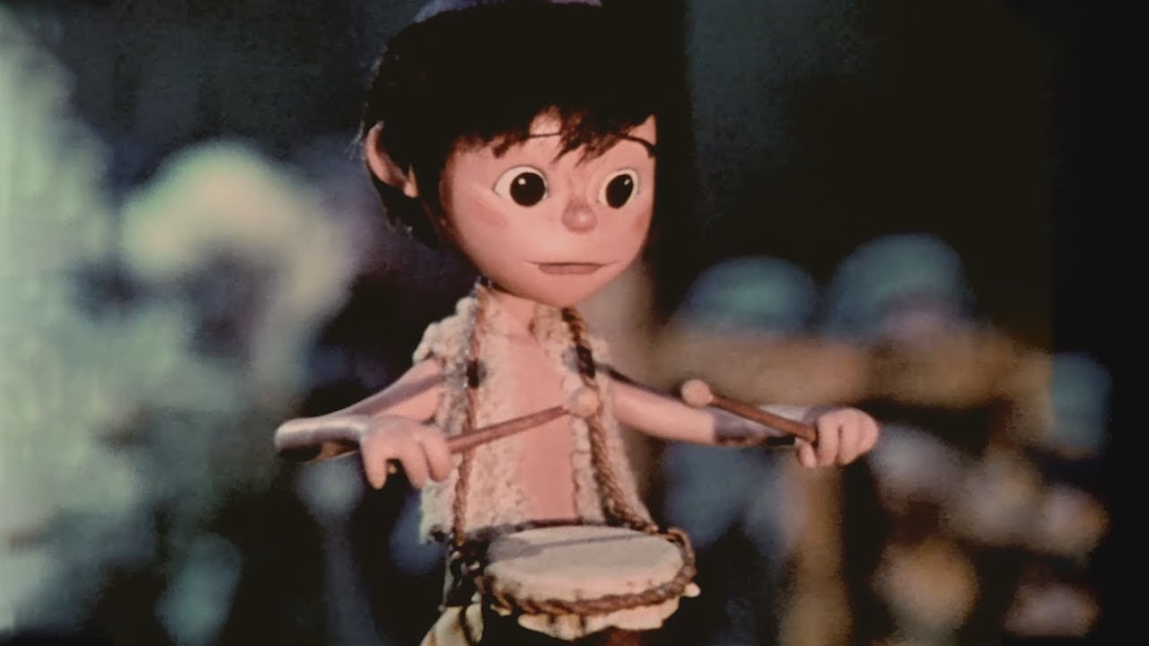
Shall I play for you, pa rum pum pum pum, On my drum?
Mary nodded, pa rum pum pum pum The ox and lamb kept time, pa rum pum pum pum I played my drum for Him, pa rum pum pum pum I played my best for Him, pa rum pum pum pum, Rum pum pum pum, rum pum pum pum,
Then He smiled at me, pa rum pum pum pum Me and my drum.
Focus “Do Haves”
What He Can Do
What He Does Have
It IS Noticed
Did it w- All Heart
It Pleased God

Slide 37
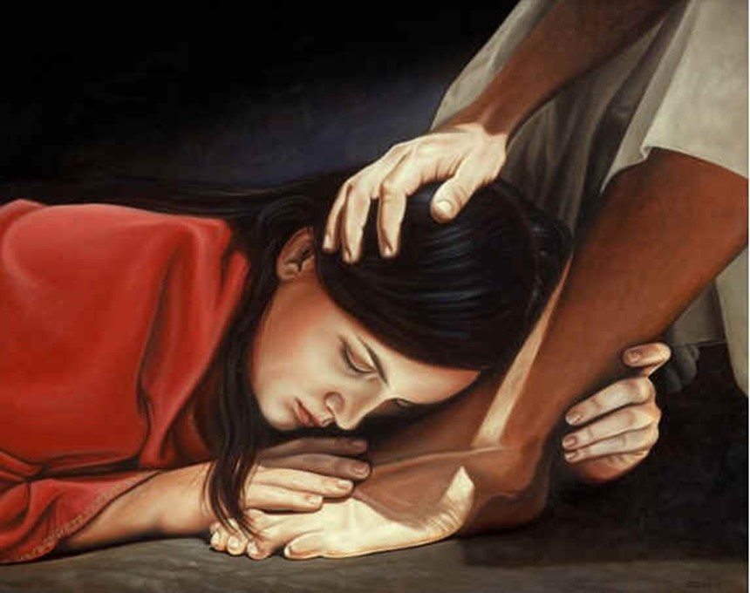
¹ It was now two days before Passover and the Festival of Unleavened Bread. The leading priests and the teachers of religious law were still looking for an opportunity to capture Jesus secretly and kill him. ² “But not during the Passover celebration,” they agreed, “or the people may riot.” ³ Meanwhile, Jesus was in Bethany at the home of Simon, a man who had previously had leprosy. While he was eating, a woman came in with a beautiful alabaster jar of expensive perfume made from essence of nard. She broke open the jar/ poured the perfume over his head. ⁴ Some of those at the table were indignant. “Why waste such expensive perfume?” they asked. ⁵ “It could have been sold for a year’s wages and the money given to the poor!” So they scolded her harshly. ⁶ But Jesus replied, “Leave her alone. Why criticize her for doing such a good thing to me? ⁷ You will always have the poor among you, and you can help them whenever you want to. But you will not always have me. ⁸ She has done what she could and has anointed my body for burial ahead of time. ⁹ I tell you the truth, wherever the Good News is preached throughout the world, this woman’s deed will be remembered and discussed.” - Mark 14:1-9 (NLT2)

Slide 38
She Recognized Her Opportunity… (3)
Some Often..
“Think” …of what They Would Do
Their Life Overshadowed by “What If ?”
If I had certain talent, skill, ability
“Complain” …about what Others Do
Their Life Overshadowed by “Why Them?”
“Complain” …about what Others Don’t Do
Their Life Overshadowed by…
…“Why Not Someone Else?”

Slide 39
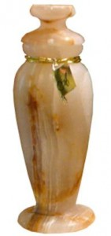
She Recognized...She Couldn’t Do All
…But She Could Do Something (3)
This Woman Did Something.
She:
“Sought out” of her Best
Alabaster Box (Spikenard)
“Counted out” the Cost
300 denari –yrs wage
“Gave out” Freely
Broke/ Poured

Slide 40

She Did What She Could Do...
…While She Could Do It (3, 8)
Church Paralyzed by Procrastination
3 Signs:
Some are Going to Do Something…
Sometime
Ecc 11:4, “..observeth wind..not sow..”
Tomorrow
Matt 6:33-34, “seek 1st..not thought ..”
Waiting for Right Time
II Cor 6:2, “now accepted time..”

Slide 41
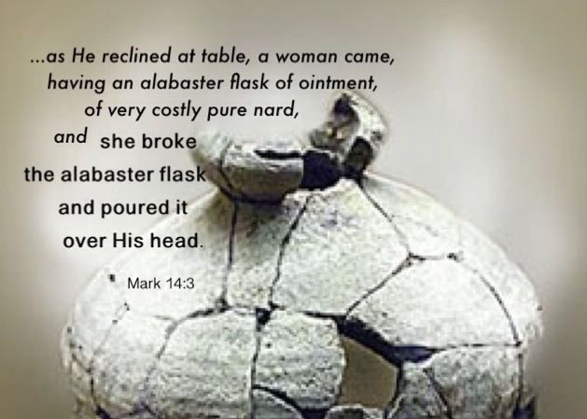
Jesus Recognized Her Effort
Recognized the Timing (1-3)
Rebuked Her Critics (4-6)
Recognized Her Effort (7-8)
Rewarded Her Sacrifice (9)

Slide 42

For God
In 2023
This Year of
Transition
Colossians 3:23-24 Whatever you do, work heartily, as for the Lord and not for men, knowing that from the Lord you will receive the inheritance as your reward. You are serving the Lord Christ.

Slide 43
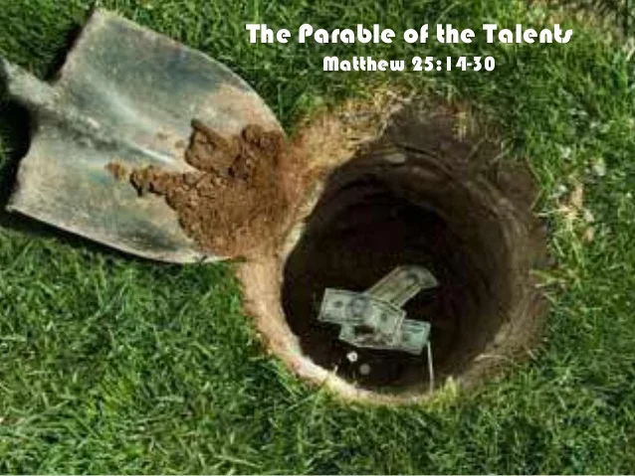
Matthew 25:14-15 (KJV) ¹⁴ For the kingdom of heaven is as a man travelling into a far country, who called his own servants, and delivered unto them his goods. ¹⁵ And unto one he gave five talents, to another two, and to another one; to every man according to his several ability; and straightway took his journey.

Slide 46
John 12:1-11 ¹ Then Jesus six days before the passover came to Bethany, where Lazarus was which had been dead, whom he raised from the dead. ² There they made him a supper; and Martha served: but Lazarus was one of them that sat at the table with him. ³ Then took Mary a pound of ointment of spikenard, very costly, and anointed the feet of Jesus, and wiped his feet with her hair: and the house was filled with the odour of the ointment.⁴ Then saith one of his disciples, Judas Iscariot, Simon's son, which should betray him, ⁵ Why was not this ointment sold for three hundred pence, and given to the poor? ⁶ This he said, not that he cared for the poor; but because he was a thief, and had the bag, and bare what was put therein. ⁷ Then said Jesus, Let her alone: against the day of my burying hath she kept this. ⁸ For the poor always ye have with you; but me ye have not always. ⁹ Much people of the Jews therefore knew that he was there: and they came not for Jesus' sake only, but that they might see Lazarus also, whom he had raised from the dead. ¹⁰ But the chief priests consulted that they might put Lazarus also to death; ¹¹ Because that by reason of him many of the Jews went away, and believed on Jesus.

Slide 47
Come they told me, pa rum pum pum pum A new born King to see, pa rum pum pum pum Our finest gifts we bring, pa rum pum pum pum To lay before the King, pa rum pum pum pum, Rum pum pum pum, rum pum pum pum,
So to honor Him, pa rum pum pum pum, When we come.
Baby Jesus, pa rum pum pum pum I am a poor boy too, pa rum pum pum pum I have no gift to bring, pa rum pum pum pum That's fit to give the King, pa rum pum pum pum, Rum pum pum pum, rum pum pum pum,
Shall I play for you, pa rum pum pum pum, On my drum?
Mary nodded, pa rum pum pum pum The ox and lamb kept time, pa rum pum pum pum I played my drum for Him, pa rum pum pum pum I played my best for Him, pa rum pum pum pum, Rum pum pum pum, rum pum pum pum,
Then He smiled at me, pa rum pum pum pum Me and my drum.

Slide 48

Worship…
= “Worth ship”
3 Words to Describe what she had:
#1- Ointment
(myrrh oil)
#2- Spikenard
(nard-India + Pure-Unadulterated)
#3- Precious
(ext expensive -very end limit …
..very costly)
She Did What She Could Do…
…with What She Had

Slide 49







Slide 52
Joy to the world, the Lord is come! Let earth receive her King; Let every heart prepare Him room, And heaven and nature sing, And heaven and nature sing, And heaven, and heaven, and nature sing.
Joy to the world, the Savior reigns! Let men their songs employ; While fields and floods, rocks, hills and plains Repeat the sounding joy, Repeat the sounding joy, Repeat, repeat, the sounding joy.

Slide 53
Silent night, Holy night,
All is calm, All is bright Round yon virgin mother and child. Holy infant so tender and mild, Sleep in heavenly peace. Sleep in heavenly peace.

Slide 54
Silent night, Holy night, Shepherds quake at the sight, Glories stream from heaven afar, Heavenly hosts sing alleluia; Christ the Savior, is born! Christ the Savior, is born!
Silent night, Holy night, Son of God, Love's pure light Radiant beams from thy holy face, With the dawn of redeeming grace, Jesus, Lord, at thy birth. Jesus, Lord, at thy birth.

Slide 55
O Lord my God
When I in awesome wonder
Consider all the worlds
Thy hands have made
I see the stars
I hear the rolling thunder
Thy pow'r thru'out
The universe displayed

Slide 56
Then sings my soul
My Savior God to Thee
How great Thou art
How great Thou art
Then sings my soul
My Savior God to Thee
How great Thou art
How great Thou art

Slide 57
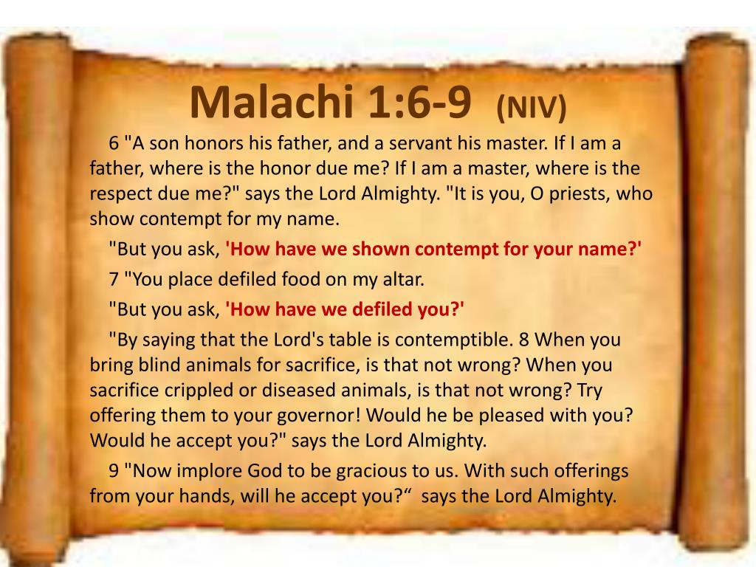

Slide 58
God exhorts us to do all for the glory of God (1 Cor. 10:31) and to work at whatev ver we do with all our heart (Col. 3:23). And, we are to “do it all in the name of the Lord Jesus” (Col. 3:17). 2 Timothy 2:15 says, “Do your best to present yourself to God as one approved …” We read of our need to test our own actions (Gal. 6:4) and to “run in such a way as to get the prize … not like someone running aimlessly” (1 Cor. 9:24-27). Certainly verses like these suggest that we give God our best.
Before continuing on, please be sure to read the previous post for some clarification of what it does not mean to do or give our best to God. What follows must be read with an understanding that this is not about gaining merit or applause but rather honoring God and doing whatever we do through His grace, power, and strength, not self-effort.

Slide 59
Don't walk around the down and out
Lend a helping hand instead of doubt
And the kindness that you show every day
Will help someone along their way
You got to try a little kindness, yes show a little kindness
Just shine your light for everyone to see
And if you try a little kindness, then you'll overlook the blindness
Of narrow-minded people on the narrow-minded streets

