Slide 1
Repeat
These are the 2 Most Important Hours of My Week – Help Me to Cherish Them
I Am Here Today to Worship
Not to Be Entertained
I Am Singing to An Audience of One
Accept My Worship Oh Lord!

Slide 2
Thank You God
For This NEW…
Year
Start
Opportunities
Challenges
Victories
Help Me to Take Advantage of These New Opportunities

Slide 4

From Surviving to Thriving P4a
New Year – New ________________

Slide 5
4th Principle
of
“KISS”
Two For One
Special

Slide 6
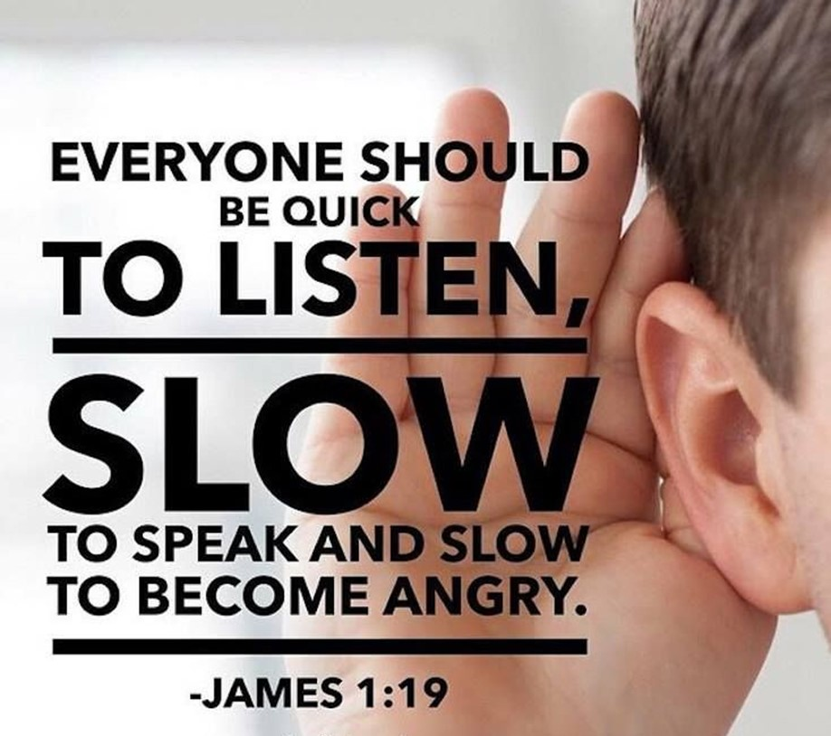
God Gave Us Two Ears and One Mouth
It Sounds Like God Wants Us to Listen…
…Twice as Much as We Talk
But Listening is a Lot More Complicated…
…Than It Sounds
If Done Correctly It Brings…
Help and Healing
If Done Incorrectly It …
Hinders and Hurts

Slide 7
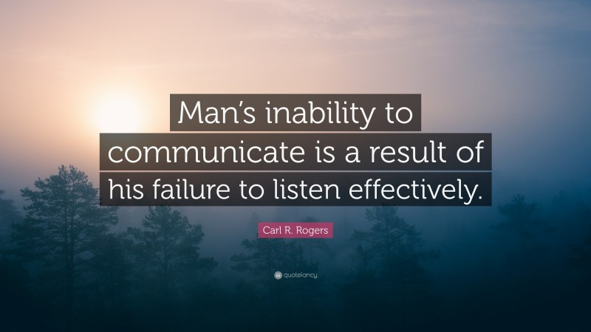
Our World is Collapsing
Communication Has All But Stopped
There is a Lot of Sabre Rattling…
…But Very Little Actual Listening
The World Needs to Listen to God
And Listen to Each Other

Slide 8
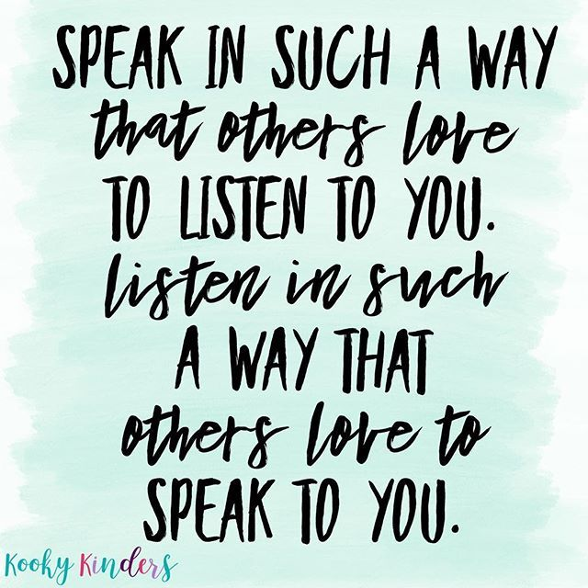
Everyone likes to Be Heard... to Be Understood... to Matter!
Again remember the saying, "God gave us one mouth and two ears so we would listen twice as much as we speak."
While everyone wants to be heard, not everyone wants to hear... to listen... to understand. Maybe that is one reason Jesus gave us what is known as
The Golden Rule:
"Do to others as you would have them do to you" -Luke 6:31
The Two for One Special:
"My dear brothers, take note of this: Everyone should be quick to listen,
slow to speak and slow to become angry." -James 1:19

Slide 9

Six Different Kinds of Listeners.
PREOCCUPIEDS
These people come across as rushed, constantly looking around or
doing something else.
OUT-TO-LUNCHERS
These people are physically here, but mentally they’re not. This is determined by the blank look on their faces and the occasional drool.
WHATEVERS
These people remain aloof, and show little reaction when listening. They don’t seem to care about anything you have to say.

Slide 10
COMBATIVES
These people are armed and ready for an argument. They listen only to find the flaw in what you say or how you say it. And they enjoy disagreeing with whatever is said.
ANALYSTS
These people are constantly in the role of counselor. They’re ready to provide you with a few “this is how you could have said that better” ideas, but do very little, if any.
The First 5 Types of Listeners are Usually:
Ineffective
Insufficient
Insulting

Slide 11
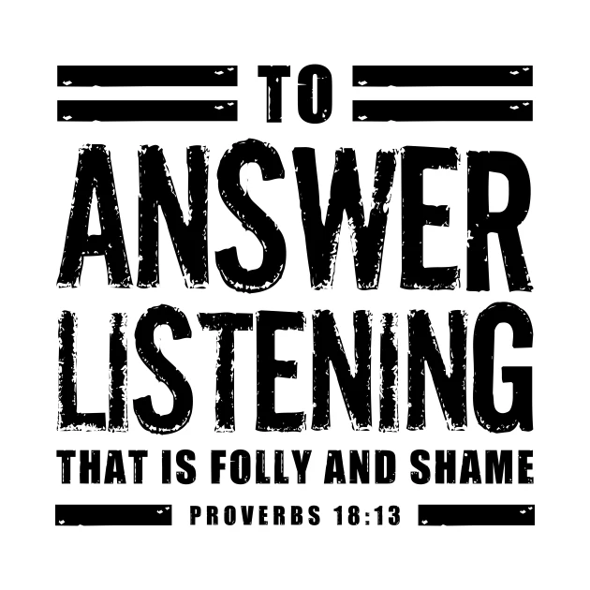
Proverbs 18:13 (KJV) ¹³ He that answereth a matter before he heareth it, it is folly and shame unto him.
Proverbs 18:13 (NLT2) ¹³ Spouting off before listening to the facts is both shameful and foolish.

Slide 12
Six Different Kinds of Listeners.
PREOCCUPIEDS
OUT-TO-LUNCHERS
WHATEVERS
COMBATIVES
ANALYSTS
The First 5 Hurt More Than They Help
But There is Better Way
Six Different Kinds of Listeners.
PREOCCUPIEDS
OUT-TO-LUNCHERS
WHATEVERS
COMBATIVES
ANALYSTS
ENGAGERS
These are the consciously aware listeners. They listen with their eyes, ears, and hearts, and want more than anything to hear what God is saying to them
AND OTHERS. This is listening at the highest level -ACTIVE

Slide 13
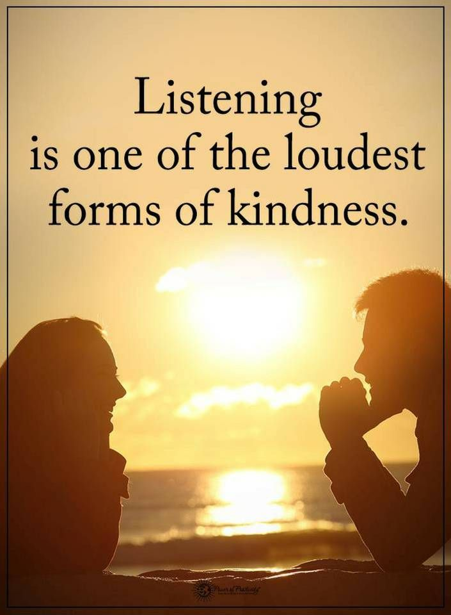
Listen to Understand.
Resist the Urge to Listen to Respond
True, Sustained, Active Listening is a Great Act of Faith, and a Great Means of Grace, Both for Ourselves and for Others in the Fellowship.
The Scripture for Christian Listening:
James 1:19: “Let every person be quick to hear, slow to speak, slow to anger.”
It’s Simple Enough In Principle, and Nearly Impossible to Live.

Slide 14
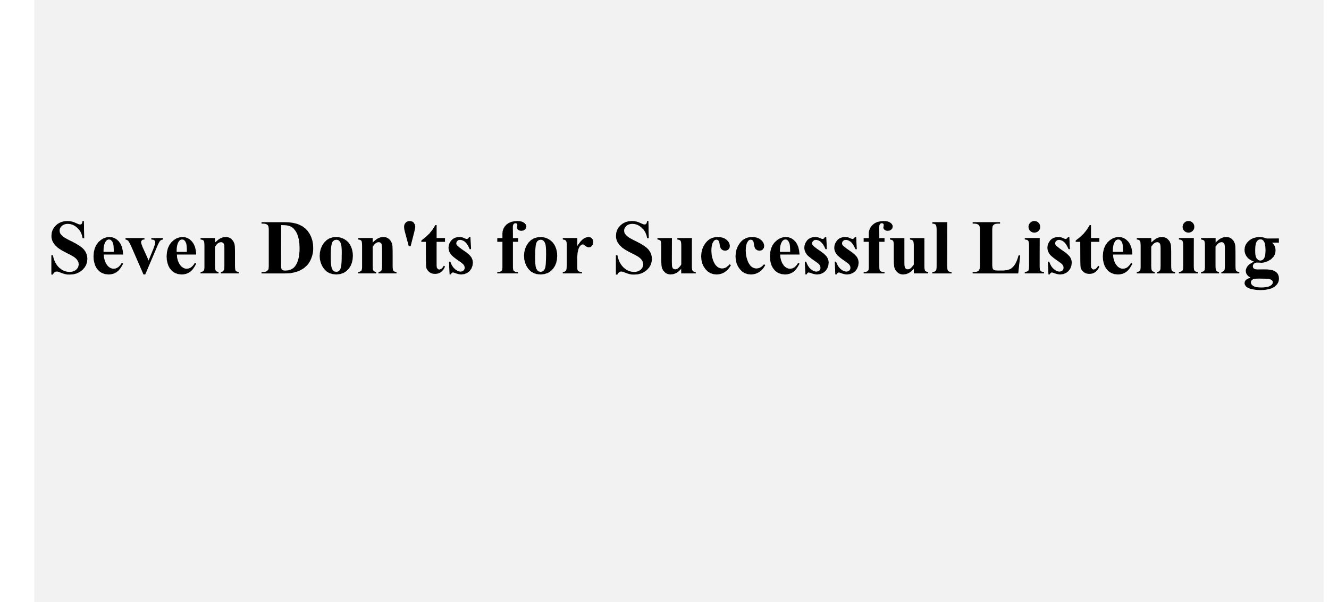
#1 Don't Feel You Must Do the Talking
"[There is] a time to tear/ a time to mend, a time to be silent / a time to speak." -Ecc 3:7
#2 Don't Give Premature Advice
"He who answers before listening—that is his folly and his shame." -Prov 18:13
#3 Don't Become Defensive
"A man's wisdom gives him patience; it is to his glory to overlook an offense." -Prov 19:11
#4 Don't Become Hot-Tempered
"A hot-tempered man stirs up dissension, but a patient man calms a quarrel." -Prov 15:18
#5 Don't Laugh At Others
"A man who lacks judgment derides his neighbor, but a man of understanding holds his tongue." -Prov 11:12
#6 Don't Hold On To Hatred.
"Hatred stirs up dissension, but love covers over all wrongs." -Prov 10:12
#7 Don’t Break a Confidence.
"A gossip betrays a confidence, but a trustworthy man keeps a secret." -Prov 11:13

Slide 15
