Slide 2
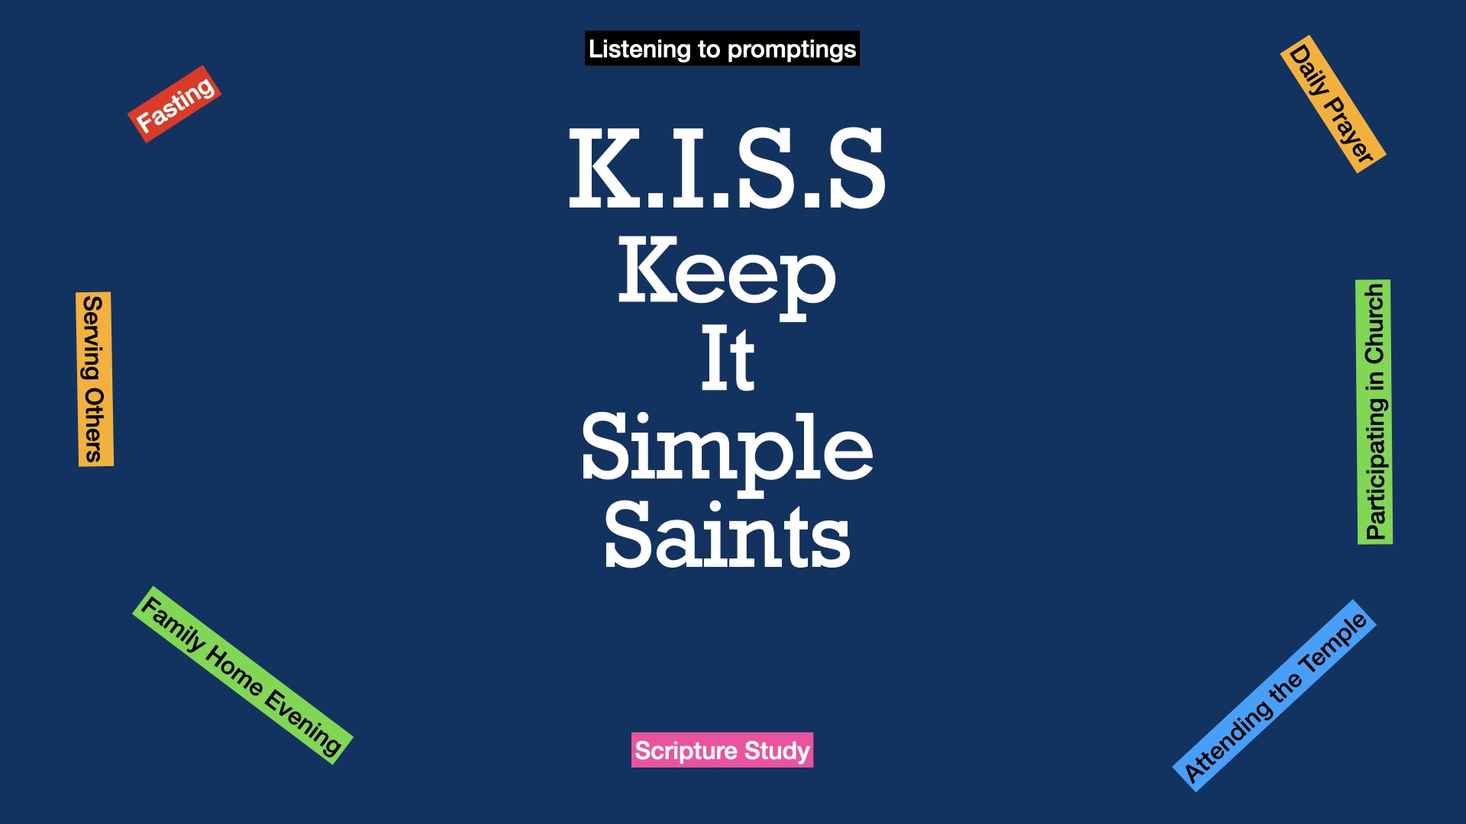
From Surviving to Thriving P4b
New Year – New ________________

Slide 3
5th Principle
of
“KISS”
Heavy on the Salt
Light on the Pepper

Slide 4
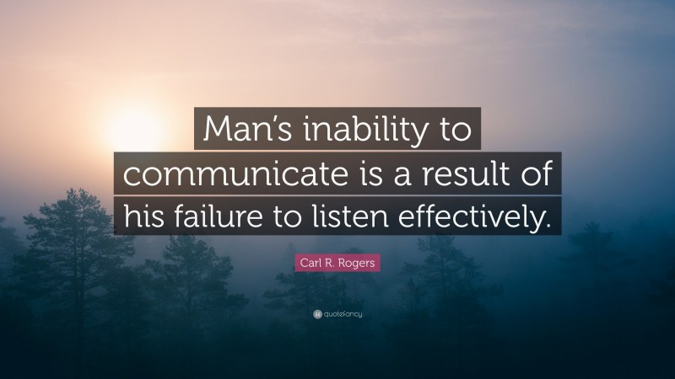
Our World is Collapsing
Communication Has All But Stopped
There is a Lot of Sabre Rattling…
…But Very Little Actual Listening
The World Needs to Listen to God
And Listen to Each Other

Slide 5
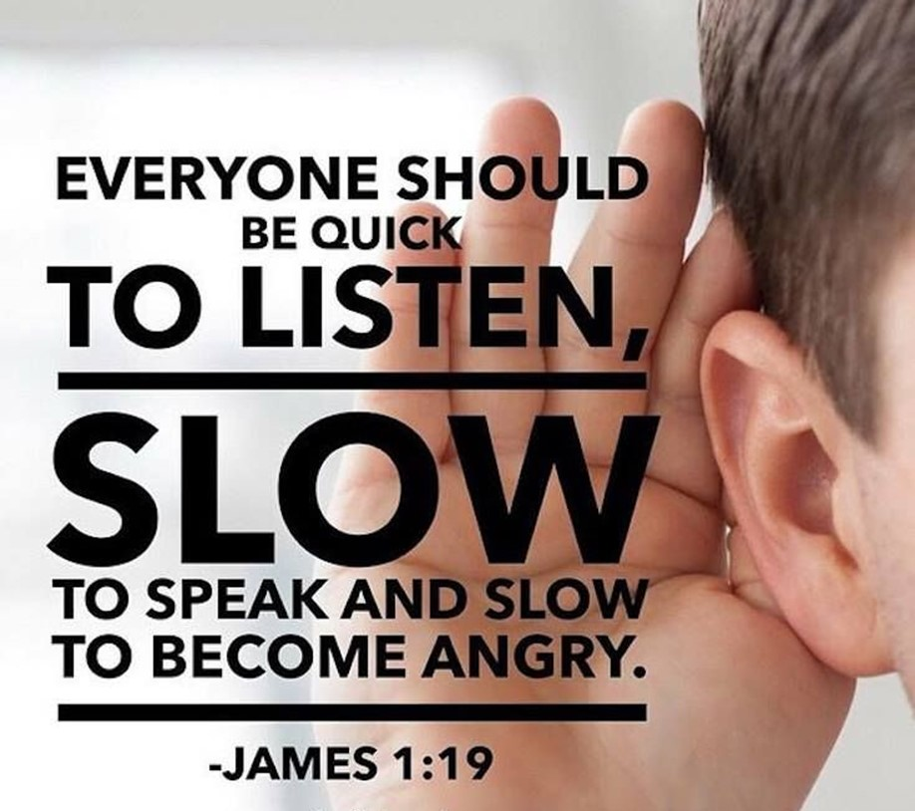
God Gave Us Two Ears and One Mouth
It Sounds Like God Wants Us to Listen…
…Twice as Much as We Talk
But Listening is a Lot More Complicated…
…Than It Sounds
If Done Correctly It Brings…
Help and Healing
If Done Incorrectly It …
Hinders and Hurts

Slide 6
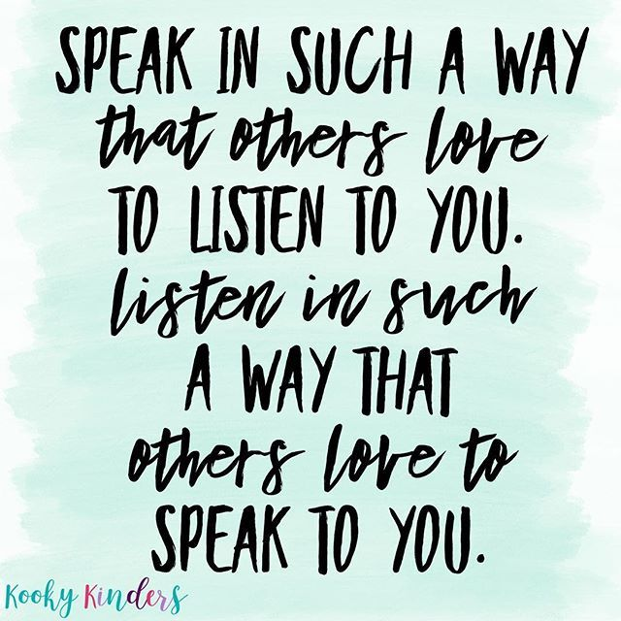
Everyone likes to Be Heard... to Be Understood... to Matter!
Again remember the saying, "God gave us one mouth and two ears so we would listen twice as much as we speak."
While everyone wants to be heard, not everyone wants to hear... to listen... to understand. Maybe that is one reason Jesus gave us what is known as
The Golden Rule:
"Do to others as you would have them do to you" -Luke 6:31
The Two for One Special:
"My dear brothers, take note of this: Everyone should be quick to listen,
slow to speak and slow to become angry." -James 1:19

Slide 7
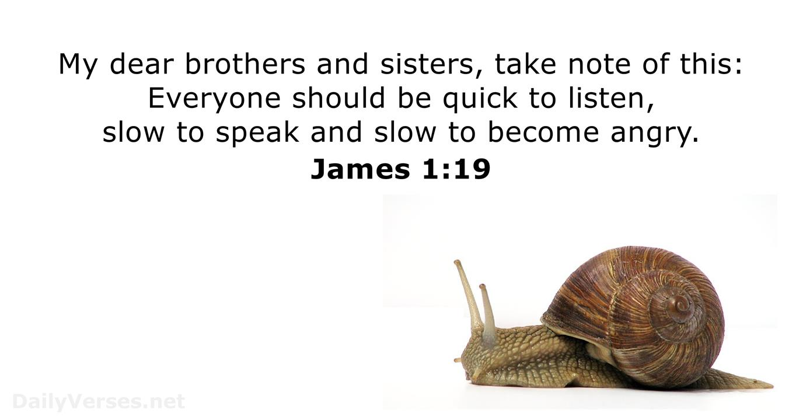
Swift to hear - quick and attentive ear
Listen to Understand.
Resist the Urge to Listen to Respond
True, Sustained, Active Listening is a Great Act of Faith, and a Great Means of Grace, Both for Ourselves and for Others in the Fellowship.

Slide 8
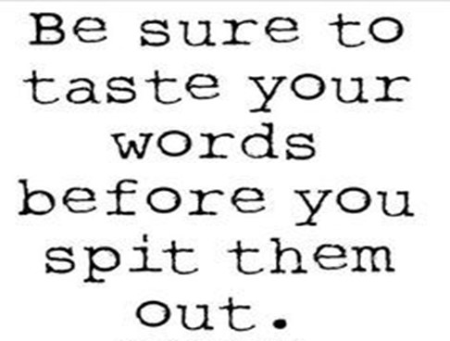
Swift to hear - quick and attentive ear
Slow to speak - slow to begin speaking, not slow while speaking
You Don’t Always Have to Have the …
First Word
Last Word
Loudest Word
“Stop and Digest What You Have Heard BEFORE Speaking”

Slide 9
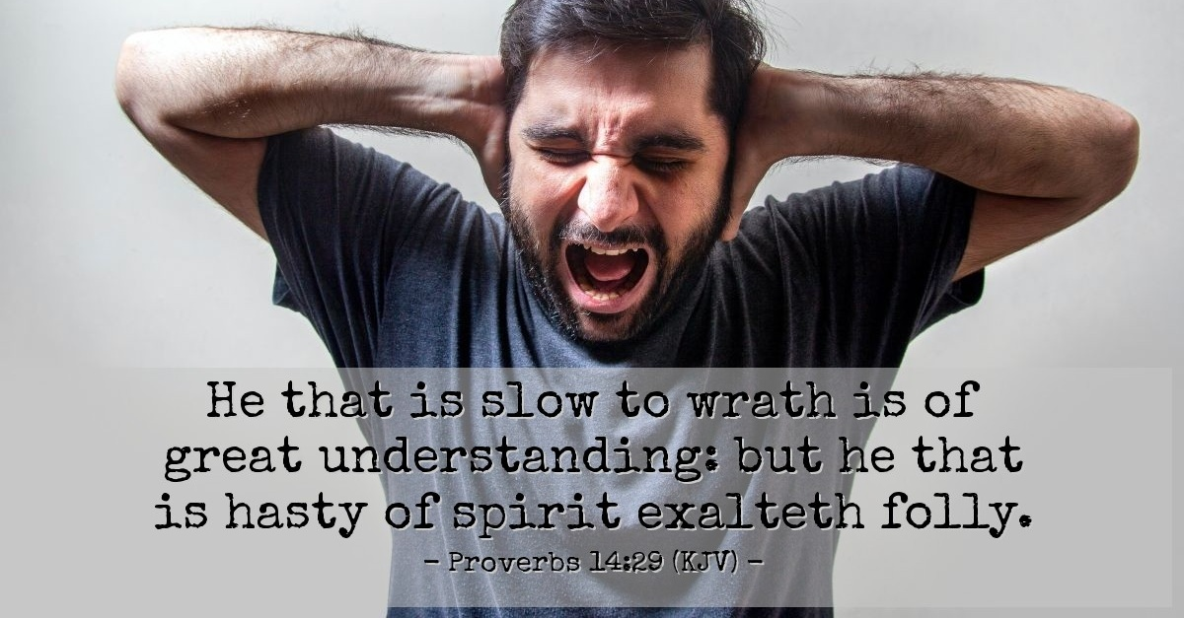
Swift to hear - quick and attentive ear.
Slow to speak - slow to begin speaking, not slow while speaking.
Slow to anger - slowness to speak up when angry, tend to curb anger
Psalm 4:4 (NLT2) ⁴ Don’t sin by letting anger control you. Think about it overnight and remain silent.
When Your Temper Takes Over …
…Your Brain Ceases to Function

Slide 10
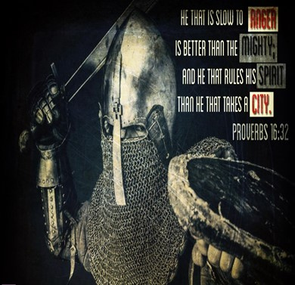
Proverbs 16:32 (NASB77) ³² He who is slow to anger is better than the mighty, And he who rules his spirit, than he who captures a city.
Proverbs 16:32 (NLT2) ³² Better to be patient than powerful; better to have self-control than to conquer a city.
Proverbs 16:32 (MSG) ³² Moderation is better than muscle, self-control better than political power.

Slide 11
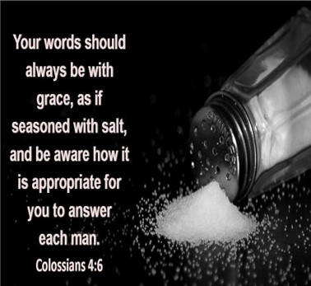
How?
Colossians 4:6 (NASB77) ⁶ Let your speech always be with grace, seasoned, as it were, with salt, so that you may know how you should respond to each person.
Colossians 4:6 (MSG) ⁶ Be gracious in your speech. The goal is to bring out the best in others in a conversation, not put them down, not cut them out.
Colossians 4:6 (AMP) ⁶ Let your speech at all times be gracious (pleasant and winsome), seasoned [as it were] with salt, [so that you may never be at a loss] to know how you ought to answer anyone [who puts a question to you].

Slide 12

Jesus called believers to be the Salt of the Earth -Matt 5:13
Salt is an Important Mineral
Preserves Food,
Brings Out Flavor,
Soothes and Heals
Necessary for Life:
Valuable – Roman Soldiers were Paid in Salt
Our Words Should Add Value to Others…
…Challenge Them to be Better

Slide 13
