Slide 2

From Surviving to Thriving p5
New Year – New ________________

Slide 3
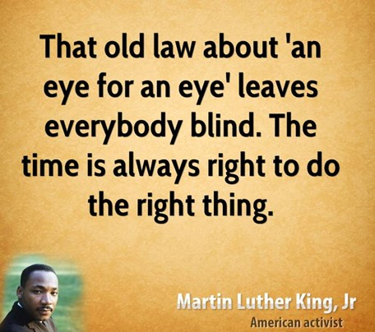
The World is Collapsing Around Us
There seems to be No Formidable Solution (Glue)
The Solution is Not “An Eye for An Eye”
BUT
            Plain
            Powerful
            Pleasing – to God and Man
It’s the Golden Rule

Slide 4
6th Principle
of
“KISS”
Be the Change

Slide 5
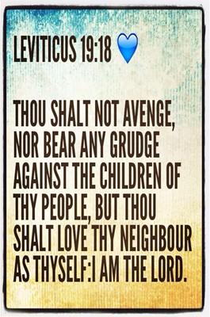
The Golden Rule is the Ethical Principle of Treating Others
as One would prefer to be treated.
One of Jesus' Most Famous and Impactful Teachings,
the Golden Rule can be Found…
“So in everything, do to others what you would have them do
to you, for this sums up the Law /the Prophets.” Matt 7:12
“Do to others as you would have them do to you.” Luke 6:31

Slide 6

All the Major Religions
Have a Code of Ethics…
…Dealing with Others
But
There is a Difference…
All of the Others…
…Focus on the Negative
Only Jesus…
...Focuses on the Positive
…Brings Positive Change
Golden Rule =
Positive Change

Slide 7

Positive Action (Change)
“Do not do unto others as you would not want done to you”
Known as the “Silver Rule”
this inversion of the Golden Rule reminds us to not do what we would prefer not to happen to ourselves.
This is the Negative Version of the Golden Rule.

Slide 8
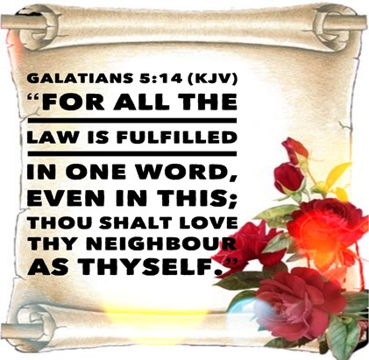
Universal Action (Change)
“It applies to every relationship in our lives”
“In everything, do to others what you want them to do to you.”
In Marriage, Parenting, Business, Friendships, Traffic.
This Should Be Our Thought in Every Relationship.
This Will Cause You to Bring Change in Most Situations

Slide 9
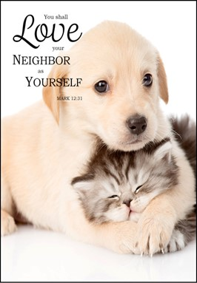
Empathetic Action (Change)
“Put yourself in their shoes”
Golden Rule is a call to Empathy and Understanding Another’s Situation and Point of View
Calls upon us to Picture Ourselves as our Fellow Human and Recognize this Will Bring Positive Change

Slide 10



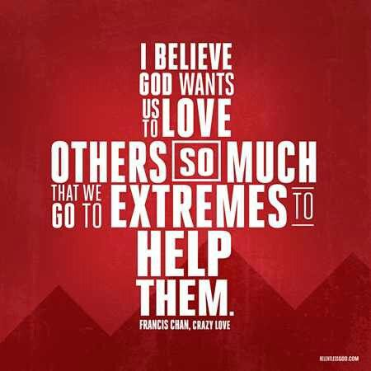
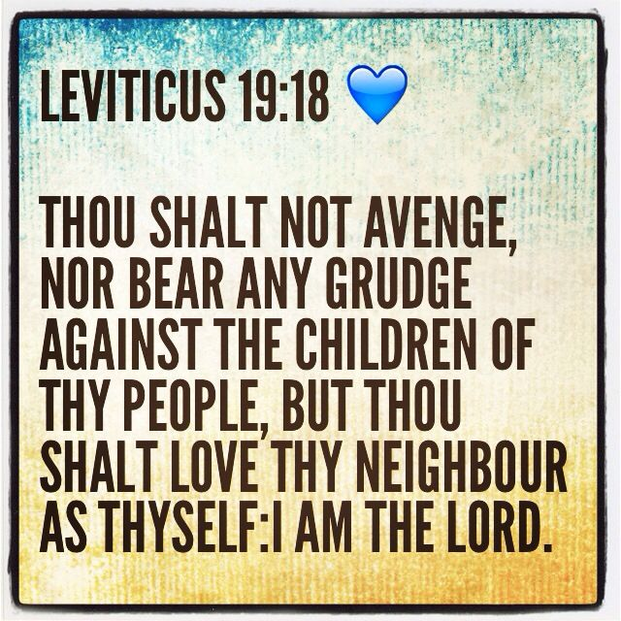
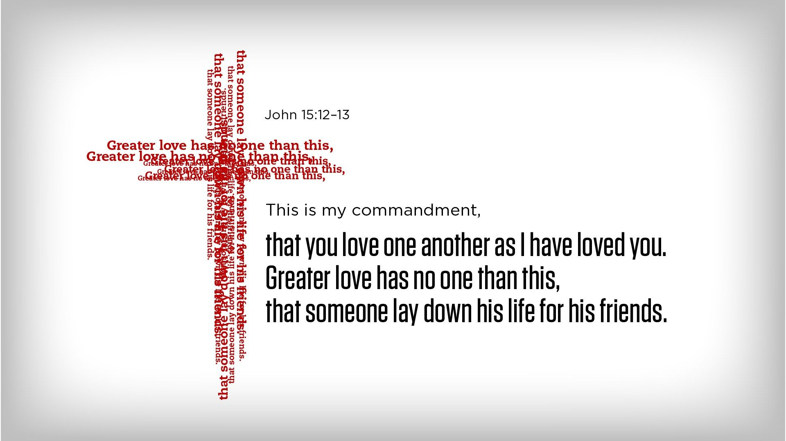
How Can You Apply the Golden Change?
Be Observant
Pay close attention to those around you.
When you “look out . . . for the interests of others,” you will likely find opportunities to say or do something helpful. -Philippians 2:4
Be Empathetic
Imagine yourself in the other person’s place. How would you feel if you were in the same situation? (Romans 12:15) When you try to understand the feelings of others, you may feel moved to help them.
Be Flexible
Keep in mind that everyone is different. What others would like to have done for them may not be the same as what you would want to have done for you. Try to choose what they will appreciate most.-1 Cor 10:24

Slide 11

Challenge - Be the Change
There are 3 Degrees of Change
#3 - Practicing the Silver Rule
#2 - Practicing the Golden Rule
#1 - Living the Golden Rule
Practicing = You Look for Opportunities
Living = Opportunity Looks for You
Now You Become the Change

Slide 12



