Slide 2

Worship Myths Pt 1
Edward Christian Church
February 19, 2023

Slide 3
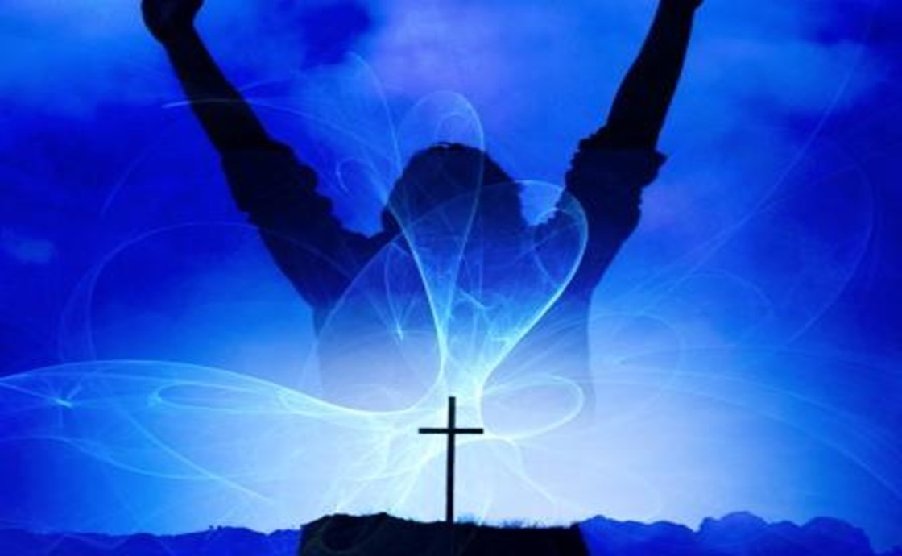

Praise and Worship
God Designed His Creation to Worship Him
Rom 1:20
“For the invisible things of him from the
Creation…. so that they are without excuse”
Rom 1:25
“changed the truth of God into a lie,
worshipped / served the creature > the Creator”
Isa 55:12
“The mountains and hills will burst into song,/ the trees of the field will clap their hands!”
Whenever God Communes With Us..
…We Respond With
Thanksgiving.. Praise ..Worship

Slide 4


The Difference
Praise is…
Worship is…
About God
Opening Up
Boldly Declaring
Praise Applauds What...
…God Has Done
to God
Entering In
Humbly Bowing
Worship is Honoring…
…God for Who He Is

Slide 5
Praise is...
Proclaiming, Declaring Things About God!!
Focuses Both on the…
Character /Acts of God
Function of Our Will, Not Our Emotions
When We Recognize the Greatness of God
Praise Comes Freely

Slide 6

Our Purpose(goal) in Worship
Myth #1:
Worship is when we Talk about God
Truth #1:
Worship is when we Come into..
…the Presence of God
True “God Encounter”

Slide 7
Our Purpose(goal) in Worship
Psalm 95:6 (NASV)“Come, let us worship and bow down; Let us kneel before the LORD our Maker.”
Psalm 22:3 (NASB77)
Yet Thou art holy, O Thou who art enthroned upon the praises of Israel.
Rev 4:10-11, “The four / twenty elders fall down before him that sat on the throne, and worship him that liveth for ever /ever, / cast Their crowns before the throne, saying, ¹¹ Thou art worthy, O Lord, to receive glory and honour and power: for thou hast created all things, and for thy pleasure they are and were created”

Slide 8
The Product(result) of Worship
Myth #2:
True Worship Leaves Me Feeling Pleased
Truth #2:
True Worship Leaves God Feeling Pleased
Eph 5:10 (AMP)
¹⁰ And try to learn [in your experience] what is pleasing to the Lord [let your lives be constant
proofs of what is most acceptable to Him].
Many Christians believe that they are the audience; in truth, God is the audience.(of One)

Slide 9
The Point of Focus in Worship
Myth #3:
In Worship, the Focus is on the Activity
(Performance Driven)
Truth #3:
In Worship, the Focus is on God
(Driven to Performance)
Worship is an Inside Job!

Slide 10
The Point of Focus in Worship
Isaiah 6:1-4 (KJV) ¹ In the year king Uzziah died I saw also the Lord sitting upon a throne, high /lifted up, his train filled the temple. ² Above it stood the seraphims: each one had six wings; w- twain he covered his face, /w- twain he covered his feet, and with twain he did fly. ³ And one cried unto another, and said, Holy, holy, holy, is the LORD of hosts: the whole earth is full of his glory. ⁴ And the posts of the door moved at the voice of him that cried, and the house was filled with smoke.

Slide 11
The Pathway to Worship
Myth #4:
True Worship happens when the Music
and Message are good
It Definitely Enhances but…
Truth #4:
True Worship happens when we
worship in Spirit / Truth
John 4:21-24. Involves: Emotion and Intellect

Slide 12
The Pathway to Worship
“The true worshipers will worship the Father in spirit / truth, for they are the kind of worshipers the Father seeks.” -John 4:23
Worship in Spirit= Attitude
...Beyond Surface
...Beyond Situation
Worship in Truth= Foundation
...Beyond Human Reasoning
...Beyond Human Reaction

Slide 13
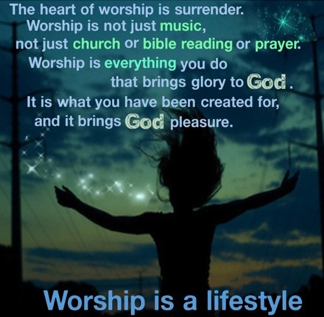
I need to worship because without it…
I can forget that I have a big God beside me-live in fear.
I can forget his calling /begin to live in a spirit of self-preoccupation.
I lose a sense of wonder/ gratitude/ plod through life with blinders on.
My natural tendency is toward self-reliance / stubborn independence.”

Slide 14
